Slide 1
The Power of Water: discussion on invasive species and river management
Teacher Workshop
August 2015
Irina Overeem

Slide 2
Definition of Invasive Species
An invasive species is a plant or animal that is not native to a specific location; and has a tendency to spread, which is believed to cause damage to the environment, human economy and/or human health
Classic example: rabbit in Australia

Slide 3
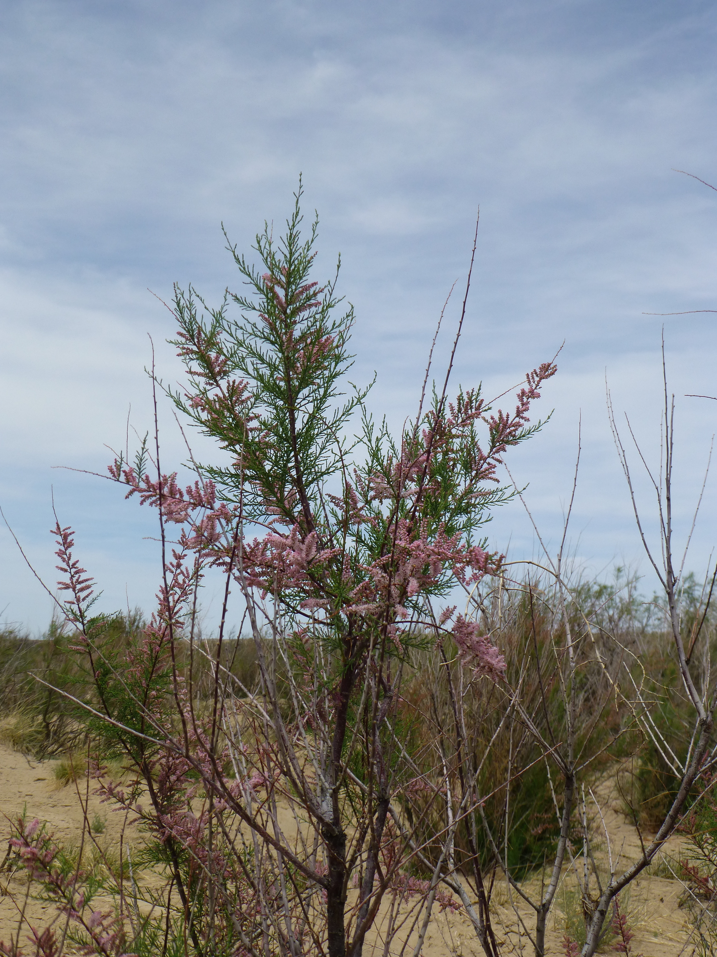
Tamarisk Sp.
Shrub-Tree, varies from 1-18m tall
Tamarix species have long tap roots that allow them to intercept deep water tables and exploit natural water resources. Upto 6m deep.
Tamarix limits competition from other plants by taking up salt from deep ground water, accumulating it in their foliage. With leafs dropping onto the soil below the shrubs, the surface soil builds up salt concentrations concentrations detrimental to some other plants.
Tamarisk outcompetes Cottonwood Trees and Sandbar Willows.
Tamarix in Rio Puerco, photo Irina Overeem

Slide 4
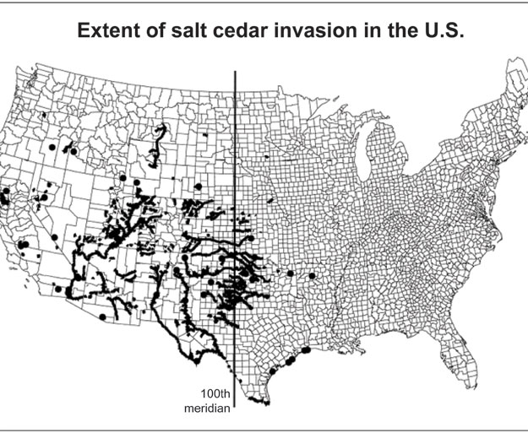
Tamarisk Occurrence
Tamarisk can colonize a river corridor at rate of 20 km/year (Glenn et al, 2004).

Slide 5
How much water do Tamarisk trees use compared to native trees?
Tamarisk has greater salt tolerance and drought, as well as fire resistance than native trees (Glenn et al, 2004).
Tamarisk may not use more water per leaf area, but it forms really dense thickets compared to native vegetation, thus the total water use becomes higher (Sala et al., 1996).
In rivers with a dynamic ‘pulse’ flood regime native trees are competitive, tamarisk does not germinate faster or establish easier than sandbar willow or cottonwood (Glenn, 2004).
Notes:
Study 1:
Water Use by Tamarix Ramosissima and Associated Phreatophytes in a Mojave Desert Floodplain
Anna Sala , Stanley D. Smith and Dale A. Devitt
Ecological Applications
Vol. 6, No. 3 (Aug., 1996), pp. 888-898

Slide 6
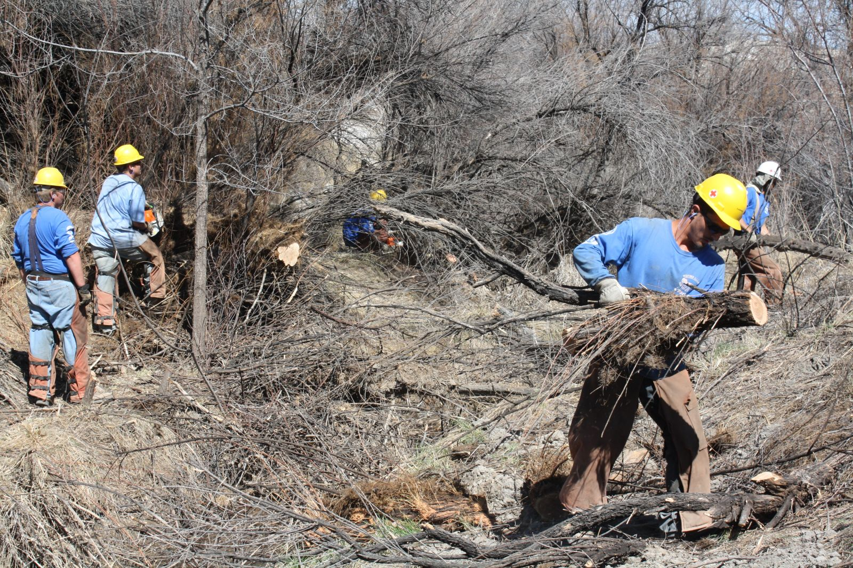
Tamarisk Removal
Along Colorado River, Grand Junction, 2014

Slide 7
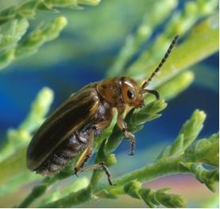
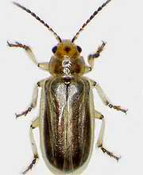
Salt Cedar Beetle
This beetle is used in North America as a biological pest control agent against saltcedar. USDA approved beetle release in 2005.

Slide 8
Introduced in 2005
Tamarisk beetle populations taken from around China and Kazakhstan, were initially released by the USDA Agricultural Research Service in 2005.
Since its release, the insect has defoliated tens of thousands of acres of tamarisk in Nevada, Utah, Colorado, and Wyoming.
Tamarisk does not usually die from a single defoliation from tamarisk beetles, and it can resprout within several weeks of defoliation. Repeated defoliation of individual tamarisk trees can lead to severe dieback the next season.

Slide 10
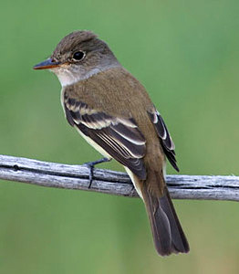
Endangered South Western Willow Flycatcher
25% of known population of this endangered bird was found to breed in Tamarisk sites.
Center for Biological Diversity and Audubon filed a lawsuit in 2013 against the USDA because the beetle release affects breeding areas of this endangered species….

Slide 11
Good or Bad?
Tamarisk is considered invasive, active management to get rid of Tamarisk includes slash and burn, beetle introduction and drastic fuel removal. But good parts…it helps vegetate disturbed river beds, provide wind breaks…?
Beetles can only defoliate Tamarisk, but not kill it, pesticides are used to kill trees. This pesticide are classified as low toxicity to wildlife, but some test shown it to be harmful. It is not very persistant.
It may be risky to introduce a new non-native species (salt cedar beetle)? No new releases currently anymore.
A rare endangered bird, Southwester Willow Flycatcher, a wetland bird has adapted to breed in Tamarisk sites.

Slide 12
More information
http://www.tamariskcoalition.org/

