Slide 1



Landlab:
A new, open-source, modular, Python-based tool
for modeling surface dynamics
Daniel E.J. Hobley, Gregory E. Tucker, Jordan M. Adams,
Nicole M. Gasparini, Eric Hutton,
Erkan Istanbulluoglu, Sai Siddhartha
Notes:
Make sure to thank everybody!
Modelling framework

Slide 2
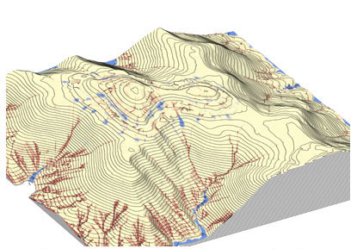
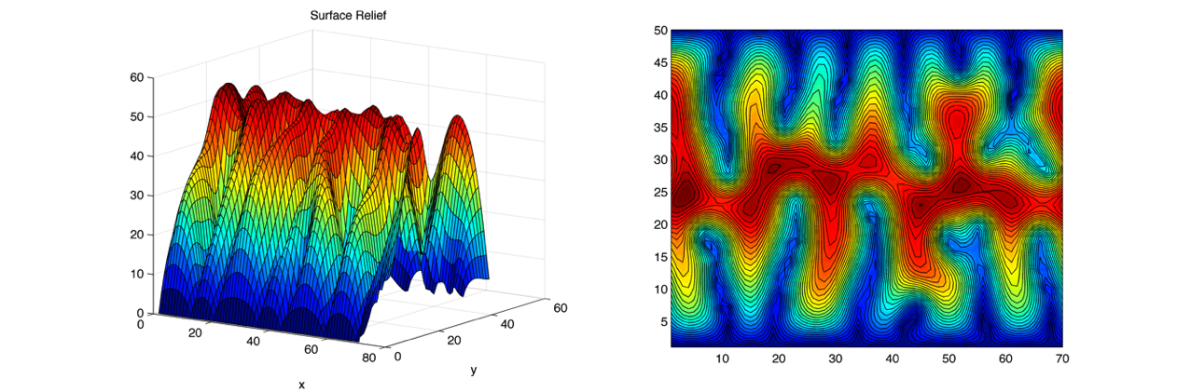
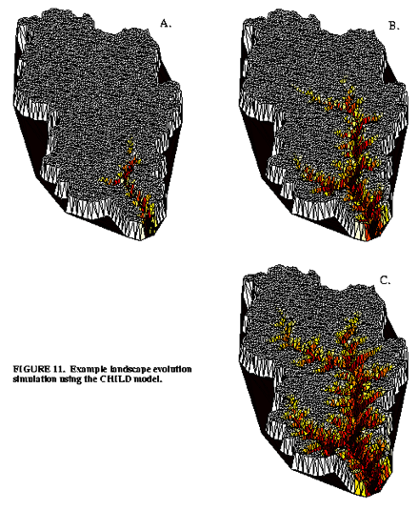
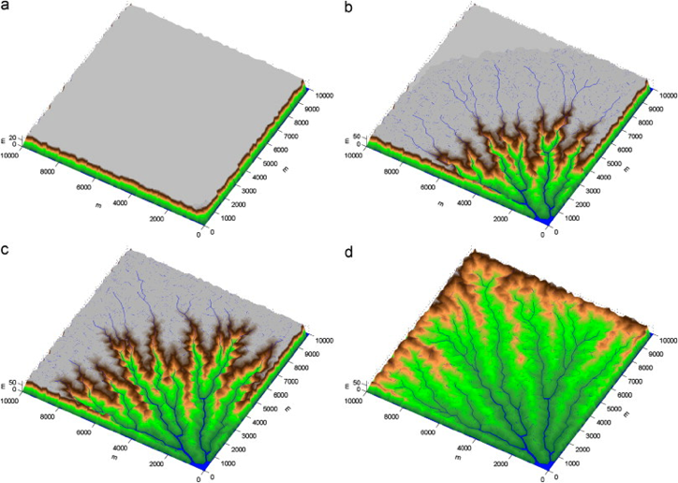
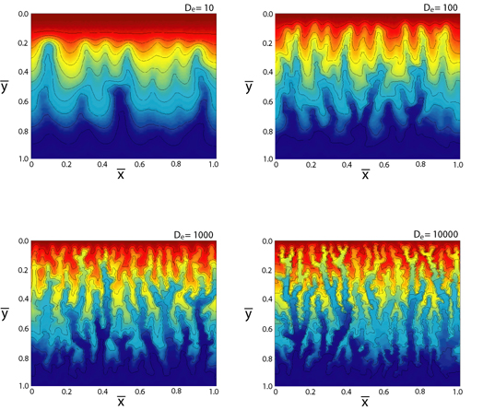
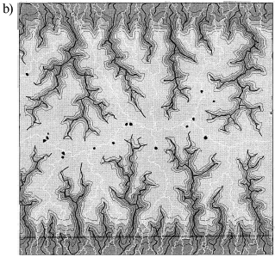
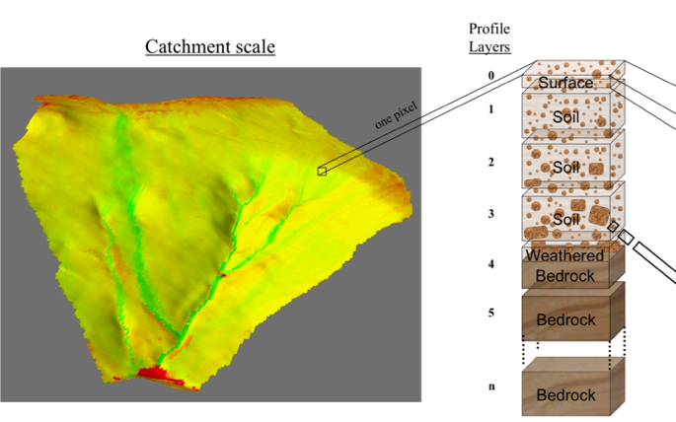
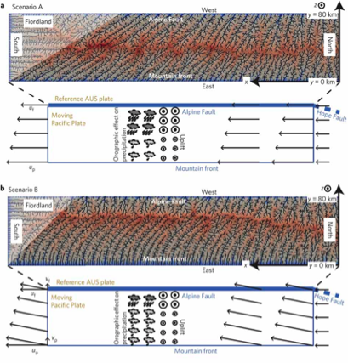
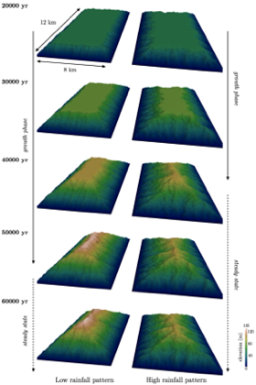
Motivation
SIBERIA (Willgoose and Riley, 1998), J. Prancevic (unpubl.), CHILD (Tucker et al., 2001), SIGNUM (Refice et al. 2012),
Simpson & Schlunegger 2003, Braun & Sambridge 1997, mARM4D (Cohen et al., 2013), Castelltort et al. 2012, Tellus (CSIRO)
Notes:
SIBERIA Willgoose and Riley, 1998, J. Prancevic unpubl., CHILD Tucker et al., 2001, SIGNUM Refice et al. 2012, Simpson & Schlunegger, 2003, Braun & Sambridge 1997, mARM4D (Cohen et al., 2013), Castelltort et al., 2012, Tellus (CSIRO) (Google image search) – only CHILD was repeated, once.
Only 3 (SIBERIA, CHILD, SIGNUM) are in the CSDMS repository
Only CHILD is CMT compliant

Slide 3
Many commonalities in earth-surface process models
CATCHMENT HYDROLOGY
(Ivanov et al., 2004)
SOIL EROSION
(Mitas and Mitasova, 1998)
GLACIER DYNAMICS
(Kessler et al., 2006)
LANDSCAPE EVOLUTION
(Tucker and Hancock, 2010)
IMPACT CRATERING AND DEGRADATION
(Howard, 2007)
LAVA FLOWS
(Kelfoun et al., 2009)

Slide 4
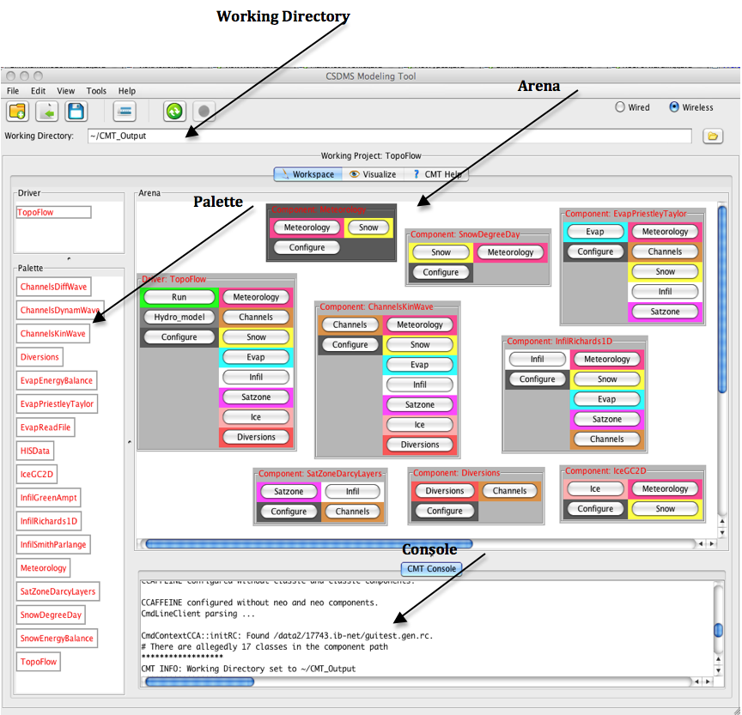

Of those 9 models:
3 are open access through CSDMS
(SIBERIA, CHILD, SIGNUM)
1 is CMT compatible (CHILD)
Our objectives:
Open-access
Non-proprietary
CSDMS CMT compatible, from the ground-up
Quick to learn
Quick to code
Modular
Flexible
(The CSDMS CMT)
Notes:
Outline talk structure here

Slide 5
Architecture
PYTHON ENVIRONMENT
(e.g., iPython)
Explore data
Export
Library of
COMPONENTS
The GRID
Run a DRIVER
(strongly coupled to…)
Preexisting, or
Build your own
Import
Instantiate
Loop
Output
DATA structures
Library of UTILITIES
Notes:
We’re going to go through these things in turn
Emphasise flex of use – script style is possible

Slide 6
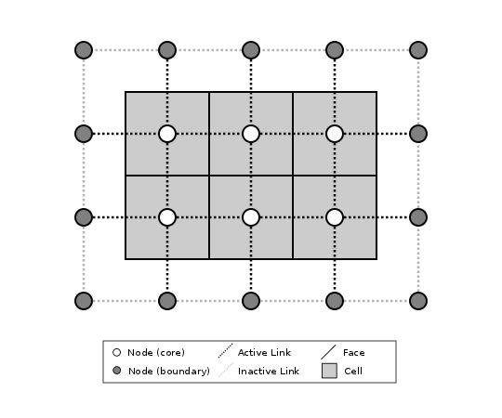
The grid
CHILD-like
Data defined on nodes or links
Explicit control of cell status
Functions describe geometry
Not limited to raster…

Slide 7
(not yet implemented!)
Notes:
Note the extra names that appear here
& hex, radial

Slide 8
The data
Nodes or links
1D arrays of values
Numpy
Grid and data are wrapped together in a single object
15 16 17 18 19
10 11 12 13 14
5 6 7 8 9
0 1 2 3 4
core_nodes: [6, 7, 8, 11, 12, 13]
surface_elev[core_nodes]: [2., 2., 2., 3., 3., 3.]

Slide 9
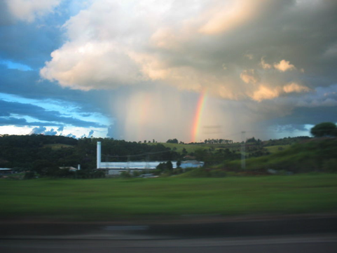
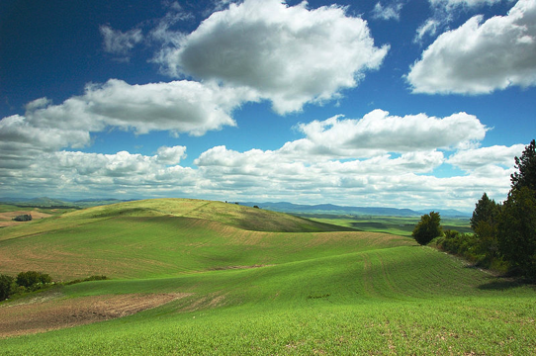
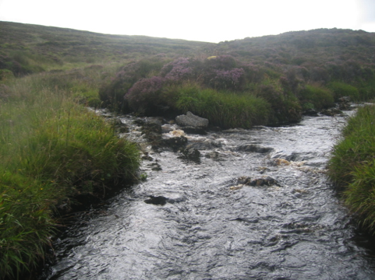
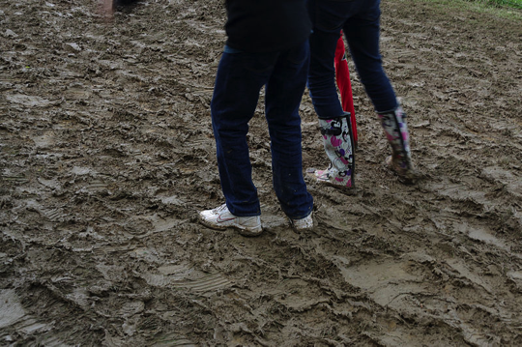
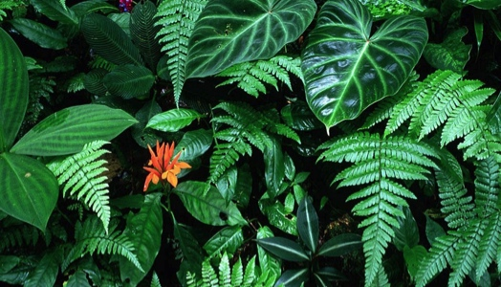
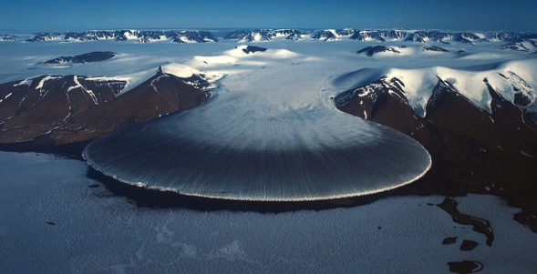
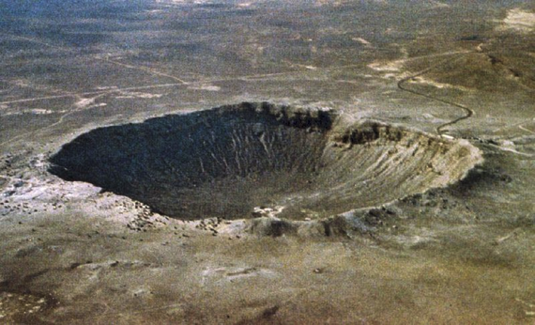
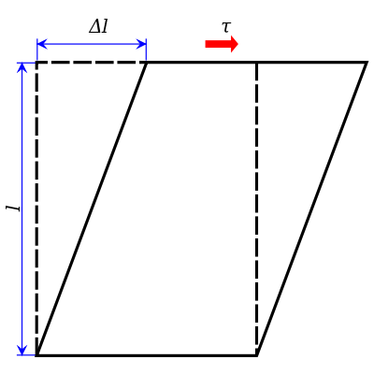
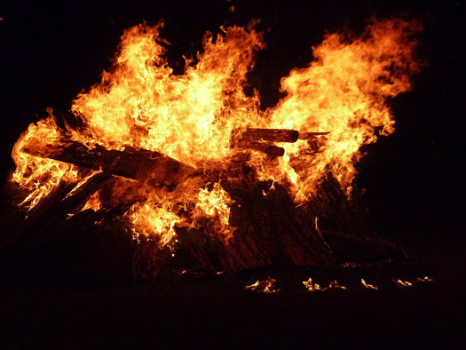
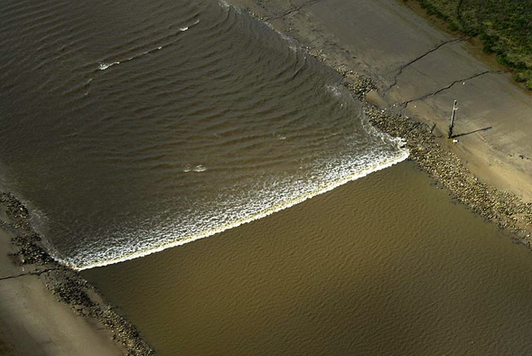
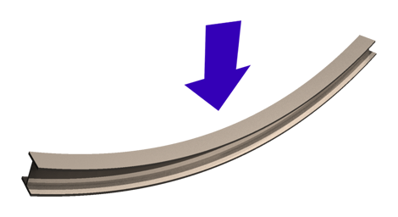
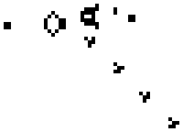
The components
Describe individual surface processes
“Plug & Play”
Standard interface
Use the library, or BYO

Slide 10
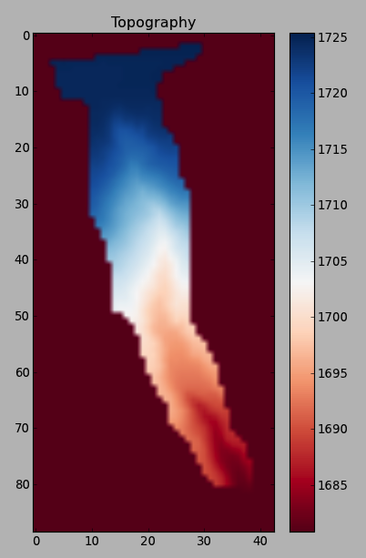
The utilities
Read DEMs
Read .txt
Output routines (e.g., netCDF)
Visualization tools
Other repetitive tasks
Notes:
Bijou Creek. Now show examples, going from simple to complex.

Slide 11
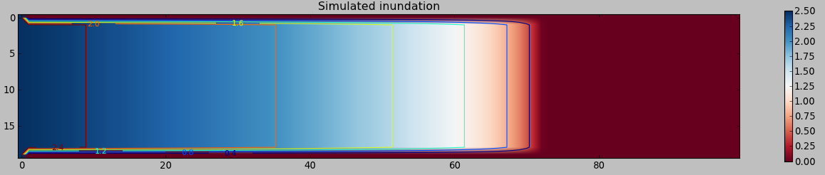
Flood-wave propagation
Follows math laid out in Bates et al. (2010)
Calculates flux divergences at nodes
Very simple to implement in driver
Notes:
Color represents water depth; scale in meters. Flow is left to right. Domain is 1 by 5 kilometers with 50-meter cells. Snapshot represents 30 minutes after dam break. Average flood-wave speed is about 2 m/s.

Slide 12
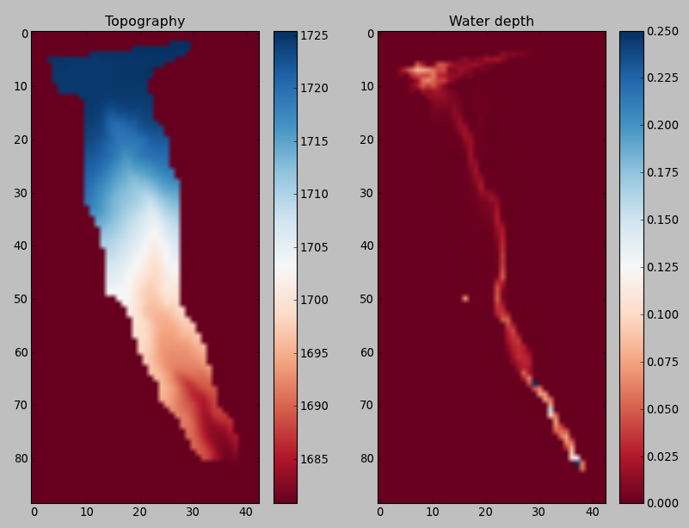
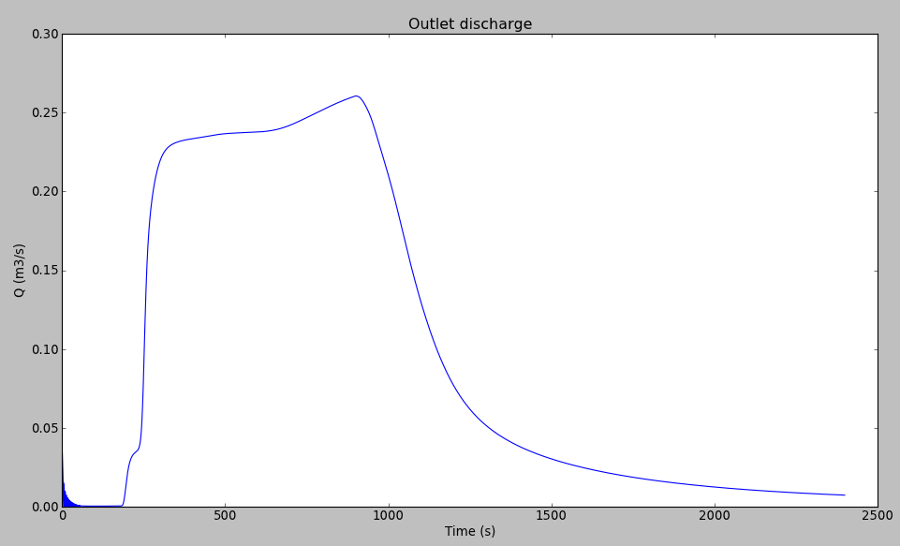
Overland flow on a DEM
Notes:
3 m resolution DEM of ~240 m long gully basin in eastern Colorado. Rainfall and runoff at 100 mm/hr for 15 minutes. Water depth shown just after cessation of rainfall.

Slide 13
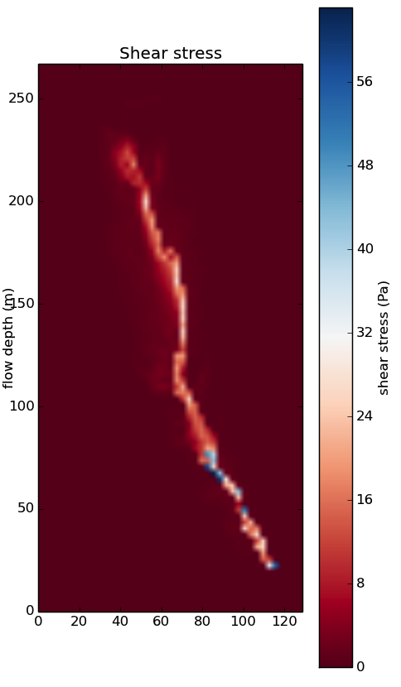
Couple shear stress component…
(Duration of rainfall)

Slide 14
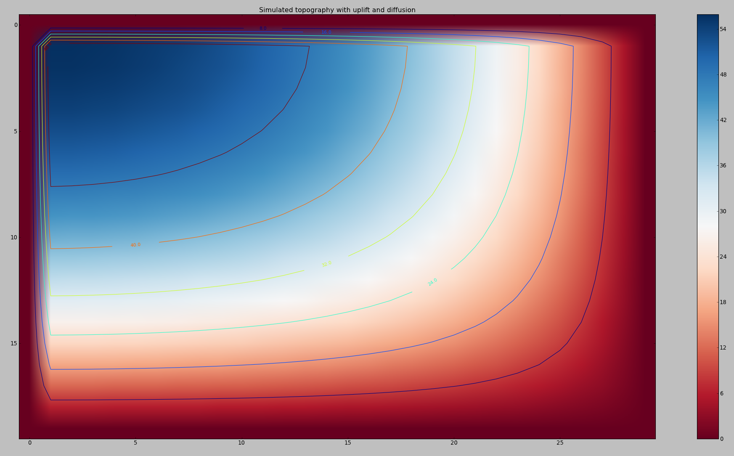
Hillslope diffusion & tectonic uplift
Notes:
Bottom and right-hand boundaries are open and fixed at zero elevation. Top and left-hand boundaries are closed (representing ridgelines). Domain is 200 by 300 meters; elevation scale is in meters.

Slide 15
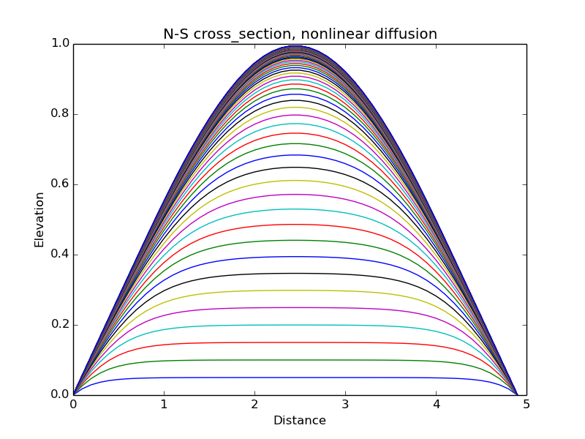
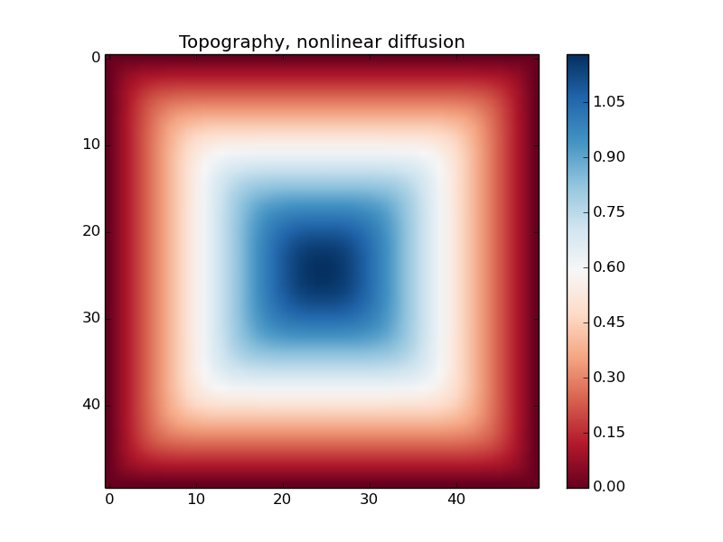
Nonlinear diffusion

Slide 16
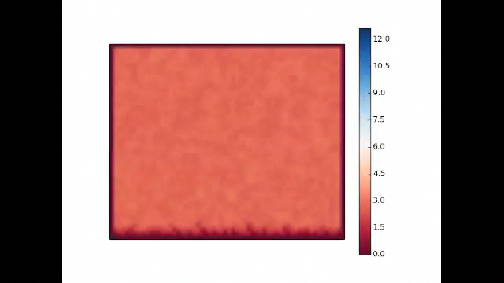
Stream power

Slide 17
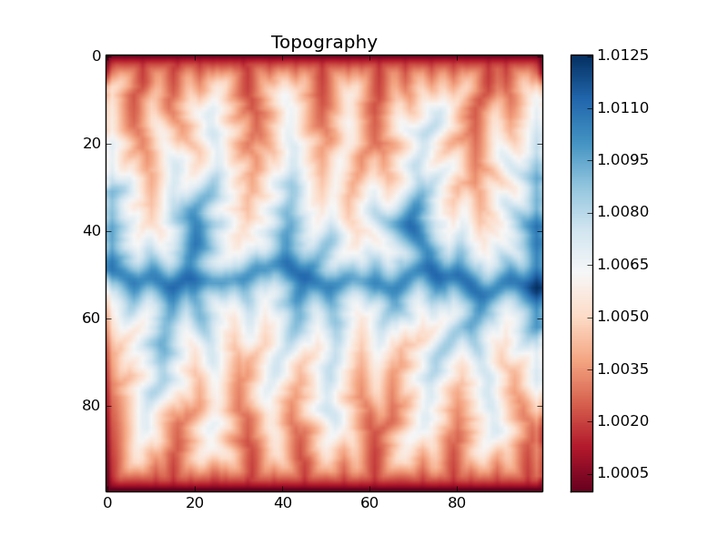
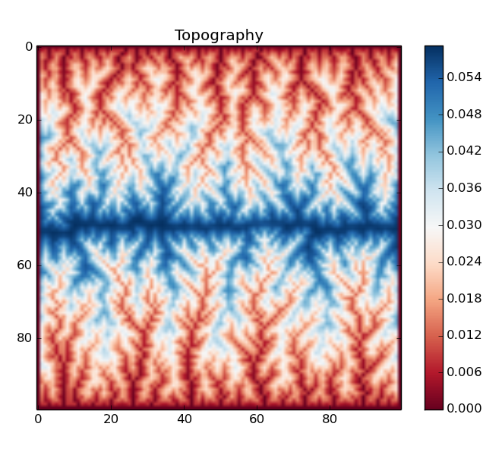
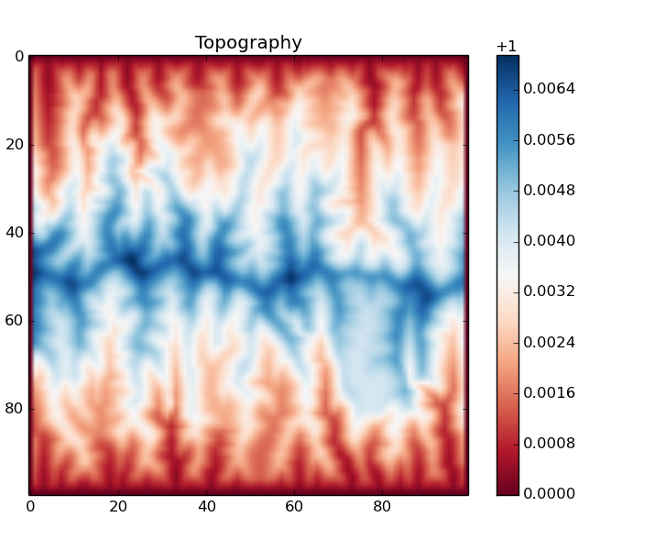
Hillslope-channel coupling

Slide 18

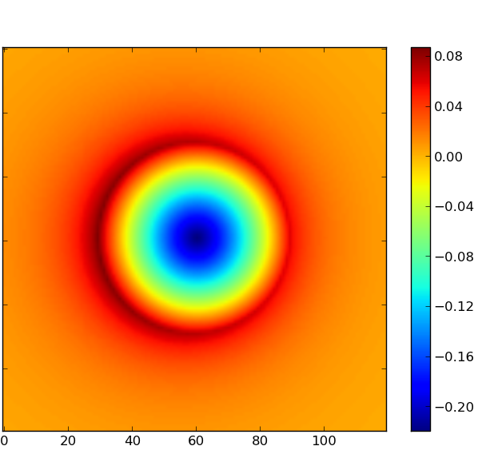
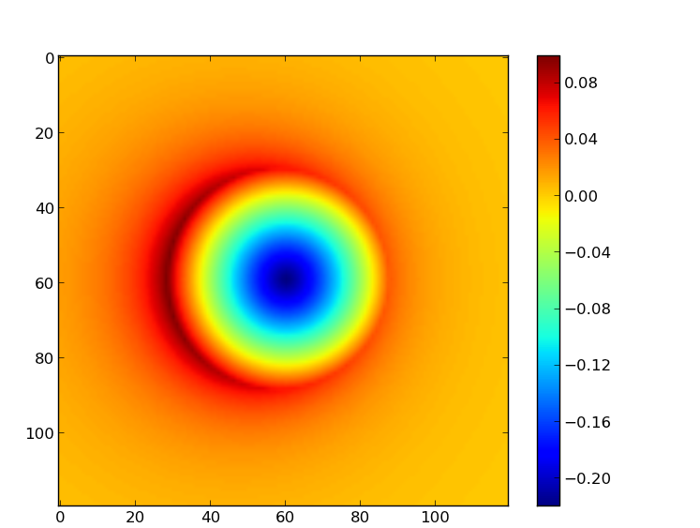
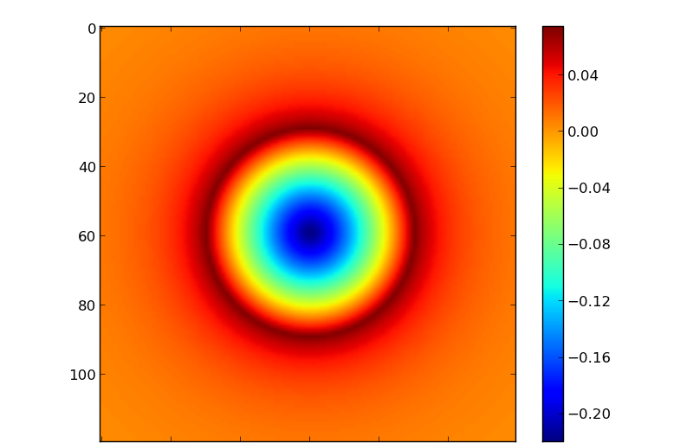
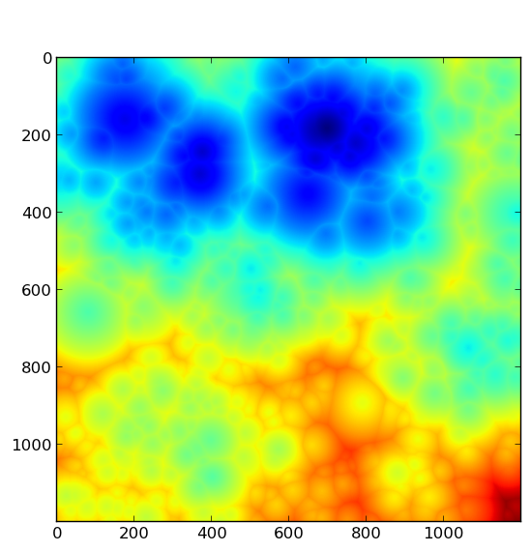
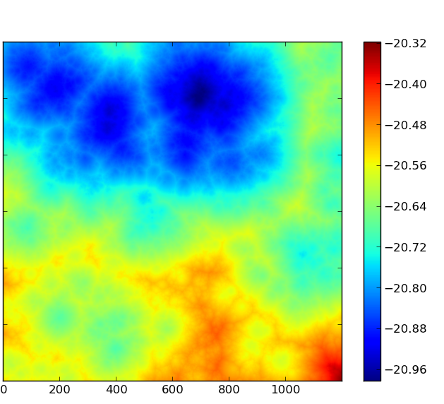
Impact cratering
Notes:
Each crater is 1.5 km across. Scales are in px; field of view is 3 km. Elevations are in km.
Landscape after 250,000 impactors, minimum size 50 m, drawn from a realistic distribution (left), then after 50,000 more impacts, but with a minimum size of 5 m (right). Scales in px; field of view is 3 km. Elevations are in km (arbitrary datum).
Come to AGU!

Slide 19
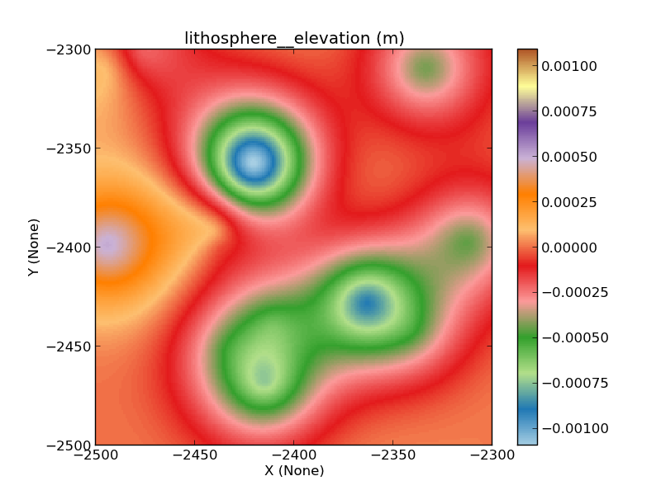
Flexure

Slide 20
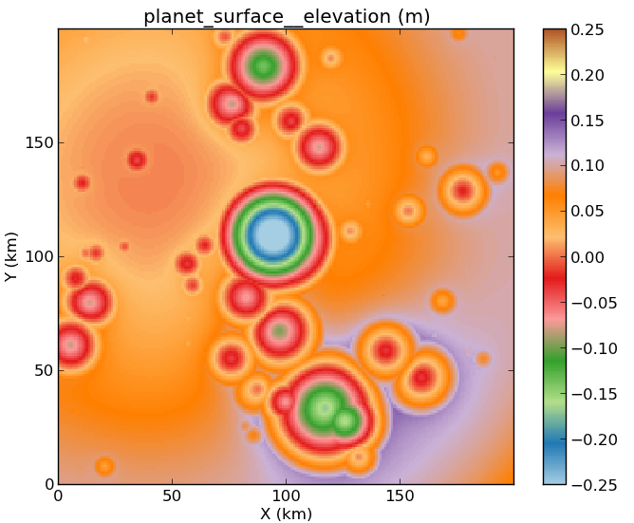
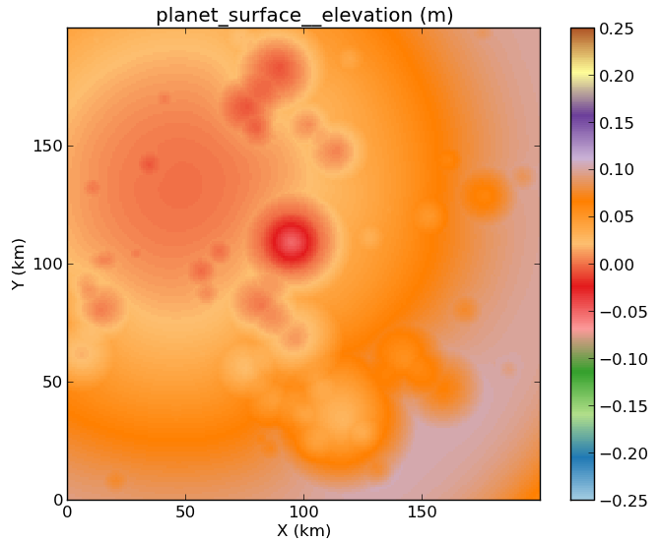
Coupled flexure

Slide 21
Cellular automata
Simple CA model of weathering around fractures (red) into a medium (blue).
Notes:
4 iterations, fixed rate term, using a heap queue to execute the transformations in time order. Solves on the links.

Slide 22
Summary
Landlab is a Python-based, flexible, quick to learn, open source, surface process model
A library of existing process modules is available
Users are encouraged to build their own!

Slide 23
Session plan

Slide 24


Technical aspects
“Developer” vs. “User”
Work with the source code
Instructions on web: landlab.readthedocs.org
From your directory, in a terminal:
$ python setup.py develop
Start python/ipython, &
>>> import landlab [as ll]

Slide 25
Landlab is object oriented
The grid and components are all objects
Import -> instantiate -> loop -> output
Data lives “inside” the grid object, as numpy arrays:
>>> mygrid = ll.RasterModelGrid(num_rows=4, num_cols=5)
>>> mygrid.create_node_array_zeros(
‘planet_surface__elevation’)
>>> mygrid.at_node(‘planet_surface__elevation’)
Grid gets passed around between components
(see examples)
15 16 17 18 19
10 11 12 13 14
5 6 7 8 9
0 1 2 3 4

Slide 26
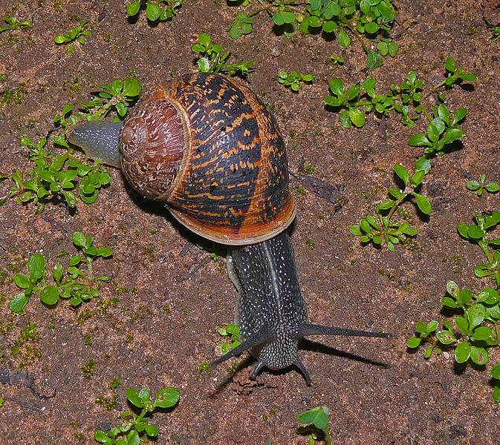
How fast is it?
Fast to code
Exploit Numpy routines
Vectorized
Cython
PyPy…?
…”Faster than you’d think”

