Slide 1
COUPLED MODELING
River – Delta Plain to Longshore Transport
Irina Overeem
(with help of Andrew Ashton and Eric Hutton)

Slide 2
Outline
  OBJECTIVE
  Learn How to Run Coupled Components in the CMT
  Discuss science & technology challenges associated with coupling.
  EXAMPLE : AVULSION-CEM
  River Changes affecting Coastline Evolution Processes
  Simple Scenario and Changes to Input Parameters
  LAB 4
  Set up a coupled run for two distributary channels
  feeding ‘wave-dominated’ deltas.

Slide 3
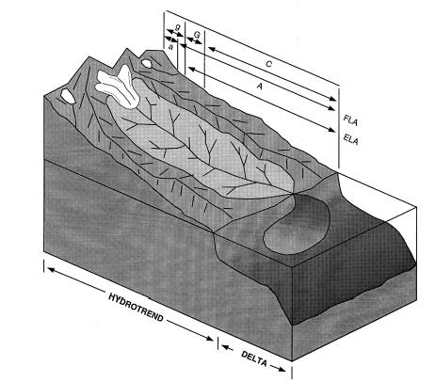
HYDROTREND Component
Task: to deliver water, sediment load from an entire drainage basin to a delta apex.
Needs: climate and basin characteristics
Provides: Q, Qs, Qb at delta apex

Slide 4
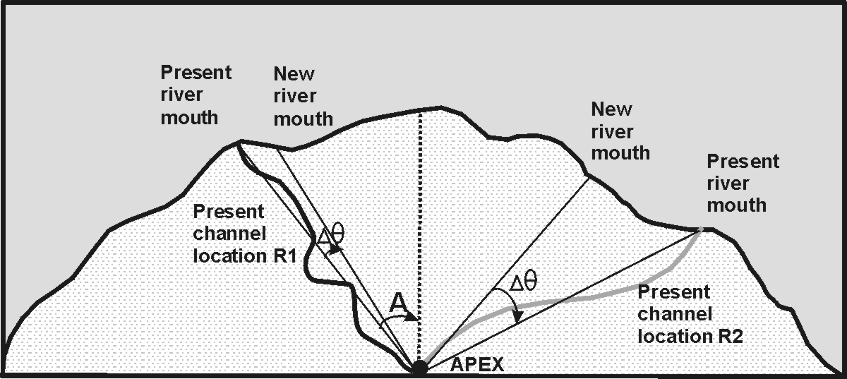
Avulsion Component
Task: to route the distributary channel(s) from the delta apex to the coastline
Needs: incoming water and sediment flux, number of dist. channels and specifications for switching frequency
Provides: sediment flux for 1 – 5 river mouths at coastline

Slide 5
Avulsion Component
Task: to route the distributary channel(s) from the delta apex to the coastline
Needs: incoming water and sediment flux, number of dist. channels and specifications for switching frequency
Provides: sediment flux for 1 – 5 river mouths at coastline

Slide 6
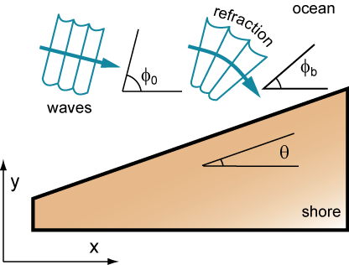
Coastline Evolution Model
Task: to evolve a shoreline due to gradients in breaking-wave-driven alongshore sediment transport.
Needs: incoming sediment flux at coast, wave regime
Provides: offshore deposition and erosion (elevation)

Slide 7
Coastline Evolution Model
Some Theory……..
1. What is wave-dominated delta?
2. Basic mechanism of longshore transport.

Slide 8
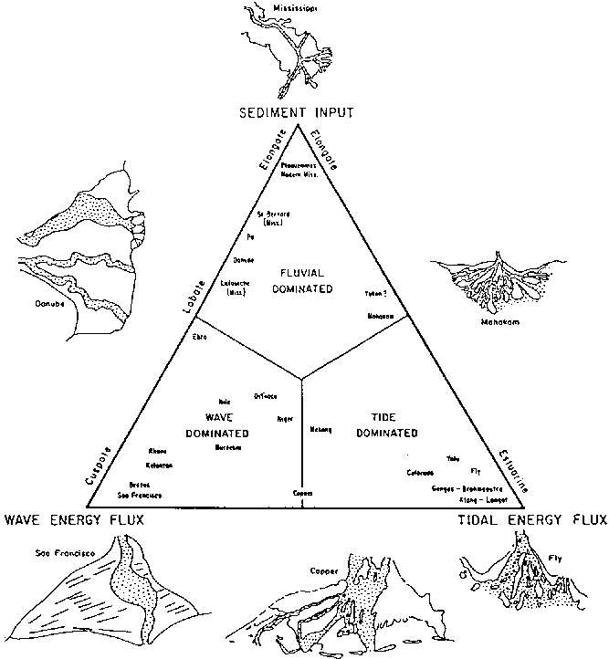
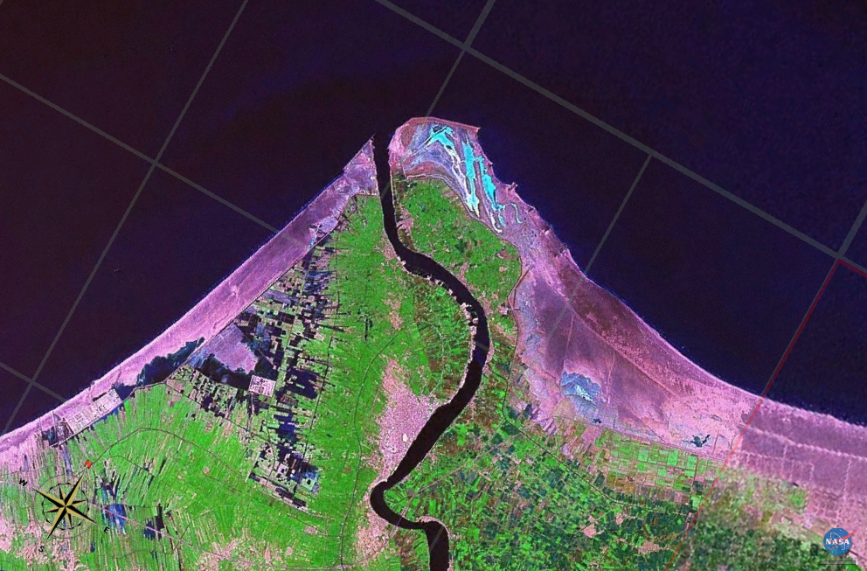
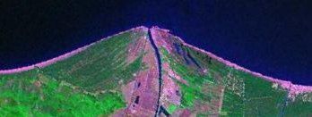
Wave-influenced Deltas
river
Rosetta Lobe, Nile Delta, Egypt
waves
tides
Arno River Delta, Italy
Galloway, 1975

Slide 9
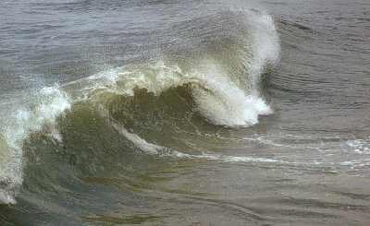
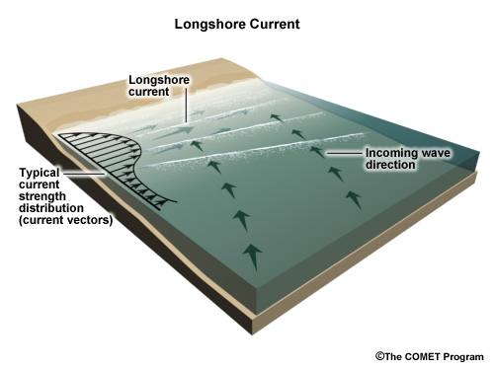
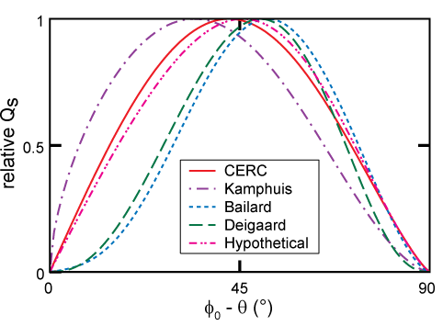
Alongshore Sediment Transport
breaking-wave-driven alongshore sediment transport (within the surf zone) is highly dependent on wave angle
maximizing angle:
~45 degrees

Slide 10
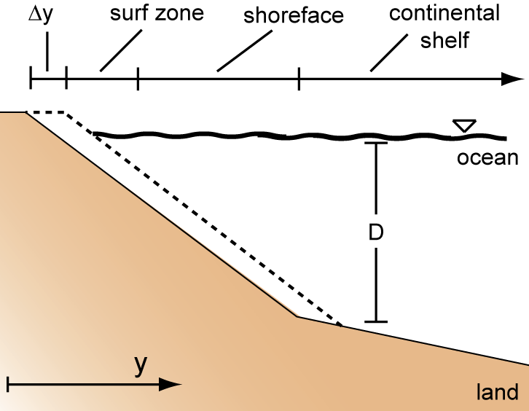
traditional approach
combining the conservation of mass:
with the small angle approximation
Q_{s} = K H_{b}^{5/2} cos (φ_{b} − θ) sin (φ_{b} − θ )
Q_{s} = K H_{b}^{5/2} (1) dy / dx
generates a shoreline evolution equation:
  (classic diffusion equation)

Slide 11
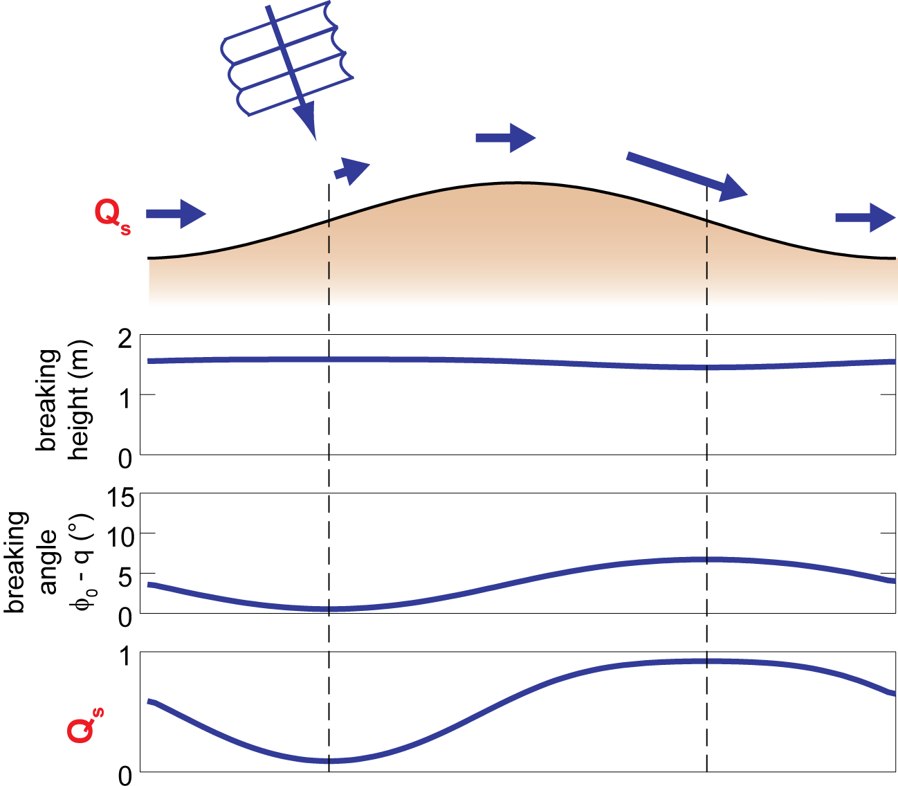
low-angle waves

Slide 12
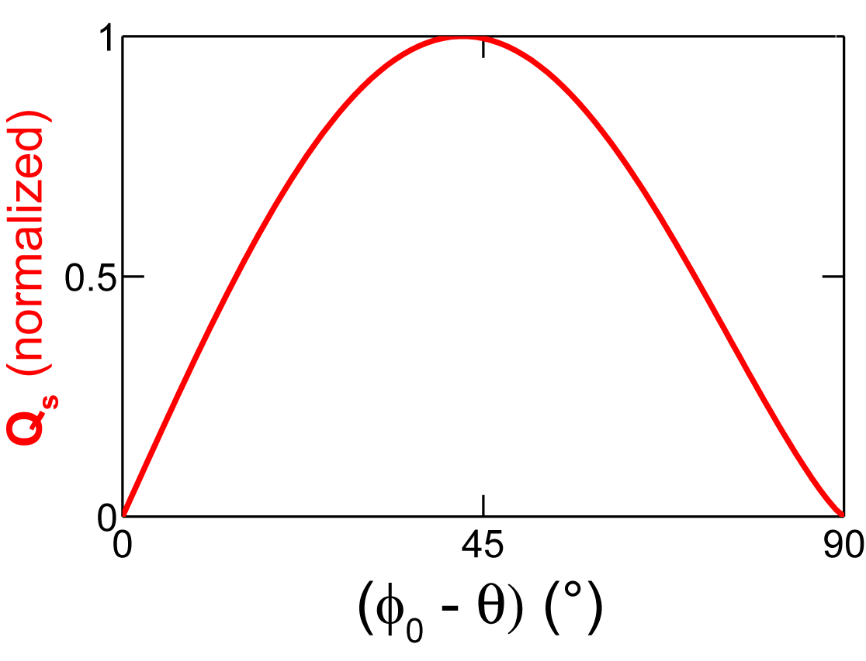
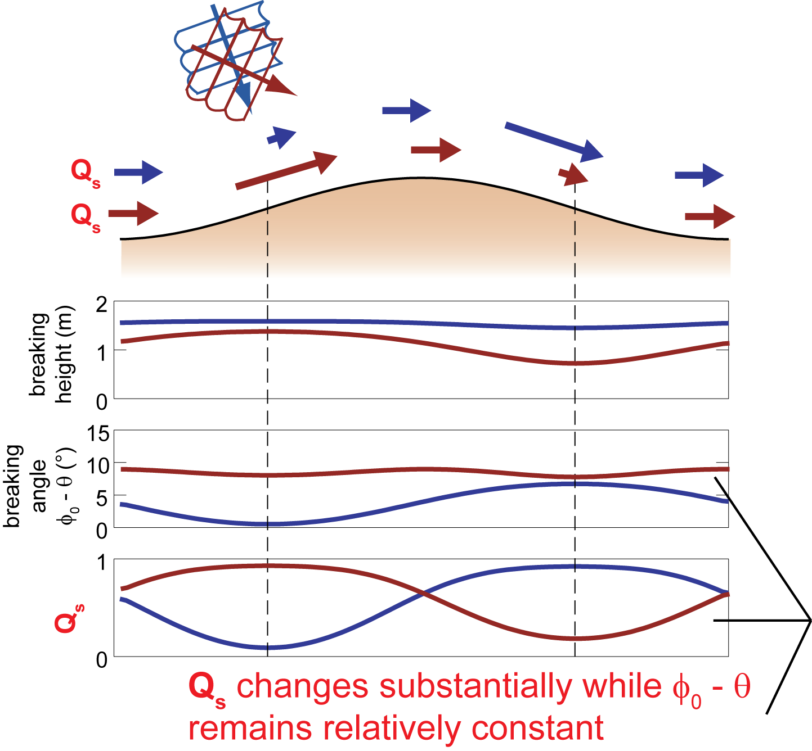
high-angle waves

Slide 13
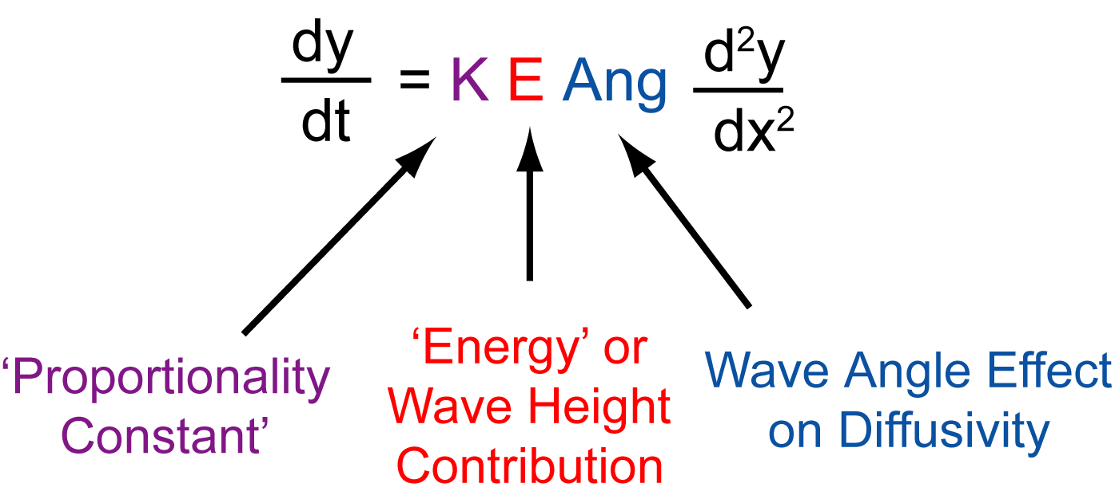
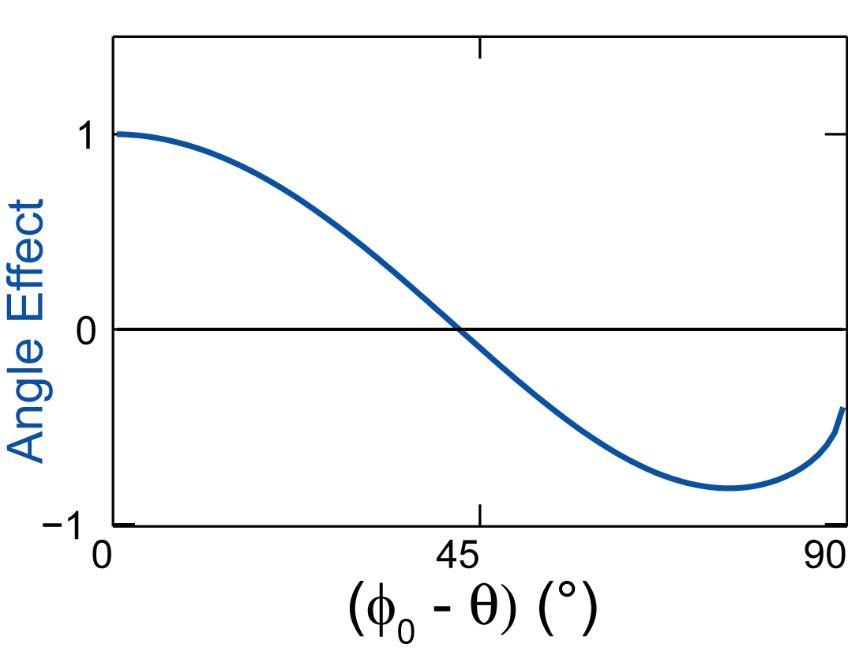
angle-dependent shoreline diffusivity

Slide 14
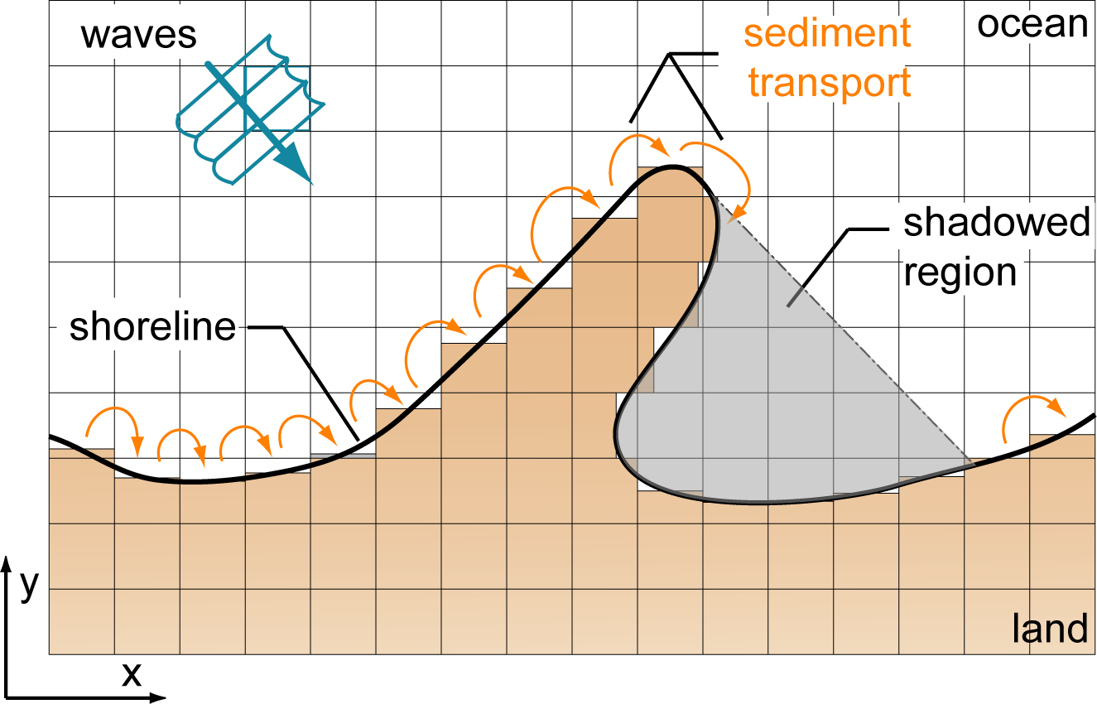
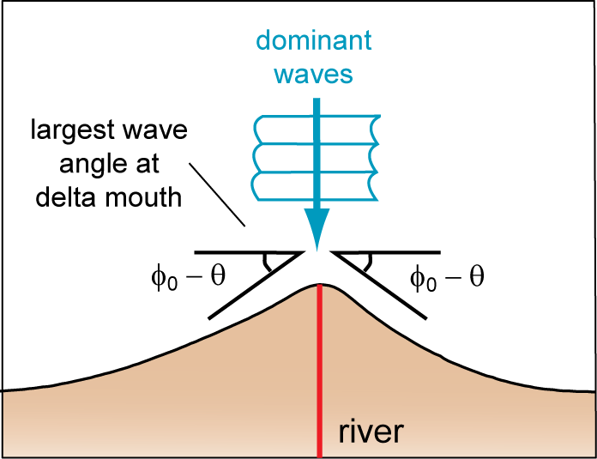
numerical model: ‘CEM’
‘Coastline Evolution Model’
discretizes the plan-view domain
tracks one contour line – the shoreline
simple wave refraction
Ashton and Murray, JGR-ES 2006

Slide 15
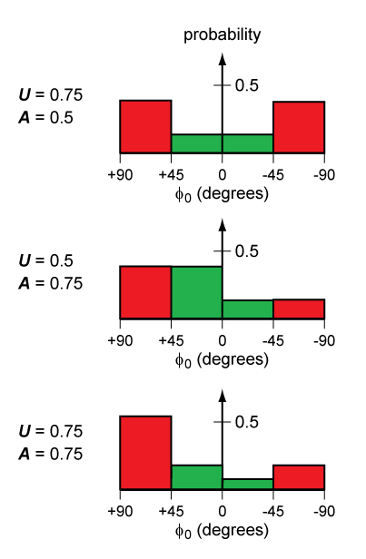
waves from all angles
random distribution of waves selected from PDF
controlled by:
    U = proportion of high-angle, ‘unstable’ waves
    A = asymmetry (proportion of waves approaching from left, driving alongshore sediment transport to the right)

Slide 16
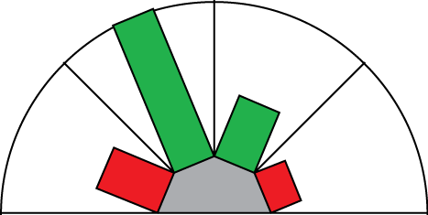
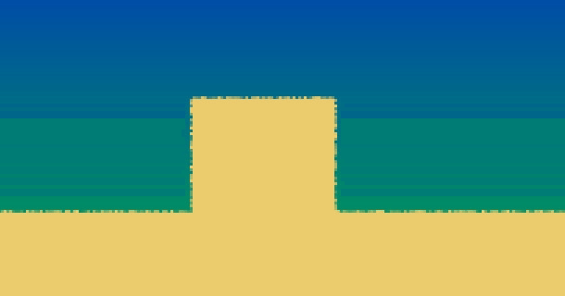
simulated low-angle spits

Slide 17
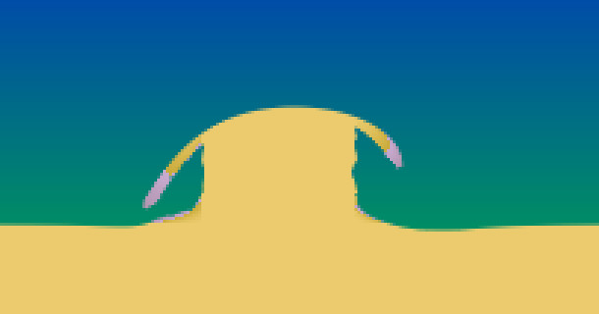
simulated low-angle spits

Slide 18
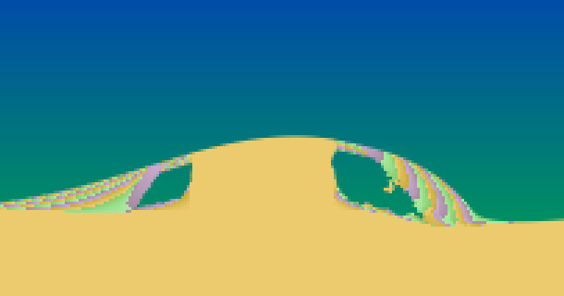
simulated low-angle spits

Slide 19
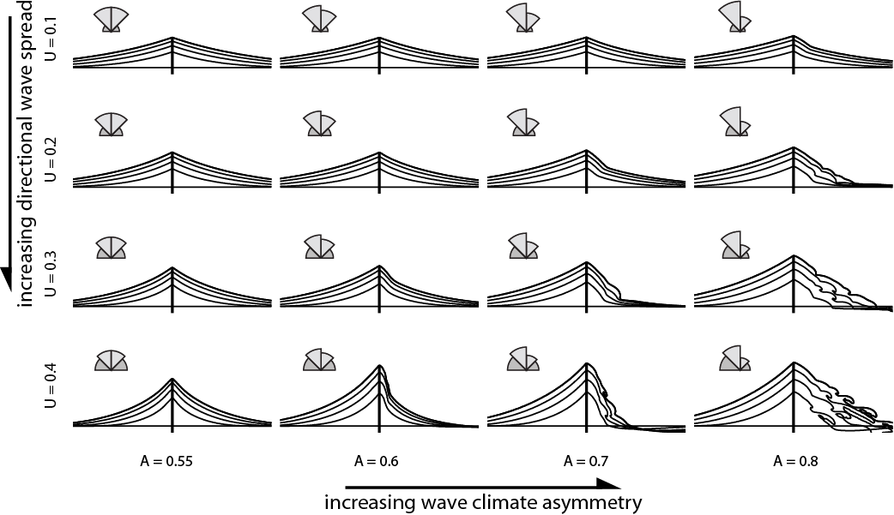
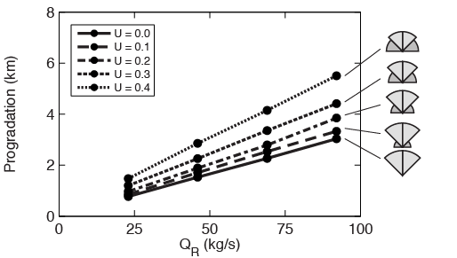
CEM results- symmetrical waves

Slide 20
Symmetrical wave-influenced deltas
Rosetta Lobe, Nile Delta, Egypt
Arno River Delta, Italy
Bhattacharya & Giosan, 2002

Slide 21
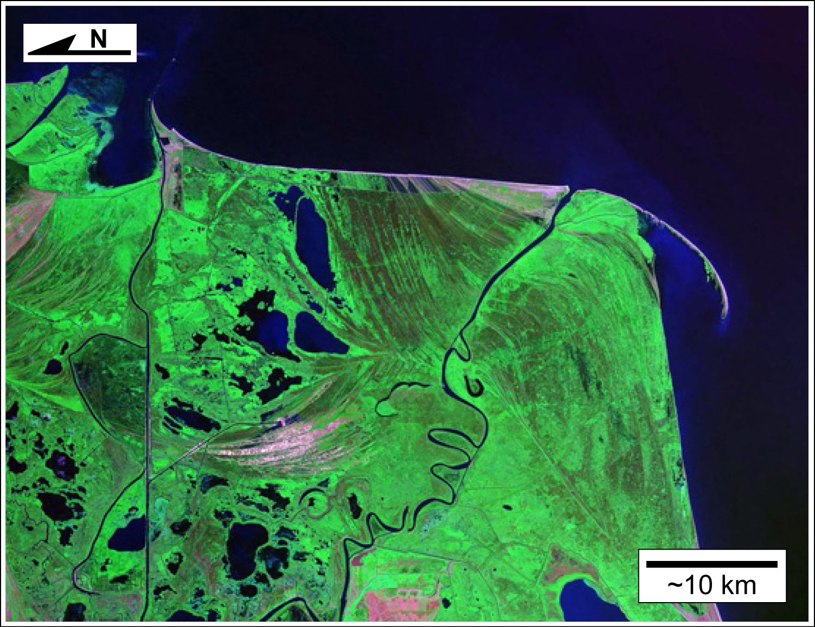
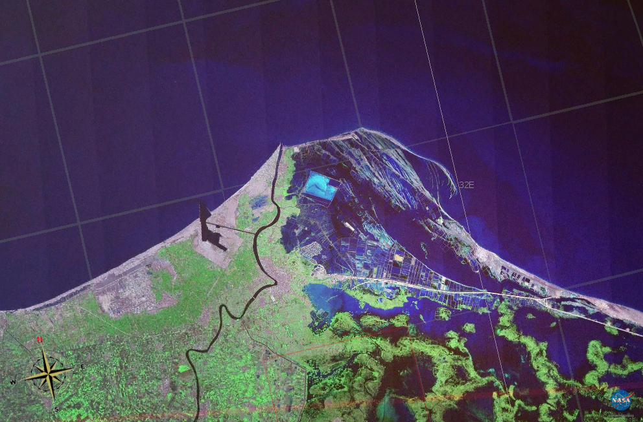
asymmetrical wave-influenced deltas
Danube Delta, Romania
Bhattacharya & Giosan, 2002
Damietta Lobe, Nile Delta, Egypt

Slide 22
delta morphologies with asymmetry

Slide 23
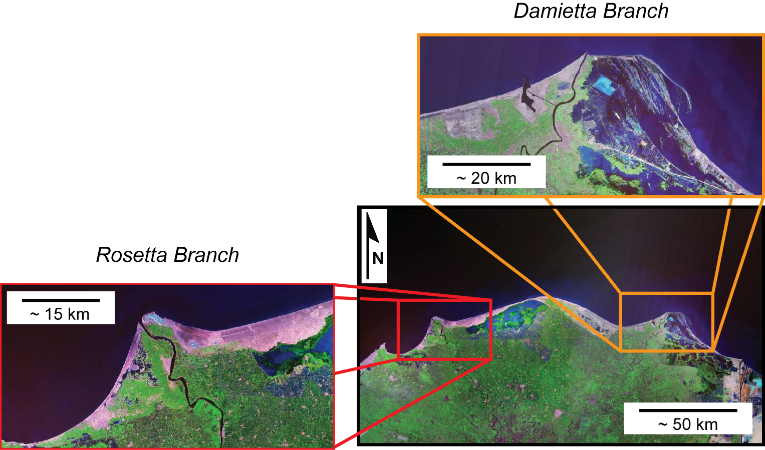

hypothesis test – Nile Delta
MedAtlas
hindcast
wave “energy”
(H₀^{12/5})

Slide 24
two-way coupling through CMT
flexible ‘avulsion’ component to implement different fluvial flux and routing schemes
    fixed direction (several rivers)
    migrating river
    geometric ‘bifurcation’ rules
    dynamic upstream avulsion
simple feedback:
  Q_{b} = a S^{b}, where
  slope S ~ river length
  b > 1 (non-linear)
  just a first try!

Slide 25
River-CEM LAB 5
Launch the WMT tool (from the CSDMS website)
Select CEM Component to be the Driver
Link the River Component, the Discharge Component, and the Waves Component
Set up a run by making changes in the parameter menus of each component

Slide 26
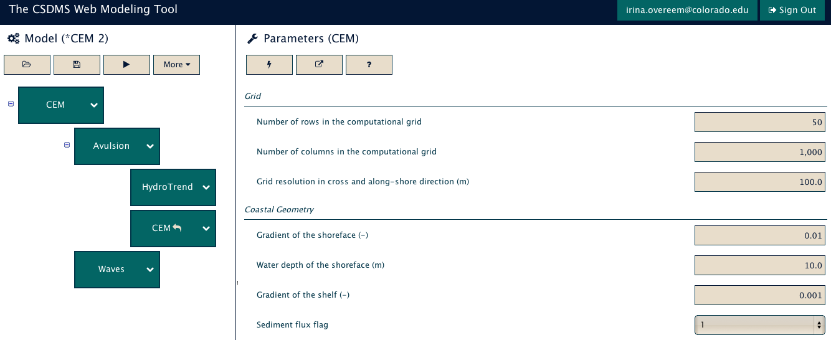
Simulation Wiring
CEM needs AVULSION to set a switching delta channel transporting bedload for sediment delivery to the coast, it needs WAVES to drive longshore tranport, the avulsion component needs incoming river discharge (CONSTANT).

Slide 27
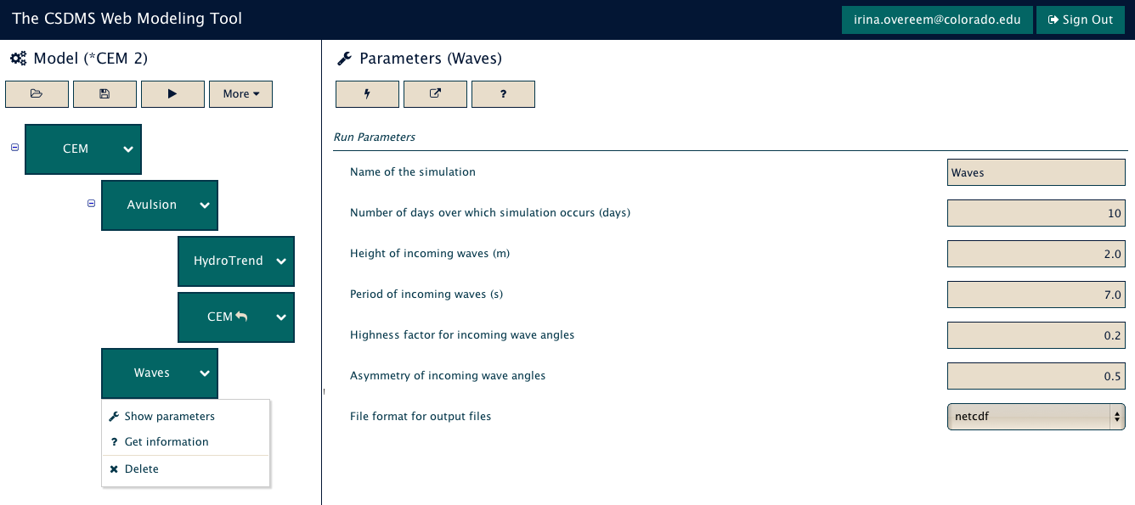
Coastline Response to Wave Dynamics?
Set up wave angle regimes which systematically change the asymmetry of the incoming wave field (A), and the proportion of high angle waves (U)
(from Ashton et al. )

Slide 28
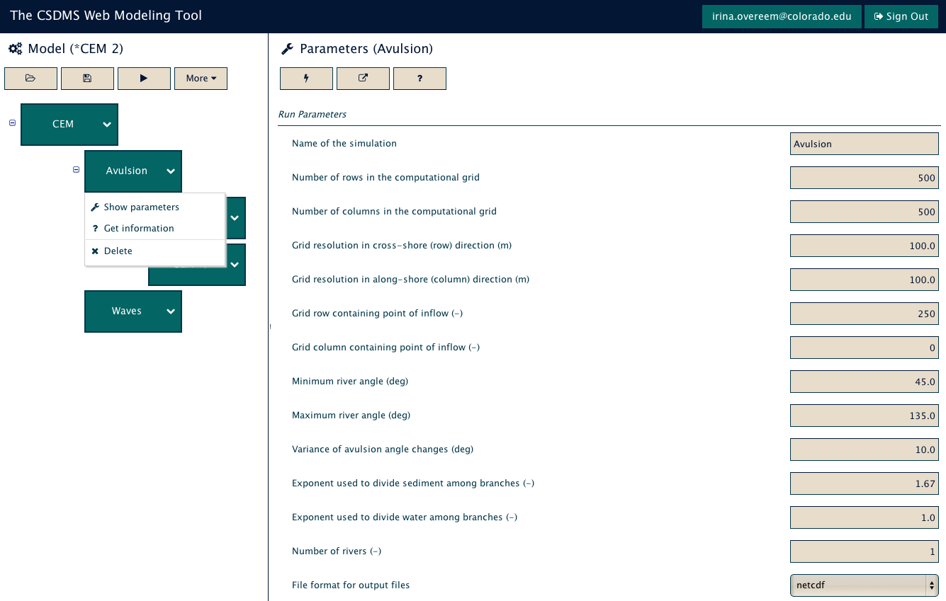
Multiple Distributary Channels
Set the number of rivers to two distributary channels.
If you adjust the sediment exponent, the channel with the shortest route to the coast will receive a higher proportion bedload at the division.
Change number
of rivers

Slide 29
References
Ashton A., Murray B.A. Arnault O. Formation of Coastline Features by Large-Scale Instabilities Induced by High-Angle Waves. Nature Magazine. Volume 414. 15 November 2001.
Ashton A.D., Murray A.B. High-Angle Wave Instability and Emergent Shoreline Shapes: 1. Wave Climate Analysis and Comparisons to Nature. Journal of Geophysical Research. Volume 111. 15 December 2006.
Ashton A.D., Murray A.B. High-Angle Wave Instability and Emergent Shoreline Shapes: 2. Wave Climate Analysis and Comparisons to Nature. Journal of Geophysical Research. Volume 111. 15 December 2006.
Overeem, I., Syvitski, J.P.M., Hutton, E.W.H., (2005). Three-dimensional numerical modeling of deltas. SEPM Spec. Issue, 83. ‘River Deltas: concepts, models and examples’. p.13-30.
Hutton, E.W.H, Syvitski, J.P.M., 2008. Sedflux 2.0: An advanced process-response model that generates three-dimensional stratigraphy . Computer & Geosciences, 34-10, 1319-1337.

