Slide 1






CZO’s-Big Data & Team Science
Towards a Cyberinfrastructure
For Scaling Up and Sharing
Data & Models
C. Duffy, L. Leonard, G. Bhatt, X. Yu, P. Raghavan Penn State Univ.
Notes:
1

Slide 2
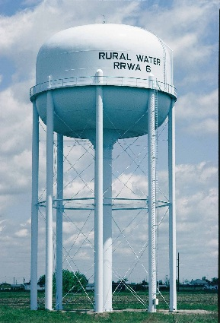
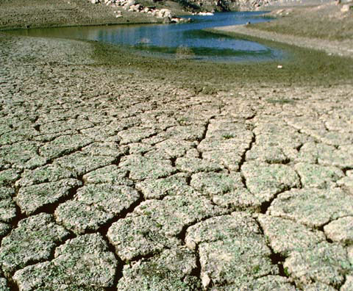
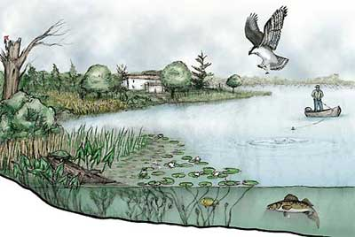
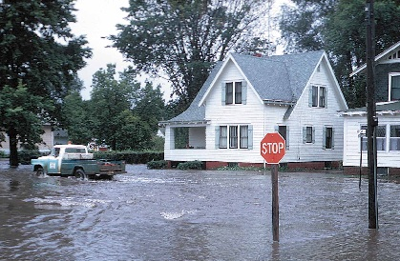
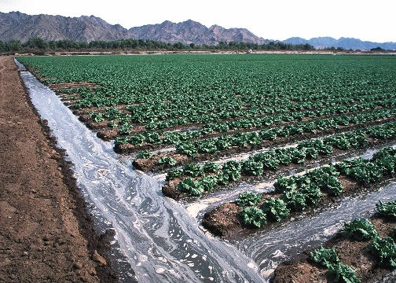
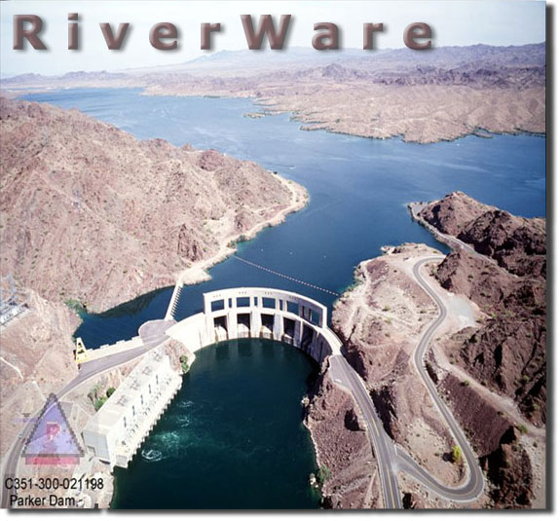
CZO Testbeds for Science and Science-Based Approach to Water & Ecosystem Services
Ecosystem Services
Drinking Water
Hydropower Generation
Irrigation
Floods
Drought
Notes:
* Water is key to sustainability. It is used for drinking, in power generation, for agriculture and support of the whole ecosystem. But too much of it can lead to floods and too little of it cause drought.

Slide 3
International Critical Zone Observatories :
Virtual Science Sharing on a Global Scale

Slide 4
  CZO’s -> Big Data & Big Simulation
Some Issues & Questions
  Scaling up CZO Simulations & Data: Framework for Earth Casting
  The Essential Terrestrial Variables - National Products?
  Cyberinfrastructure for Virtual Data and Models
  Reanalysis - Reconstruction and the Role of Environmental Observatories
  Platform for communicating science and science-based decision making?

Slide 5
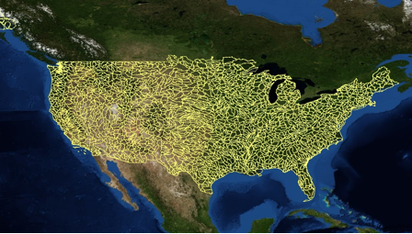
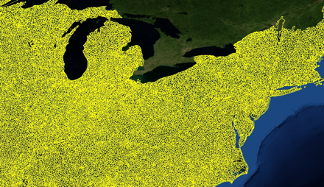
2,268 USGS
HUC 8
watersheds
The Watershed – River Basin
Basis For Model-Data Sharing
103,444 USGS
HUC 12
watersheds

Slide 6
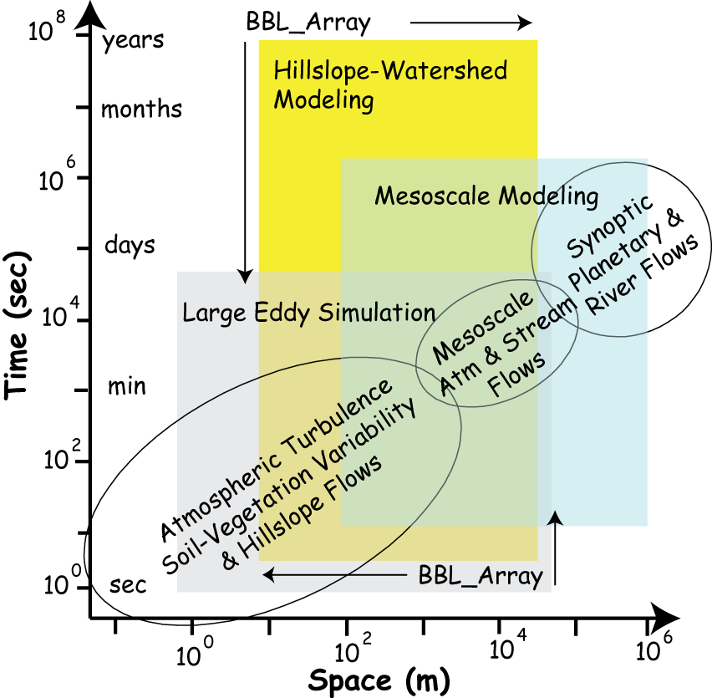
Importance of CZO’s for Scaling Up Processes/Models
CZO Scales
aaaaaaaa mmm

Slide 7
What are the Essential Terrestrial Variables?
Water-Energy-Solute-Vegetation
Atmospheric Forcing (precipitation, snow cover, wind, relative humidity, temperature, net radiation, albedo, photosynthestic atmospheric radiation)
Digital elevation models (30, 10, 3, 1m resolution)
River/Stream discharge, stage, cross-section
Soil (texture, C/N, organic, hydrologic & thermal properties)
Groundwater (levels, extent, hydrogeologic properties)
Land Cover (biomass/leaf area index, phenology,……. )
Land Use (human infrastructure, demography, ecosystem disturbance, property & political boundaries)
Environmental Tracers- stable isotopes
Water Use and Water Transfers
Lake/Reservoir/Diversion (levels, extent, discharge, operating rules)
…to be cont’d……..??
Most data reside on federal servers ….many terabytes

Slide 8
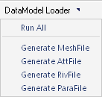
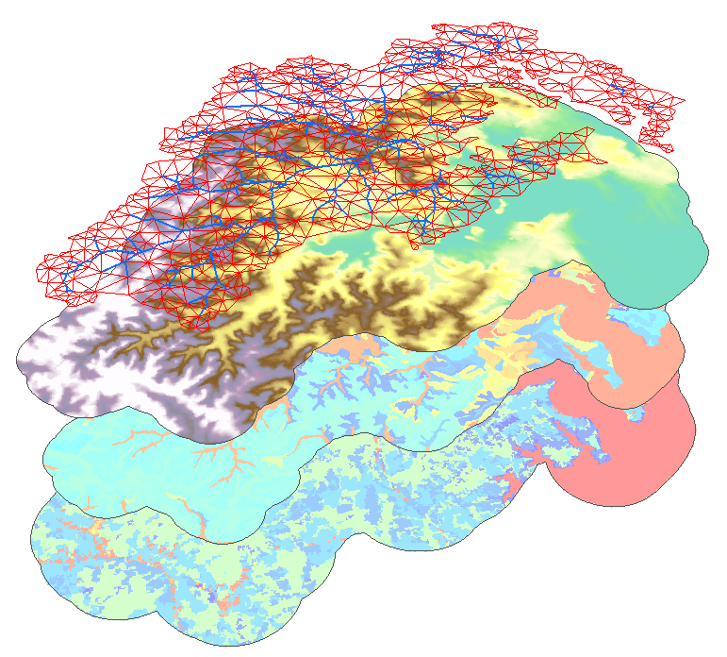
Irregular Mesh &
Stream Network
Register geospatial & geo-temporal fields
Access to ETV’s
Automate CZO Modeling Workflow
Elevations
Soil Classes
Land Cover

Slide 9
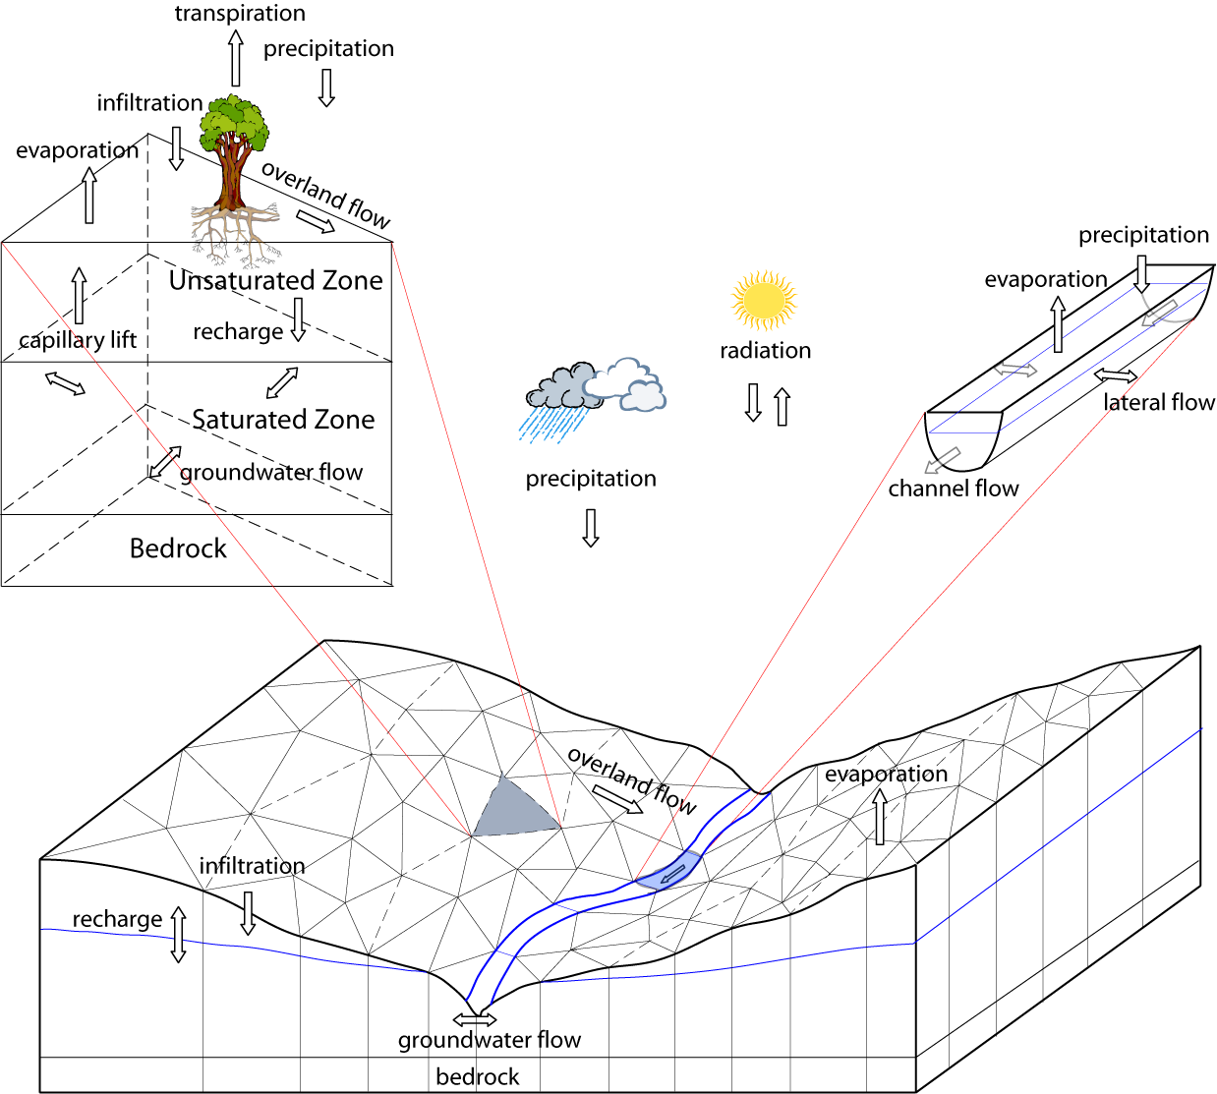
Penn State Integrated Hydrologic Model (PIHM)
NOAH Land
Surface
Model
PIHM Qu and Duffy 2007. Kumar, Bhatt, Duffy 2009

Slide 10
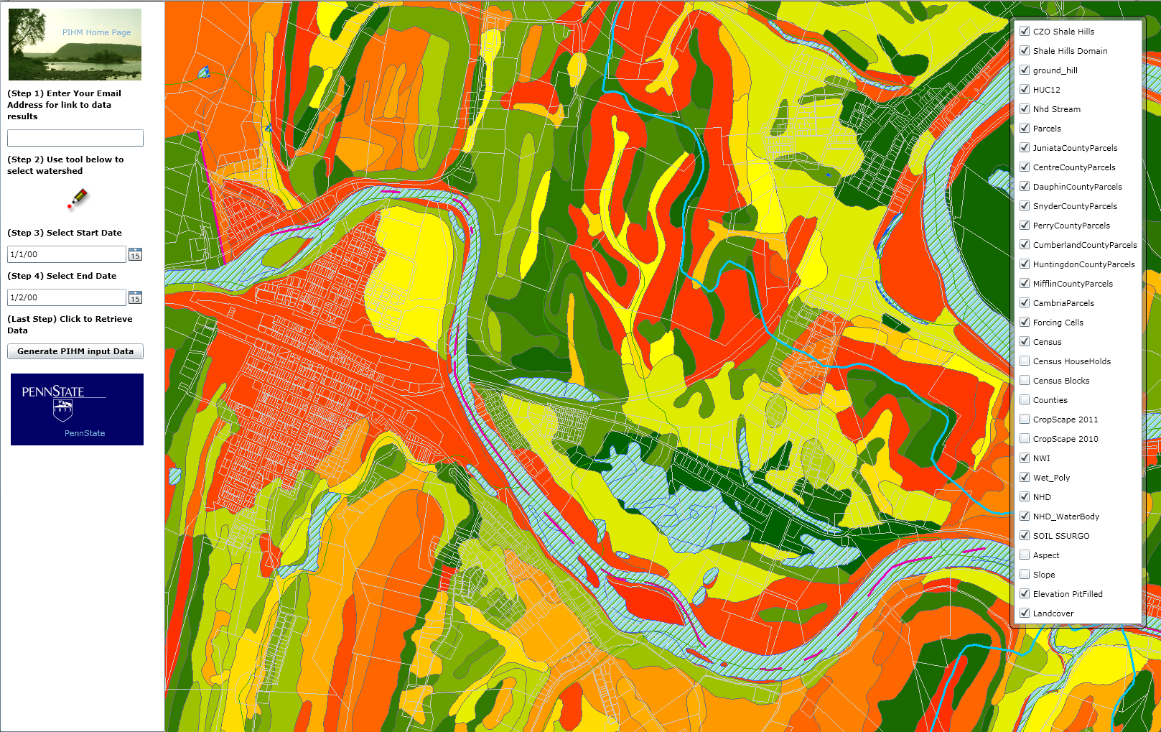
HydroTerre: A Prototype for Model-Data Access
Land Parcel Data; NHD: Stream, Lake, HUC’; USDA: Soils/Crops; NLCD: LU_LC;

Slide 11
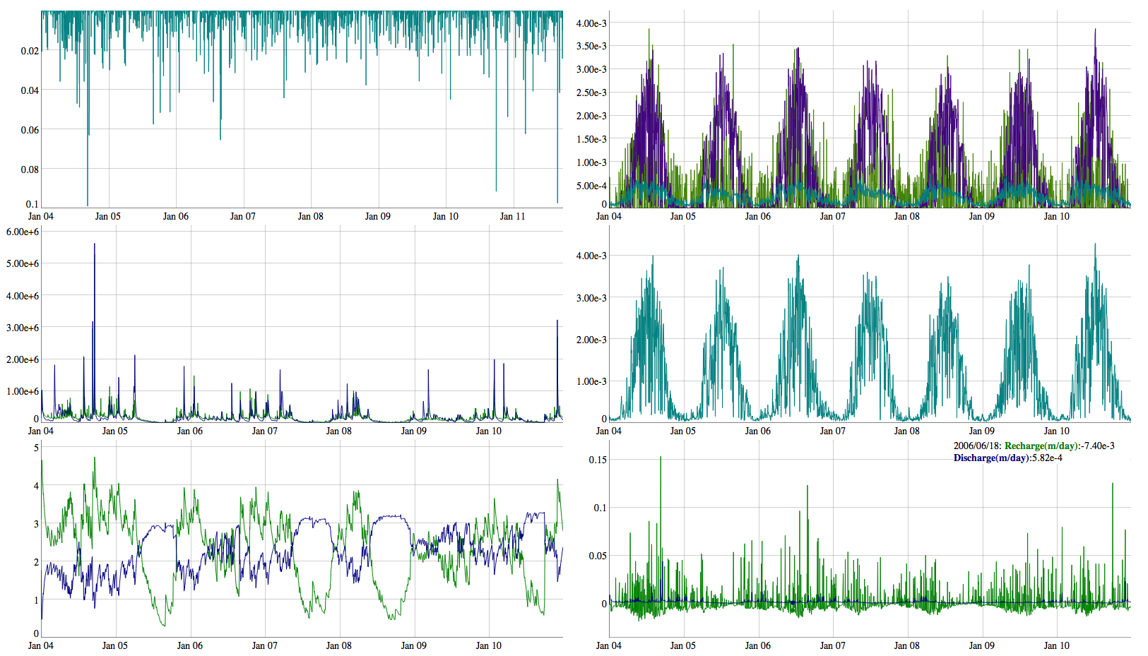
http://www.pihm.psu.edu/applications.html
CZO Reanalsysis time series: 1979-Present
Xuan Yu, lead

Slide 12
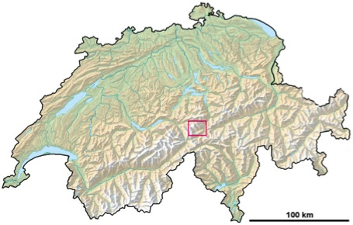
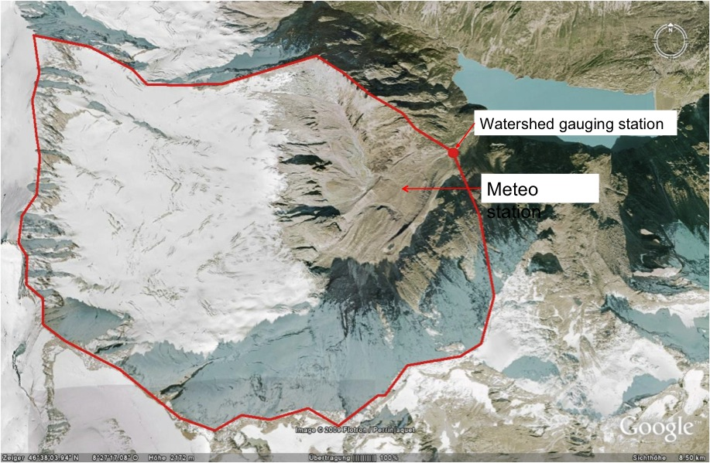
Damma glacier CZO
Stefano Bernasconi, ETHZ
Maria Andrianaki, ETHZ
Xuan Yu Penn State
Drainage area: 10.7 km²
Elevation range: 1800–3600
Precipitation: 2400 mm/yr
Snow depth: 2-7 m
Glacier extent: 5 km²
Present retreat: 10 m/yr
Geology: central: Aar granite

Slide 13
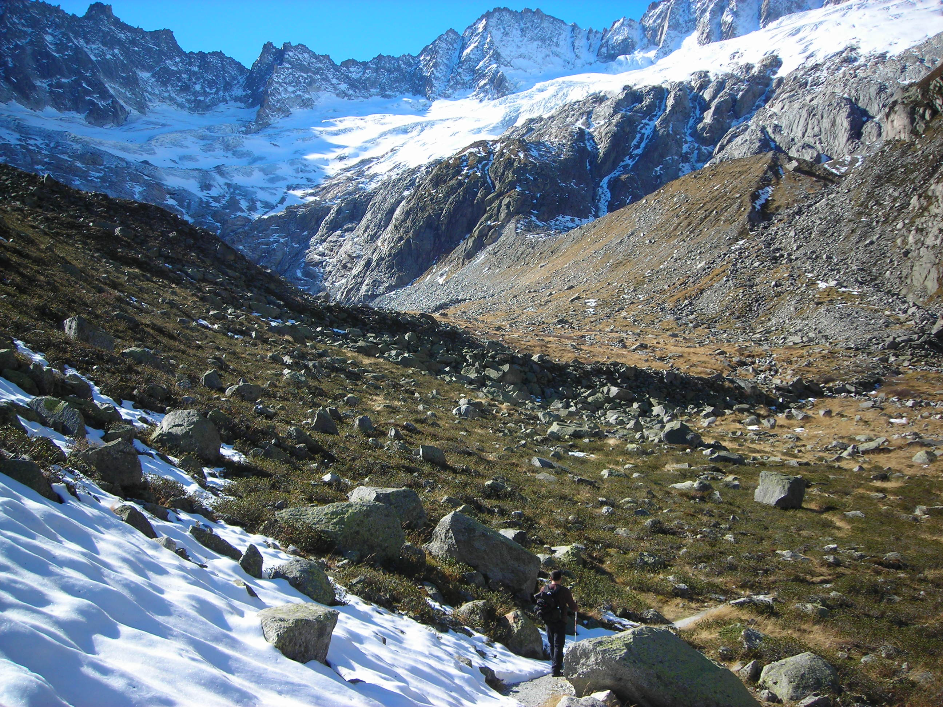
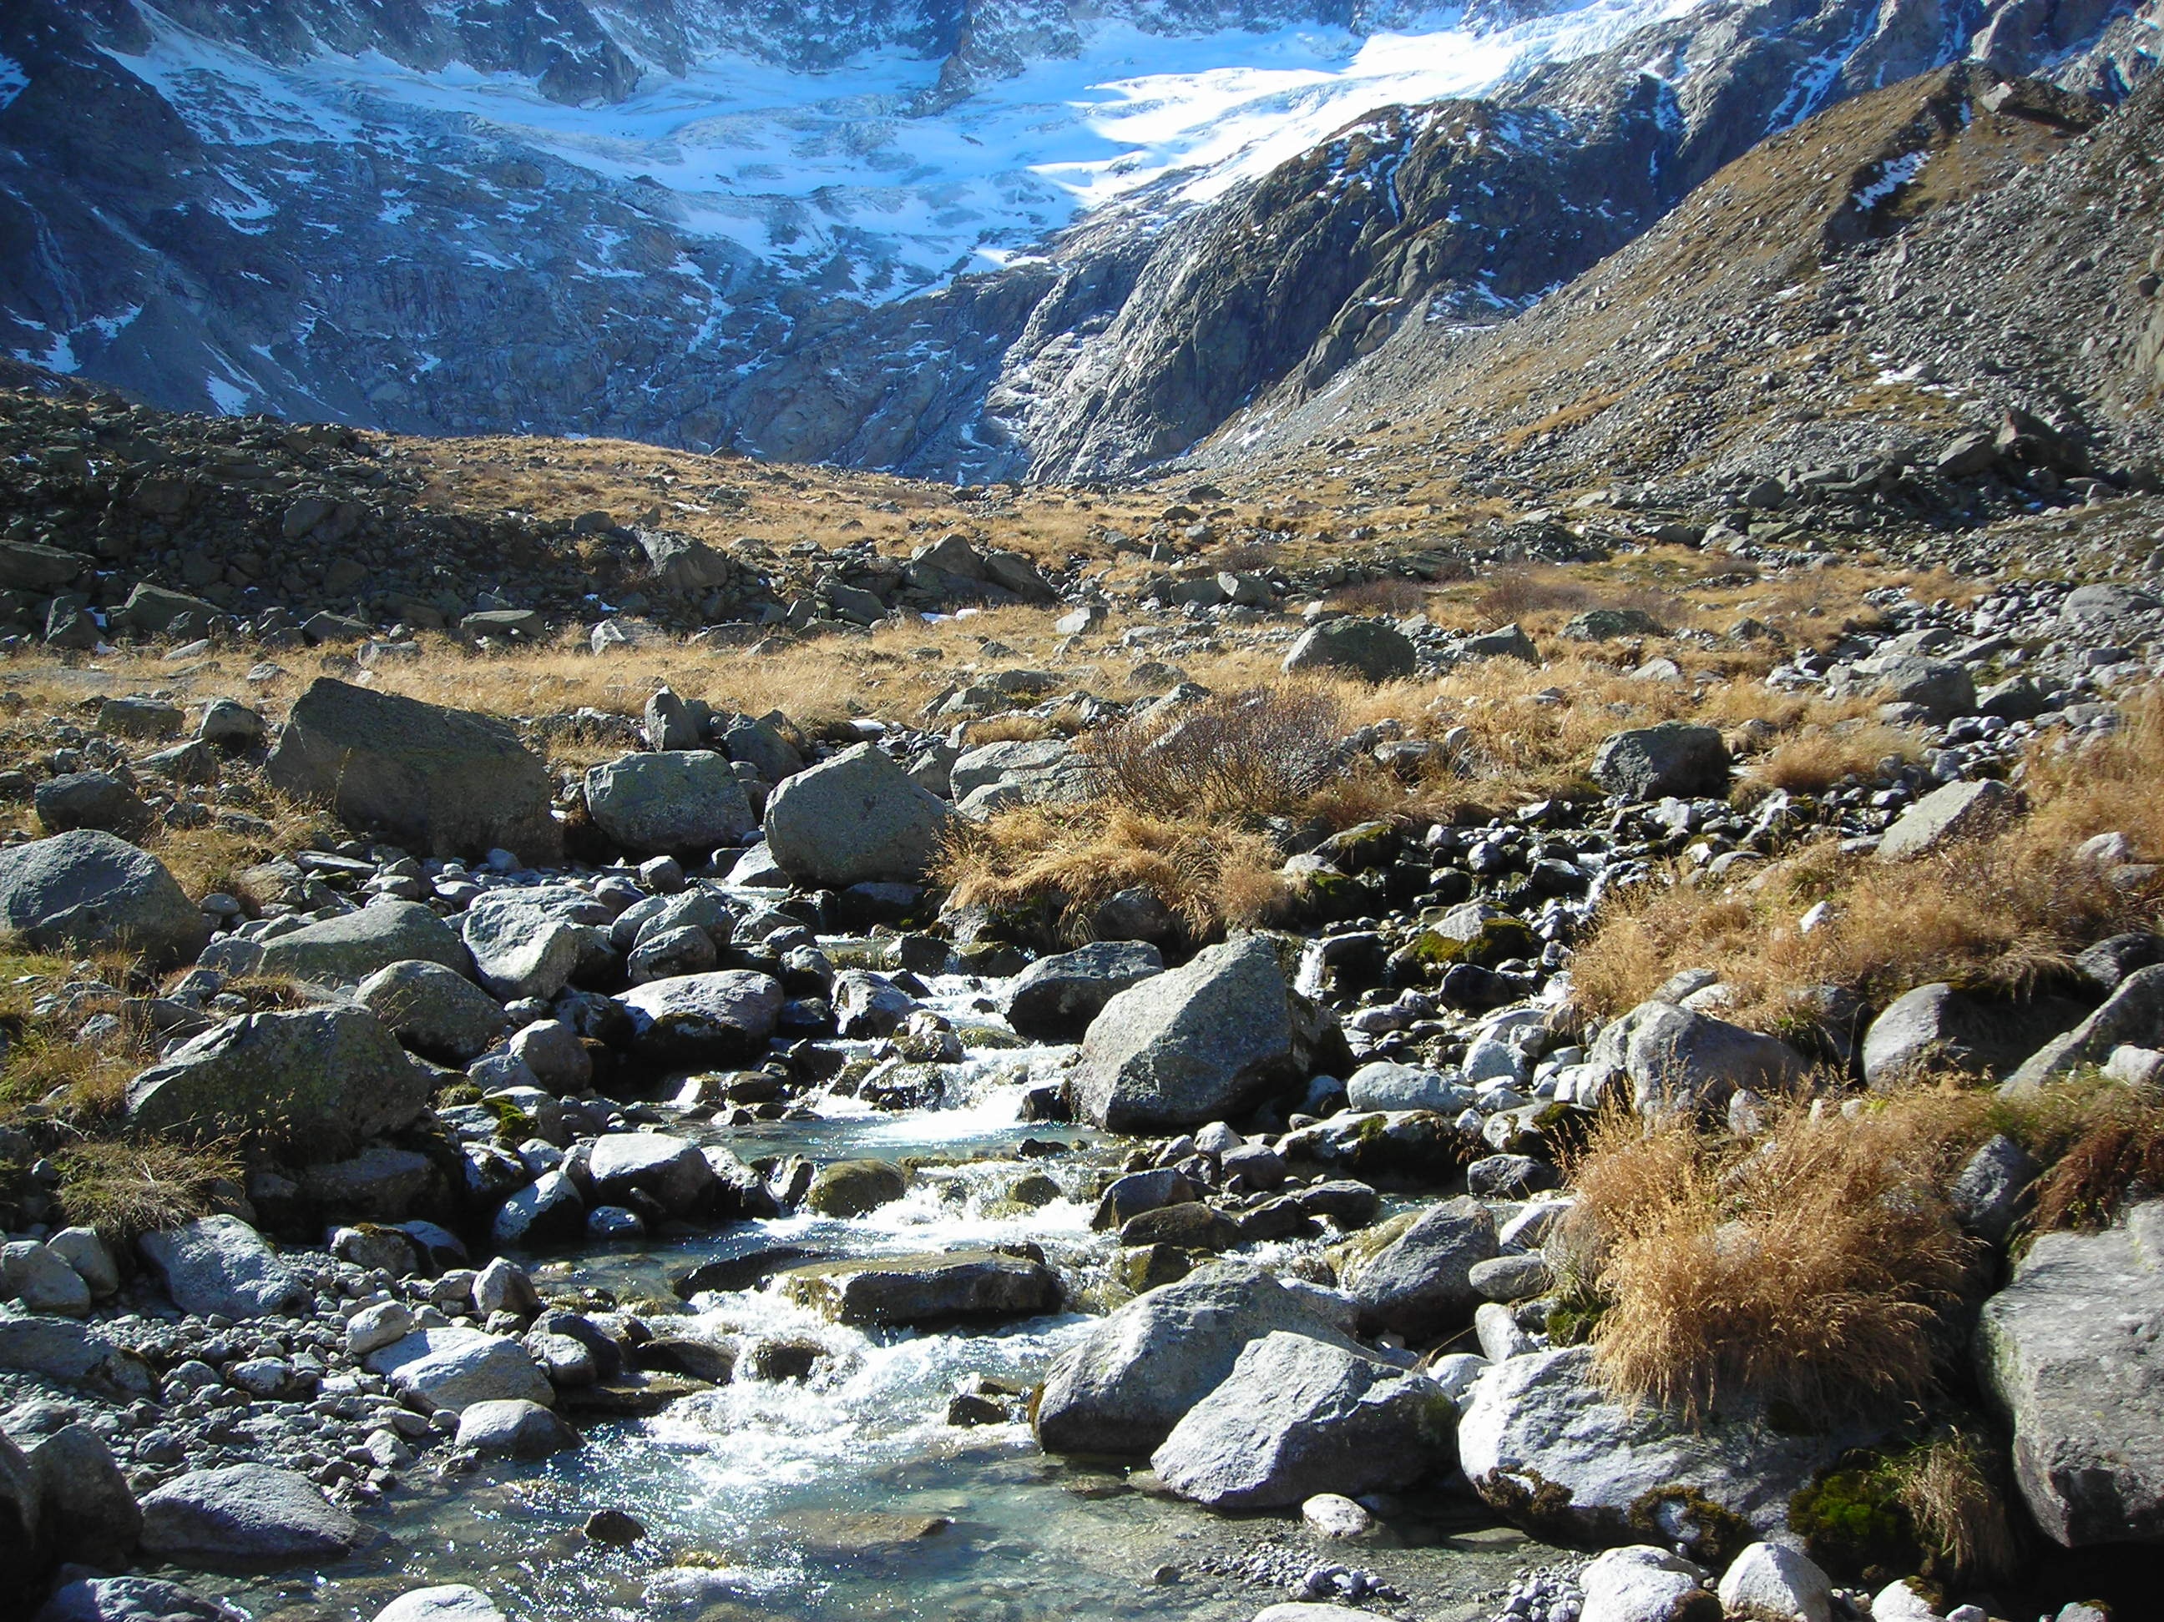

Slide 14
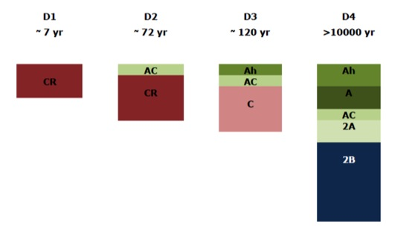
Soil profiles

Slide 15
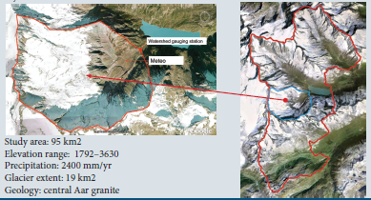
Modelling for PIHM

Slide 16
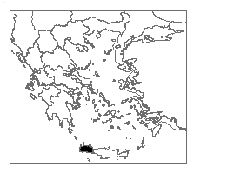
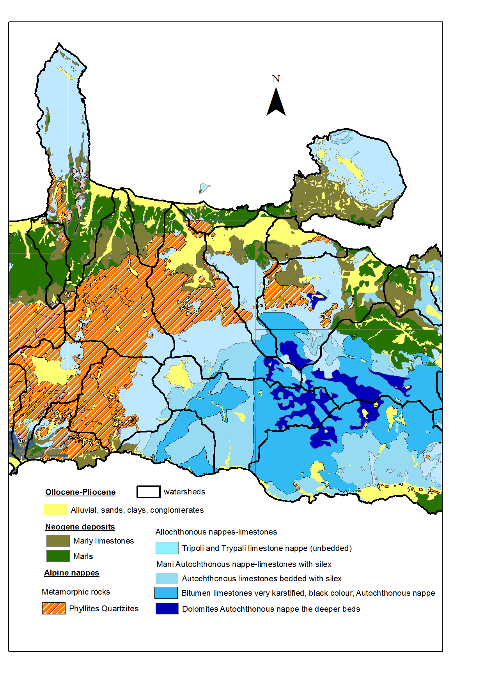
Koiliaris CZO,
Crete
Nikos Nikolaidis, TUC
Daniel Moraitus, TUC
Xuan Yu Penn State
Chris Duffy, Penn State

Slide 17
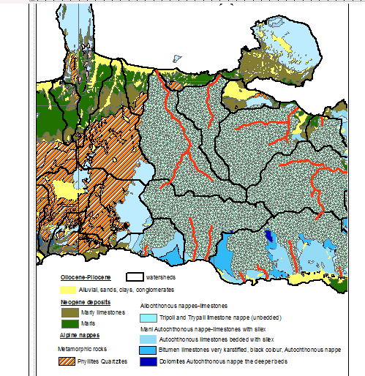
River network created
with pihm

Slide 18
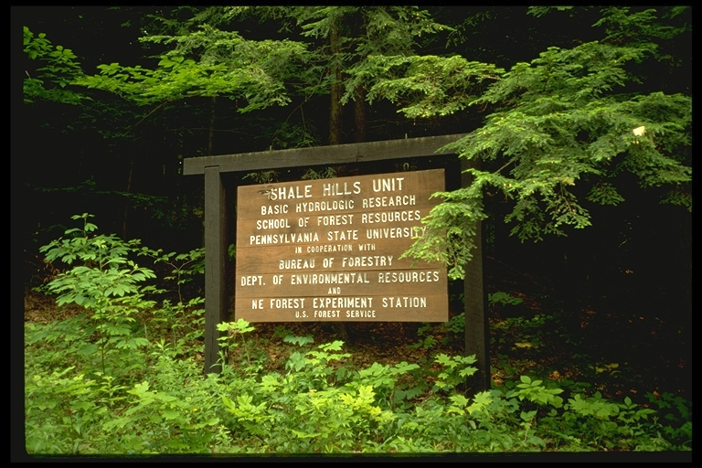
Shale Hills CZO: 1979-2010 Watershed Reanalysis

Slide 19
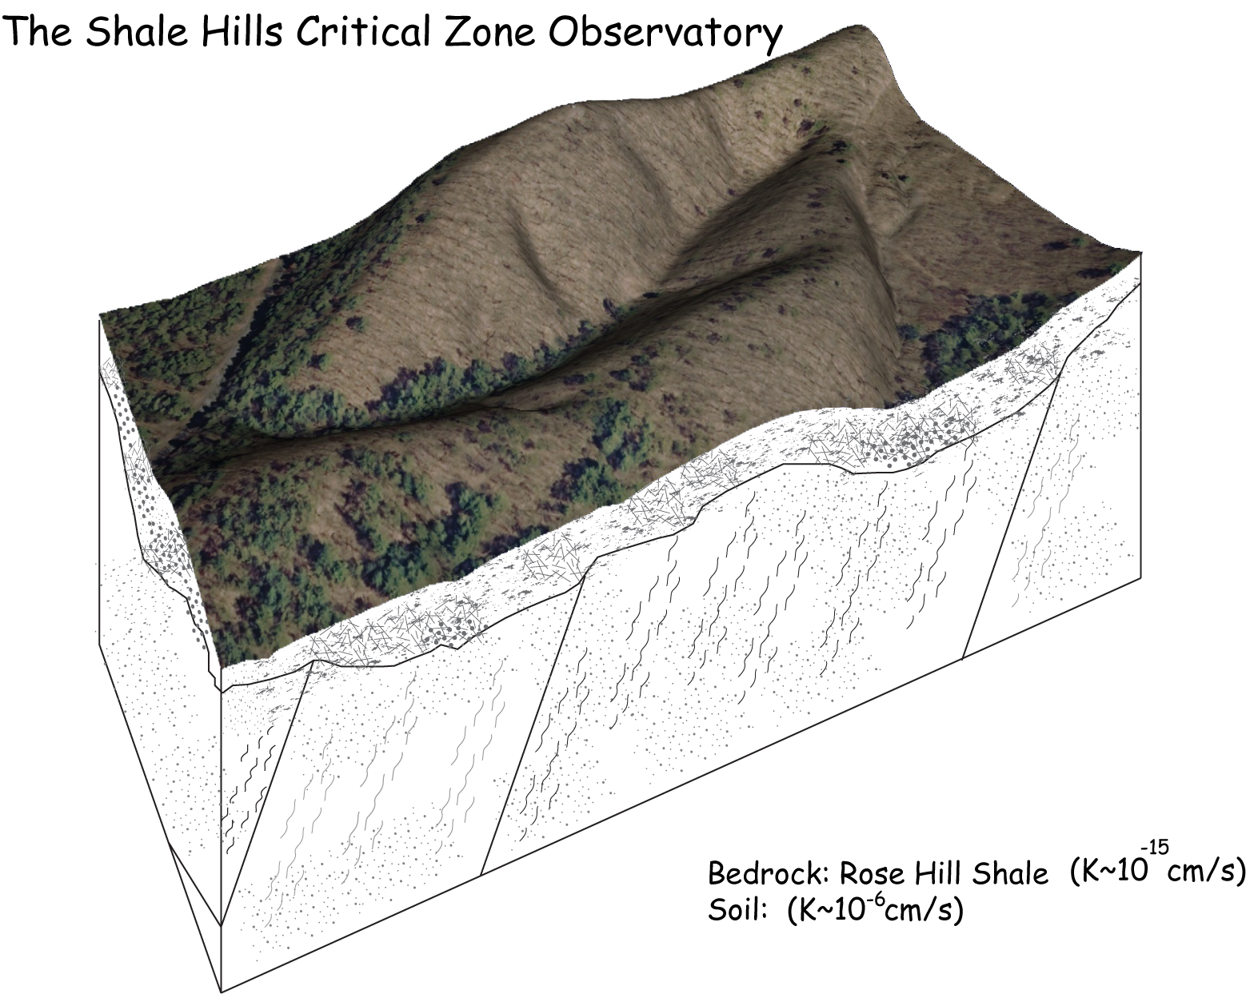

Slide 20
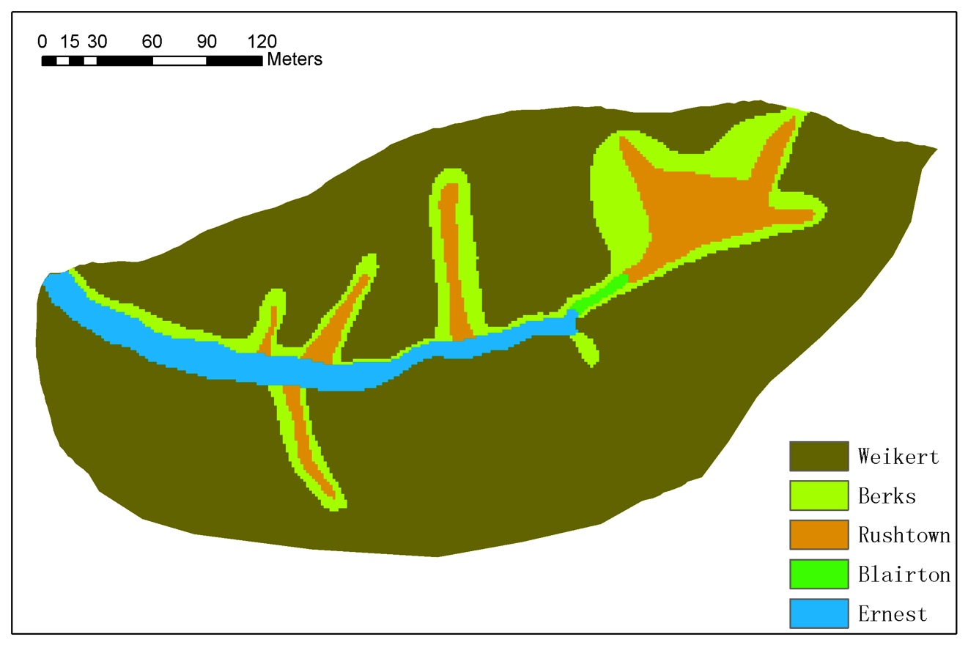
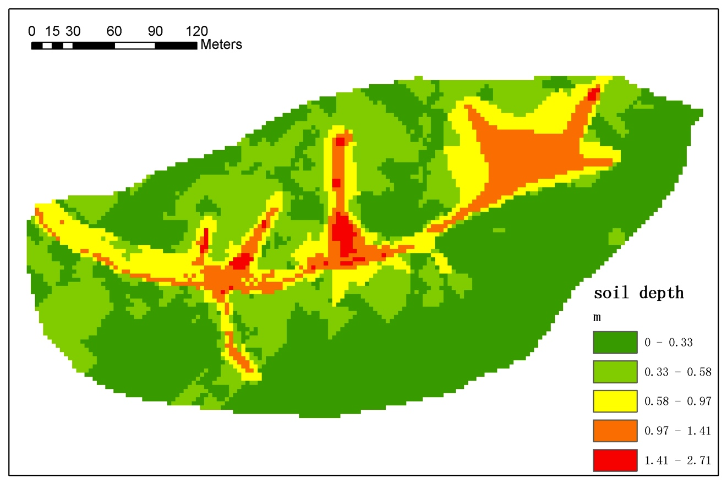
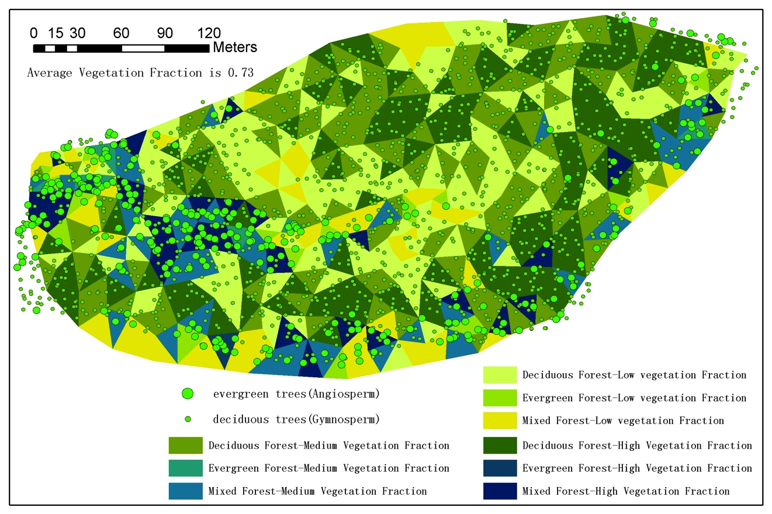
CZO Data ->lidar, Soil, Regolith,Veg

Slide 21
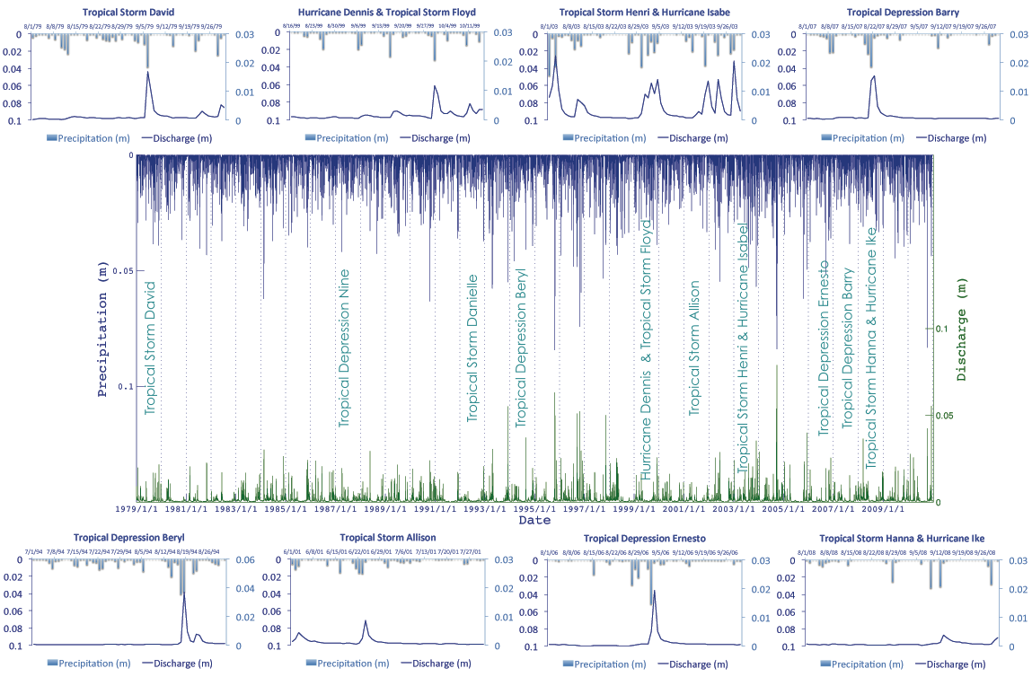
Virtual Watershed Storm Library From ”Downscaled” Reanalysis
CZO Reanalysis:
Shale Hills Storm Library
1979-2011

Slide 22
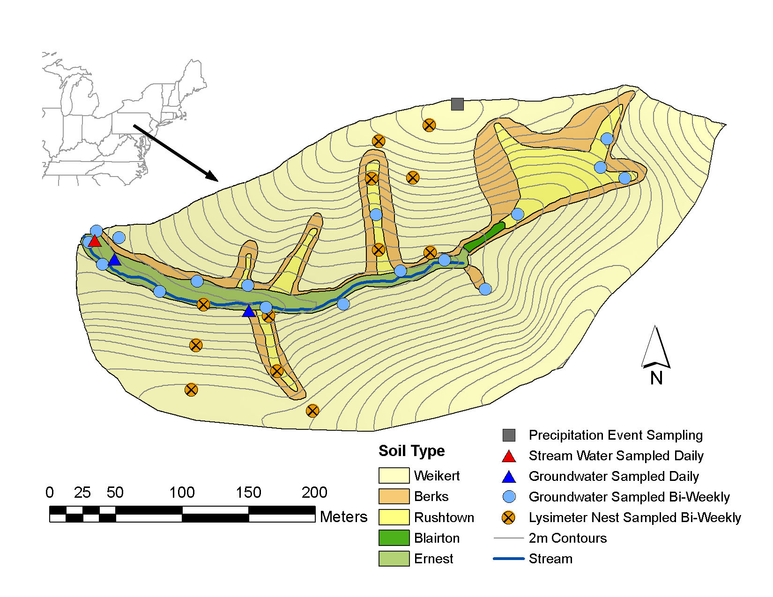
Water Isotopes O18-D Network At Shale Hills CZO
C. Duffy PSU
G. Bhatt
G. Holmes. PSU
E. Thomas, PSU
H. Lin, PSU
L. Jin, PSU
P. Sullivan PSU

Slide 23
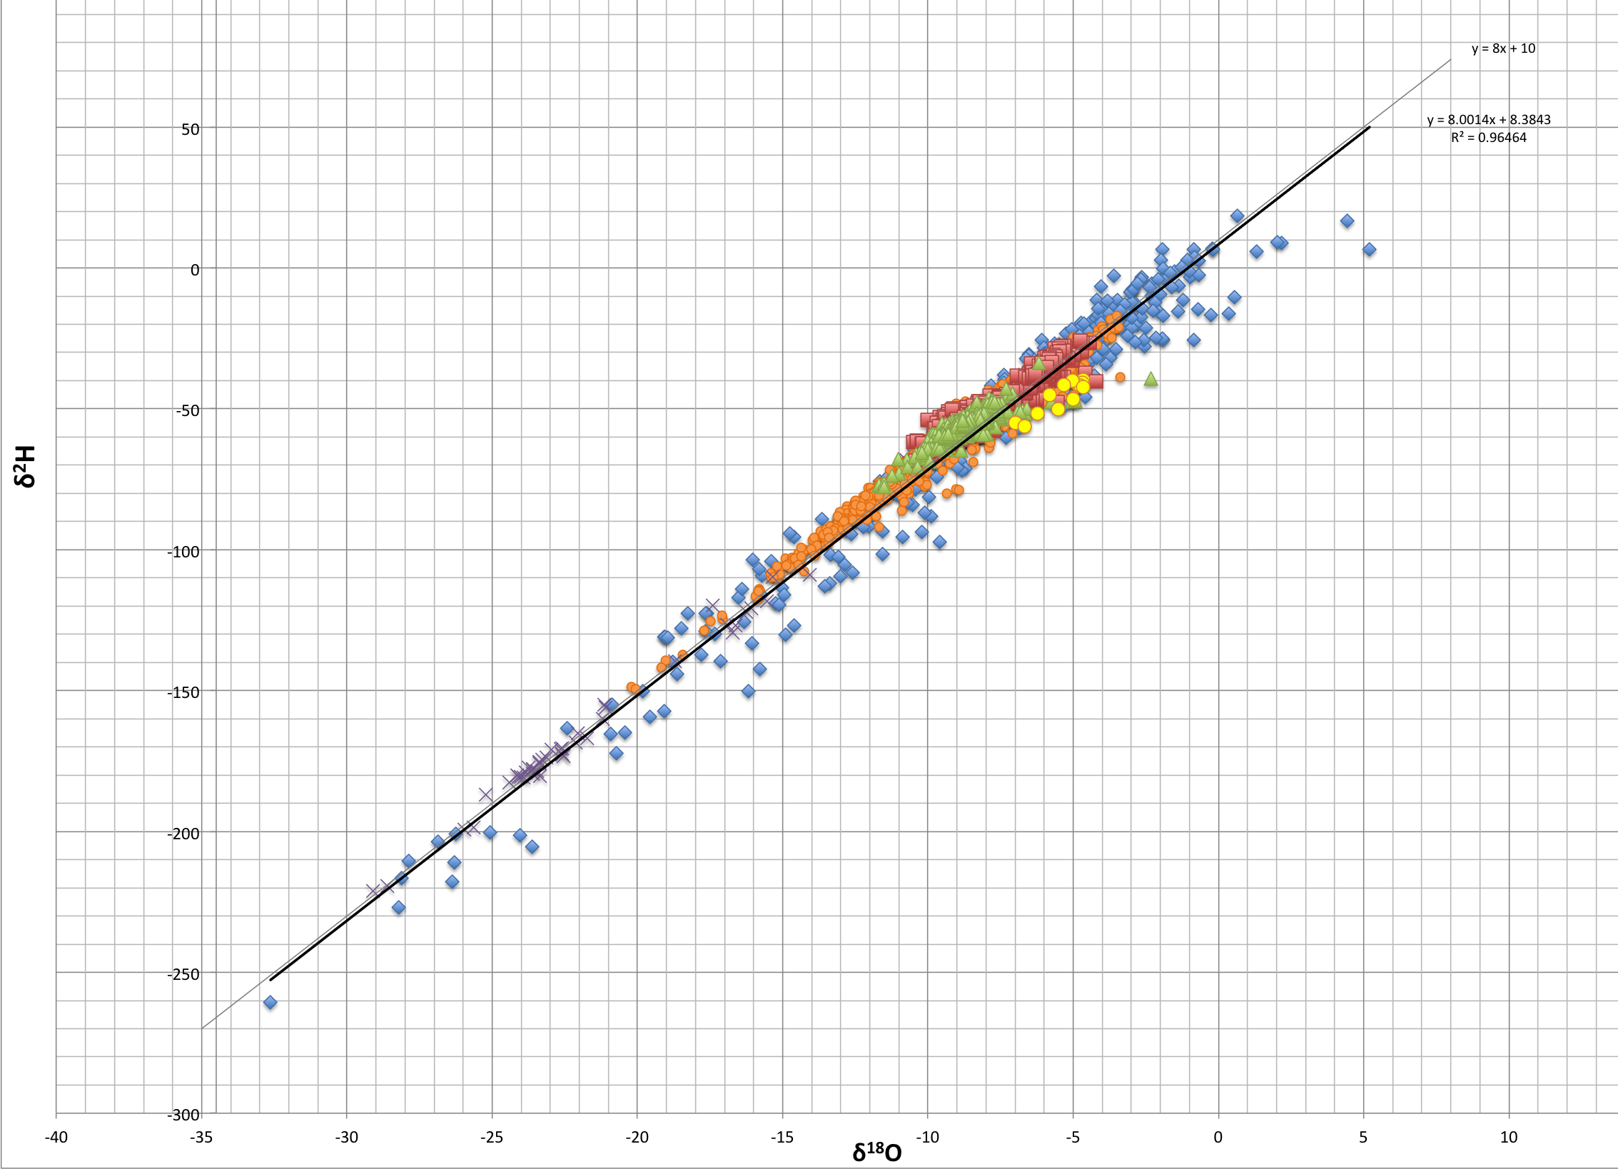
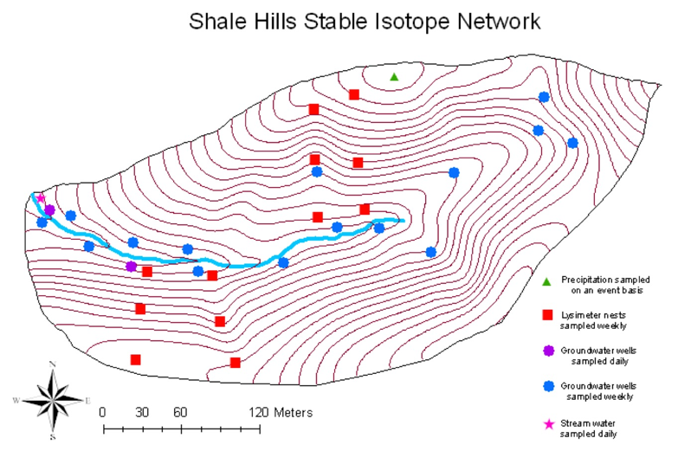
Stable Isotope Experiment 2008-20012
Shale Hills CZO
Precipitation
LMWL
Stream
Tree Xylem Water
Groundwater
Shale Hills Isotope Network
Soil Moisture
> 6000 Samples
Holmes, M.S 2011, Thomas MS. 2013

Slide 24
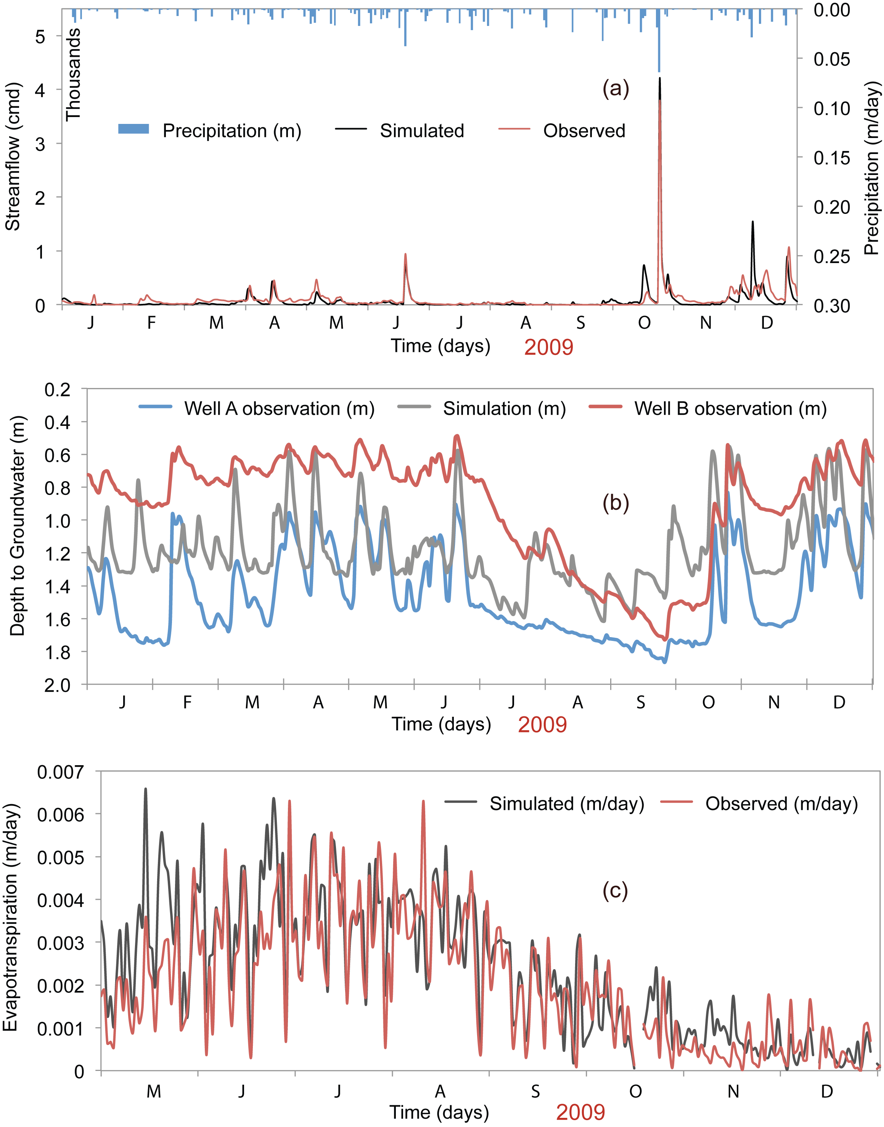
Multi-State
Calibration For
PIHM at the
Shale Hills CZO
Runoff
Water Levels
Evapotranspiration

Slide 25
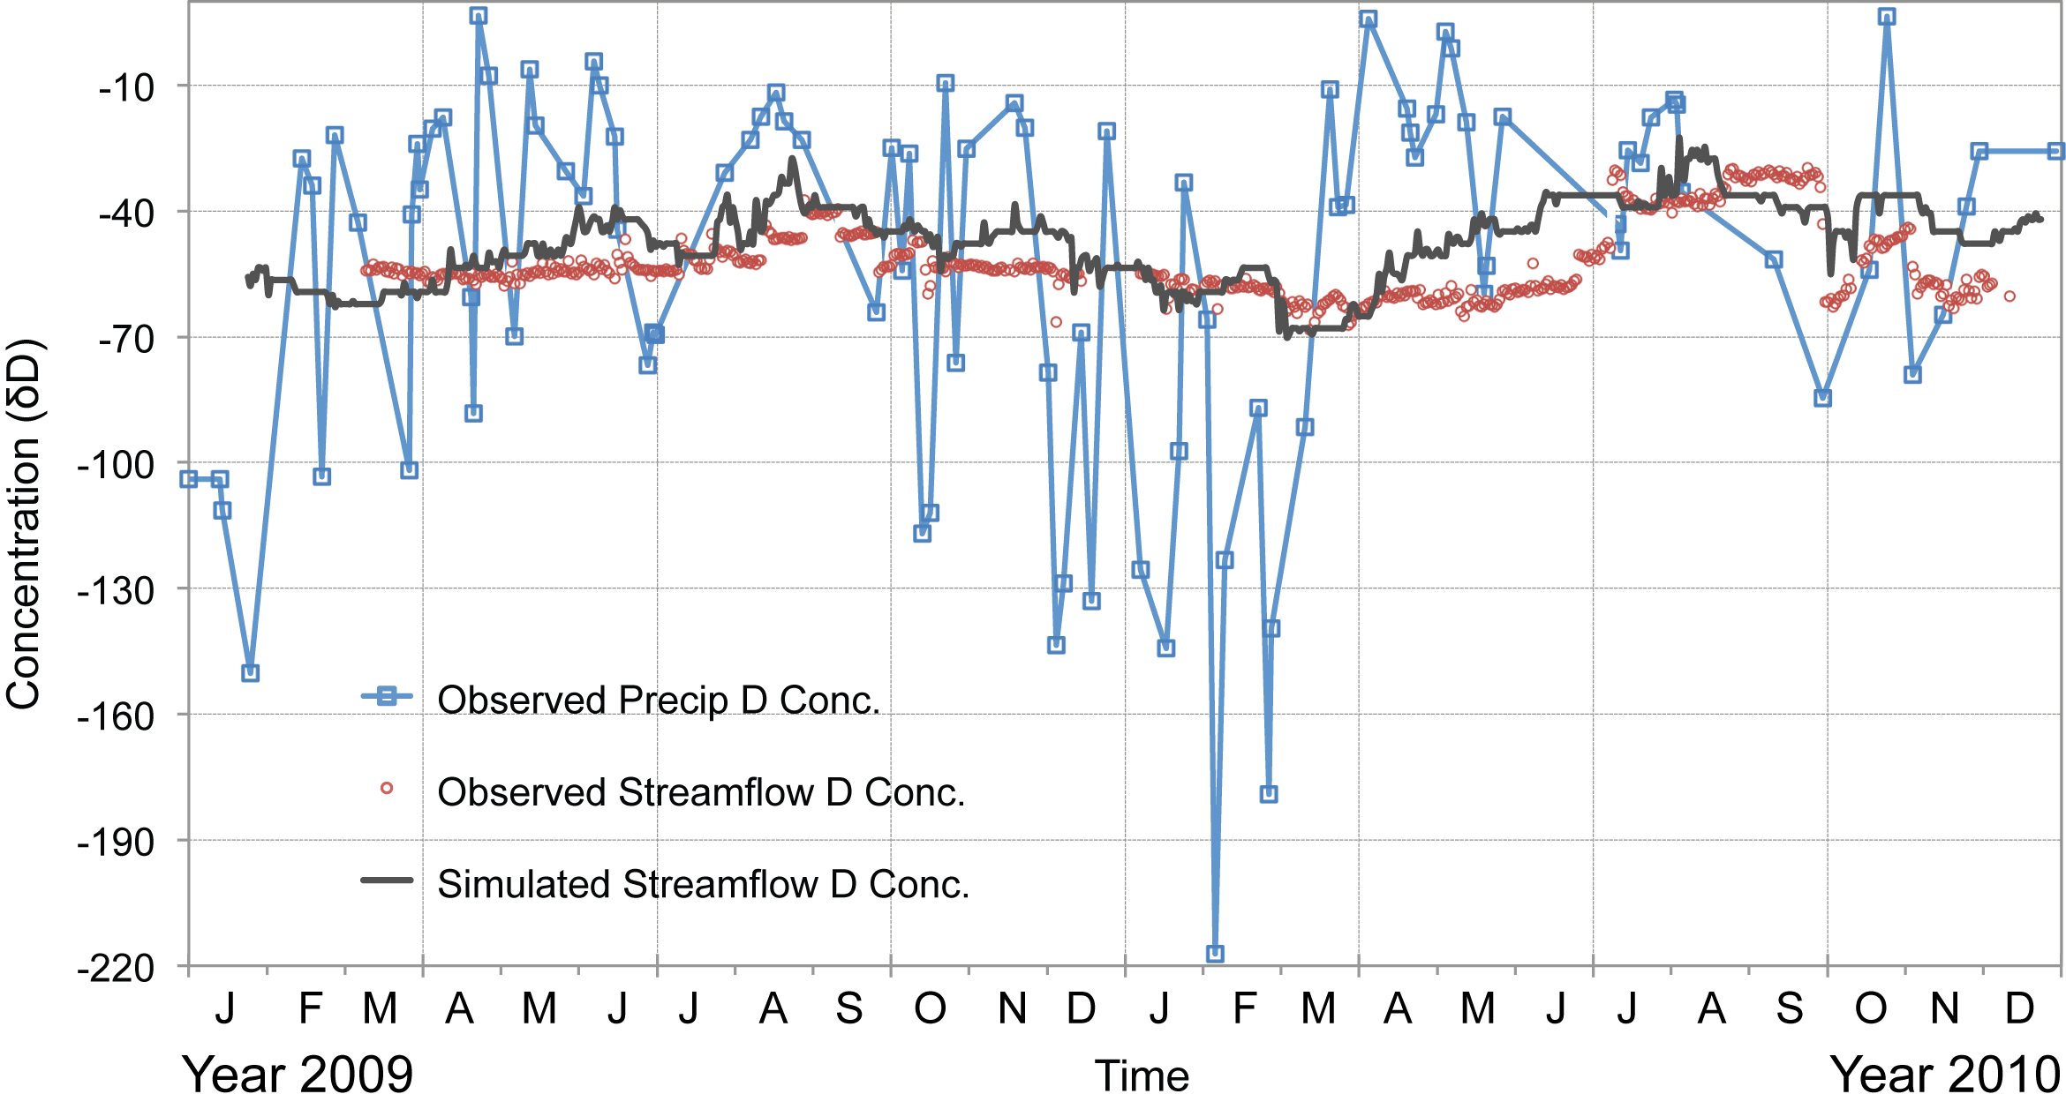
Predicted and Observed O18-D Compositions
At Shale Hills CZO
G. Bhatt

Slide 26
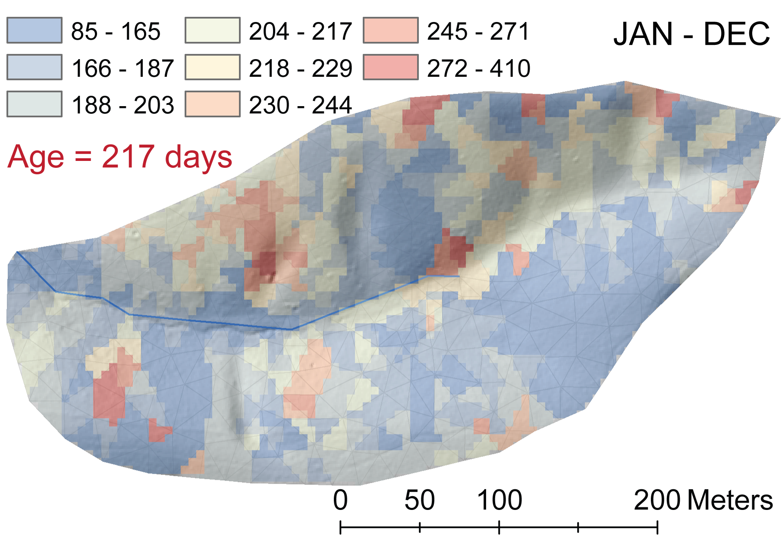
Simulated Average Age of Groundwater + Soil Water
At Shale Hills CZO
C. Duffy PSU
G. Bhatt
G. Holmes. PSU
E. Thomas, PSU
H. Lin, PSU
L. Jin, PSU
P. Sullivan PSU

Slide 27
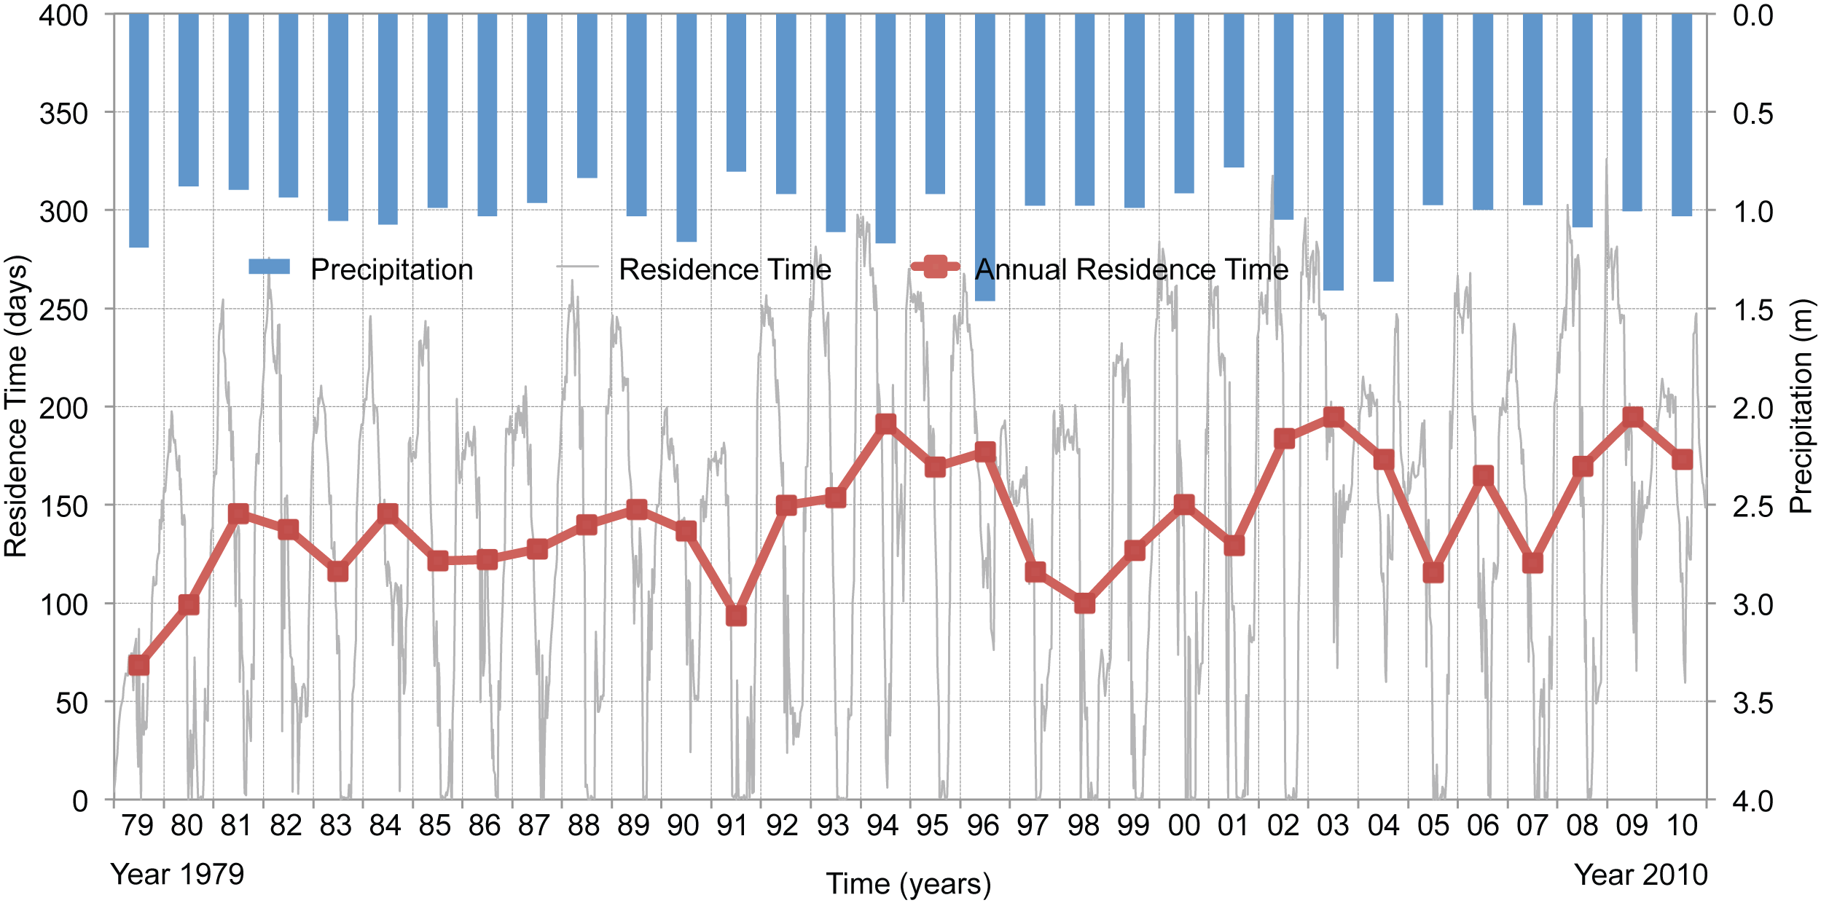
Reanalysis Forced Dynamic Residence Time of Runoff
from Shale Hills CZO
G. Bhatt

Slide 28
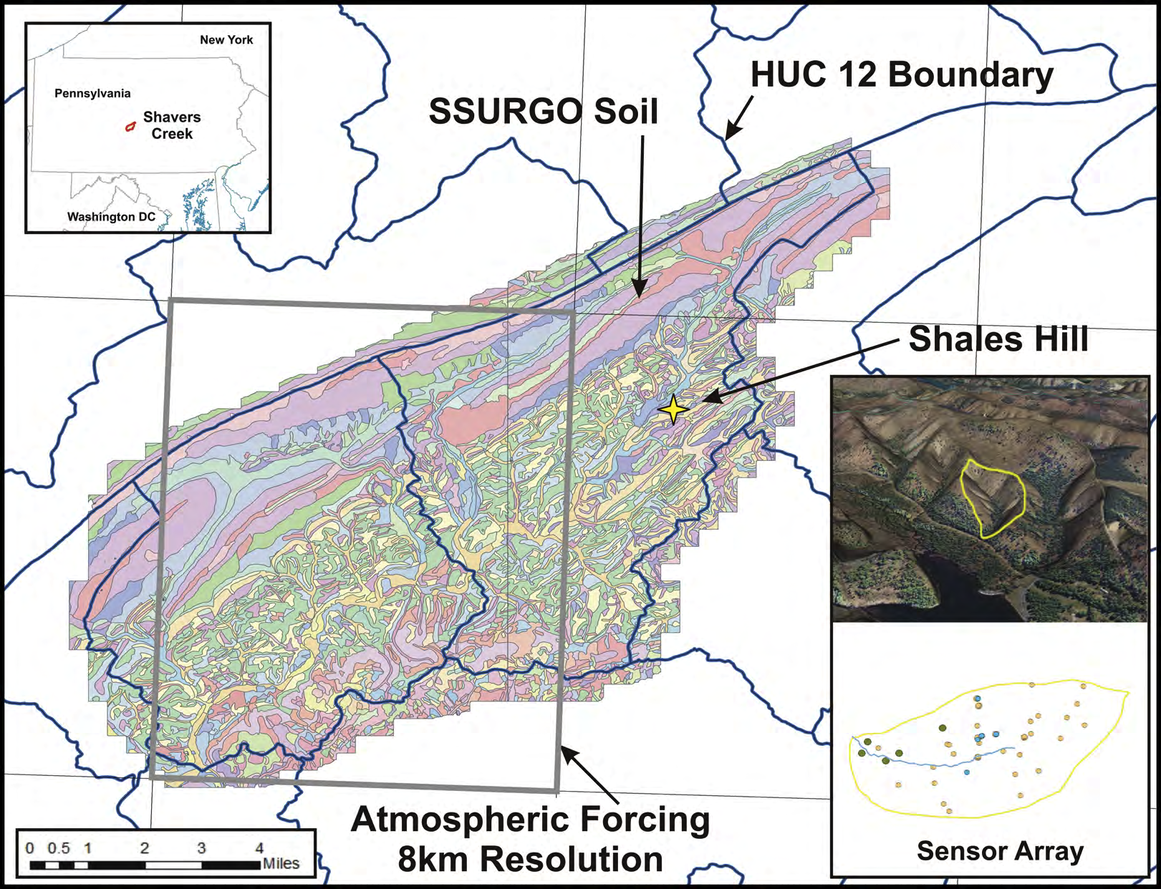
Scaling Up To HUC-12 Scale Catchment

Slide 29
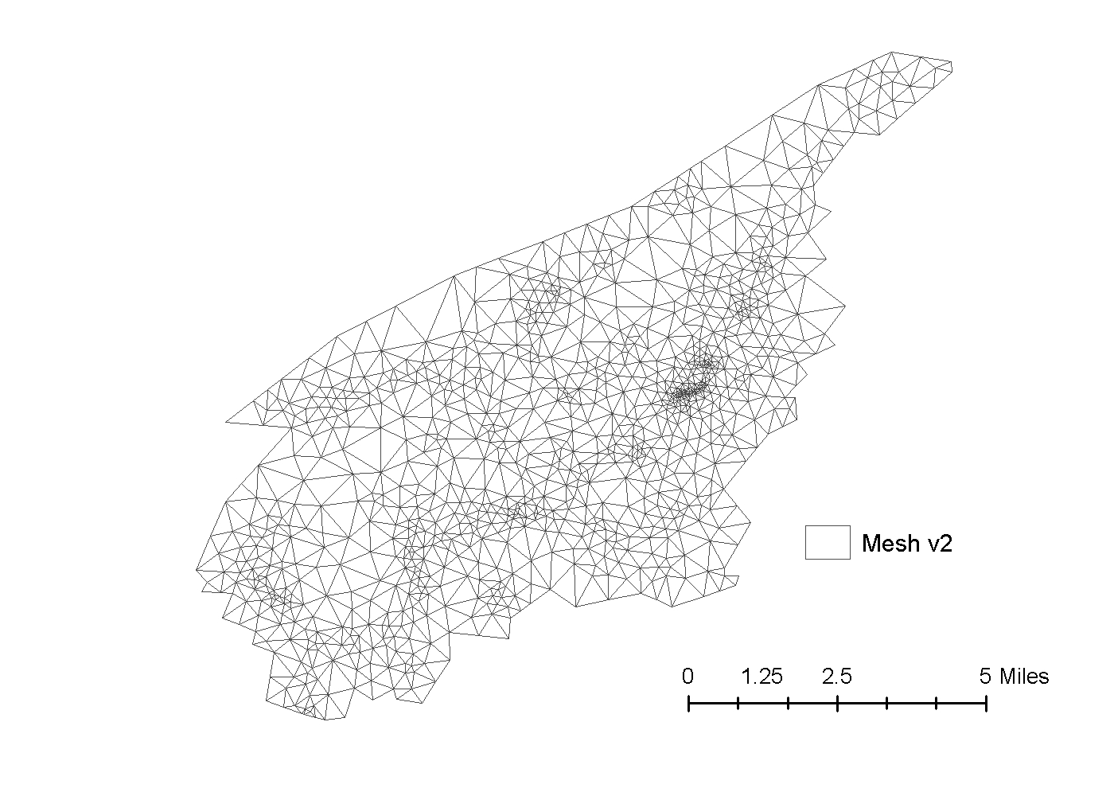
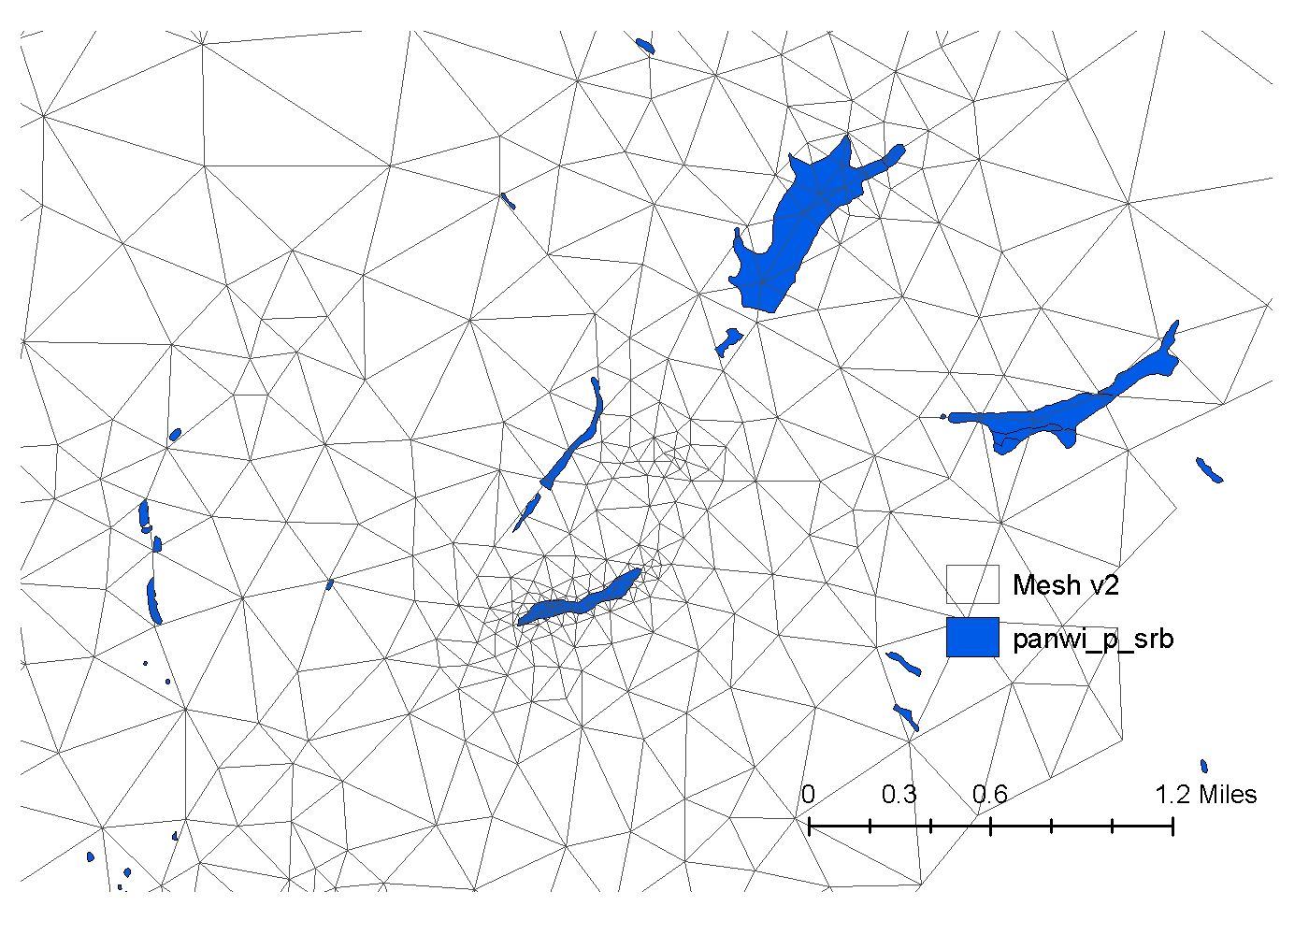
EPA Wetlands Study: Historical Reanalysis-IPCC Scenarios
Nested Grid to resolve wetland
1986 TINs

Slide 30
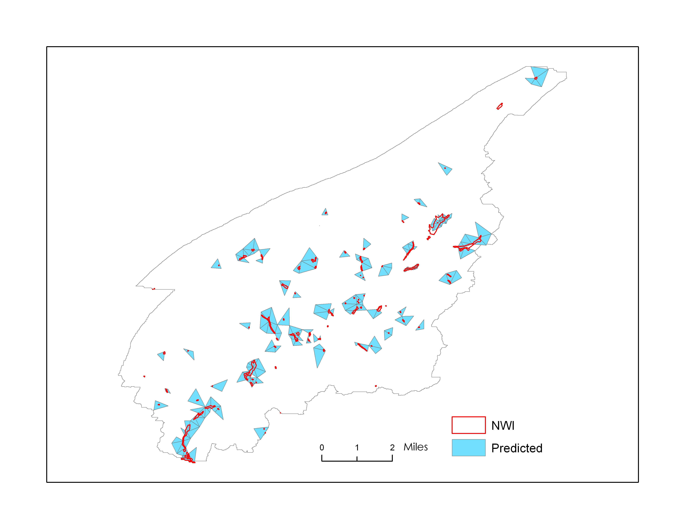
Comparing predicted wetlands based
on 30 cm depth rule with National Wetland
Inventory (NWI) map

Slide 31
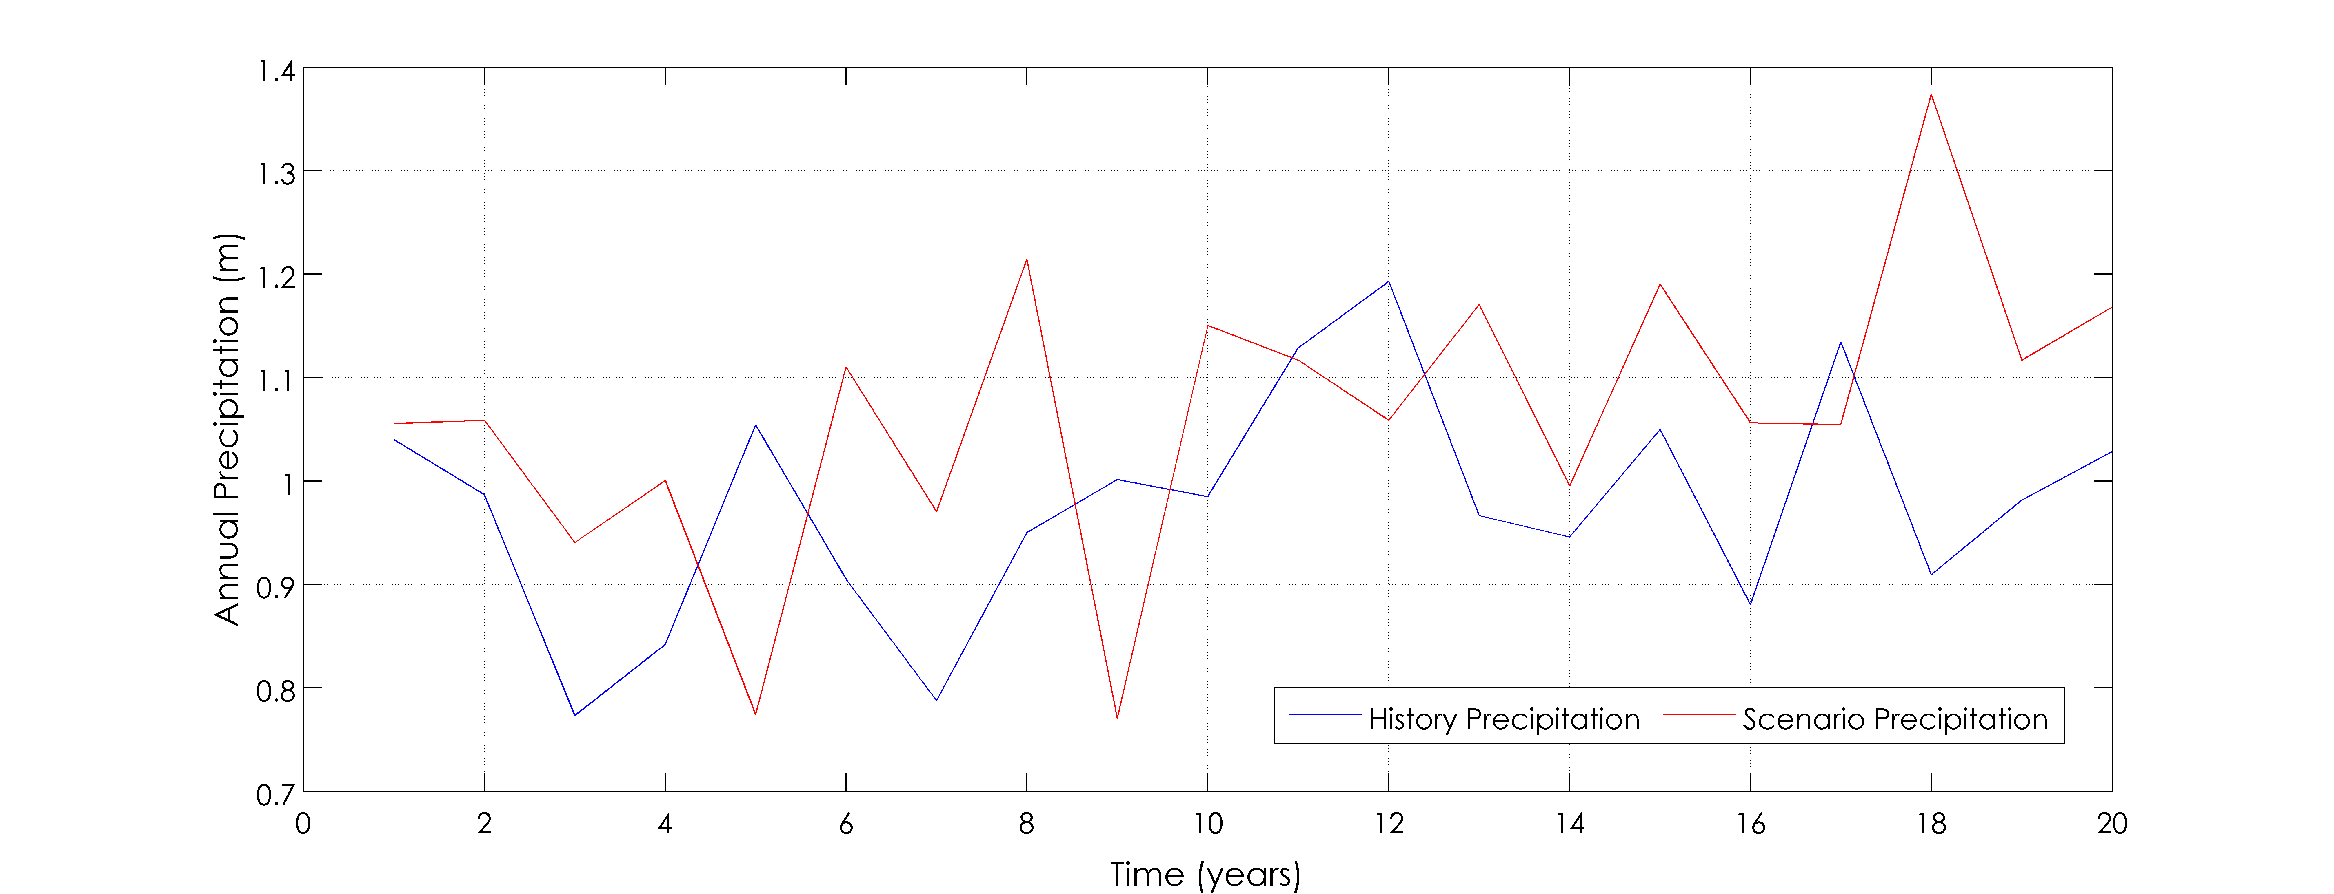
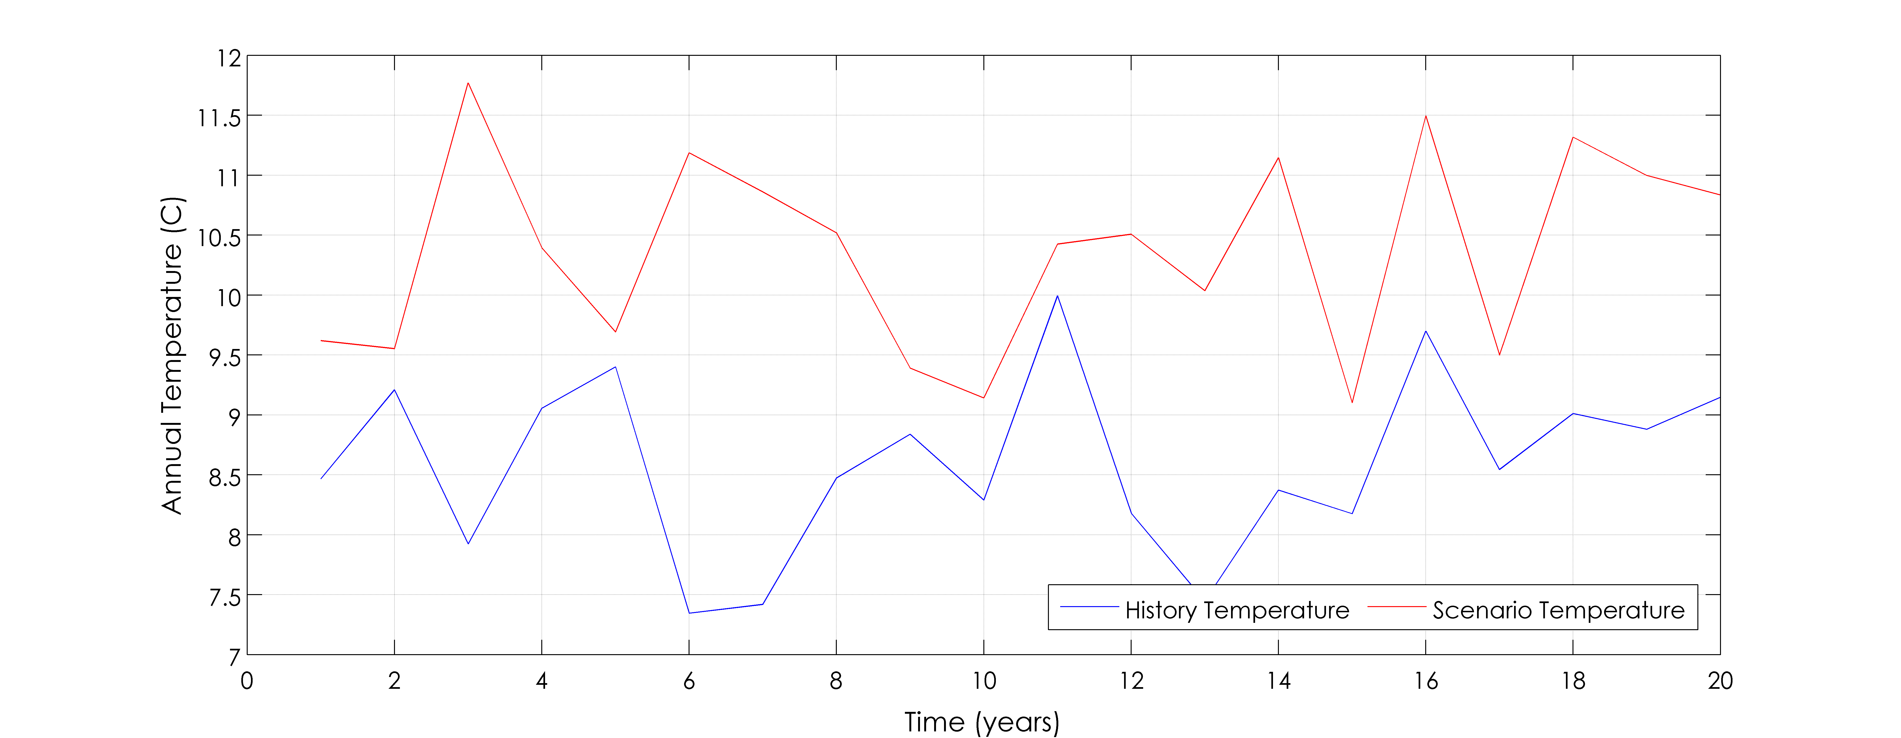
Compare Historical & IPCC Forcing
Precipitation
2046-2065
1979-1998
Temperature
2046-2065
1979-1998

Slide 32
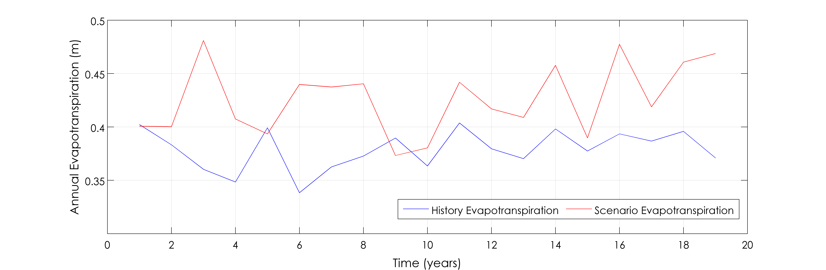
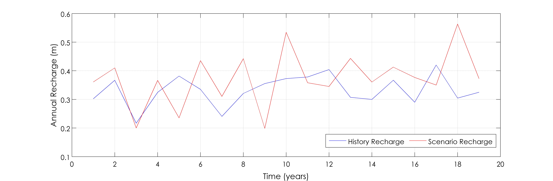
Historical vs IPCC ET-Recharge
Evapotranspiration
2046-2065
1979-1998
Recharge
2046-2065
1979-1998

Slide 33
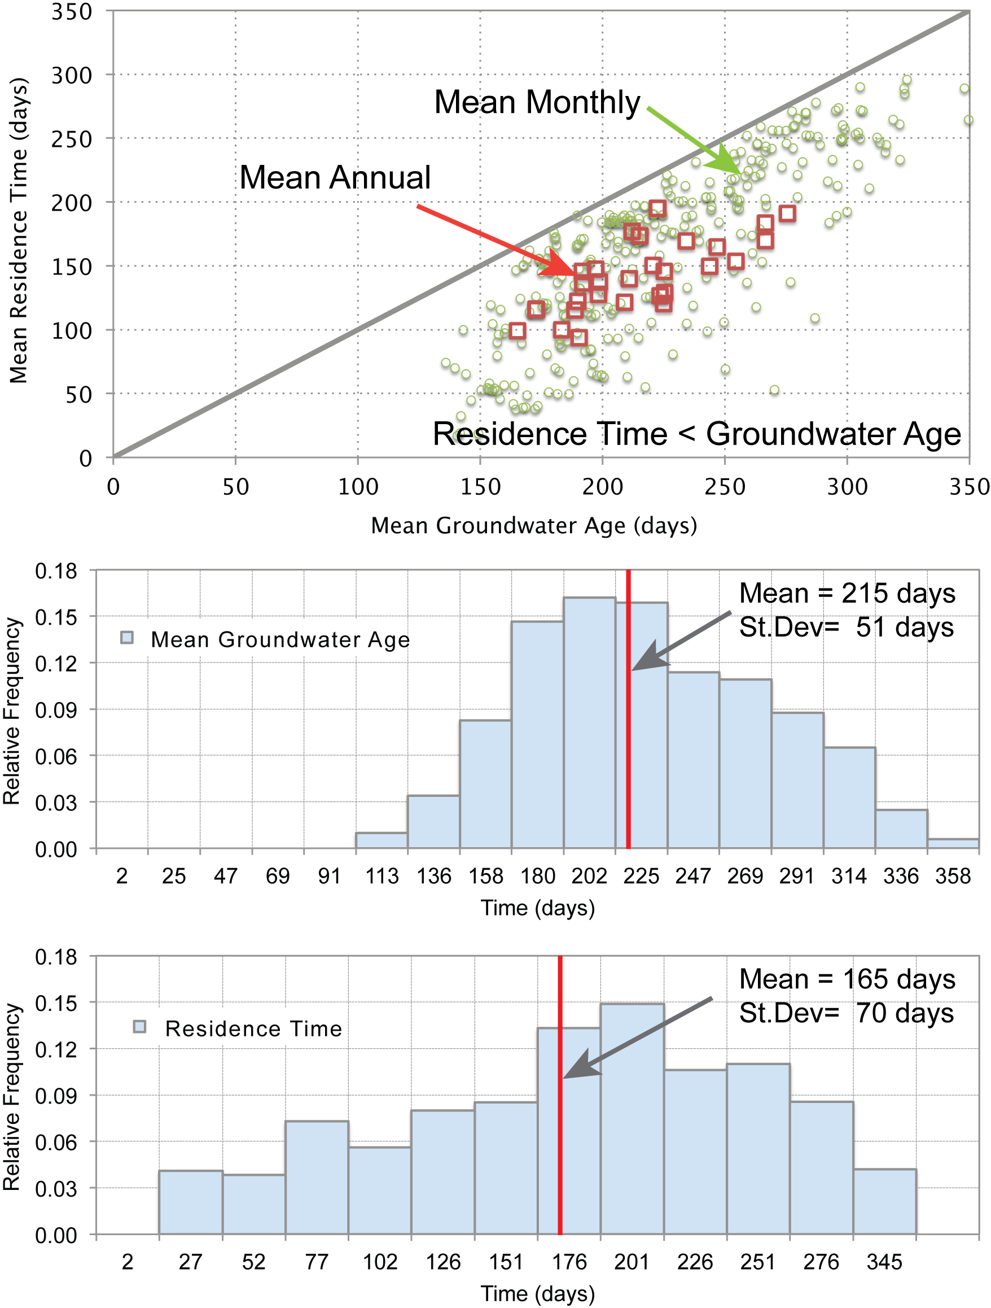
Relative Frequency for Groundwater Age & Runoff Residence Time

Slide 34
Atmospheric Modeling of Stable Isotopes in Precipitation
IsoRSM experiment over Chesapeake Bay Watershed
10km Simulation covering 85.5W-71.3W/35.5N-46.2N
Boundary Conditions: IsoGSM simulation based on NOAA Climate Reanalysis
Kei Yoshimura, University of Tokyo, Japan
(Yoshimura et al., 2010)

Slide 35
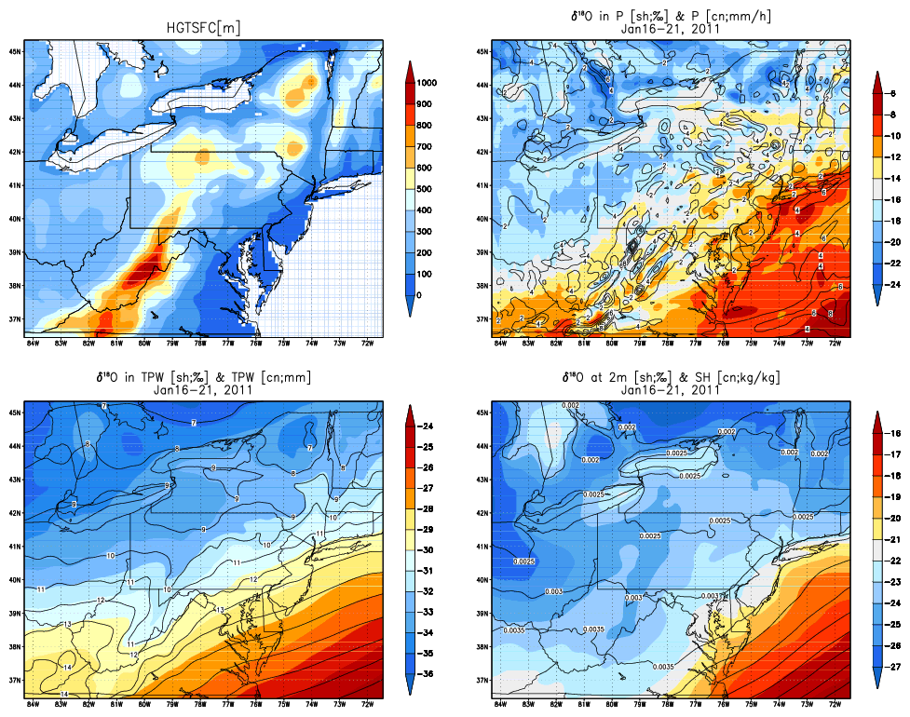
Regional 10 km res.

Slide 36
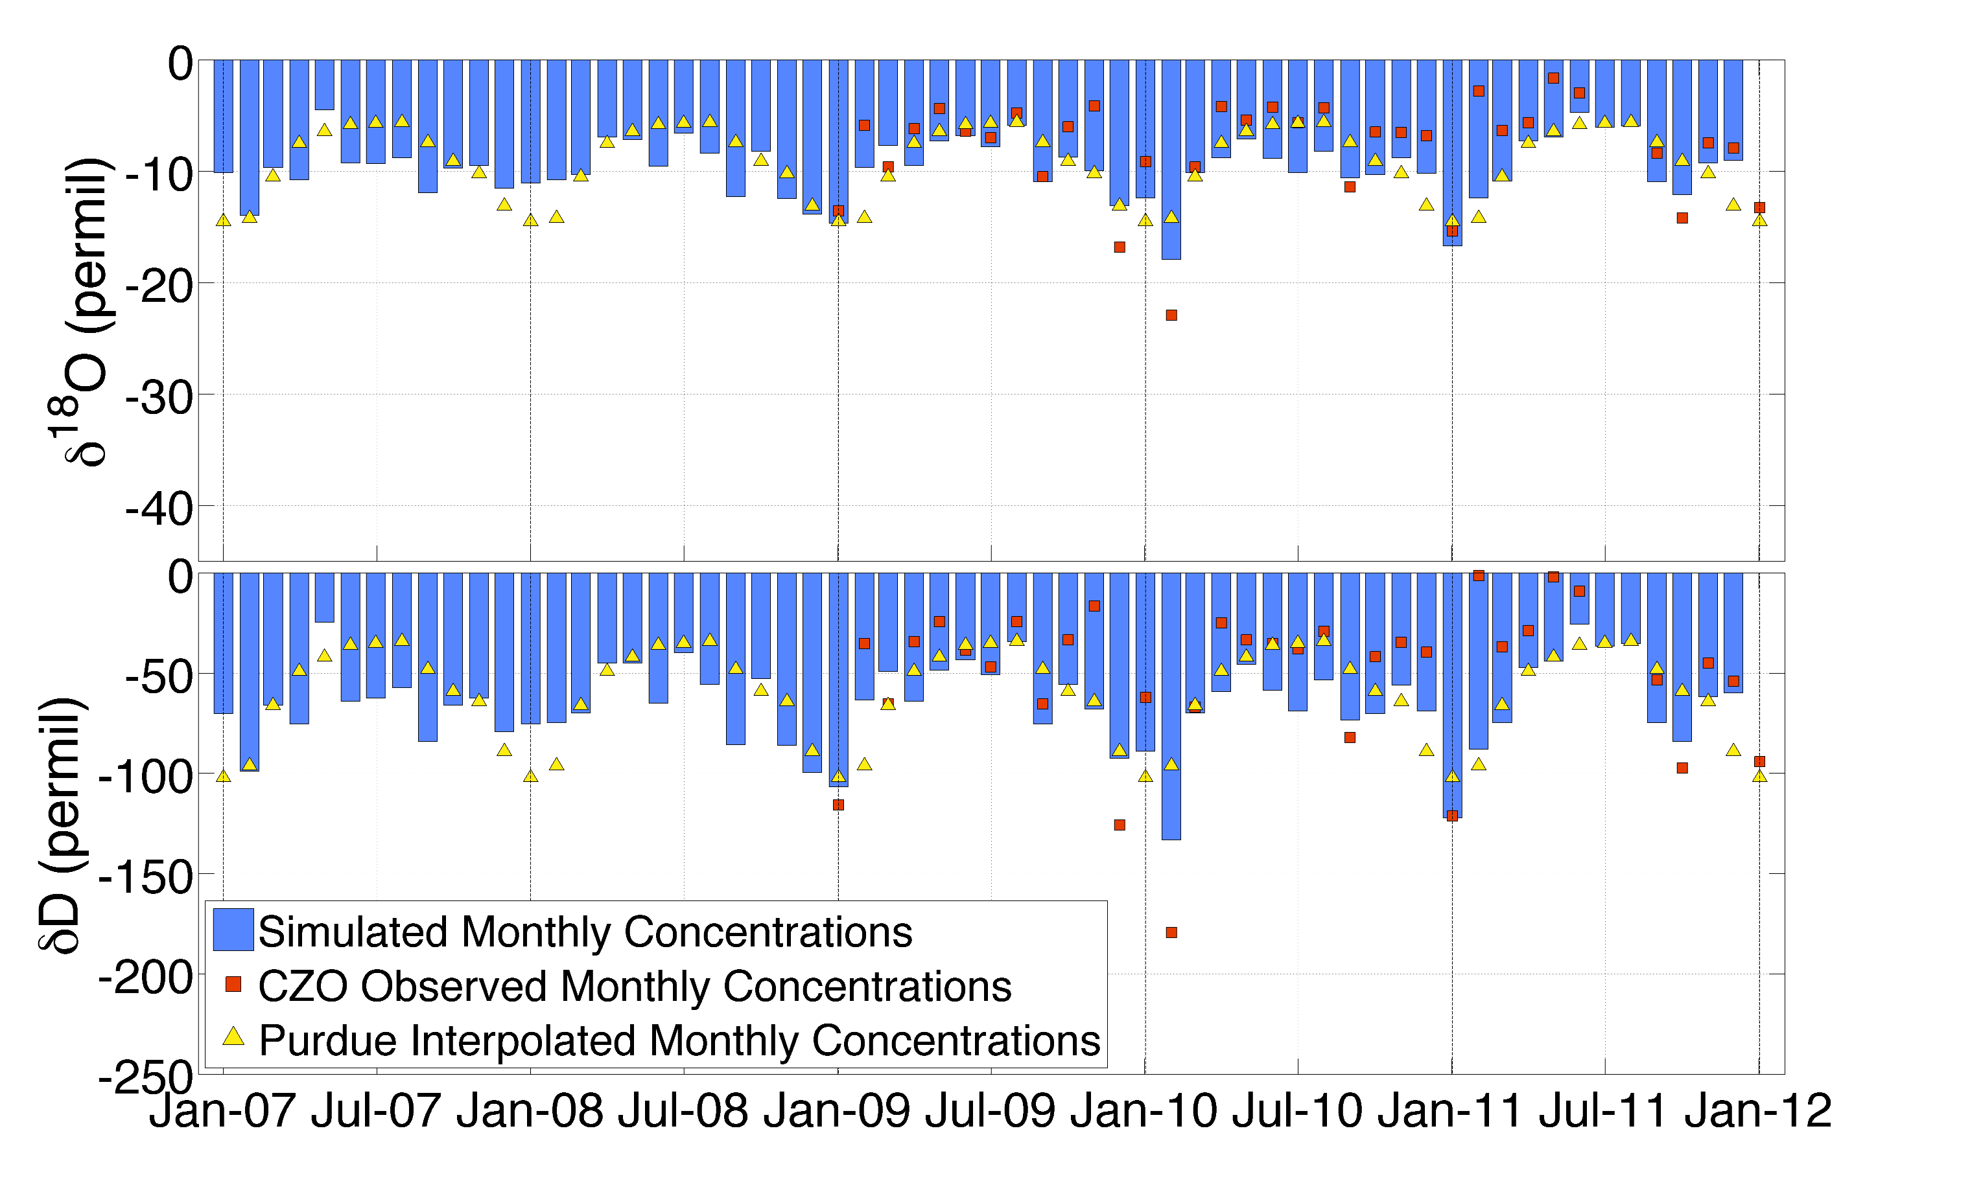
Simulated-Observed Seasonal Isotopes in Precip.

Slide 37
HPC Model-Data Access & Scalability
Scaling Concepts and Models From Observatories to Major River Basins

Slide 38
  CZO’s -> Big Data & Big Simulation
Some Issues & Questions
  Multi-Model Simulation Framework for Earth Casting
  The Essential Terrestrial Variables - National Products?
  Cyberinfrastructure for Virtual Data and Models
  Reanalysis - Reconstruction and the Role of Environmental Observatories
  Platform for communicating science and science-based decision making?

Slide 39
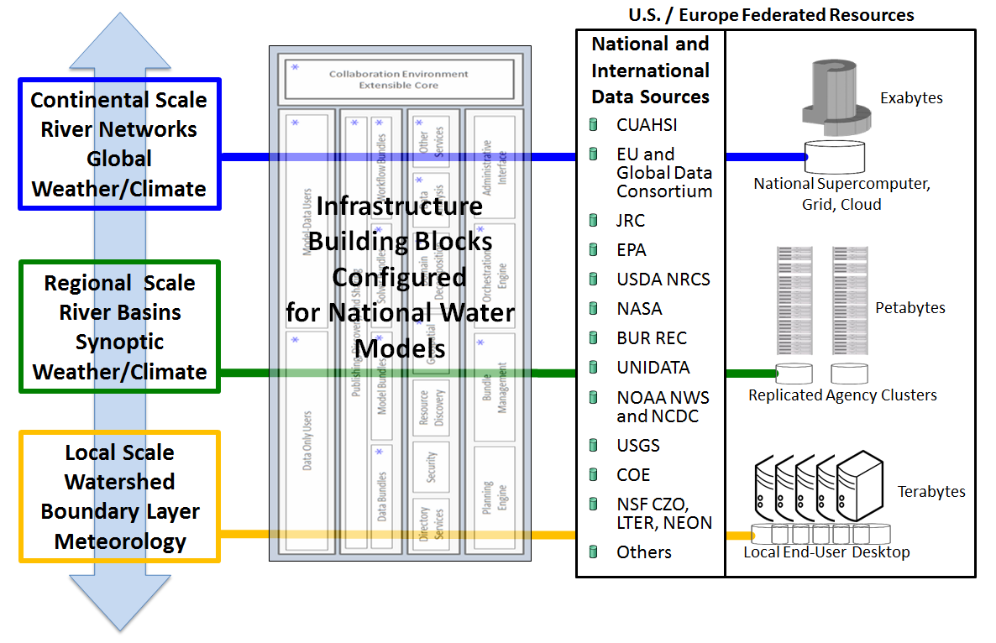
Collaborations: RENCI UNC, HYDROSHARE/HIS USU , CUAHSI, CyberScience Institute PSU
Stan Ahalt, David Tarboton, Rick Hooper, Lorne Leonard, Padma Ragavan

