Slide 1
Quo vadis ecosystem?
Insights from ecological modelling and systems ecology
Brian D. Fath
Professor, Biology Dept., Towson University, USA
Research scholar, International Institute for Applied Systems Analysis, Austria
Editor, Ecological Modelling Journal

Slide 2

Formed by Sven Jørgensen, in 1970s as companion to the journal Ecological Modelling.
Over 300 members-based on conference attendance
Chapters in North America, Europe, Asia, and Africa

Slide 4


IIASA’s
Young Scientists Summer Program (YSSP)
Ph.D. students
June 1 – August 31
Independent Research
mentored by IIASA
scientists
Funded by NMO &
other sources
January application deadline

Slide 5
Objectives
Ecosystem Dynamics
  Openness
  Complexity
  Ecological goal functions
  Adaptive cycle
  Collapse response
  Future research

Slide 6
Open Systems
Open systems connect to their environment through both inputs and outputs
Environment
System
Sink
Source
Input-State-Output

Slide 7
Thermodynamically, Open Systems
…build and maintain order and organization by taking in high quality energy, using it, and passing degraded energy outside of the system.
High quality
Energy Input
Low quality
Energy output (heat)
System
(human or
natural)

Slide 8
Ecosystem Input Constraints
Solar radiation
Global carbon cycle
Rate of nutrient cycling
Rate of hydrological cycle
Input ?
System
Output

Slide 9
Ecosystem Output Constraints
Rate of decomposition
Rate of accumulation of unwanted byproducts
Input
System
Output ?

Slide 10
Input
Ecosystem ?
Output
Environment
Ecosystems have evolved and developed within these input-output environmental constraints.
What patterns of organization and complexity arise in ecosystems?

Slide 11

Ecosystems are dynamic
Biological systems are characterized by a capacity for directional change – the cumulative manifestation of positive feedback.
Succession – ordered pattern of growth and development
Increase in complexity and order as the result of controlled growth – decrease internal entropy

Slide 12
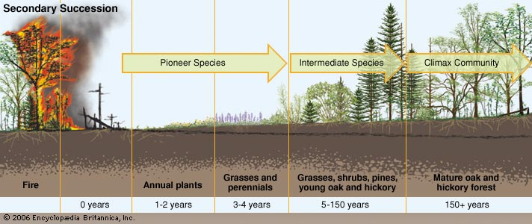
Secondary succession – reestablishment of an ecosystem from the remnants of a previous biological community following disturbance

Slide 13
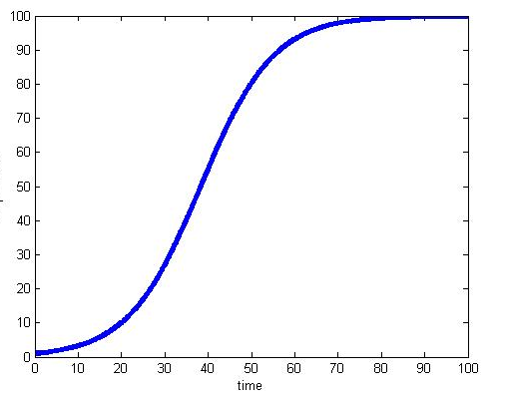
Logistic growth from early to late successional stages
Late stage
Early stage

Slide 14
Extremal Concepts
• Can extremal principles contribute to better understanding and management of environmental Complex Adaptive Hierarchical Systems, and what is their potential for future research strategies?
• What are the salient extremal principles involved in ecological processes, and how are they interrelated?

Slide 15
Trends to be expected in ecosystem development (Odum 1969)
Ecosystem Attribute Developmental Mature
Stage Stage
Community energetics
Gross production/community respiration (P/R ratio) >1 ~1
Gross Production/standing crop biomass (P/B ratio) high low
Biomass supported/unit energy flow (B/E ratio) low high
Food chains linear weblike
Nutrient cycling
Mineral cycles open closed
Nutrient exchange rate rapid slow
Nutrient conservation poor good
Overall homeostasis
Stability (resistance to external perturbations) poor good
Entropy high low
Information low high

Slide 16
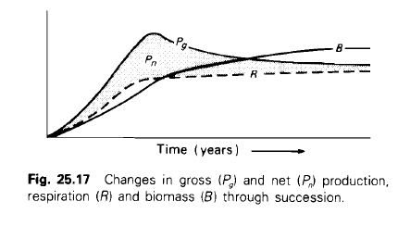
Bioenergetic model of succession
In early stages of succession, P>R and excess is channeled into growth and accumulation of biomass.
Increase capacity and complexity of the energy storage compartments (total biomass of all species and trophic levels) as well as the complexity of energy transfer pathways.
In late stages of succession, P=R as maintenance costs increase respiration
Negative feedback maintains steady state, with little or no change in biomass (network, feedback, cycling).

Slide 17
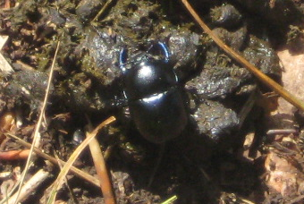
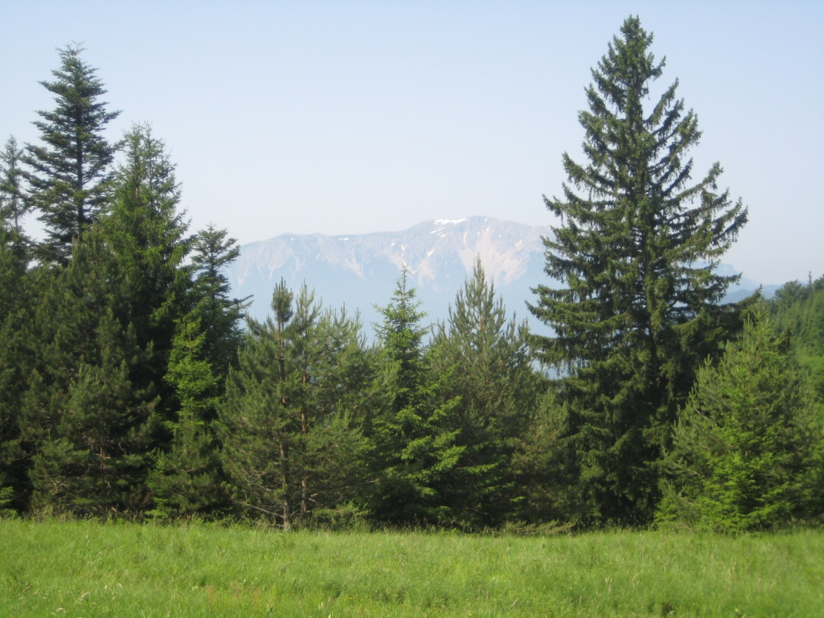
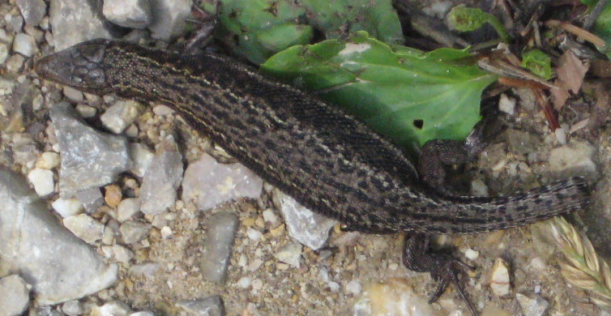
Complexity
Increase in complexity and order as the result of controlled growth.
HOW CAN WE MEASURE THIS COMPLEXITY?

Slide 18
Environmental systems are far-from-equilibrium systems.
How do we measure this “complexity”?
  Extensive variable * Intensive variable
  How much * What characteristics
  Quantity * Quality
I=PAT
Env. Impact = Population x [Affluence x Technology]
(how much) x [(use/person) x (impact/use)]

Slide 19
In ecological systems
Pioneer researchers have tried several methods
Energy times “quality”
  Exergy (Jorgensen):
  Emergy (HT Odum):
  Ascendency (Ulanowicz):
Extensive
Intensive

Slide 20
Growth → Quantitative increase
Development → Qualitative increase
"We must realize that growth and development are two very different things. You can develop without growing and vice versa.“
Tibor Vasko, 2009, www.solon-line.de/interview-with-tibor-vasko.html

Slide 21
ECOLOGICAL GOAL FUNCTIONS
1. Maximize Power (Lotka 1922, Odum and Pinkerton 1955)
Increase in the internal energy flow: max(TST)
2. Maximize Exergy Storage (Jørgensen-Mejer 1979)
Biomass storage and information increase: max(TSS)
3. Maximize Dissipation (Schneider-Kay 1994)
Increase in dissipative flows: max(Total System Export)
4. Maximize Cycling (Morowitz 1968)
Increase in cycling: max(Total System Cycling)
5. Minimize Specific Dissipation (Prigogine 1955)
Decrease in the respiration to biomass ratio: min(TSE/TSS)
6. Maximize Residence Time (Cheslak and Lamarra 1981)
Increase time lags to maintain the energy stores longer: max(τ)

Slide 22
Complementarity of
Ecological Goal Functions

Slide 23
Flow Partitioning
mode 2
recycle
mode 1
1st passage
mode 3
dissipation
i
system

Slide 24
Network representation of flow and storage partitioning for any (i,j) pair in the system.
 | FLOW pair-wise interactions | STORAGE pair-wise interactions
mode 1 (first passage)
mode 2 (cyclic)
mode 3 (dissipative)

Slide 25
Goal Function | Ecological Representation | Network Parameter | Network Analysis Formulation
max power | max(TST) | TST = f⁽¹⁾ + f⁽²⁾ | TST = ∑∑ (n_{ij})z_{j}
max exergy storage | max(TSS) | TSS = x⁽¹⁾+x⁽²⁾ | TSS = ∑∑τ_{i}(n_{ij})z_{j}
max dissipation | max(TSE) | TSE = f⁽³⁾ | TSE = ∑∑ (n_{ij}/n_{ii})z_{j}
max cycling | max(TSC) | TSC = f⁽²⁾ | TSC =∑∑ (n_{ij}/n_{ii})(n_{ii}−1)z_{j}
min specific dissipation | min(TSE/TSS) | TSE/TSS = f⁽³⁾/(x⁽¹⁾+x⁽²⁾) | TSE/TSS = ∑∑ ((n_{ij}/n_{ii})z_{j})/x_{ij} = ∑∑1/(τ_{i}n_{ii})
max residence time | max(TSRT) | TSRT = τ | TSRT = ∑∑x_{i}/(n_{ij})z_{j} = ∑∑τ_{i}

Slide 26
Conclusion
Goal functions are consistent and mutually implicating
Three common properties:
First passage flow
Cycling
Retention time
Get as much as it can (maximize first passage flow);
Hold on to it for as long as it can (maximize retention time); and
If it must let it go, then try to get it back (maximize cycling).

Slide 27
Four types of Ecosystem Growth and Development
0. Boundary Growth: Low-entropy energy enters the system.
I. Structural Growth: Increase in quantity of biomass as the number and size of components in the ecosystem increase.
II. Network Development: Change in system connectivity transactions, which results in more cycling.
III. Information Development: Qualitative change in system behavior to more energetically efficient ones.

Slide 28
Purpose: to investigate behavior of ecological goal functions during different growth and development stages.
Hypothesis 1: Storage and throughflow increase during all stages.
Hypothesis 2: Exergy degradation increases initially, then levels off.
(III) initial condition
(II) Middle-to-late succession
Exergy captured/biomass (d⁻¹)
(I) early-to-middle succession
(0) initial condition
Exergy stored (kJ/m⁻²)

Slide 29
Ecosystem | % exergy use* | exergy storage
Quarry | 6 | 0
Desert | 2 | 0.07
Clear-cut | 49 | 0.59
Grassland | 59 | 0.94
Fir Plantation | 70 | 12.7
Natural Forest | 71 | 26
Old deciduous forest | 72 | 38
Tropical rain forest | 70 | 64
Empirical data support the theory
*Kay and Schneider 1992

Slide 30
Debeljak, 2004

Slide 31
Network models representing different growth & development stages
y₁=1.5
y₂=1.1
y₁=3
y₂=2.2
z₁=5
x₁=6
f₂₁=4.5
x₂=4.5
z₁=10
x₁=12
f₂₁=9
x₂=9
f₁₄=1
f₃₂=3.4
f₁₄=2
f₃₂=6.8
x₄=2.5
f₄₃=2.5
x₃=3.4
x₄=5
f₄₃=5
x₃=6.8
y₄=1.5
y₃=0.9
y₄=3
y₃=0.9
a)
b)
y₁=3.6
y₂=2.6
y₁=2.1
y₂=3.6
z₁=10
x₁=14.2
f₂₁=10.6
x₂=10.6
z₁=10
x₁=16.7
f₂₁=14.6
x₂=14.6
f₁₃=3
f₃₂=8
f₁₃=4.8
f₃₂=11
f₁₄=1.2
f₁₄=1.9
x₄=3
f₄₃=3
x₃=8
x₄=4.8
f₄₃=4.8
x₃=11
c)
y₄=1.8
y₃=2
d)
y₄=2.9
y₃=1.4

Slide 32
Ecosystem Development Trends
Figure
Comparison
Specific entropy (output/storage)
Energy throughflow
Exergy storage (biomass)
Exergy degradation
Retention time
Fig. 7a→7b
Growth form I
0.30→0.30
(unchanged)
16.4→32.8
(increased)
16.4→32.8
(increased)
5→10
(increased)
3.3→3.3
(unchanged)
Fig. 7b→7c
Growth form II
0.30→0.28
(decreased)
32.8→35.8
(increased)
32.8→35.8
(increased)
10→10
(unchanged)
3.3→3.6
(increased)
Fig. 7c→7d
Growth form III
0.28→0.21
(decreased)
35.8→47.1
(increased)
35.8→47.1
(increased)
10→10
(unchanged)
3.6→4.7
(increased)

Slide 33
 | Boundary G&D | Structural G&D | Network G&D | Information G&D
 | Biomass Throughflow | Biomass Maintenance | Cycling | Information
Specific entropy | ↔ | ↔ | ↓ | ↓
Energy throughflow | ↑ | ↑ | ↑ | ↑
Exergy degradation | ↑ | ↑ | ↔ | ↔
Exergy storage | ↑ | ↑ | ↑ | ↑
Retention Time | ↔ | ↔ | ↑ | ↑
System moves to more conservative strategies – storage, throughflow, cycling, and retention time increase

Slide 34
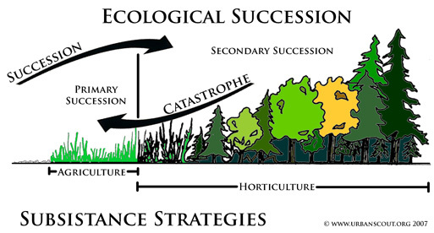

Slide 35
A
B
t
Ecosystem
orientor
s
E
F
D
C
Time
G
H
I
J
K
Sketch of the dynamics of ecosystem variables on two scales, both variables are influenced by the disturbances (A and B) with different magnitudes (C and D) and durations (H and J), and both variables are due to orientor dynamics during the phases G, I and K.

Slide 36
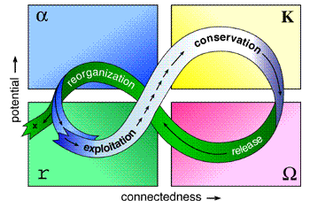
Adaptive Cycle: Holling’s 4-stage model of ecosystem dynamics
Logistic growth only captures part of the cycle
Orientor
rs.resalliance.org/wp-content/uploads/2007/02/4box-adaptive-cycle.gif

Slide 37
Conservation – mature stage
Exergy
stored
Reorganization
Release –
creative
destruction
Exploitation – pioneer stage
Connectedness
Ecosystem succession in the collapse dynamic

Slide 38
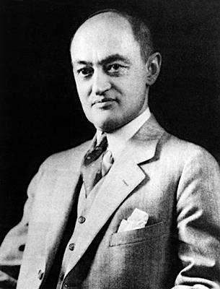
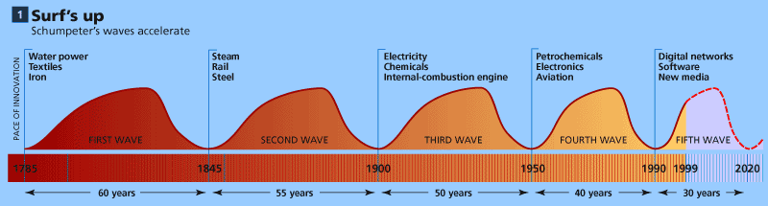

Benefits of collapse
Schumpeter labeled the collapse, “creative destruction”, since it allowed for new configurations and innovation opportunities

Slide 39
Develop-
mental
potential
Connectedness
Developmental opportunities result from the collapse

Slide 40
ecosystem indicator
number of connections
Long-term succession of ecosystems: small-scale disturbances may support the development of the overall system.

Slide 41
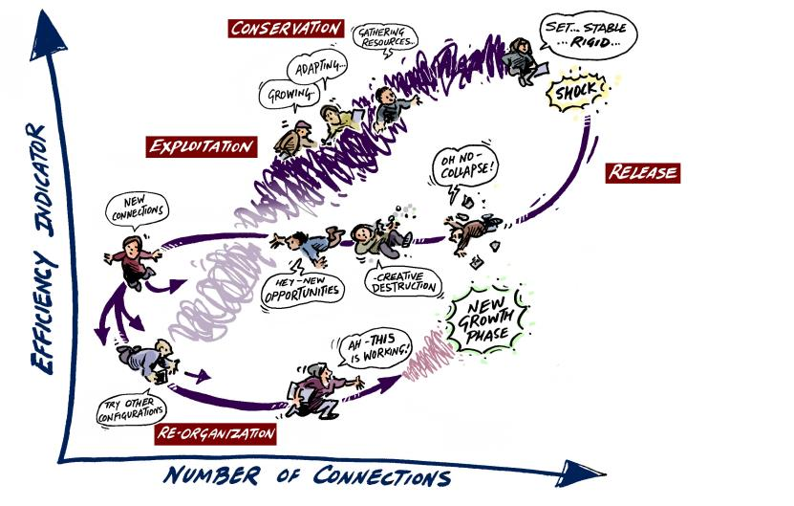
Synthesis model

Slide 42
Conclusions
Ecological systems are open systems that use resource inflows to increase complexity and move further from thermodynamic equilibrium
Some orientors can track the dynamic development phase
Systems go through a complex cycle of growth, development, stability, collapse and reorganization.
Collapse is a normal response of the long term dynamic
Understanding ecosystem dynamics, design, and function may help manage socio-economic systems

Slide 43
Future research in ecosystem dynamics and ecological modelling
Individual based models
Socio-economic-ecological models
Spatially explicit and land use models
Climate factors as drivers and coupled processes

Slide 44
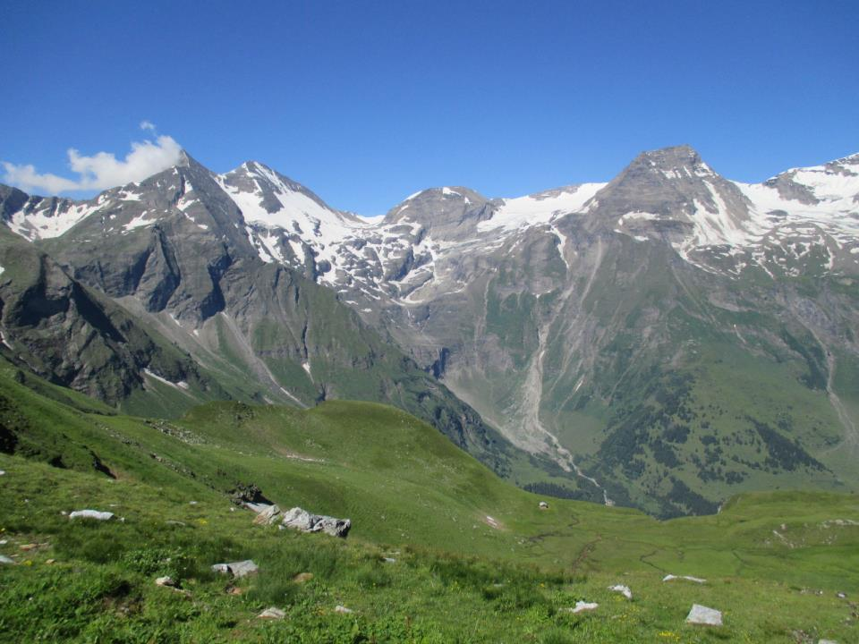

THANK YOU FOR YOUR ATTENTION

