Slide 1
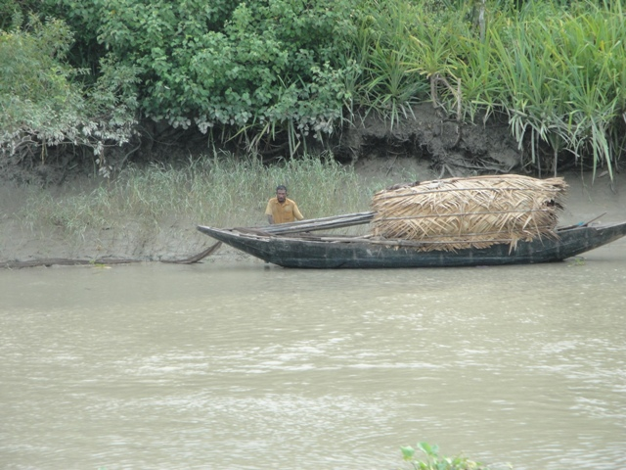
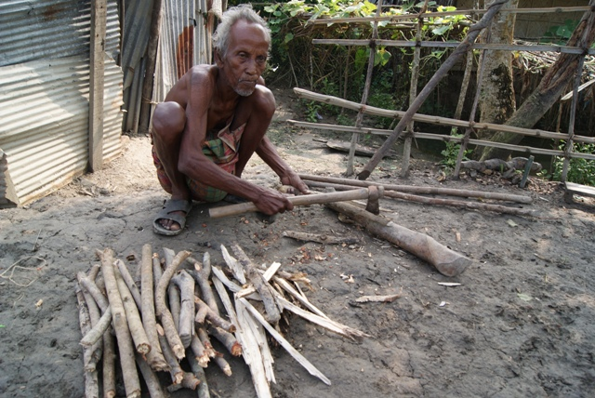
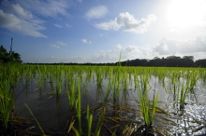
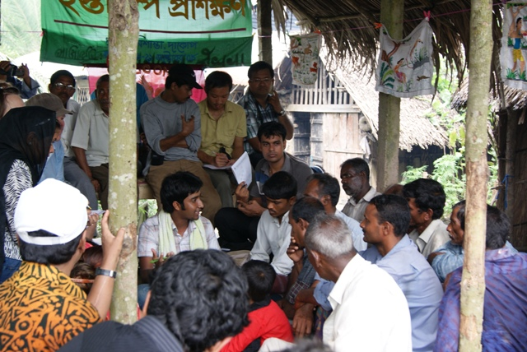





Community Surface Dynamics Modelling System (CSDMS)
2014 Annual Meeting
Uncertainty and Sensitivity in Surface Dynamics Modeling
May 20 - 22, 2014, Boulder Colorado, USA
Coupling terrestrial and marine biophysical processes with livelihood dynamics for analysis of poverty alleviation in Bangladesh
Attila N. Lázár¹, R. J. Nicholls¹, C. Hutton¹, H. Adams²,
M.M. Rahman³, M. Salehin³, D. Clarke¹, J. A. Dearing¹,
J. Wolf⁵, A.R. Akanda⁴, P.K. Streatfield⁶, F.A. Johnson¹
¹ University of Southampton, UK
² University of Exeter, UK
³ Bangladesh University of Engineering & Technology , Bangladesh
⁴ Bangladesh Agriculture Research Institute, Bangladesh
⁵ National Oceanography Centre, UK
⁶ International Centre for Diarrhoeal Disease Research, Bangladesh
a.lazar@soton.ac.uk

Slide 2
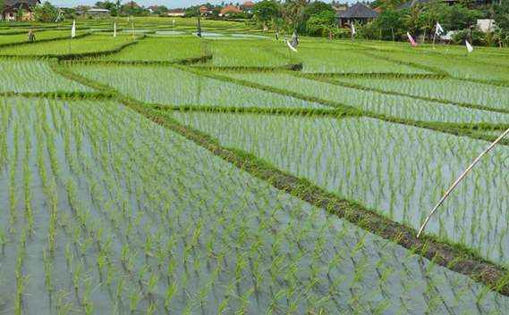
Presentation overview
The ESPA Deltas project
Integration (aim & concept)
Some preliminary results
Handling uncertainty / model testing
Summary

Slide 3
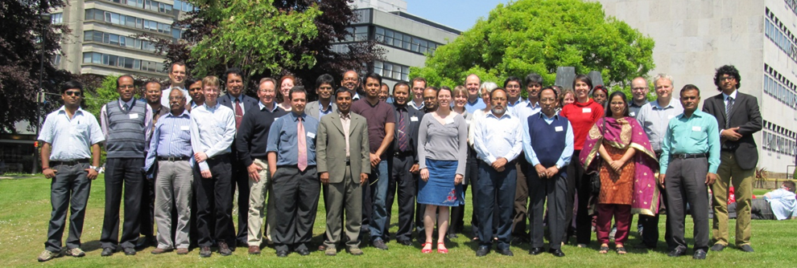
The ESPA Deltas project (http://www.espadeltas.net/)
(2012-16)
Overarching aim:
to provide the Bangladeshi policy makers with the knowledge and tools that enable them to evaluate the effects of policy decisions on people's livelihoods
Consortium:
UK (7), Bangladesh (11), India (4)
Lead partner: University of Southampton

Slide 4
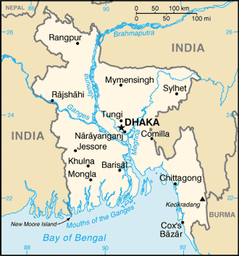
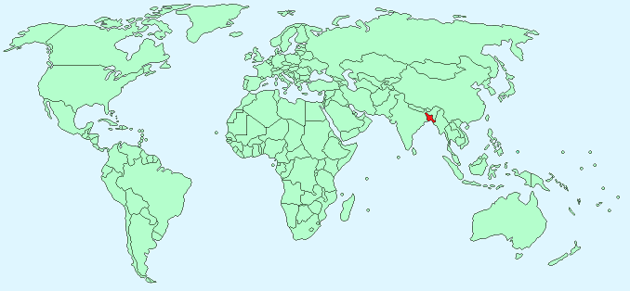
Scales and project elements
Endogenous governance
(BD policies, laws, subsidies, flood protection, education system, …)
Land use / Land Cover
demography incl. migration
char land
markets
agriculture
inland
aquaculture
fisheries
Livelihood & land use
settlements
security
(financial, environmental)
Morphodynamics
Sundarbans
GBM River Basin
livelihood
& poverty
off-shore fisheries
Bay of
Bengal
Exogenous drivers
(upstream flow diversion, climate change, macro-economics, …)

Slide 5
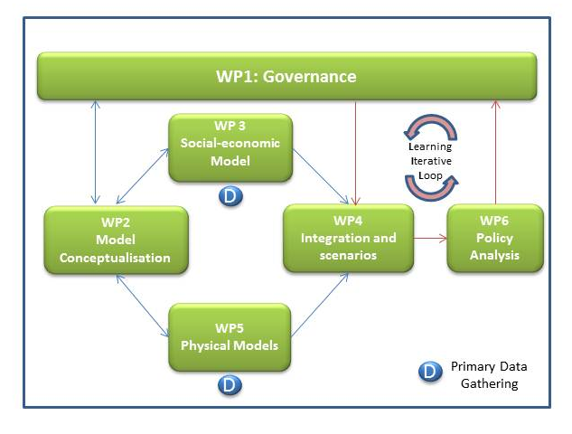
Iterative learning with stakeholders

Slide 6
Project elements
GCM/ RCM
Laws, policies
Temp, rainfall
Catchment Models:
GWAVA / INCA
MODFLOW
HydroTrend
Gaps, Conflicts, Implementation efficiencies
Sea level, SLP, SST, winds
Key issues, Scenarios
Governance research
Water, sediment, nutrients
Crop Model: CROPWAT
Qualitative survey
relationship b/t environment & social behaviour
Delta Model
FVCOM,
Delft3D
Morphology &
Land Cover
Aquaculture Model
Knowledge integration / Scenarios
Land Use
Water flow, level, salinity, temp, sediment, nutrients
Quantitative survey
(consumption, assets, employment, migration, health, poverty, …)
Surge level
Mangrove Model
Process understanding
for each socio-ecological group
+ quantified behaviour
Bay Bengal Model
GCOMS
Primary productivity, T,S,O₂, currents
Coastal Fisheries Model
Size- & Species-based models
Spatial associative model b/t land use and poverty
Inland Fisheries Model
Population
projections
Quantitative Physical/Ecological Models
Demographics, economics & poverty

Slide 7
Aim of integration work
Special focus:
  support & dependence of the rural poor on ecosystems
The Aim of this work is to quantify ecosystem provisions with an integrated model (ΔDIEM)
The model will be used to explore the impacts of changes in
  climate and sea level rise
  environmental change (e.g. salinization)
  land use changes (e.g. rice to shrimp farming)
  external influences (e.g. water and nutrient changes in rivers)
  etc.
The outputs will enable decision makers to identify the likely
key drivers of change and the impacts of policy decisions

Slide 8
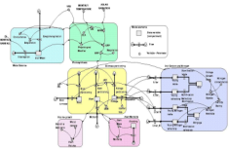
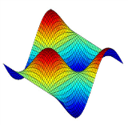
Project (integration) approaches
1. Chain of existing models
2. Chain of simple models &
Bayesian emulators
Climate model
Climate model
Hydrological model(s)
Hydrological model(s)
Marine / Coastal / Estuarine model(s)
Marine / Coastal / Estuarine emulators
Fisheries model
Social analysis & modelling
Livelihood and land use model
Fisheries emulator
Mangrove model
Agriculture model
Mangrove emulator
Agriculture model
Pros:
existing models / methods
process understanding
Cons:
slow running time
limited no of scenarios
no feedback
Pros:
builds on calibrated models
quick running time
forward stepping feedback
estimated uncertainty
Cons:
simplification
boundary condition changes

Slide 9
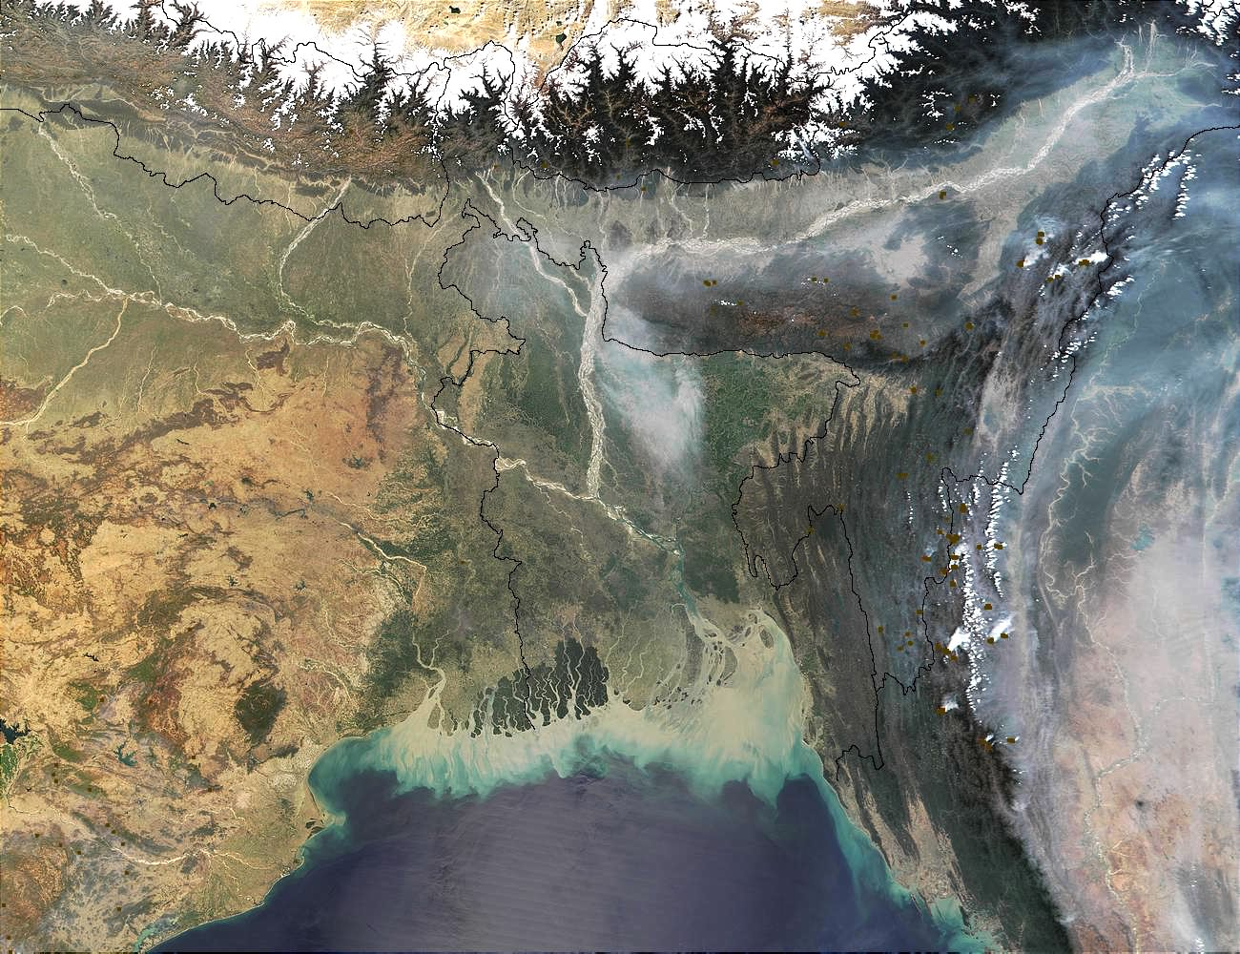
The ΔDIEM model
Delta Dynamic Integrated Emulator Model - ΔDIEM
a holistic tool to capture the trends and emergent properties of a system:
  bio-physical environment (upstream, coastal/marine and local environments),
  social behaviour and livelihood
  governance
a metamodel that enables the efficient run of different models in a harmonised and systematic way
model elements working on different spatial and temporal scales:
  statistical relationships,
  deterministic models,
  probabilistic emulators,
  agent-based type model

Slide 10
The ΔDIEM models
feedback
feedback
Environmental changes
Hybrid model
Land use / Land cover
Spatial (statistical)
association
Livelihood poverty
Demography
Governance
Crop yield
Fish catches
Household-level livelihood model
Cultured fish/shrimp
Forest resources
…..
(more) Process-based model
Not all model elements and relationships are shown!

Slide 11
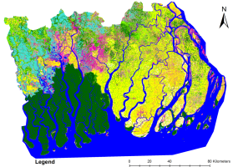
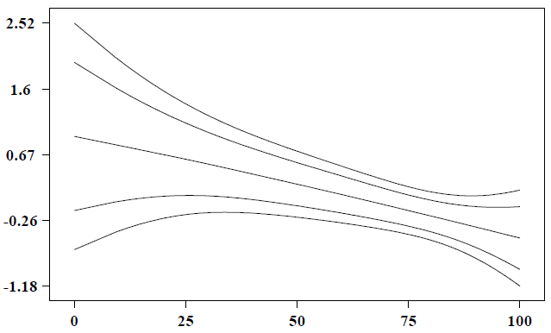
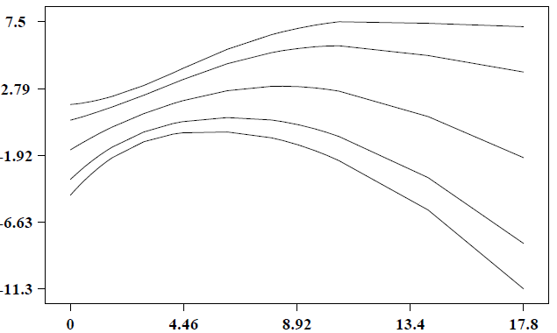
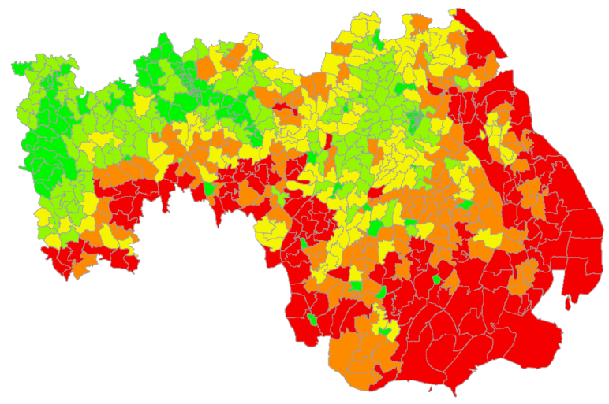
The Hybrid ΔDIEM
Poverty index
Poorer Better-off
100 75 50 25 0
% irrigated land
Searching for associative relationships amongst:
  land use/land cover,
  environmental quality and
  Poverty (based on Census data)
considers spatial dependence and spatial heterogeneity
uses a variety of techniques:
  Spatial autocorrelation techniques
  Multivariate logistic regression models
  Bayesian Geoadditive Semiparametric (BGS) logistic regression model
Poverty index
Poorer Better-off
% mangrove area
Relative poverty

Slide 12
The process-based ΔDIEM
Upstream hydrology / sediment transport
Coastal flow and inundation emulator
Coastal salinity emulator
Land cover & land use ‘model’
Bay of Bengal
Productivity models (crop, fish, resources, ..)
Household-level livelihood model
Human well-being & poverty indicators
Demography model

Slide 13
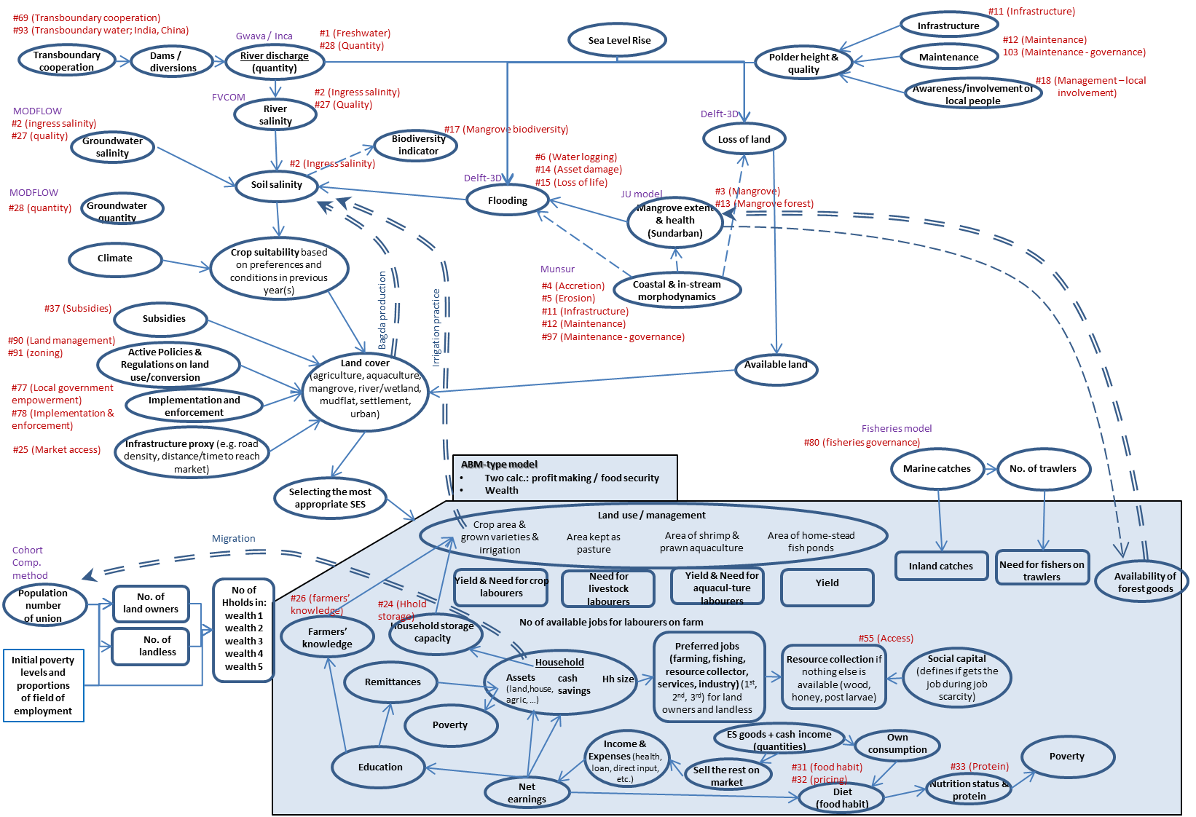
The process-based ΔDIEM

Slide 14
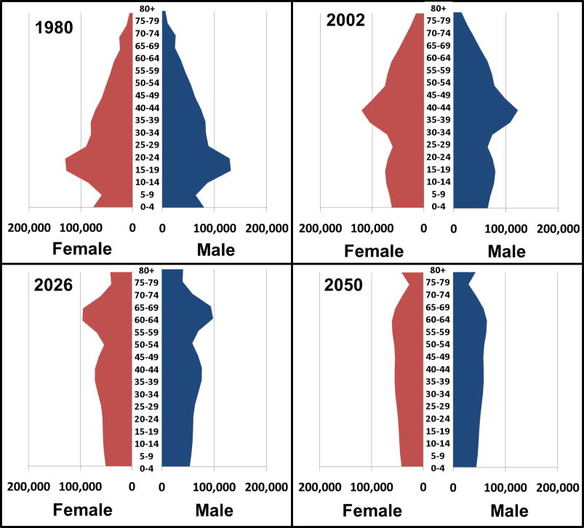
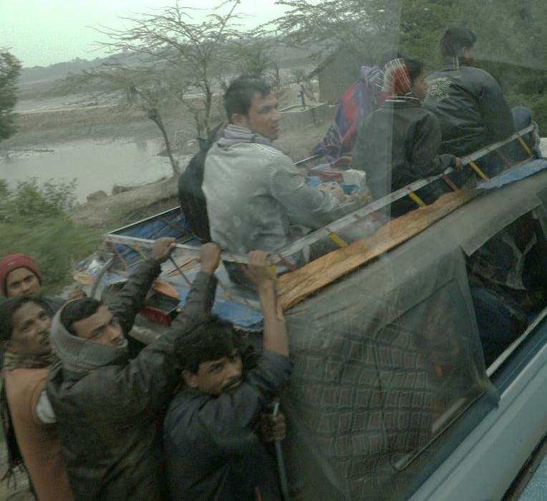
Some early results - demographic changes
-20%
-15%
-10 - -5%
4 - 38%
78%
Barisal (decrease)
The model suggests decreasing population over time in many districts (land fragmentation, salinization, migration)
These are not final results!

Slide 15
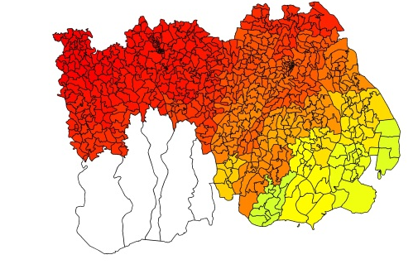
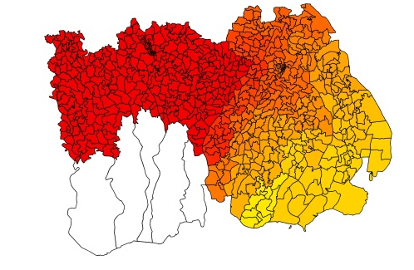
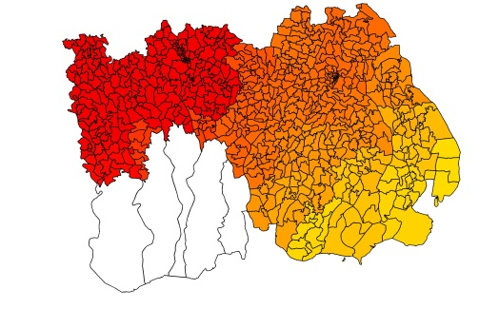
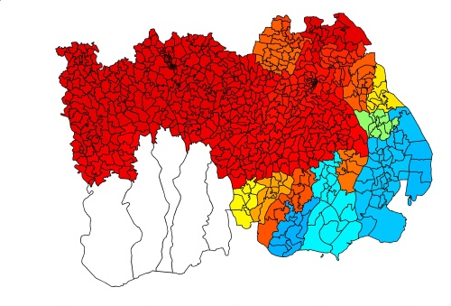
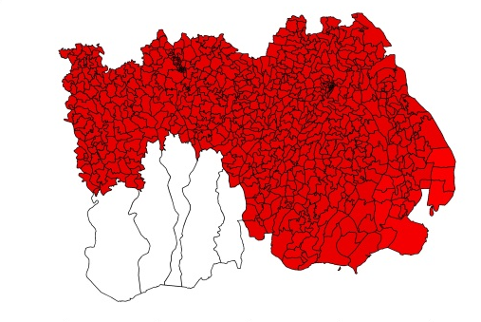

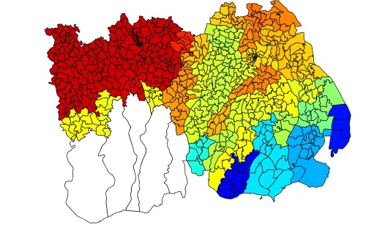
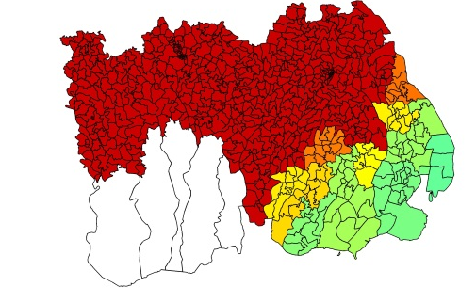

Some early results – crop suitability - yield (t/ha)
scenario: no irrigation & Salinity increases by 5dS/m from 2010 to 2050
1981
2015
2050
Changes are necessary:
- Crop diversification
+ value addition
- Better management
- multiple jobs
These are not final results!
Rice
(Aman)
Wheat
Maize
Very low yield |  | Low yield |  | Moderate yield |  | Good yield |  | Very good yield

Slide 16
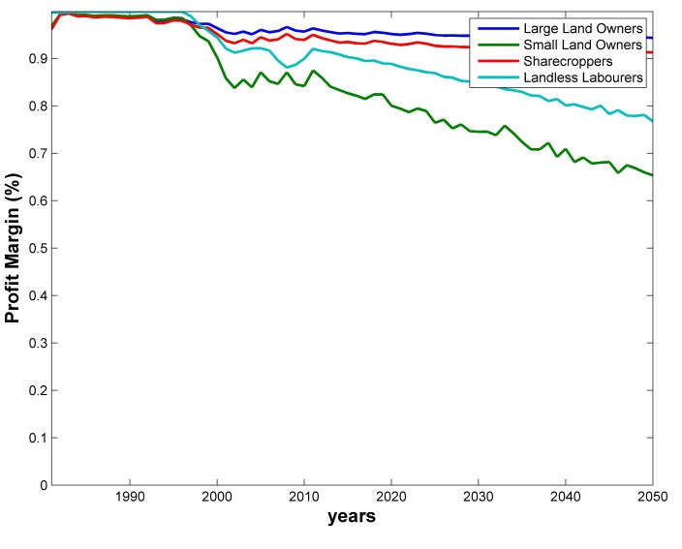
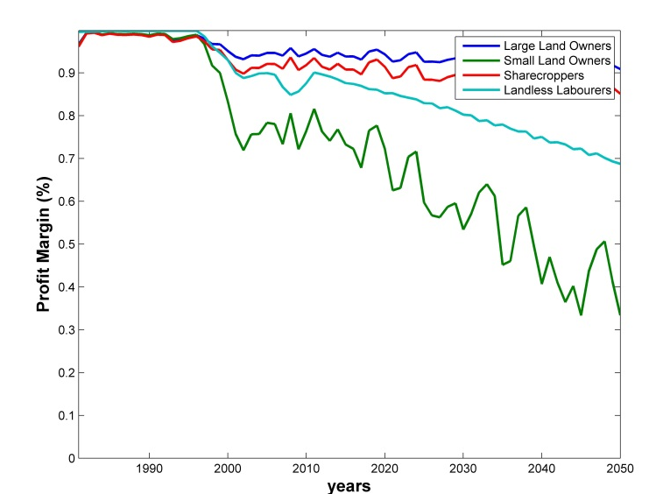
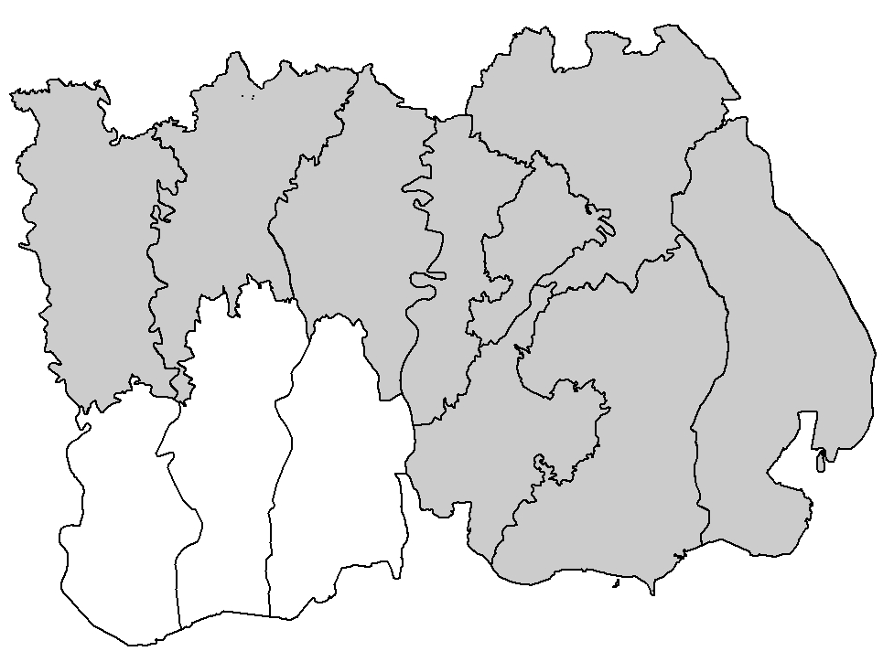
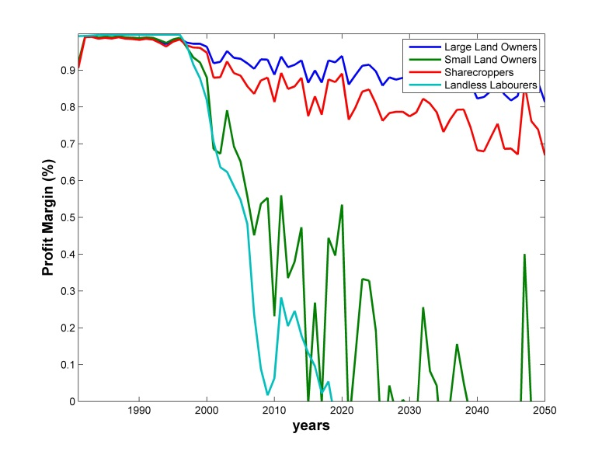
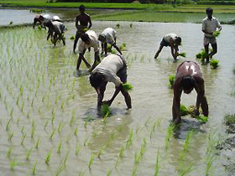
1.0
0.8
0.6
0.4
0.2
0
Some early results - Profit Margin (fraction)
the fraction of revenue that remains in the pocket of the households after all the costs paid
When fraction is around zero, loan is necessary or multiple jobs
Khulna
1980 1990 2000 2010 2020 2030 2040 2050
1.0
0.8
0.6
0.4
0.2
0
Farming is increasingly difficult over time
These are not final results!
Barisal
1980 1990 2000 2010 2020 2030 2040 2050
1.0
0.8
0.6
0.4
0.2
0
Large Land Owners
Small Land Owners
Sharecroppers
Landless Labourers
Barguna
1980 1990 2000 2010 2020 2030 2040 2050

Slide 17
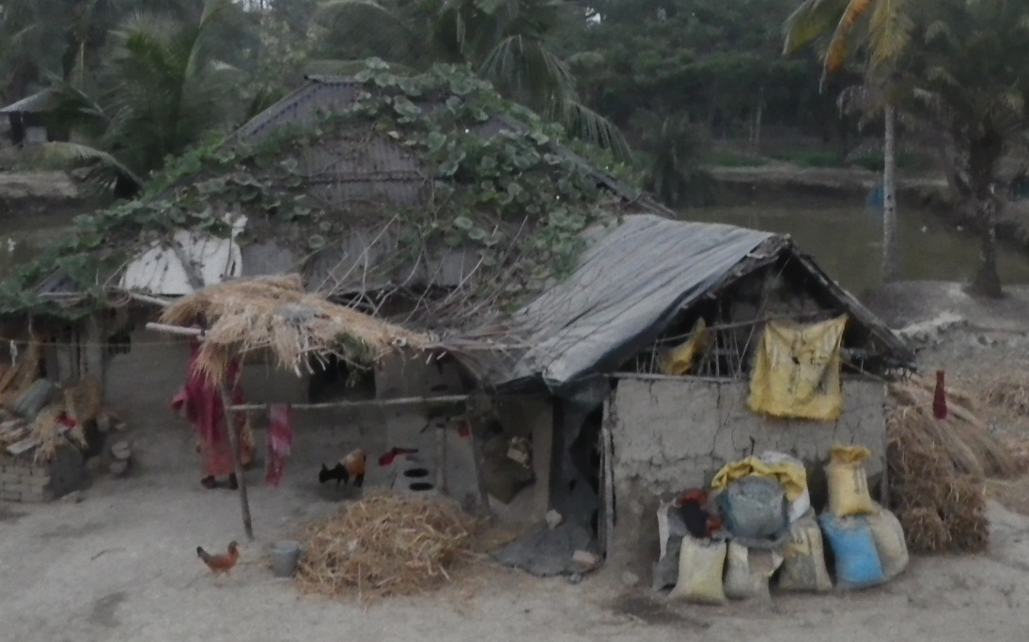
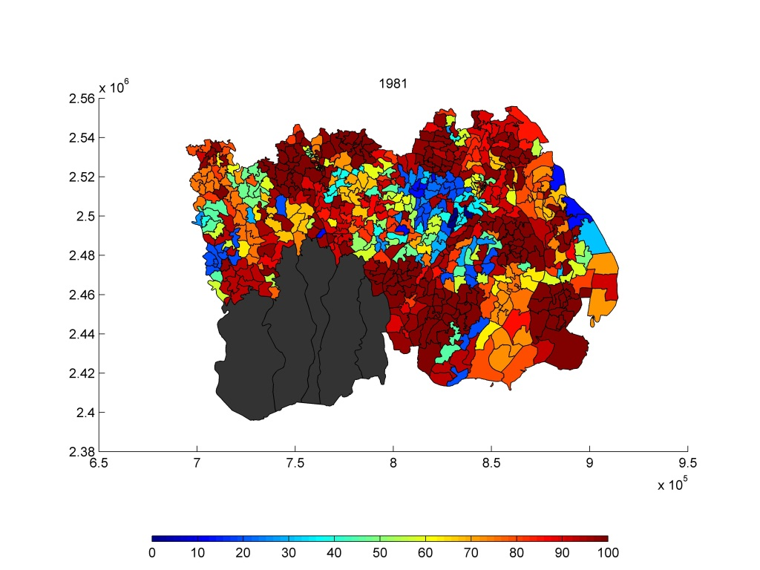
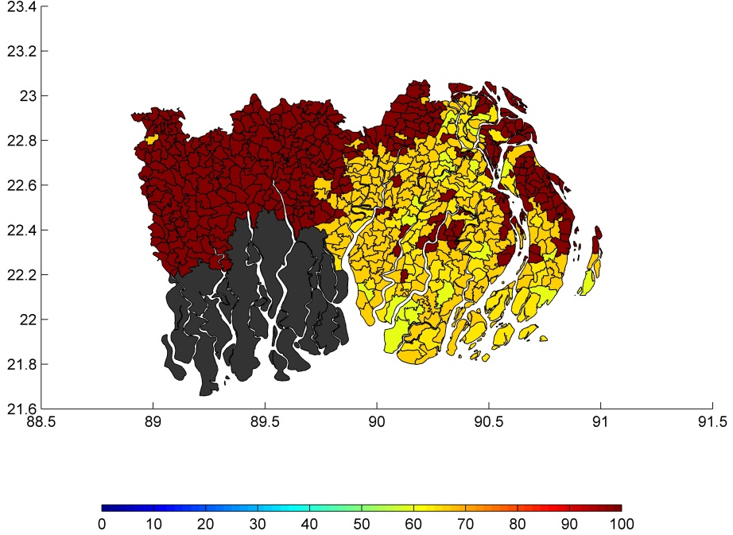
Livelihood, poverty and health
Livelihoods:
Income using different Ecosystem Services
Income/expenditure ratio
Health:
Nutritional status: Calorie/protein intake
Blood pressure and hypertension
BMI nutrition
Poverty:
$1.25 Headcount (monetary poverty)
Food insecurity / Hunger periods
Multi-dimensional poverty index
% of farmers living under the $1.25 Poverty line
2050
Indicators are being developed.
Poverty levels are high.
These are not final results!

Slide 18
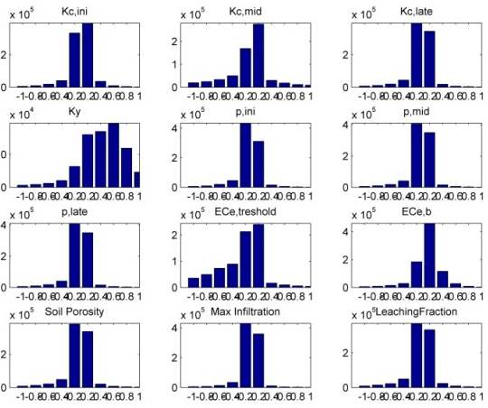
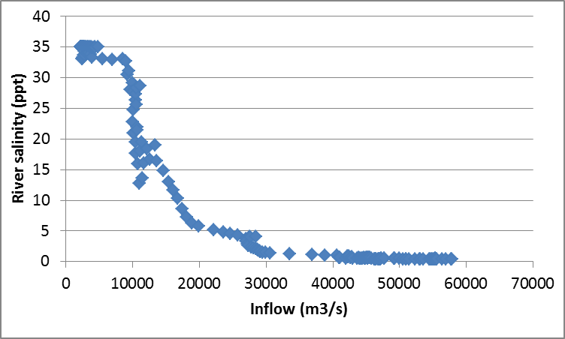
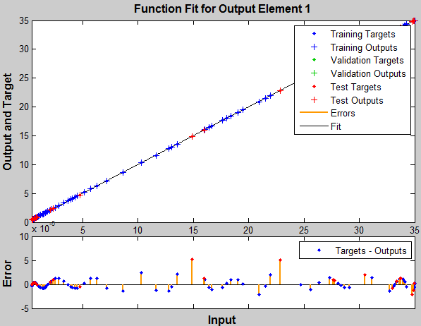
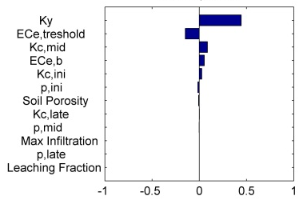
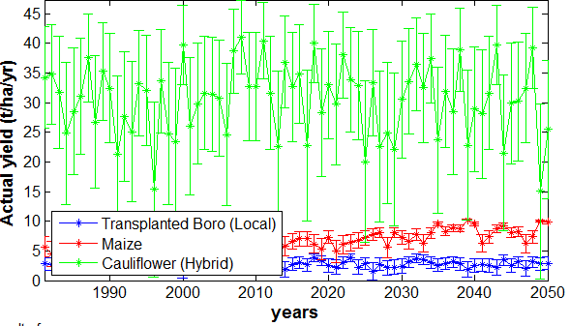
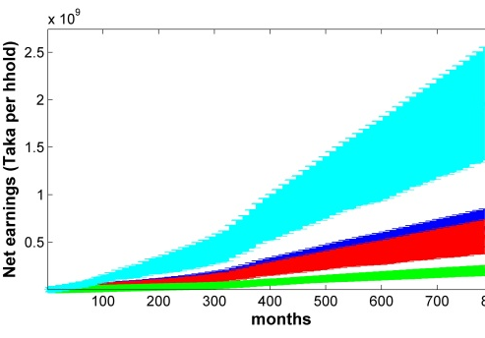
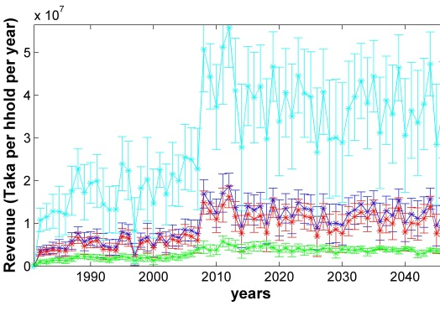
Uncertainty estimation in ΔDIEM (accuracy & precision)
1. Formal sensitivity analysis of process-based models
2. Process-based models –
built-in Monte Carlo sequence (mean, ±1 std dev)
Bayesian emulators – uncertainty automatically calculated
Accounting uncertainties all the way along the model chain.

Slide 19
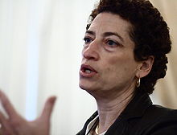
Model testing & validation
Oreskes, Shrader-Frechette, Belitz
Verification, Validation, and Confirmation of Numerical Models in the Earth Sciences
Science 4 February 1994:
Vol. 263 no. 5147 pp. 641-646
DOI: 10.1126/science.263.5147.641
Naomi Oreskes

Slide 20
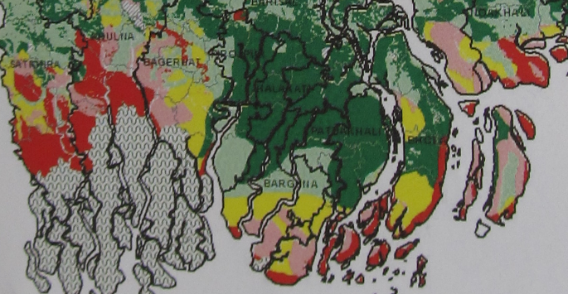
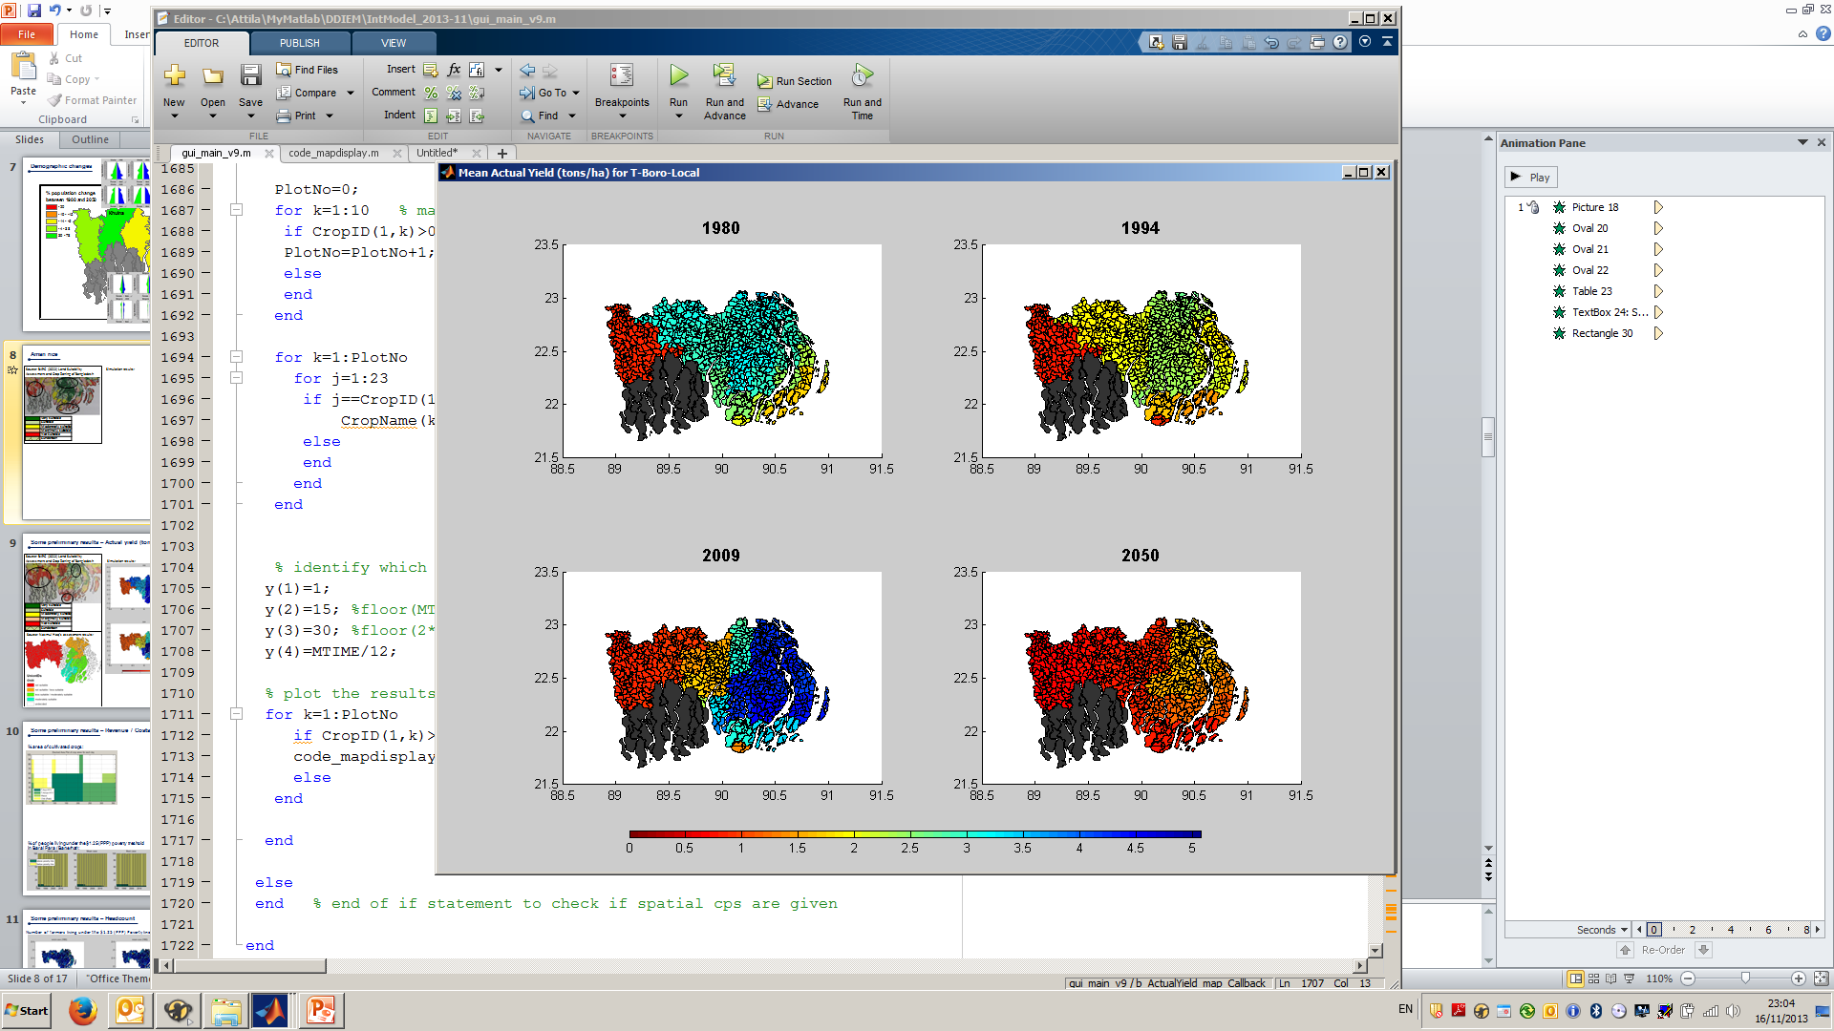
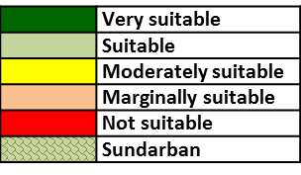
Model testing & validation
1. Debugging the code by comparing model results with
outputs of the real model(s)
2. Testing of individual elements (with observed data from 1981-2013)
E.g. population numbers, water depths / discharges , farmers’ yield, fish catches, etc.
3. Testing of entire model (with observed from 1981-2013)
E.g. land cover, poverty levels, extent of flooding after an event, migration patterns, etc.
4. Compare Hybrid and (more) process-based results
and discuss with stakeholders
Boro rice yield (2009) – t/ha
Source: BARC (2012) Land Suitability Assessment and Crop Zoning of Bangladesh

Slide 21
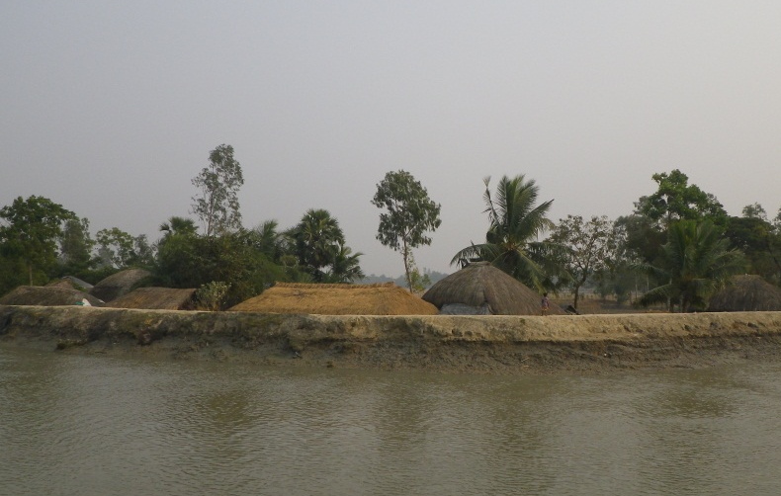
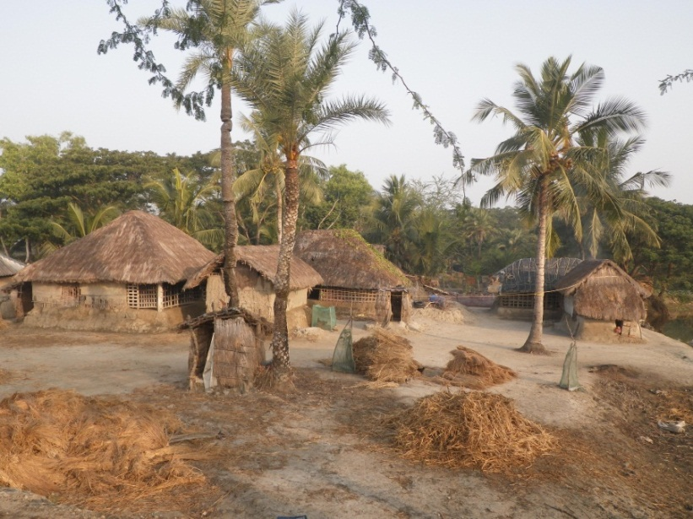
So what can we capture? – a few examples
We will not give accurate ‘weather’ forecasts - only trends, likelihoods, robustness
What will be the extent of inland flooding following a hypothetical cyclone event?
Where will the isoline for threshold (wheat, rice) salinity lie?
What will be the effect of changing climate, river regime and salinity on agricultural, fisheries and aquaculture and thus poverty?
What happens if there is a massive decline in GBM river flow and sediment transport?
Where will the ability to derive any livelihood drop below an acceptable level thus driving migration?
To what extent would subsidies or remittances offset the poverty increases or losses of livelihood in rural areas?
What would be the effect on farmers and ecosystem services of a rapidly increasing trend in global commodity prices (eg rice)?

Slide 22
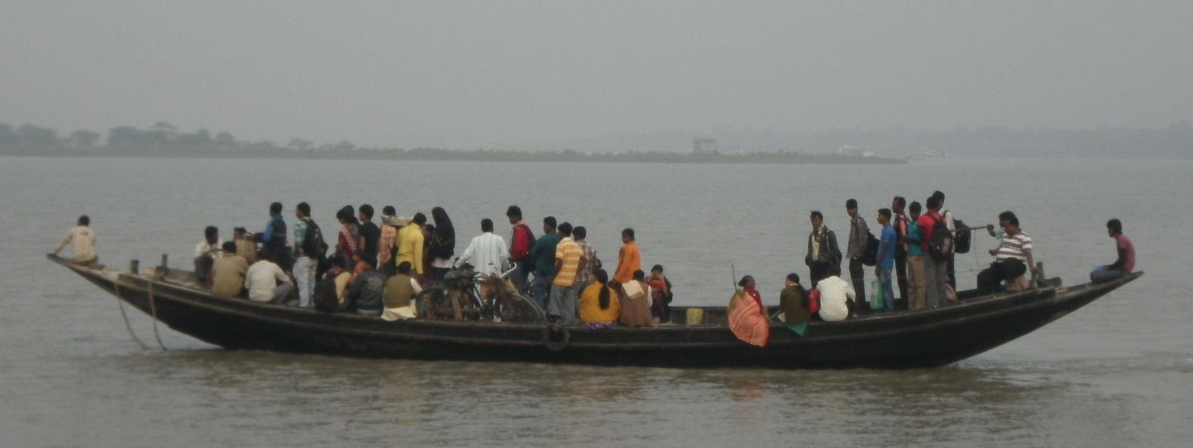
Summary
A generic, holistic approach
To understand the importance of the environment on livelihood, poverty and health
Ongoing in-depth research & integrative model development/testing
First comprehensive simulation results are expected in November 2014

Slide 23
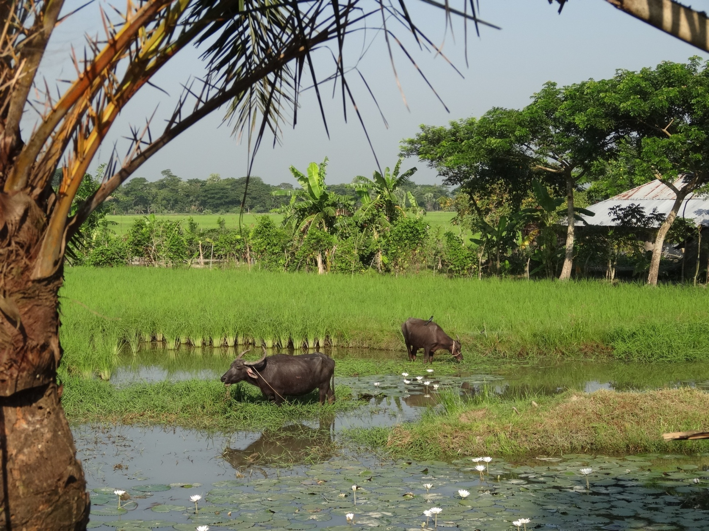

Thank you for your attention!
a.lazar@soton.ac.uk
http://www.espadeltas.net

Slide 24
Scenario development & policy testing
Scenarios
Literature
Narrative
Scenario
Meeting 1
Stakeholder
SSP for Bangladesh
Baseline
Δ DIEM 2014
Integrated
Model
Quantitative
Qualitative
Socio/Environmental
Models
Scenario
Meeting 2 to N
Adaptation
Responses
(e.g. coastal defence structures, irrigation projects, etc.)
Data
Expert
Exogenous Drivers
iterative learning loop
Simulations
S1, S2, S3, S4

