Slide 1
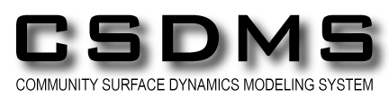
Rudy Slingerland
Penn State University
&
Dave Mohrig, Doug Edmonds, Efi Foufoula-Georgiou, Wonsuck Kim, Ehab Meselhe, Chris Paola, Gary Parker, Paola Passalacqua, James Syvitski, Paul Venturelli, Alberto Canestrelli, Fei Xing, Ben Roth, Ashok Khadaka, Man Liang Corey Van Dyk, Matt Czapiga, Enrica Viparelli, William Nardin
Funded by the National Science Foundation FESD and CSDMS Programs
The FESD Delta Dynamics Modeling Collaboratory
A Progress Report

Slide 2
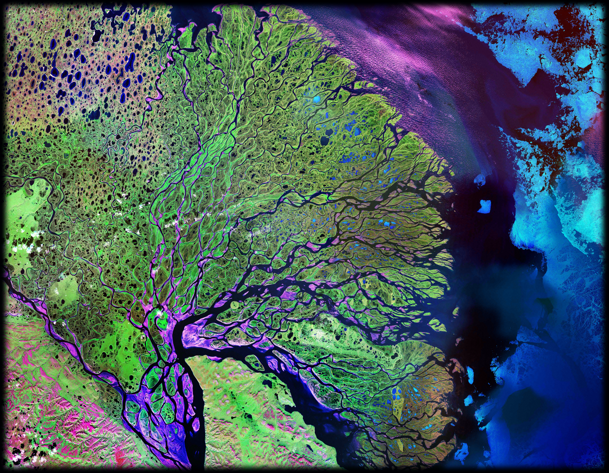
Deltas as a Morphodynamic System
Lena Delta
Siberia
10 km
Notes:
We would argue that deltas epitomize the complexity and beauty of self-organizing morphodynamic systems. Here the combined actions of expanding turbulent jets and plumes, sediment kinetics, plant growth, and a host of other processes operating across at least 7 orders of magnitude in scale, create an orderly landscape out of nothingness. And interestingly, given roughly the same river discharges and wave and tidal climates, sometimes different forms arise for reasons that remain unknown.
Lena Delta
Image taken 7/27/2000
The Lena River, some 2,800 miles (4,400 km) long, is one of the largest rivers in the world. The Lena Delta Reserve is the most extensive protected wilderness area in Russia. It is an important refuge and breeding grounds for many species of Siberian wildlife.
The Lena Delta can be found on Landsat 7 WRS Path 131 Row 8/9, center: 72.21, 126.15.

Slide 3
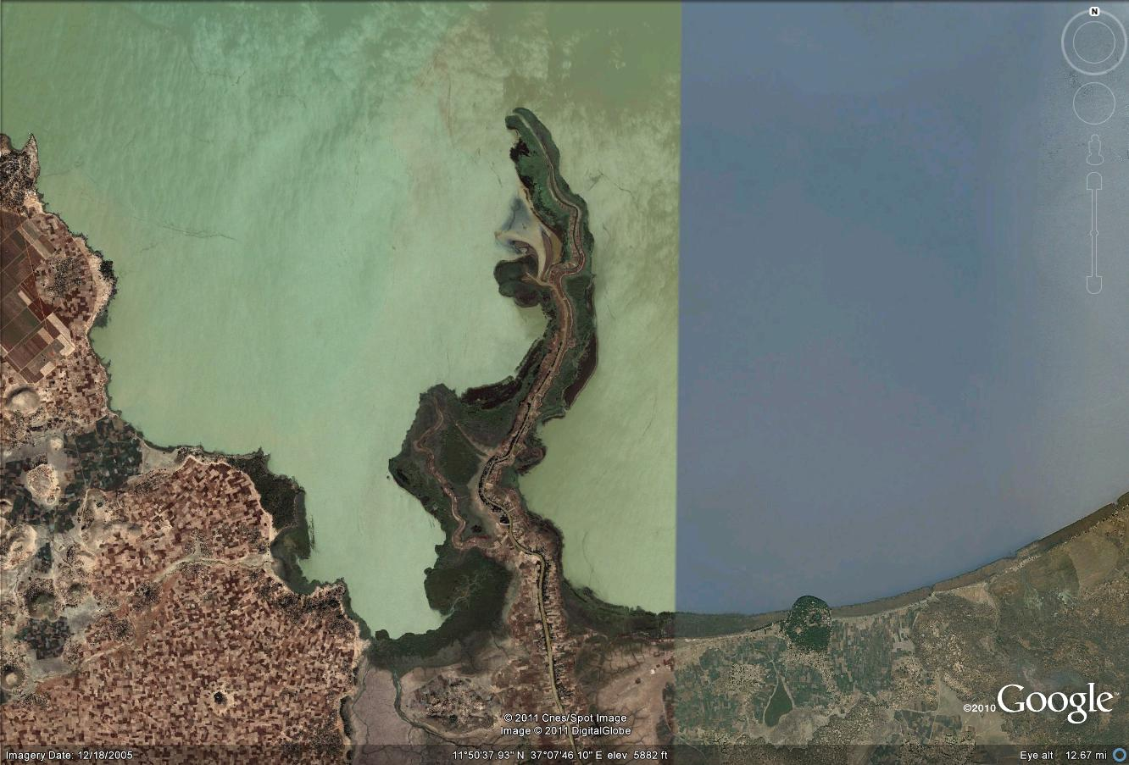
Deltas as a Morphodynamic System
Gilgel Abay River Delta in Tana Lake
Ethiopia

Slide 4
Questions
How do deltas self-organize into such diverse natural geomorphic forms?
What are their feedback loops and parameters governing the length scales and response times?
How will deltas respond to perturbations in sediment fluxes and types, sea level rise, changes in salt/nutrient fluxes, and climate change?

Slide 5
FESD Delta Dynamics Collaboratory (DDC)
Five-year effort to develop tested, high-resolution, quantitative models incorporating morphodynamics, ecology, and stratigraphy to predict river delta dynamics over engineering to geologic time-scales
Funded through the National Science Foundation’s “Frontiers in Earth System Dynamics” (FESD) Program
Specifically address questions of delta system dynamics, resilience, and sustainability
Notes:
And so we proposed to NSF that deltas really were a “Frontier in Earth Surface Dynamics”.

Slide 6
FESD Delta Dynamics Collaboratory
Two laboratories
  Wax Lake Delta—a field laboratory for discovering process-interactions and testing model predictions
  (contact Dave Mohrig--mohrig@jsg.utexas.edu--for more information)
  Virtual Modeling Laboratory in CSDMS for model
  development and hypothesis testing
  Three types of models
    reduced complexity
    multidimensional
    ecomorphodynamic
    ecologic
Notes:
6 real-time island stations measuring water level, temp, conductivity and turbidity;
4 stations with ADVs,
3 stations with Nitrate sensors
4 real-time island stations: all four stations have ADCP and CTDTu equipment measuring the velocity field, as well as water conductivity, temperature, depth, and turbidity
Here we report on the progress made to date in advancing models of delta processes and morphodynamic interactions.
The models consist of three types: 1) reduced complexity delta models (RCDM); 2) a 2- and 3D eco-geo-morpho-dynamic sediment transport delta model; and 3) vegetation and fish population ecological models. The RCDM are focused on large-scale interactions, and as such offer the opportunity to explore aspects of system dynamics that may be harder to pick out of the details of a high-resolution model.

Slide 7
Reduced Complexity Delta Models (RCDM)
DeltaRCM a “2.5-D” cellular delta formation model
  Team: Man Liang, Paola Passalacqua, Corey Van Dyk w/ collaborators Doug Edmonds, Nathanael Geleynse, Vaughan Voller, Chris Paola
  Focus on large-scale system dynamics

Slide 8
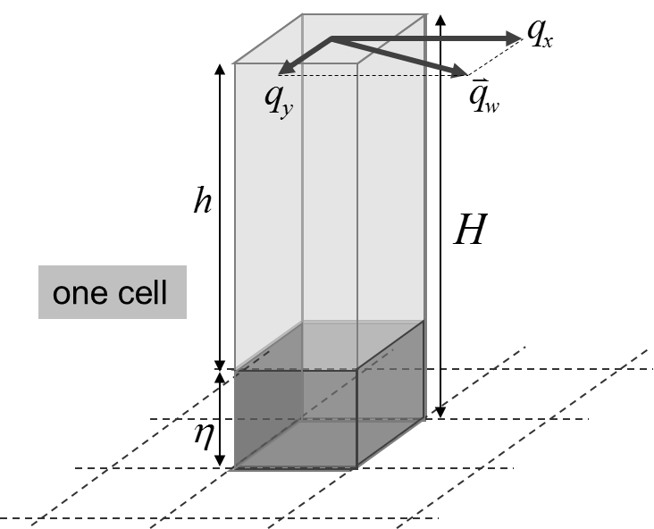
DeltaRCM
Cellular routing framework
Lattice domain of square cells
Calculates unit discharge vector, bed elevation and water surface elevation at each cell
Weighted random walk
Water and sediment flux are treated as “parcels” in a Lagrangian view
Parcels are routed stochastically based on a probability field calculated from simplified physics
H - water surface elevation
η - bed elevation
- water unit
discharge
At each time step
Calculate routing probabilities for water parcels
Route water and update flow field and water surface elevation
Calculate routing probabilities for sediment parcels
Route sediment and update bed elevation
Notes:
The model (referred to as “DeltaRCM”) uses a cellular-routing framework.
The domain is a lattice of square cells representing topography.
At each cell, resolved variables include water unit discharge, bed elevation and water surface elevation.
The model adapts a Lagrangian view of transport: water and sediment flux are treated as a large number of “parcels”.
These parcels are routed stochastically through the lattice based on a probability field that is updated through time.
The calculation of the probability field is based on rules abstracting the governing physics – that’s where the “reduced-complexity” comes in.
The model starts with an arbitrary basin topography with given water and sediment discharge and sea-level as boundary conditions, and evolves through time following steps:
Calculate routing probability field for water parcels
Route water parcels and update flow field and surface elevation
Calculate routing probabilities for sediment parcels
Route sediment parcels and update bed elevation according to rules for deposition and erosion

Slide 9

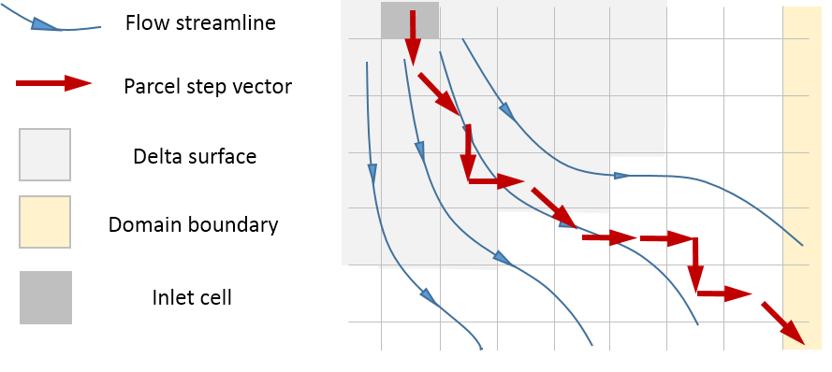
DeltaRCM
Water Routing Probabilities
Key elements in deciding the routing weight (probability) of flow to a neighbor cell
Water depth in that cell (an approximation of conductivity, or the inverse of flow resistance)
Whether the cell is in the “downstream” direction (determined by a combination of flow inertia and water surface gradient)
Water surface is updated along the paths of water parcels assuming a 1-D profile (finite difference scheme)
Notes:
For routing water parcels, the probability field is mainly determined by two things:
Flow depth at a cell (as an approximation of the inverse of flow resistance – assuming constant friction coefficient)
A “downstream” direction defined at each cell. It’s a combination of flow inertia and water surface gradient.
Water surface is updated along the paths of water parcels assuming a 1-D profile (e.g., constant slope, or backwater equation), using a finite difference scheme.

Slide 10
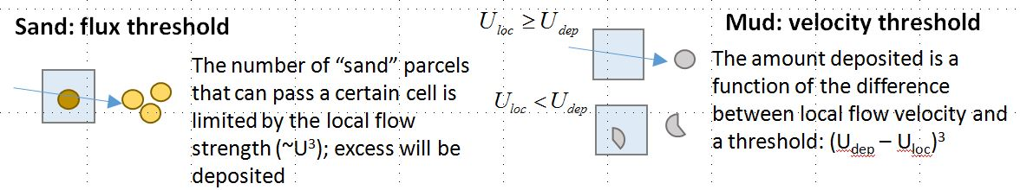
DeltaRCM
Sediment Routing Probabilities
Two types of sediment parcels (sand/mud) that have:
Different routing probabilities
Different rules for deposition/erosion
Updating topography
A sediment parcel loses mass by deposition and gains mass by erosion; the bed adjusts accordingly
Erosion and deposition are determined by local flow conditions
Notes:
For sediment transport, all sediment parcels are treated as “leaking buckets” that carry a certain volume of sediment and travel with the flow.
Entrainment will cause a sediment parcel to gain volume while the bed is eroded.
Deposition will cause a sediment parcel to lose volume while the bed aggrades.
The model uses two types of sediment parcels, representing coarse and fine sediment respectively.
They are referred to as “sand” and “mud” parcels.
Their differences are:
In calculating routing probability field, sand parcels are more affected by flow depth, which makes them tend to follow topographic lows.
In determining erosion and deposition, sand and mud parcels have different rules.
For example, sand parcels use a flux threshold for deposition while mud parcels use a velocity threshold (as shown in the bottom portion of the slide)

Slide 11

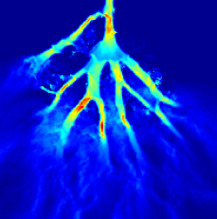
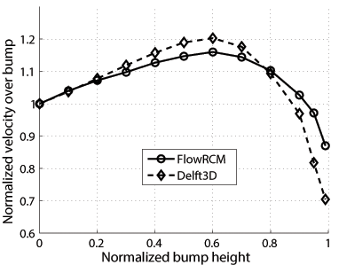
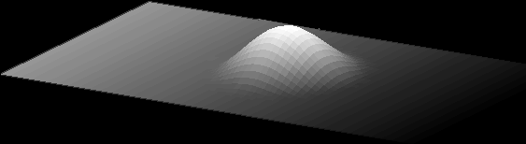
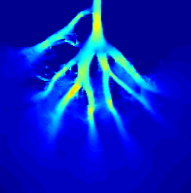
DeltaRCM
Validation of the hydrodynamic component
Flow over a bump (river mouth bar)
Flow through Wax Lake
network
V (m/s)
Delft3D
DeltaRCM
Notes:
Test 1 shows that FlowRCM is able to reproduce the backwater profile in a simple straight channel setup.
Test 2 shows that FlowRCM is able to reproduce the transition from flow acceleration over a bump of a moderate height to flow deceleration over a bump of a height comparable to flow depth.

Slide 12
Other Reduced Complexity Models
A network-based modeling framework for understanding delta vulnerability to change
  Team: Efi Foufoula-Georgiou, Alej Tejedor, Anthony Longjas, Ilya Zaliapin
  Map delta network into a directed graph composed of a set of nodes (or vertices) and links (or edges) and represented by its connectivity or adjacency matrix
  Operations on the adjacency matrix quantify immediate or distant connectivity, distinct sub-networks, and downstream regions of influence from any point on the network.
  Use these representations to construct “vulnerability maps”

Slide 13
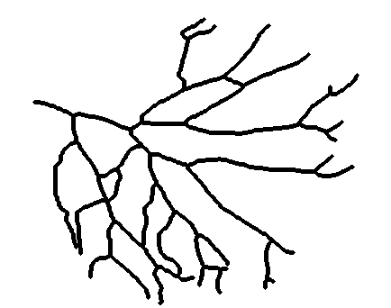
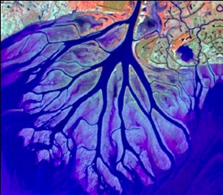
Other Reduced Complexity Models
A network-based modeling framework for understanding delta vulnerability to change
Wax Lake Delta
Directed Graph:
  Node ➔ Junction
  Link ➔ Stream
1
2
4
3
Index each link
N is the total number of links = 59
  Adjacency Matrix A (N x N)
      if there is a connection i→j
      otherwise
      (Note: 1* replaced with w_{ij} for flux propagation)
6
5
7
.
.
.
Notes:
Degree Matrix D (N x N)
Diagonal matrix with d_{ii} = number of links
directly downstream from i.
(Most links have d=2, and outlets have d=0)

Slide 14
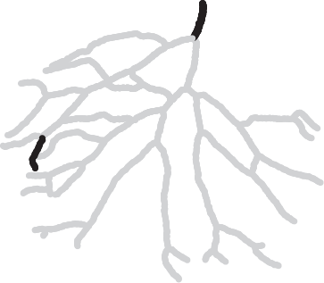
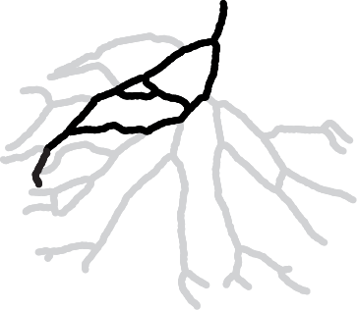
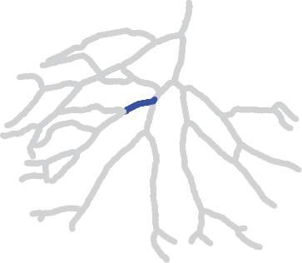
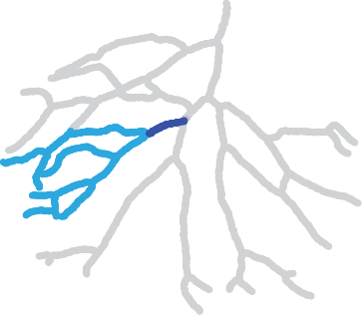
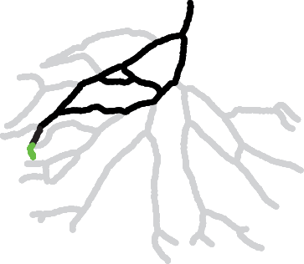
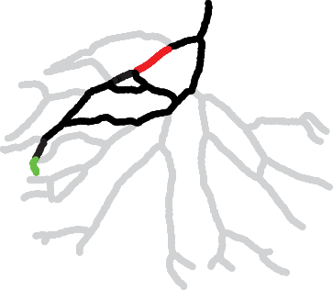
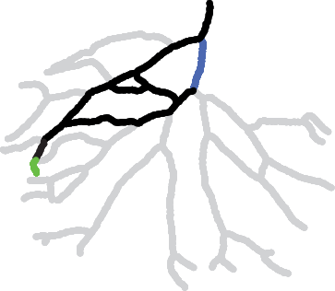
Other Reduced Complexity Models
Find Sub-networks (apex to specific outlets)
=> Each v_{i} represents a different sub-network
Degree Matrix D (N x N): Diagonal matrix with d_{ii} = number of links
directly downstream from i.
Find Downstream Regions of Influence of a link k, R_{k}.
3. Find ‘hotspots’ of change (links where a flux reduction would cause most drastic reduction at the shoreline)
Apex
Outlet
k
Union of all v vectors with non-zero entries at link k
(D-A) with first (k-1) columns and rows are set equal to zero
Same reduction applied
to different links
Causes different
reductions at the
same outlet
High reduction
Low reduction
Notes:
The hotspots of change asks the question: if the flow were reduced in a particular upstream link, what links at the shoreline will be most affected?

Slide 15
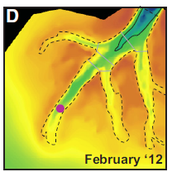
Other Reduced Complexity Models
A 1D delta restoration model
  Team: Matt Czapiga Gary Parker, Enrica Viparelli
  Treatment of alluvial-bedrock and bedrock-alluvial transitions in low-slope sand-bed rivers
Wax Lake Delta
Exner equation for bedrock-alluvial and purely alluvial morphodynamics:
  p_{c} = areal fraction cover of alluvium
  q_{tc} = capacity sed. transport rate/width
  η = bed elevation
  λ_{p} = alluvial porosity
stiff bay mud
alluvium
Shaw and Mohrig
2014

Slide 16
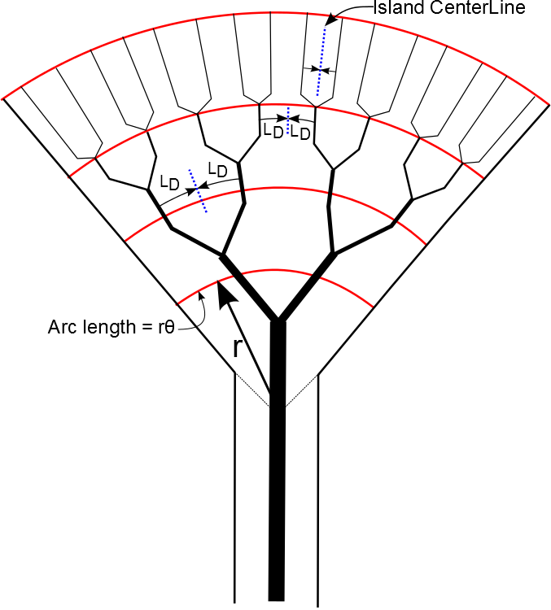
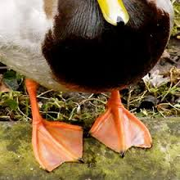
Other Reduced Complexity Models
An Implicit 2D Delta Model: The Depositional Web
New self-formed channel closure:
Each channel deposits a width L_{D} to left and right, L_{D} = ϕB_{bf} (hence the web); B_{bf} = bankfull width, ϕ can be partitioned for sand and mud.
Number of channels λ varies continuously, so channels are implicit:
Closure finished with bifurcation relation similar to Edmonds and Slingerland (2008)
θ
Channel
Floodplain
, where L_{B} = length to bifurcation

Slide 17
Multidimensional Ecomorphodynamic Models
  Current open-source, state-of-the-art in 3D delta morphodynamic modeling:
  Delft3D-FLOW Version 6.00.00.2367 http://www.deltares.nl/en or http://csdms.colorado.edu/wiki/Model:Delft3D
Example: Caldwell Keynote earlier this morning
Example: Flow and sediment routing through Wax Lake Delta
  Team: Ehab Meselhe, Ben Roth, Ashok Khadaka
  Objective: Investigate the interaction and feedback among hydraulics, morphology, vegetation, and nutrient loading

Slide 18
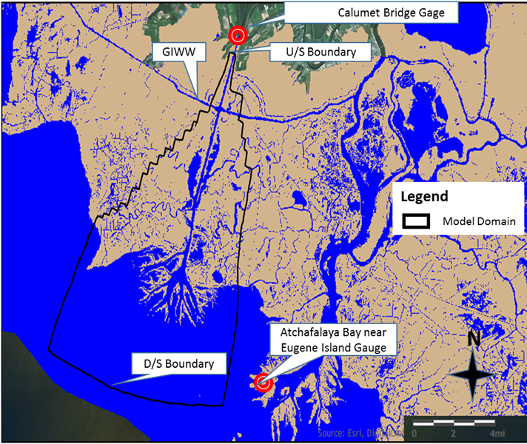
Multidimensional Ecomorphodynamic Models
  Model Setup
    Discharge and Sediment Inflow at Calumet Bridge Station
    Stage/Tide at Atchafalaya Bay near Eugene Island
    Orthogonal curvilinear grid with resolution 25m by 25m to 100m by 100m
    10 sigma layers in vertical direction
    Initial Bathymetry: USACE 1998 Hydrographic survey bathymetry & DDC lidar

Slide 19
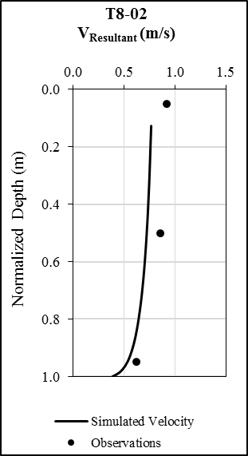
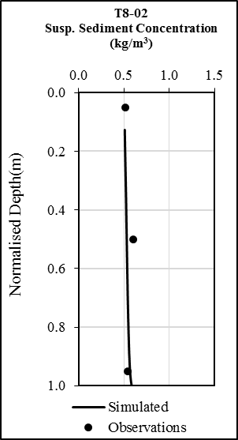
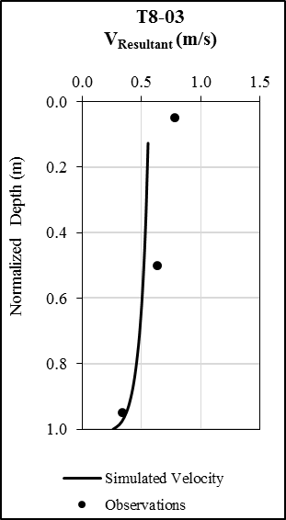
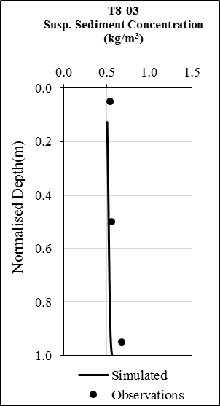
Multidimensional Ecomorphodynamic Models
    Vertical velocity profiles Suspended sediment profiles
Notes:
Conclude that are accurate in many situations….

Slide 20
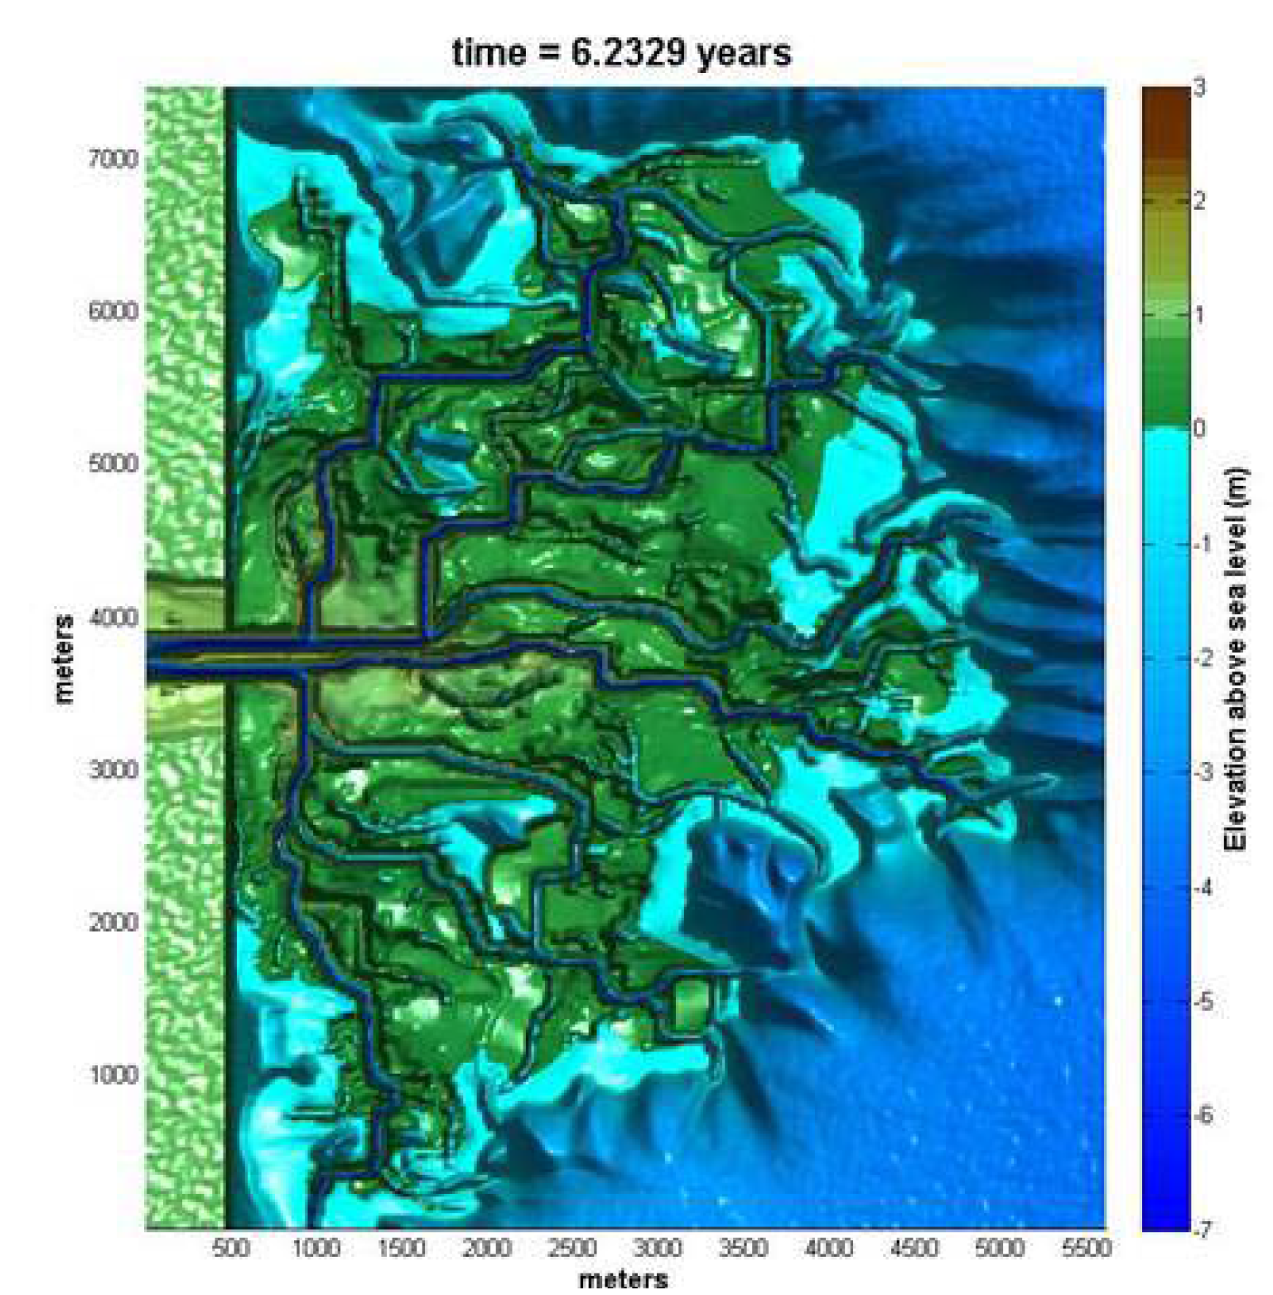
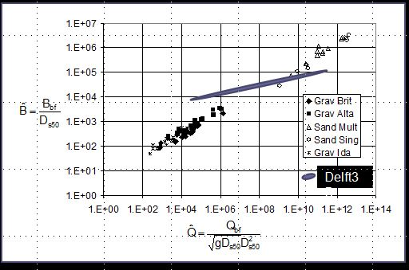
Multidimensional Ecomorphodynamic Models
But there are problems……
  morphodynamic simulations of deltas are an artifact of the underlying orthogonal grid structure
  2) self-formed channel hydraulic
  geometries are inaccurate
20

Slide 21
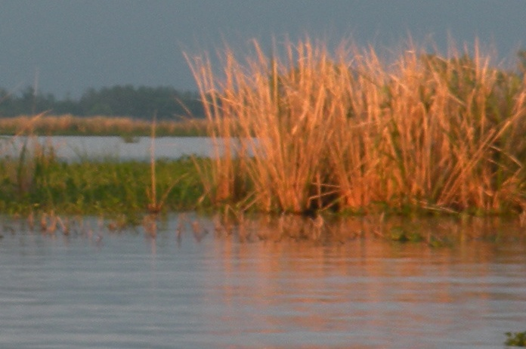
Multidimensional Ecomorphodynamic Models
Problems with current models (cont.)
  3) the algorithms for eroding channel banks are ad hoc
  4) the ecogeomorphic interactions are primitive
No dynamic vegetation with its effects on sediment trapping, turbulence generation, nutrient uptake
dx
dx
dry cells
wet cells
cohesive non-cohesive

Slide 22
A New Multidimensional Ecomorphodynamic Model: D3D+
A mass-conservative, staggered, three-dimensional, shallow water model
Includes:
  ghost-cell immersed boundary method for land/water boundaries
  a sub-grid vegetation-flow interaction module
Team: Alberto Canestrelli, Aukje Spruyt, Bert Jagers, Rudy Slingerland, Fei Xing, James Syvitski, Doug Edmonds, William Nardin

Slide 23
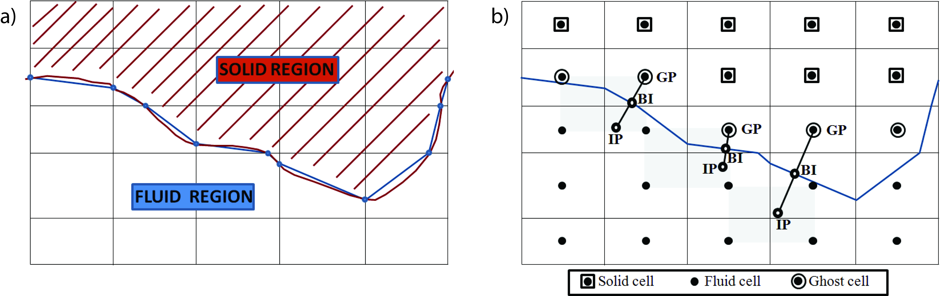
A New Multidimensional Ecomorphodynamic Model: D3D+
Ghost cell immersed boundary method for land/water boundaries
  A hybrid cut-cell/ghost-cell method: ghost cells are used for the momentum equations
  Cut-cells are used in the continuity equation in order to conserve mass
Notes:
a) The brown polygonal line represents the immersed boundary and in the model it is approximated by the blue polygonal line, formed by the Intersection points between the brown polygon and the cell interfaces.
b) Schematic description of the ghost-cell methodology (Mittal et al., 2008). The figure shows an immersed boundary cutting through a Cartesian grid and identifies three particular ghost-cells (GC) that form the basis for discussion in this section. GP, BI and IP denote ghost point, boundary intercept and image-point respectively. The gray areas denote the stencil used for interpolation of the image point.

Slide 24
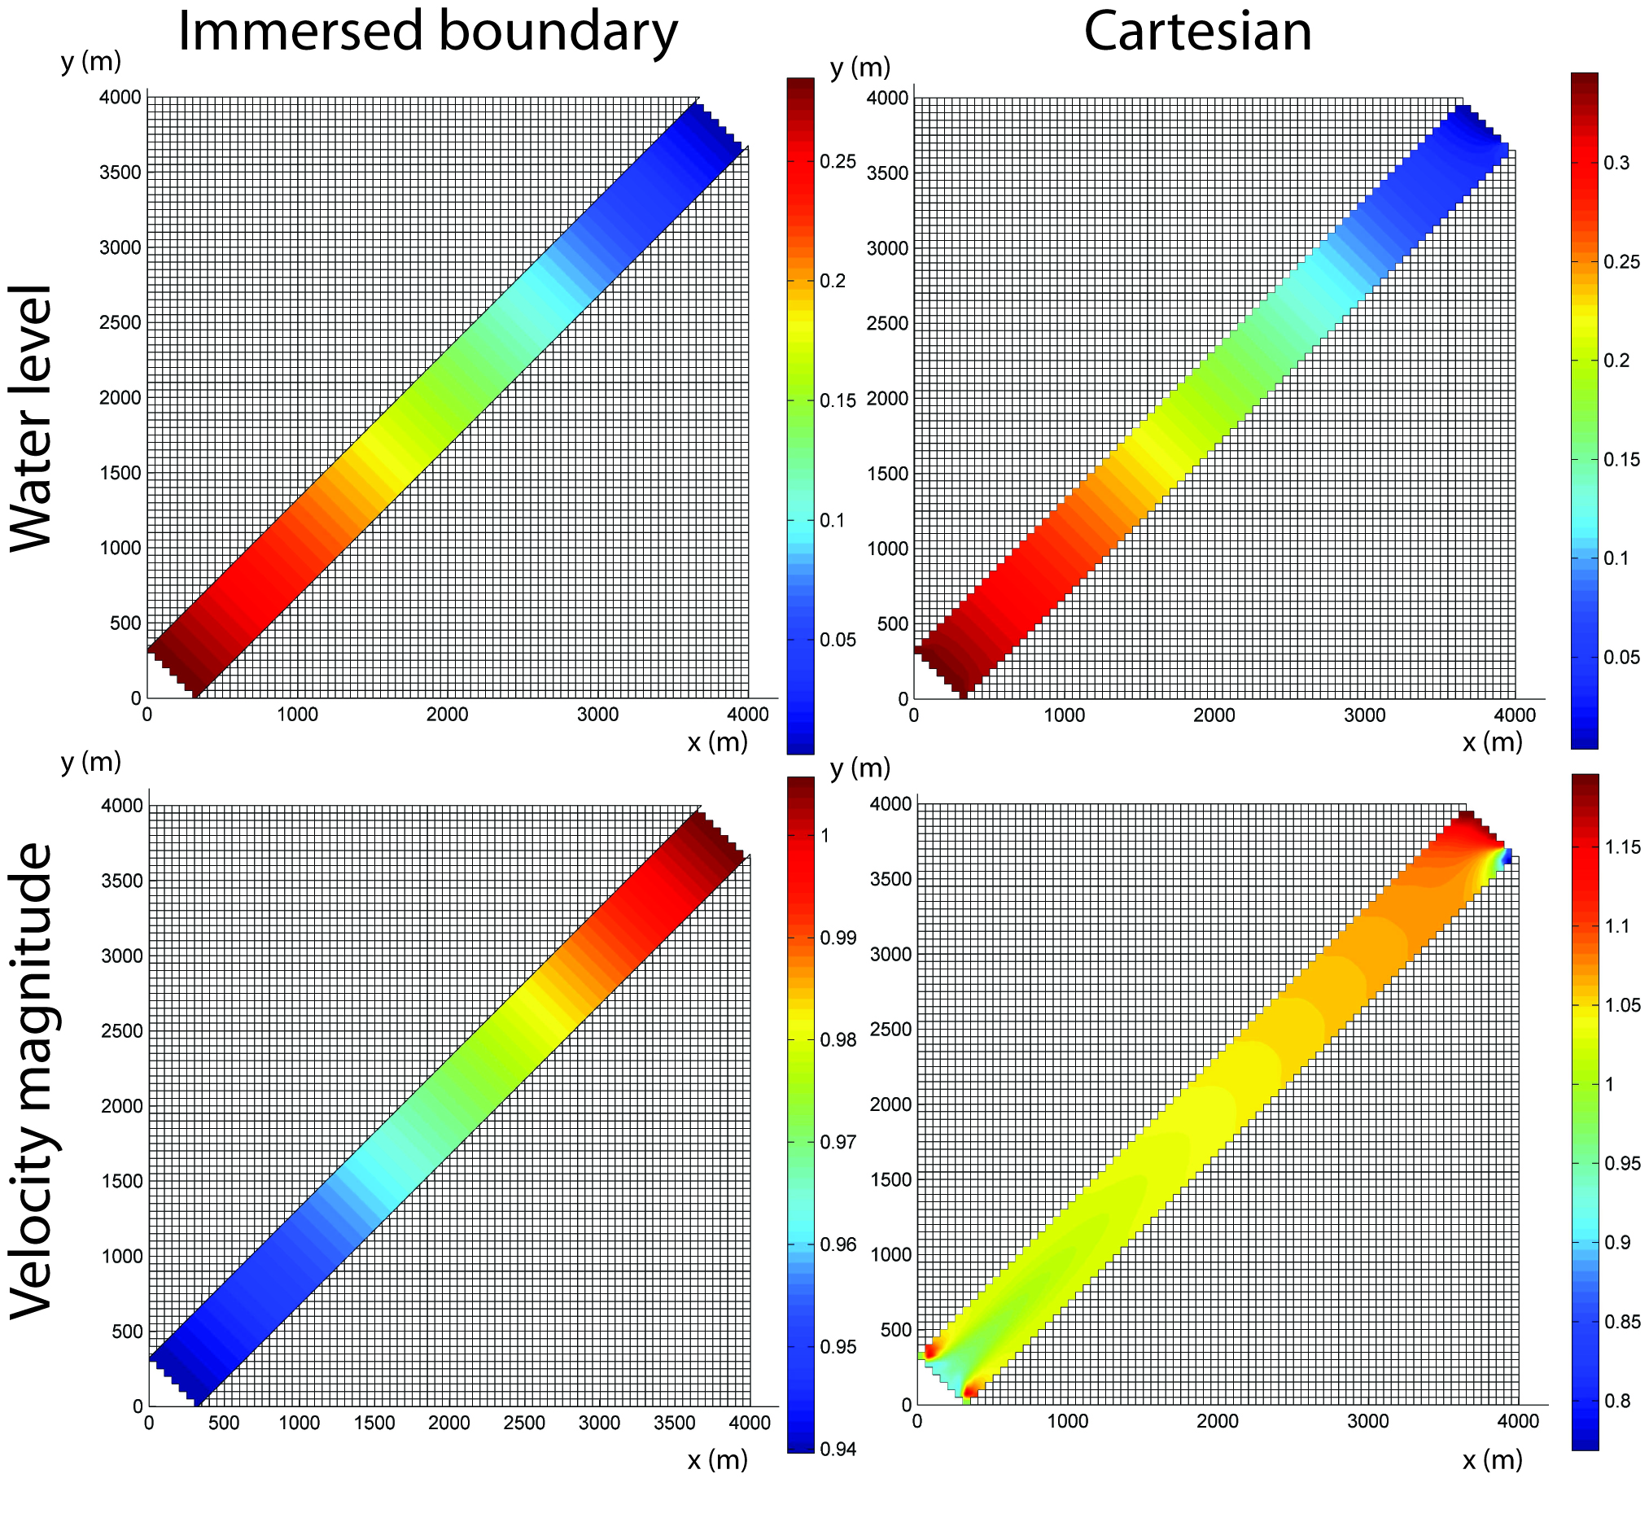
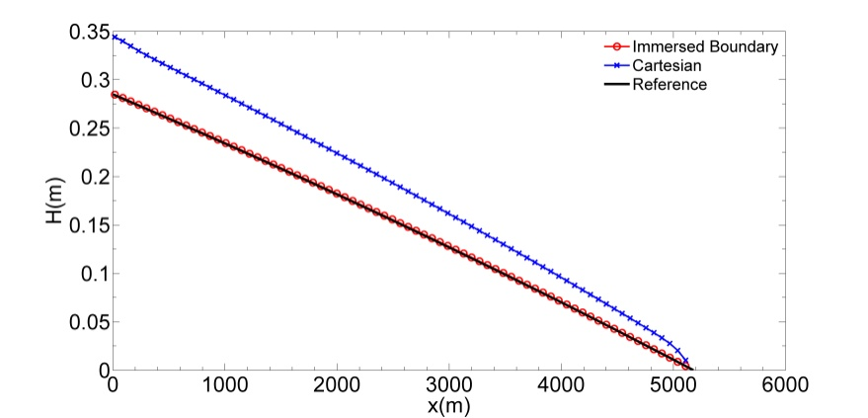
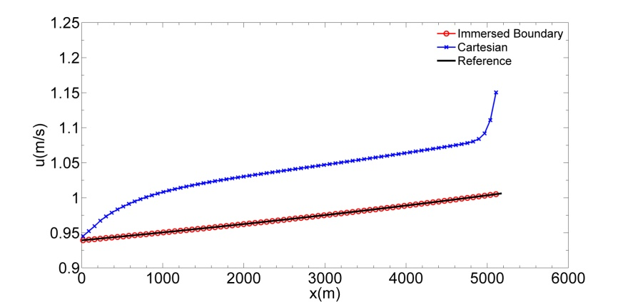
A New Multidimensional Ecomorphodynamic Model: D3D+
Test Case: Flow in channel not oriented with grid
Longitudinal water level
flow
Longitudinal velocity
Notes:
Steady non-uniform flow

Slide 25
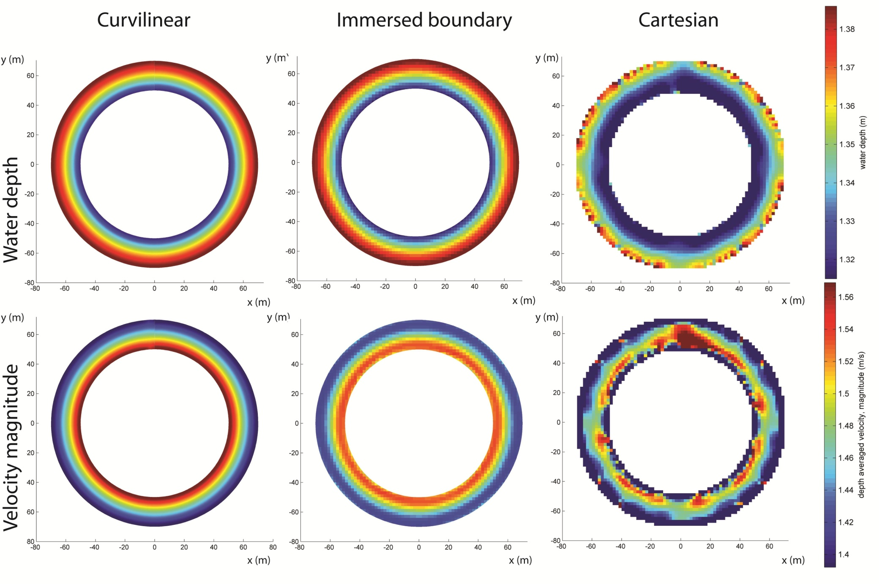
A New Multidimensional Ecomorphodynamic Model: D3D+
Test Case: Flow in an infinite river bend
Periodic BC
Deltares

Slide 26
A New Multidimensional Ecomorphodynamic Model: D3D+
A mass-conservative, staggered, three-dimensional, shallow water model
  Can now treat lateral bank erosion…..
    Use wall shear stress to predict particle-by-particle bank erosion (e.g. Darby & Thorne formulation)
E
dx
dx
dry cells
wet cells
cohesive non-cohesive

Slide 27
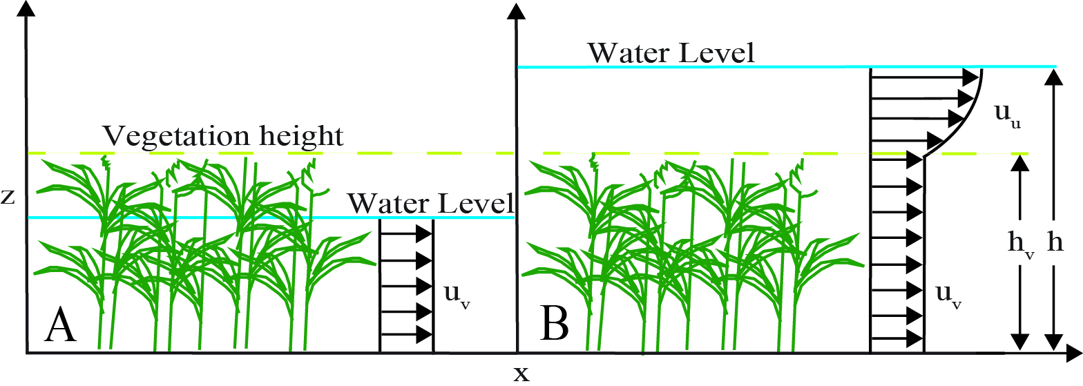
A New Multidimensional Ecomorphodynamic Model: D3D+
  A sub-grid vegetation-flow interaction module
    based upon the Baptist et al. (2005) equations
      Vegetation modeled as rigid cylinders characterized by plant height, density, stem diameter, and drag coefficient in the model.
      Vertical flow velocity profile is divided into a constant zone of flow velocity inside the vegetated part and a logarithmic velocity profile above for submerged vegetation

Slide 28
A New Multidimensional Ecomorphodynamic Model: D3D+
  A sub-grid vegetation-flow interaction module
    Results
      Adding vegetation increases the local fraction of sediment deposited inside a marsh but…..
      the vegetative roughness also forces more water into the channels, leading to more erosion in the channels and more water by-passing the marsh surface
intermediate vegetation
height maximizes
sedimentation on bars
R_{S(nc)} = the ratio between vegetated and non-
vegetated sand deposition
Notes:
h_hat = vegetation height relative to average water depth over the bar

Slide 29
A New Multidimensional Ecomorphodynamic Model: D3D+
  A sub-grid vegetation-flow interaction module
    Turf Erosion Module
      A new module calculates the critical shear stress needed to rip up turf
      turf parameters are a 3D function
Stress balance on a cube of turf…..
where: τ_{wc} = wave-current shear
τ_{root} = root strength
τ_{cohesion} = sediment strength

Slide 30
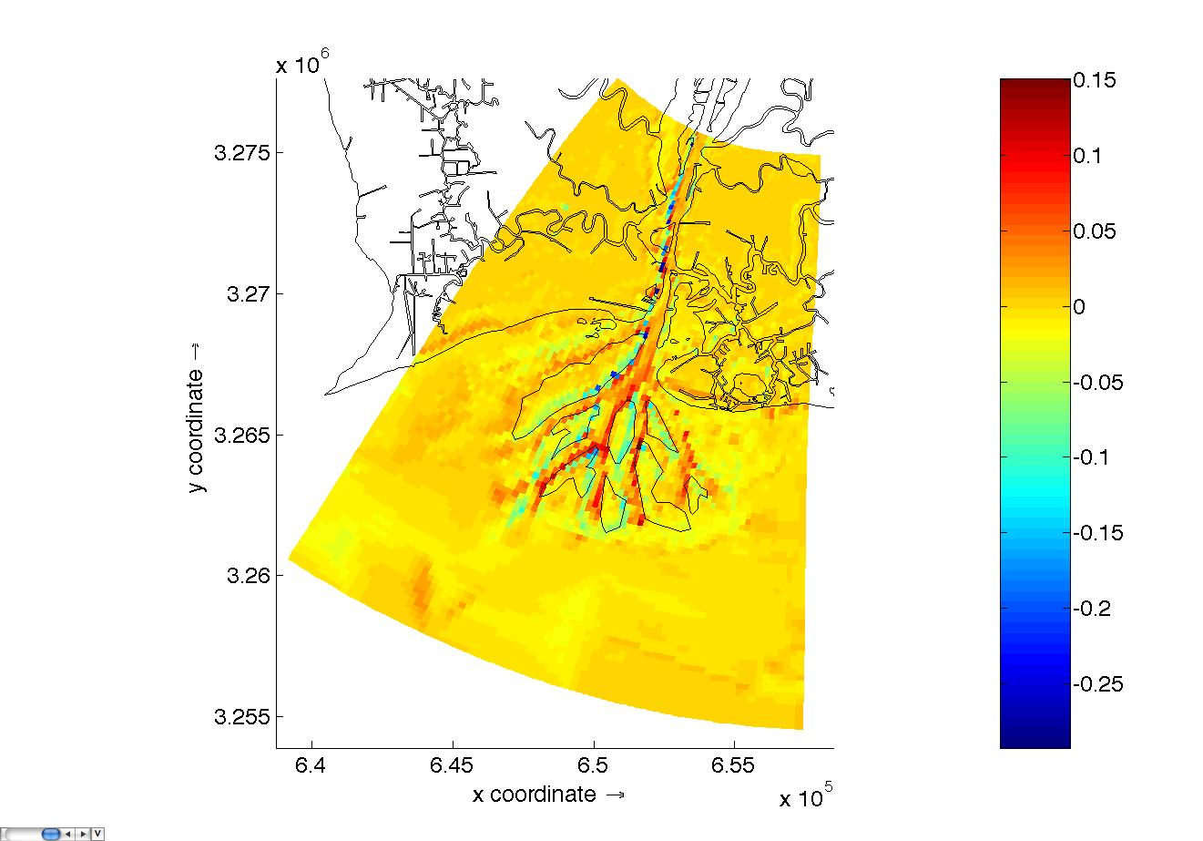
Numerical Scheme: Add a vegetation root routine in Delft3D model
Turf Erosion Module
      Application: Wax Lake Delta during Hurricane Rita in 2005
      Delft3d Flow + SWAN wave model yields wave-current shear stresses
      Figure: Predicted bed elevations at end of storm from original Delft3D - predicted bed elevations from Delft3D with root module
      Conclusion: can now quantify the amount that roots protect vegetated marshes from erosion
elevation difference(m)
Notes:
The cubic box model is developed by Hoffmans (2008) to exploring wave overtopping of clay and grass upon a turf-element. The WIPE model uses this concept, and consider both aggradation erosion and block erosion
Root strength: 2.8~11.2 kN/m²; root tensile strength: 20*10⁶ N/m²
Aggradation erosion happens when wind-wave shear stress is larger than grass-soil aggradation strength; Block erosion happens when hydrodynamic shear stress is able to erode a whole block of soil which is deeper than plant root depth

Slide 31
A New Multidimensional Ecomorphodynamic Model: D3D+
An individual-based community model for predicting fish productivity on an evolving coastal delta
  Team: Paul Venturelli, Manuel Garcia-Quismondo
  Objectives
    develop an individual-based community model to predict fish productivity on an evolving delta
    determine the structural features of a delta that are highly correlated to fish productivity
    develop a mechanism for evaluating alternative restoration scenarios in terms of fish productivity

Slide 32
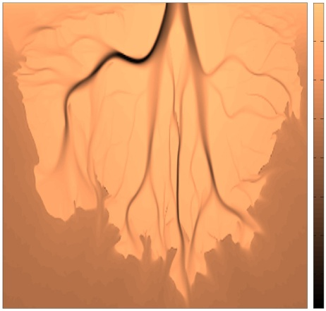
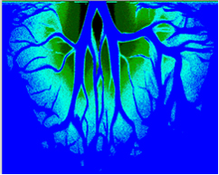
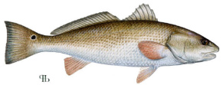




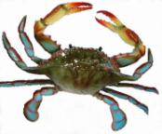






A New Multidimensional Ecomorphodynamic Model: D3D+
An individual-based fish productivity cellular model
Layer 1: bathymetry
1.8 x 10⁶ cells, each 2 x 2 m
DELFT3D output (Edmonds)
Layers 2 and 3: water and vegetation
hourly water levels (from station data)
vegetation (empirically-derived inundation rules)
also temperature
Layer 4: individual-based fish model
400 x 400 m sub-grid
5 species
- Δt = 1 hour
feed and grow
swim about
reproduce
die

Slide 33
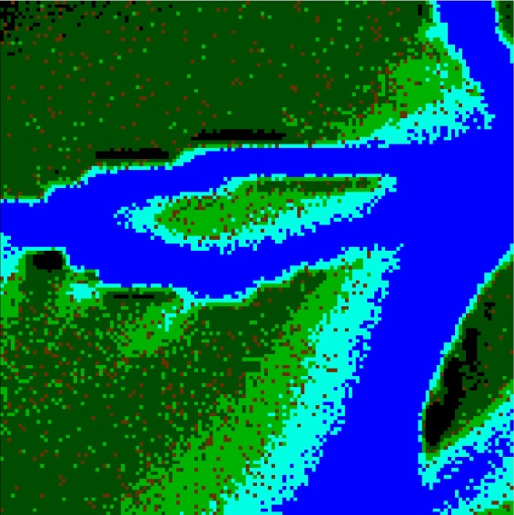


A New Multidimensional Ecomorphodynamic Model: D3D+
An individual-based fish productivity cellular model
  Results: snapshot of biomass distribution showing habitat associations
habitat
open-water species
marsh species

Slide 34
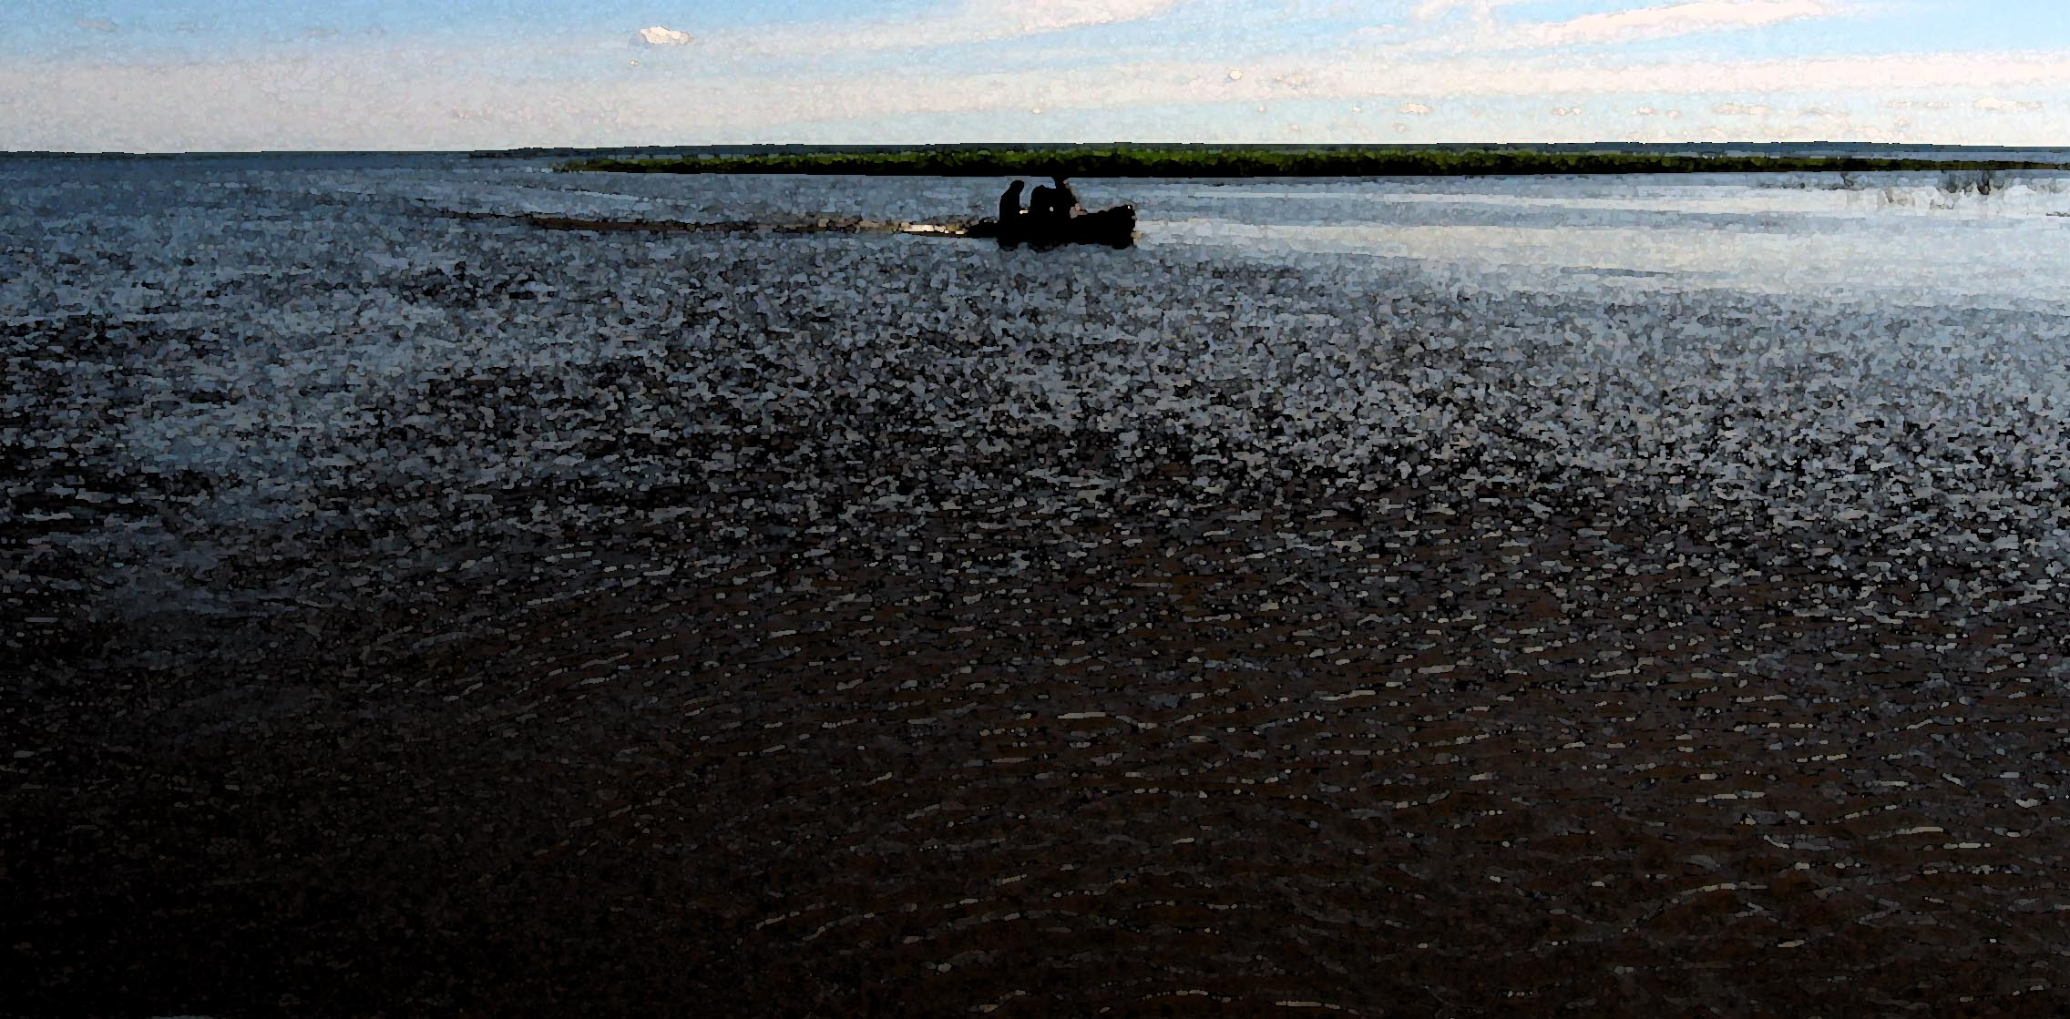

Summary Remarks
As these models reach maturity in the next two years they will be further tested against Wax Lake data and incorporated into the CSDMS architecture and framework
All models will be open source and made freely available via the CSDMS Repository
If you have a specific immediate request please email sling@psu.edu.

