Slide 1
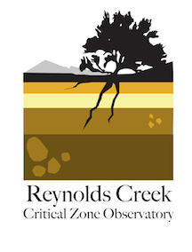
Modeling the Critical Zone: Challenges and opportunities for network science
Lejo Flores
Boise State University
CSDMS Annual Meeting

Slide 2
Takeaways…
Critical Zone Observatories (CZOs): a network of sites to advance fundamental critical zone understanding
Models are critical tools for gaining insight into CZ processes
CZO modeling efforts at present are robust, but fragmented
Opportunities abound… (but maybe not money, yet)

Slide 3
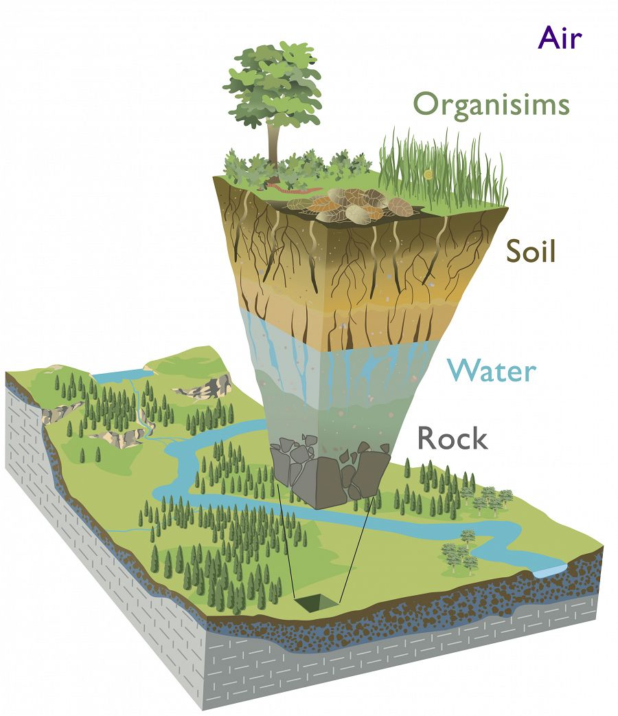
What is the critical zone?
From the bedrock to the top of the canopy
Where rock meets life
Illustration modified from Chorover, J., R. Kretzschmar, F. Garcia-Pichel, and D. L. Sparks. 2007. Soil biogeochemical processes in the critical zone. Elements 3, 321-326. (artwork by R. Kindlimann).

Slide 4

What is the critical zone?
From the bedrock to the top of the canopy
Where rock meets life
Where rock becomes life
Illustration modified from Chorover, J., R. Kretzschmar, F. Garcia-Pichel, and D. L. Sparks. 2007. Soil biogeochemical processes in the critical zone. Elements 3, 321-326. (artwork by R. Kindlimann).

Slide 5
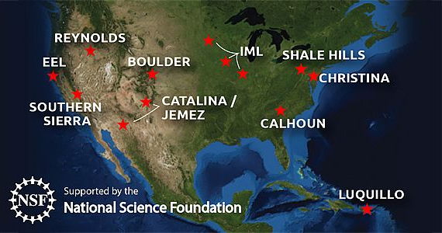
A Network of Sites for CZ Science
10 CZOs established in 2 competitions
Network office (Lou Derry, Tim White), data team (Anthony Aufdenkampe)
International CZOs in Europe, Australia, China
Notes:
Context:
Sites awarded through individual competitive proposals
NSF views these CZOs as a network and expects synergistic research activities across them
This creates challenges of potential scope and mission creep, but opportunities for collaboration – particularly for modelers

Slide 6
The CZ as a central component to ESMs
Bretherton, 1985
Notes:
The item in the middle of the diagram is “soil development.” To contribute the final piece to this integrated Earth System Model we need to be able to answer the question “what will the critical zone look like and how will it behave in 100, 200, 500 years?”

Slide 7
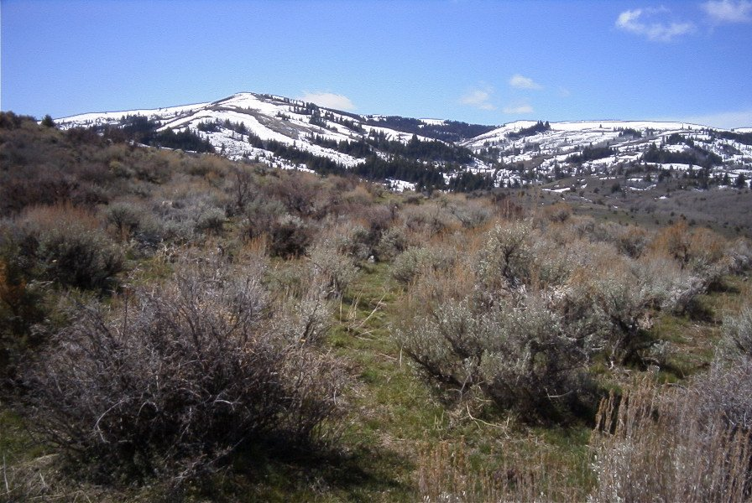
Some specific examples from Reynolds
Background:
  USDA ARS experimental watershed since the 1960s
  Rich historical and contemporary datasets
Key issues:
  Large gradients in elevation, slope, aspect, vegetation cover
  Land management activities (fire, grazing)
  Significant warming in the last 50 years
Charge: Gain insight on how distribution of soil carbon changes under future scenarios of climate change, land management…

Slide 8
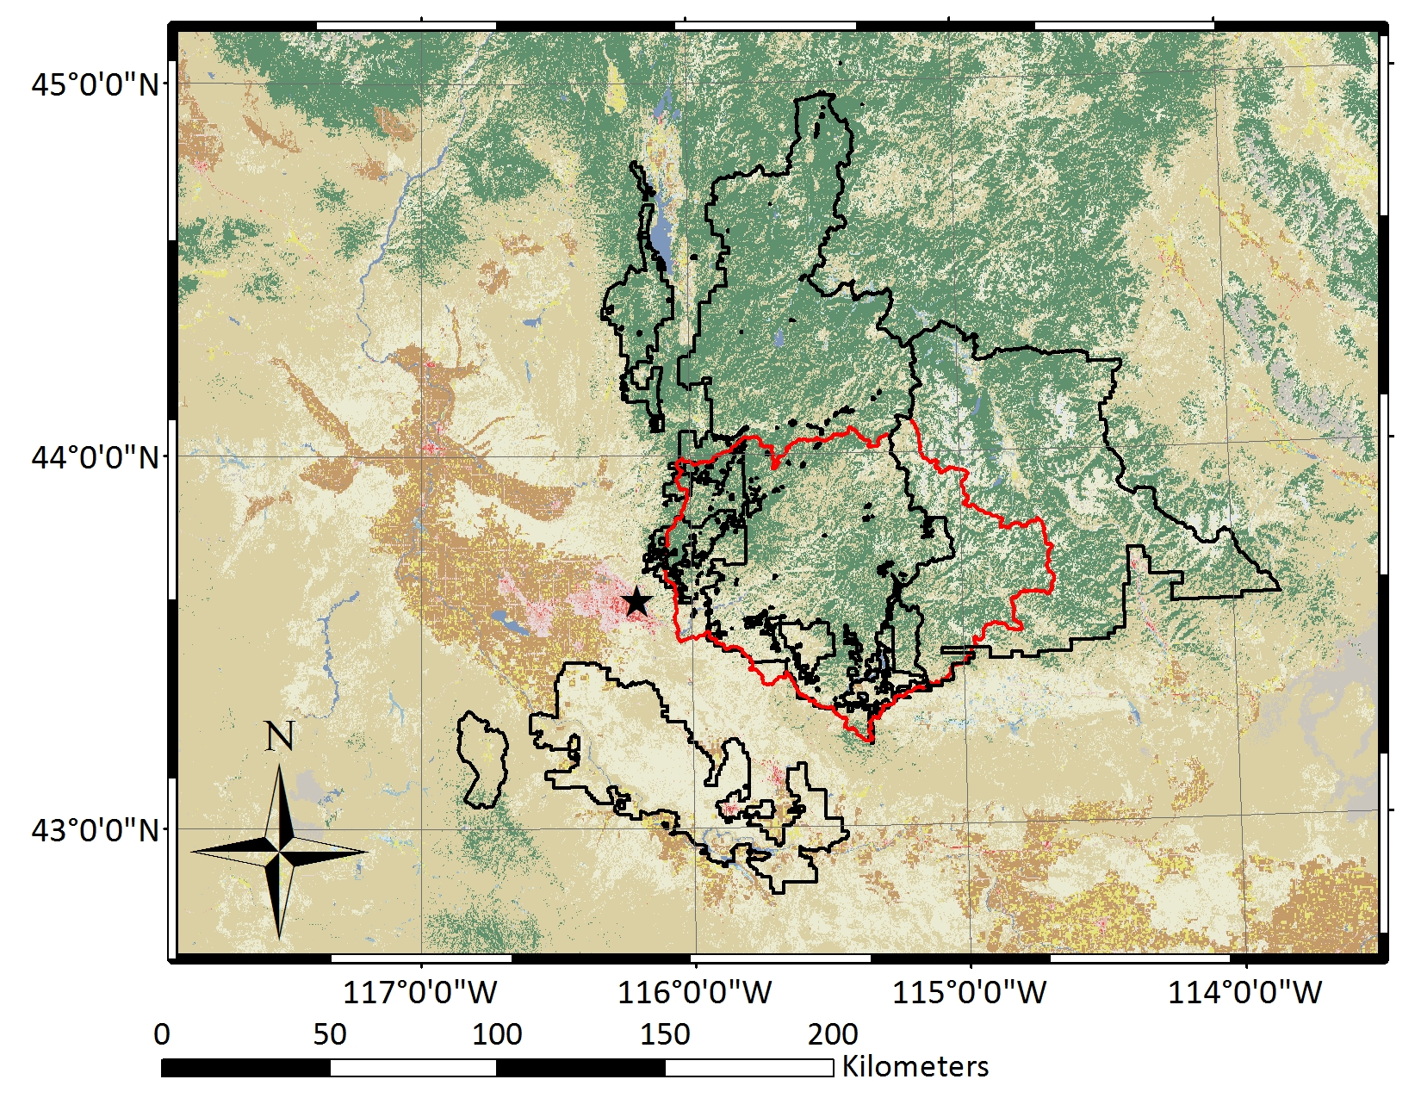
Geographic setting and context
Reynolds is part of a larger platform of cold desert sites for surface dynamics research in the Great Basin

Slide 9
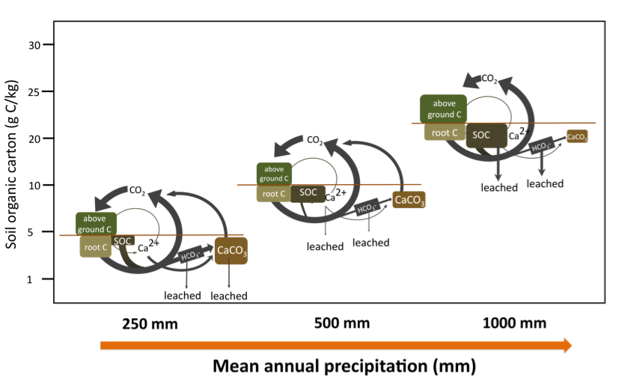
Reynolds Creek: A CZO for soil carbon
Notes:
Understanding how land modification alters the structure and function of the critical zone necessitates a network of observatories that exhibit both within and between site variability in climate, geology, and geomorphic context. Many CZOs also have “extended” platforms with which to integrate regional activities and also act to further tie CZOs together

Slide 10
Modeling framework

Slide 11
WRF: 1 km; ParFlow 30 m

Slide 12
WRF: 9 km; ParFlow 30 m
Resolution of forcings important for BOTH precipitation amount AND phase

Slide 13
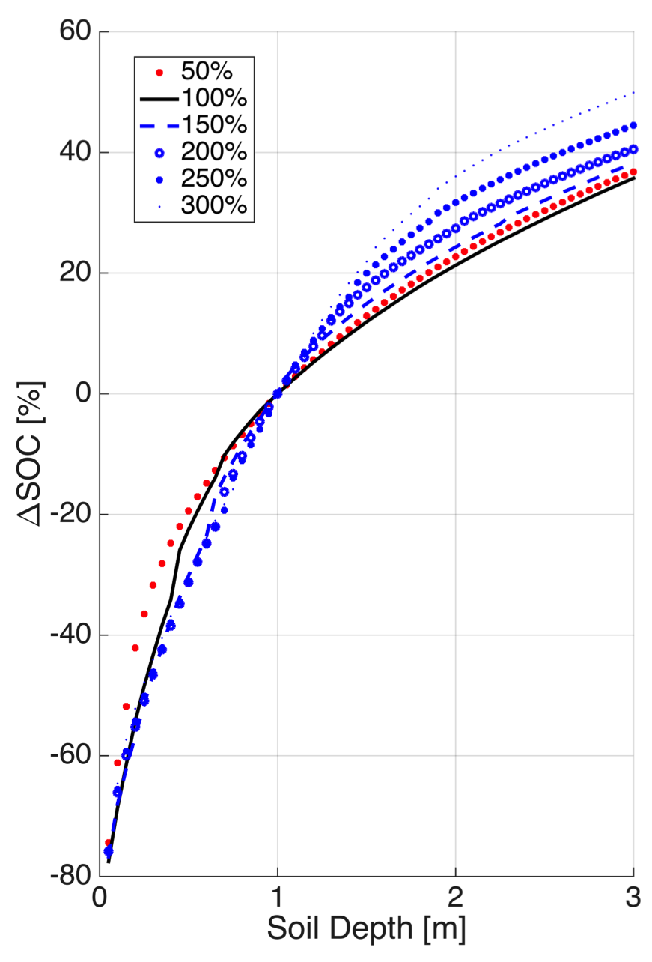
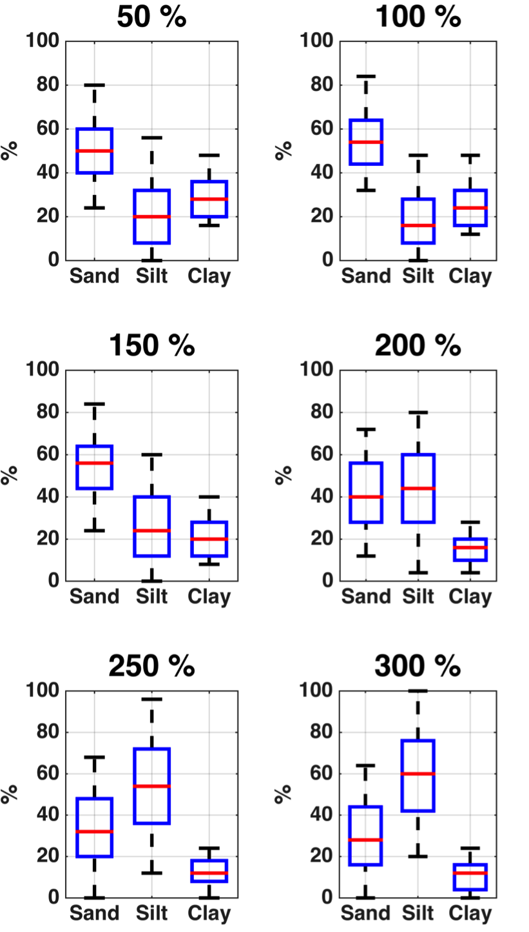
Ramifications for predicting SOC

Slide 14
But it’s not the only story…

Slide 15
Opportunities on the horizon
Integration of models and data to advance understanding of cross-scale interactions
Understanding of hillslope-scale controls on global water, energy, biogeochemical cycling
Explicit representation of human dimensions of disturbance on the critical zone
Modeling frameworks to facilitate network modeling efforts

Slide 16
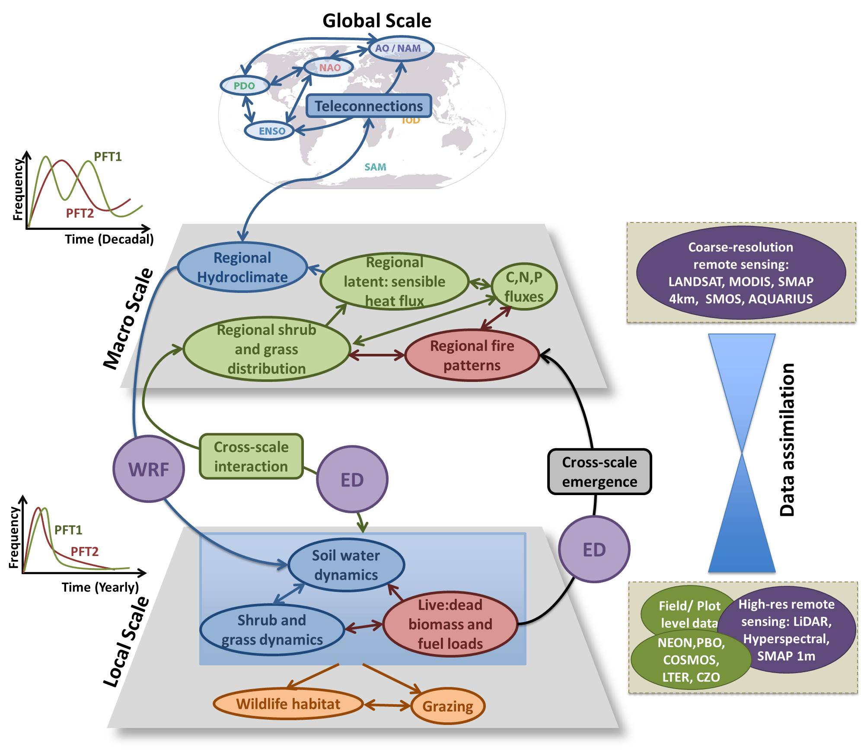
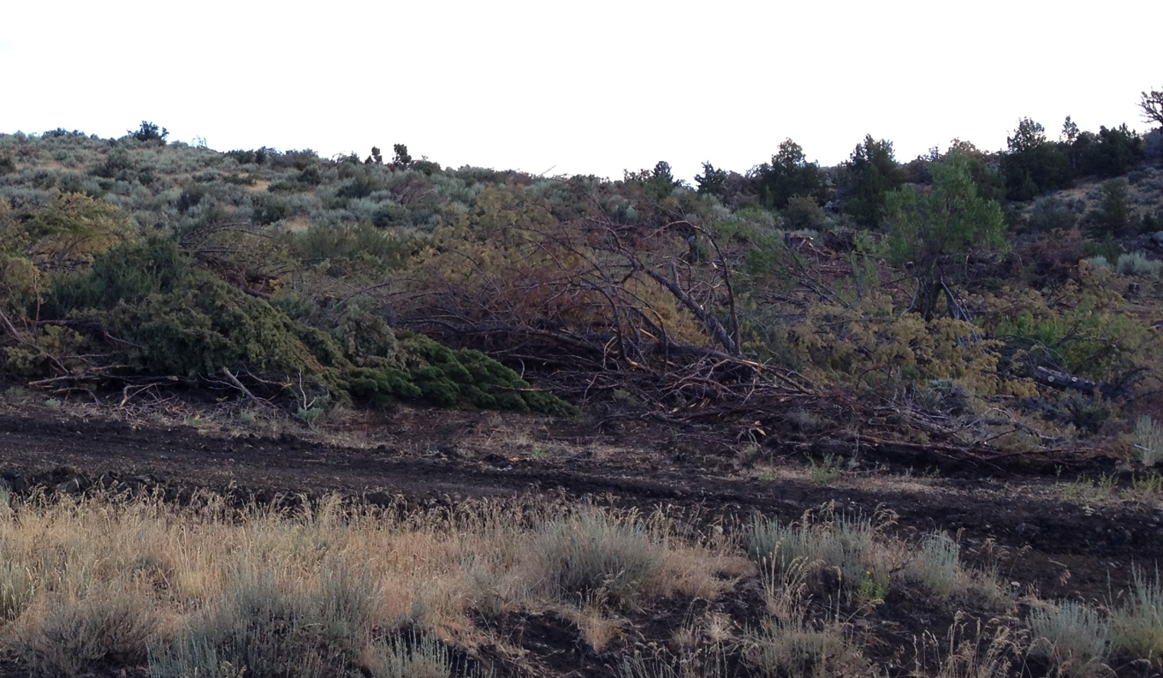
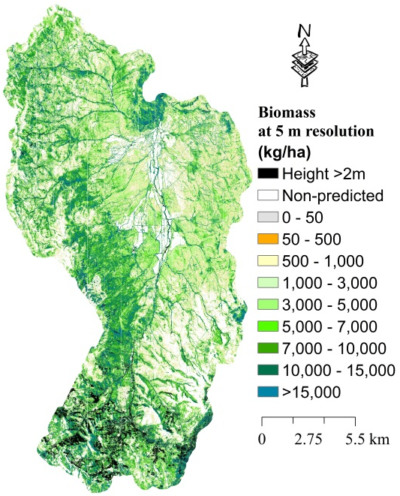
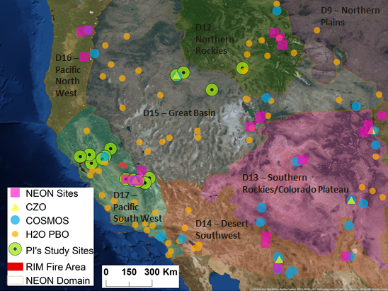
Synthesis between models AND data
Notes:
Not meant to be inclusive of all the data and models available, but demonstrative of a key component… the ability to fuse models and data together.

Slide 17
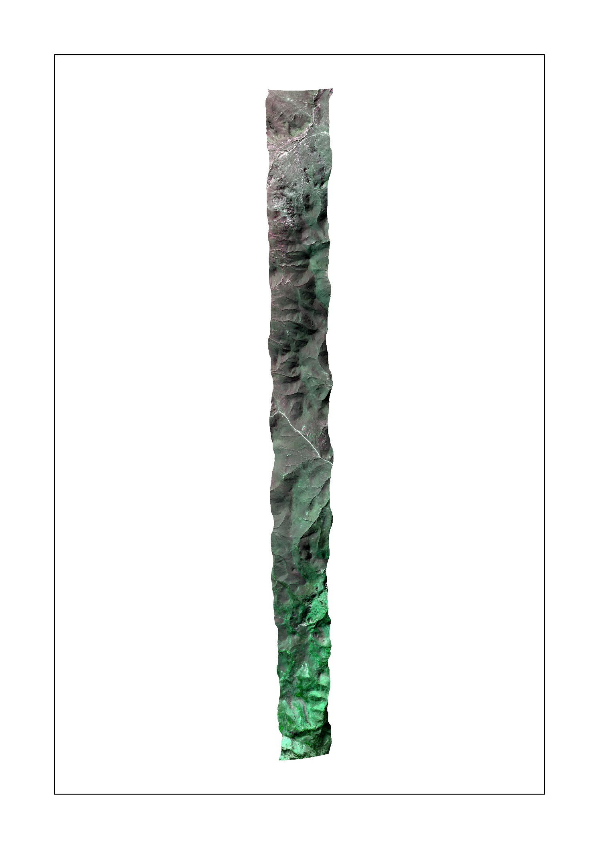
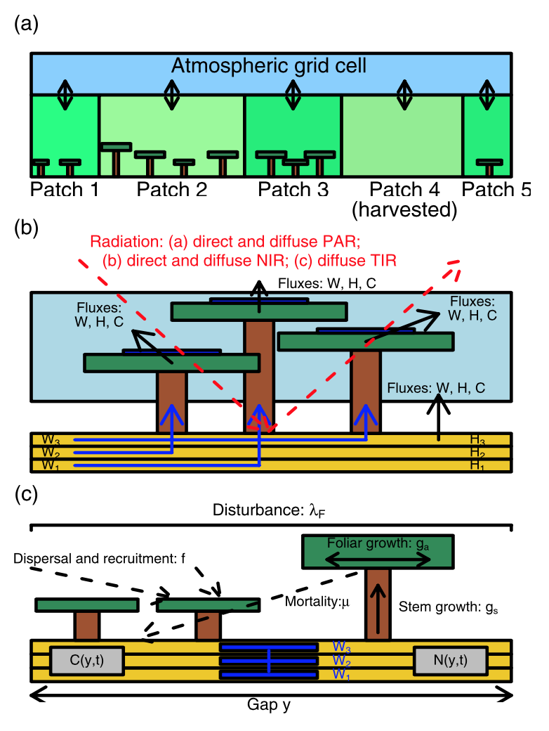
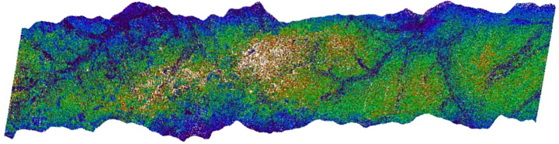
Synthesis between models AND data
AVIRIS-NG acquisition in Reynolds
ASO acquisition in Reynolds
Medvigy, D. et al. 2009

Slide 18
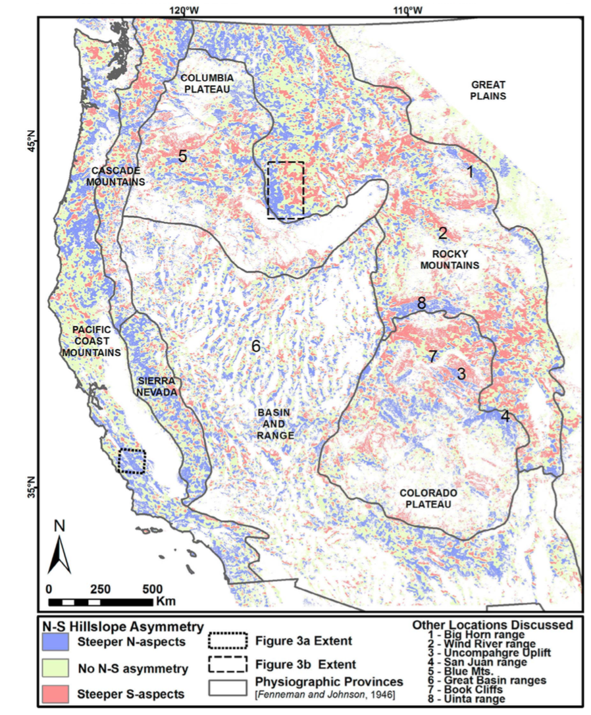
Hillslope-scale controls
M. J. Poulos, J. L. Pierce, A. N. Flores, and S. G. Benner, “Hillslope asymmetry maps reveal widespread, multi-scale organization,” Geophys. Res. Lett., vol. 39, no. 6, p. L06406, Mar. 2012.

Slide 19
Human dimensions of CZ dynamics
Land modification occurs against a climatic, lithologic, and geomorphic template
At Reynolds Creek CZO: Grazing, fire, juniper removal
Notes:
Understanding how land modification alters the structure and function of the critical zone necessitates a network of observatories that exhibit both within and between site variability in climate, geology, and geomorphic context. Many CZOs also have “extended” platforms with which to integrate regional activities and also act to further tie CZOs together

Slide 20
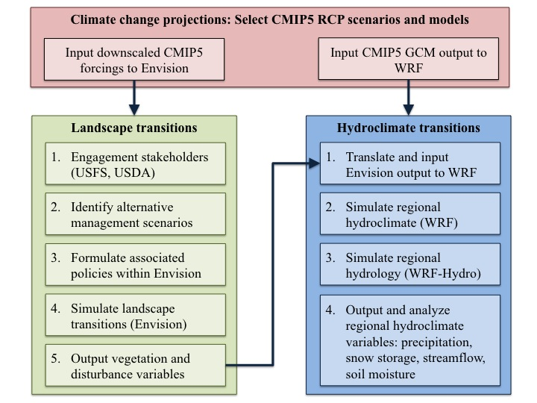
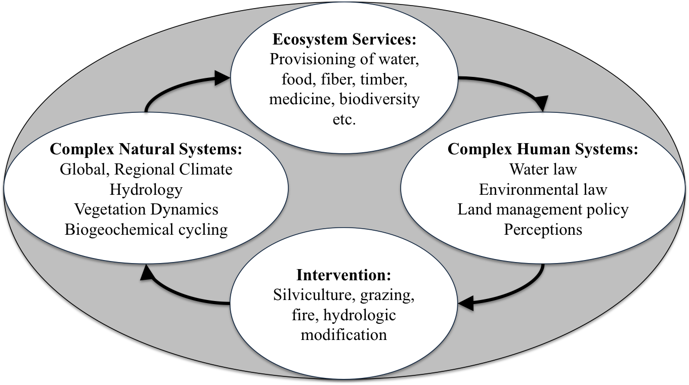
Human dimensions of CZ dynamics
To what degree are social and biophysical systems coupled? And does this coupling need to be explicitly included in models?

Slide 21
Human dimensions pervade CZOs
IML CZO: Completely re-plumbed physical system, nutrient input
Christina River CZO: Nonpoint source nutrient loading, urbanization
Eel River CZO: Illegal marijuana farms and associated hydrologic modification
Reynolds Creek CZO: Mixture of public/private land management activities (grazing, fire, etc.)

Slide 22
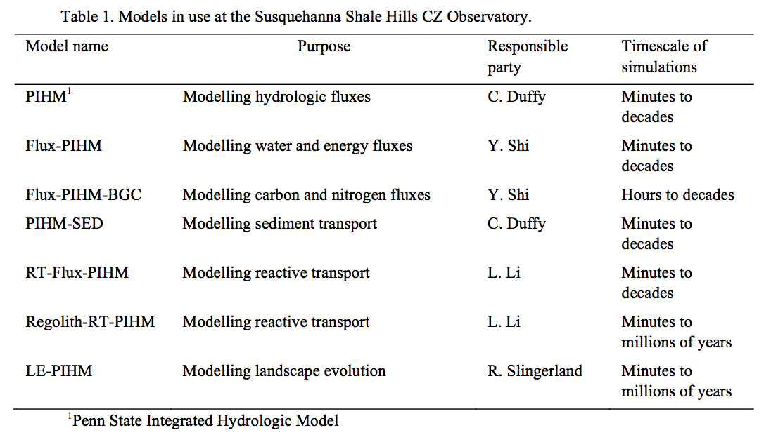
PIHM-X framework
C. Duffy, Y. Shi, K. Davis, R. Slingerland, L. Li, P. L. Sullivan, Y. Goddéris, and S. L. Brantley, “Designing a Suite of Models to Explore Critical Zone Function,” Procedia Earth and Planetary Science, vol. 10, pp. 7–15, 2014.

Slide 23
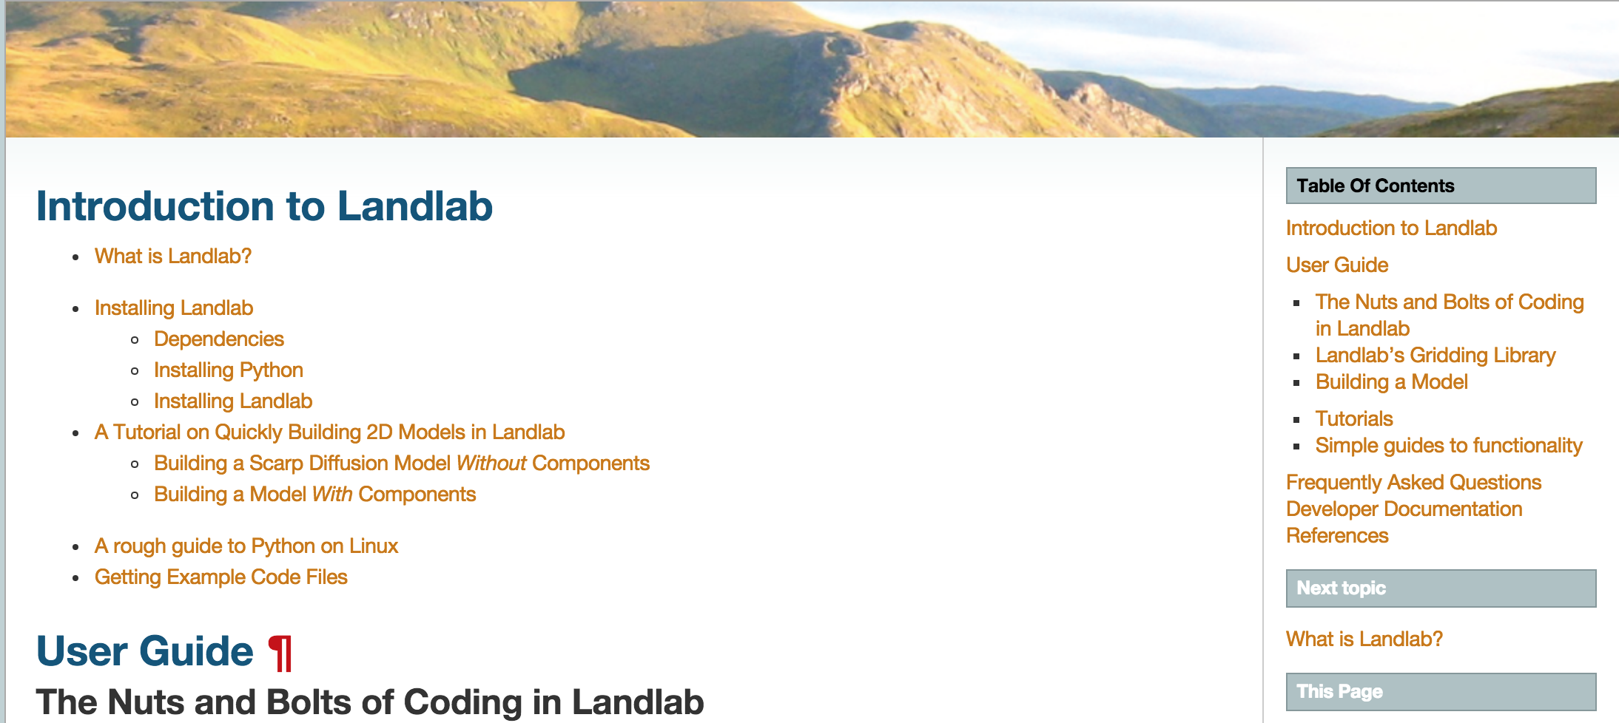
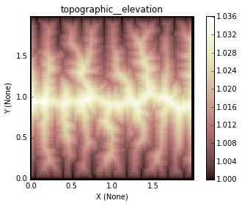
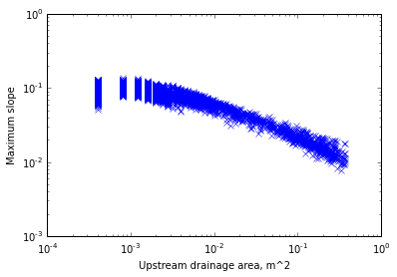
LandLab framework

Slide 24
Some challenges
There is no conceptual model of the CZ that community has developed and agrees upon
Cross CZO communication among modelers limited (who needs another monthly telecon?)
Network CZ modeling efforts were not something originally in scope
A great opportunity for CSDMS and infrastructure to play a facilitative role

Slide 25
Thanks! Questions?
Post script:
Chris Duffy, Scott Peckham, Adrian Harpold and I are working on a workshop proposal
Outcomes:
  A conceptual model of the CZ
  Mapping of ongoing modeling activities to that conceptual model; identification of gaps, synergies, and opportunities
  List of 5-7 science questions to enable network modeling
  White paper, a move towards an RCN proposal

