Slide 1




CSDMS 2011 ANNUAL Meeting
Impact of time and process scales
October 28-30th, Boulder Colorado, USA
Day 1-3: Mornings: keynote addresses on concepts and models
Day 1-3: Hour lunch
Day 1-3: Early Afternoons: Clinics (models, generic)
Day 1-2: Later Afternoons: Posters with Refreshments
Day 3: Later Afternoon: Working Group or FRG meetings
Day 2: Banquet: Poster Award; Lifetime Achievement Award
Day 4: Morning: ExCom Meeting & Steering Committee Meeting

Slide 2
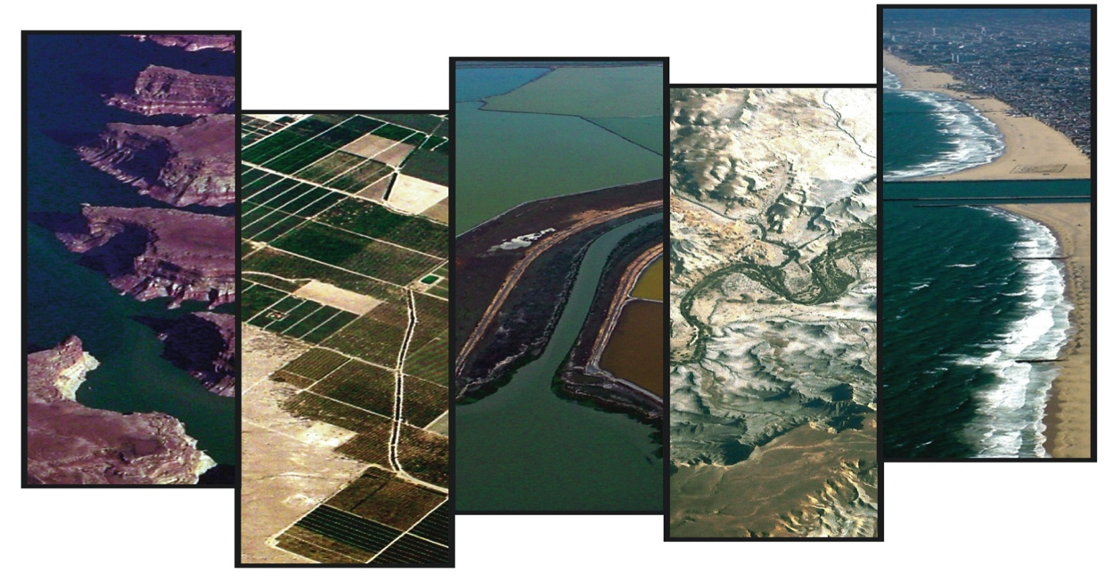
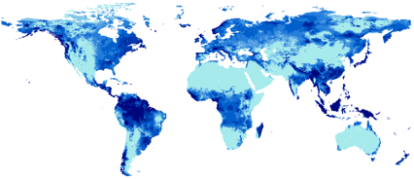
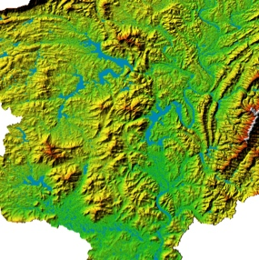
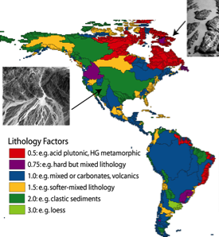
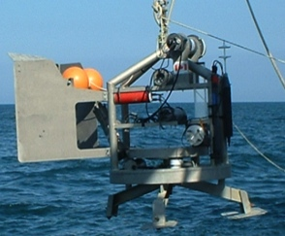

CSDMS Model Domain:
Glacier, Iceberg Models,
Transport or Flux Models,
Ocean & Weather Circulation Models,
Morphodynamics Models,
Landscape or Seascape Evolution Models,
Stratigraphic Models
Boundary
Conditions
CSDMS offers
Development & Support of an International ESD Community
A Model Repository
Model Coupling & Model Reuse Middleware
High Performance Computing Support
Education & Knowledge Products
Model Support Services
  Data Repository
  Modeling Tools
  Model Metadata & Info
Data Integration
in Modeling
Initializations
Observations

Slide 3

CSDMS offers a community of communities to promote the modeling of earth-surface processes
650 Members contribute to 8 Working or Focus Research Groups
Terrestrial | 303
Coastal | 240
Hydrology | 215
Marine | 173
Cyber | 113
EKT | 83
Carbonate | 52
Chesapeake | 39
CSDMS partners with:
>125 U.S. institutions (>95 universities, 12 private corp., 19 gov’t. labs or agencies)
>125 non-US institutions from 40 countries (>85 universities, 3 private, 27 gov’t agencies)
Argentina, Australia, Austria, Bangladesh, Belgium, Bolivia, Brazil, Canada, Chile, China, Cuba, Denmark, France, Germany, Greece, Hungary, India, Indonesia, Ireland, Italy, Japan, Korea, Malaysia, Myanmar, New Zealand, Nigeria, Norway, Peru, Poland, Portugal, Scotland, Singapore, Spain, Sweden, Switzerland, The Netherlands, UK, Uruguay, USA, Venezuela)
month

Slide 4
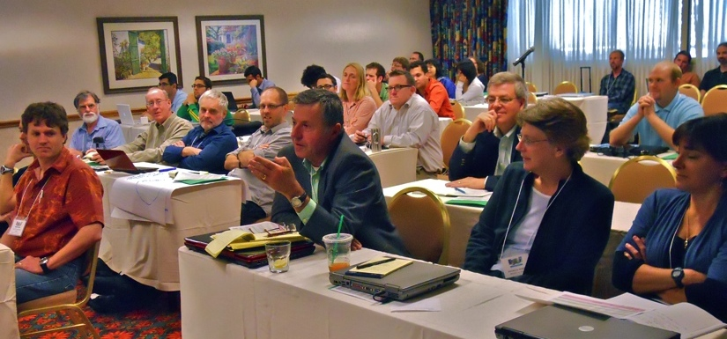
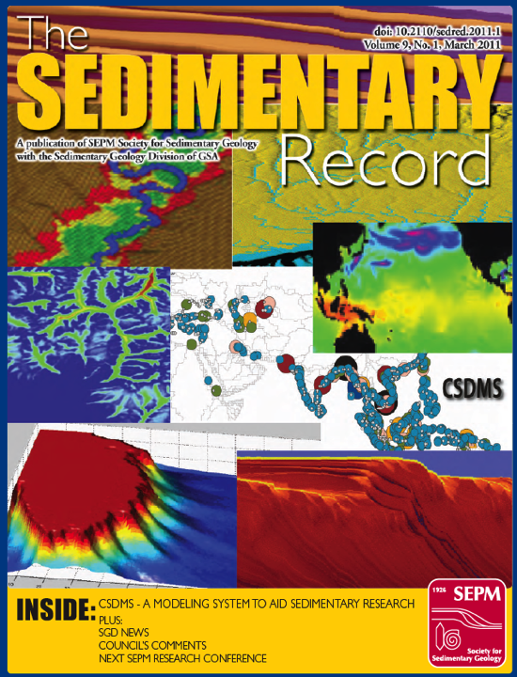
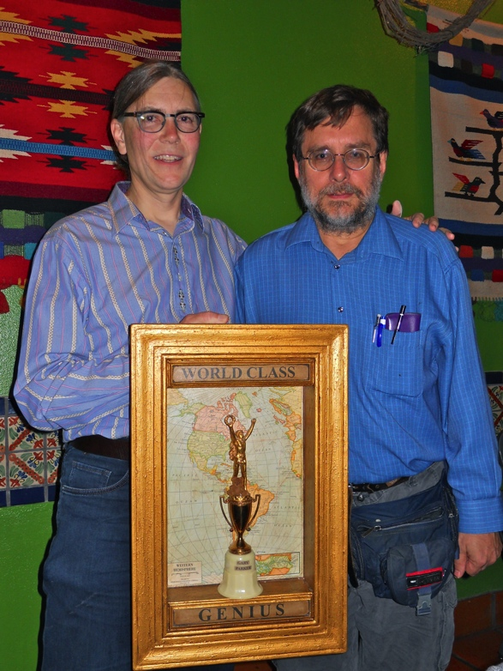
CSDMS Community and Activities (2007-11)
120 workshops, symposia & meetings
11 CSDMS Short Courses (U.S.A., Germany, Korea, New Zealand)
190 IF staff presentations
123 IF staff peer-reviewed journal papers, books and book chapters
Annual Student award
Annual Lifetime Achievement award

Slide 5
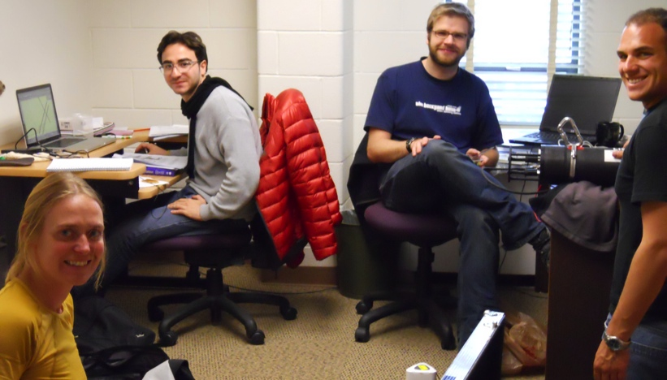
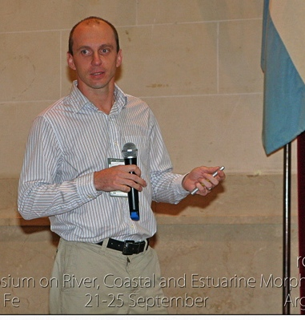
CSDMS Integration Facility (IF) Staff
1. NSF-supported CSDMS Staff 5.6 FTE (2011)
• Exec. Director 2007 0.25 FTE
• Software Architect 2007 0.71 FTE
• Software Engineer 2007 0.92 FTE
• Cyber IF Scientist 2007 0.60 FTE
• EKT Scientist 2009 0.62 FTE
• Computer Scientist 2009 0.90 FTE
• Exec Assist 2007 1.00 FTE
• Accounting Tech 2007 0.36 FTE
• Systems Admin 2007 0.28 FTE
2. Staff support from other sources 2.4 FTE (2011)
3. CSDMS-related support from other sources (2007-2011)
9 grad students
2 undergrad students
3 postdocs
2 senior research scientists
34 CSDMS Visiting Scientists & Students (USA, Canada, Germany, Norway, Australia, Italy, Columbia, China, Netherlands, Belgium)

Slide 6
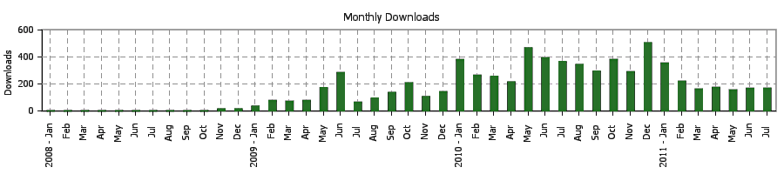
CSDMS Model Repository:
Domain | Models | Tools | Components
All domains | 140 | 47 | 53
Terrestrial | 74 | 44 | 33
Coastal | 42 | 1 | 3
Marine | 28 | 2 | 6
Hydrology | 47 | 34 | 43
Carbonate | 1 | 1 | 0
Climate | 5 | 2 | 0
Repository consists of more than 4 million lines of code, valuable metadata for each model with up-to-date references behind the model and its application.
CSDMS provides the cyber-infrastructure to distribute software tools, models & model data in aid of application and education.
No. of models | No. of downloads
14 | >100
29 | 50-100
29 | 20-49
45 | <20

Slide 7
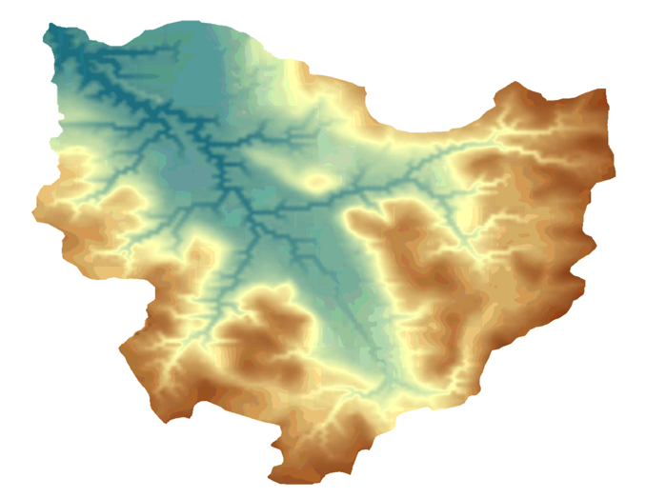
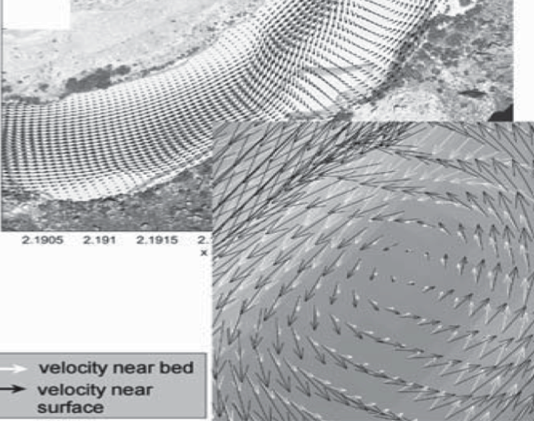
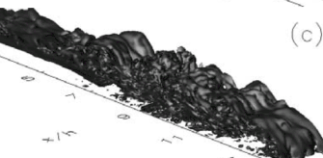

Types of CSDMS models
1) Landscape / Seascape Evolution Models: Geomorphic & stratigraphic models to simulate across geological time and space by incorporating geophysical & geochemical feedbacks including isostasy, eustasy, tectonics, climate change, sea level, post-depositional processes and biology.
2) Morphodynamic Models:
Engineering & sedimentology models to simulate the evolving transport pathway and mobile bed with dynamical feedback to fluid transport processes — may include ecodynamics.
3) Transport / Circulation Models: Oceanographic, hydrologic & sedimentologic models to simulate the material flux along pathways at the even scale (e.g. river floods, ocean storms) using advanced computational fluid dynamics

Slide 8
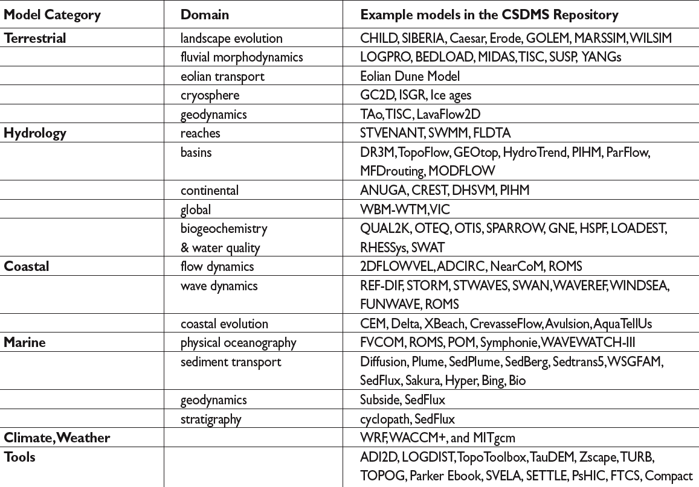
CSDMS Model Examples

Slide 9
CSDMS members may gain access to the CU/USGS experimental supercomputer Beach supporting >150 CSDMS members who have met a use criteria
  Running CSDMS models to advance science
  Developing a model for the CSDMS model repository.
  Developing a data or visualizations systems in support of CSDMS models.
Beach a 8Tflop/s HPCC employs:
88 compute nodes
704 x 3-GHz cores
2-4 GB/core
non-blocking infiniband
~100TB RAID storage.

Slide 10
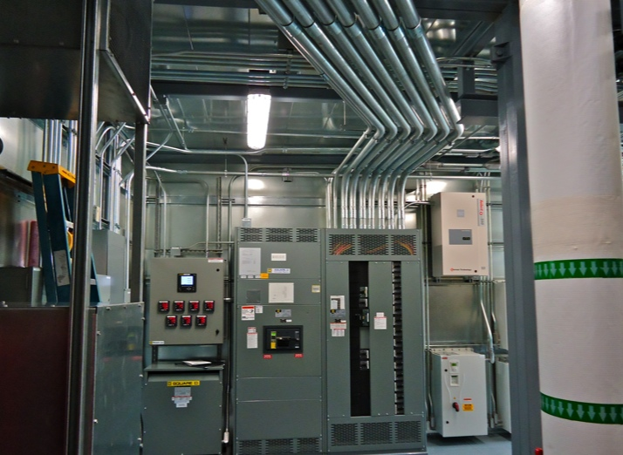
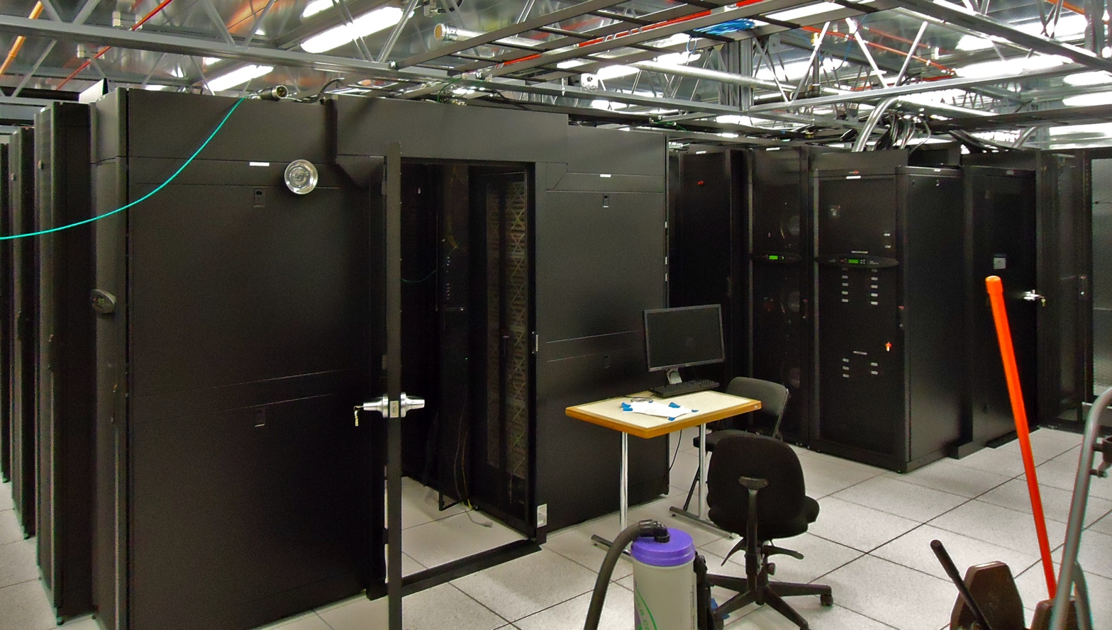
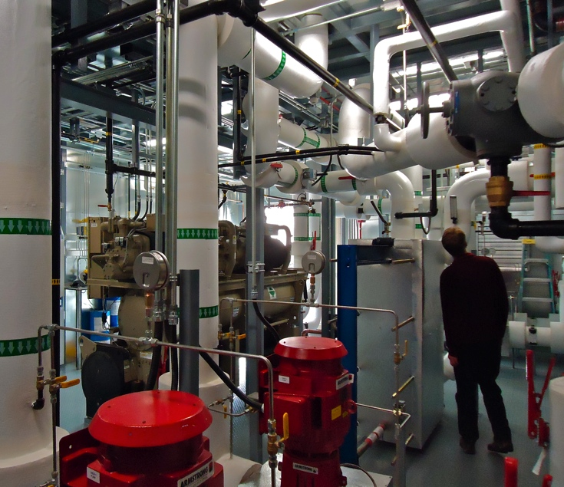
Janus (NSF & CU)
Beach is linked to NSF/CU Janus offering 16,416-cores (>150 Tflop/s) --- 1368 nodes: 6 cores/processor x 2 - 2.8 GHz processors; 2 GB/core; non‐blocking Infiniband; ~1PB of RAID storage.

Slide 11
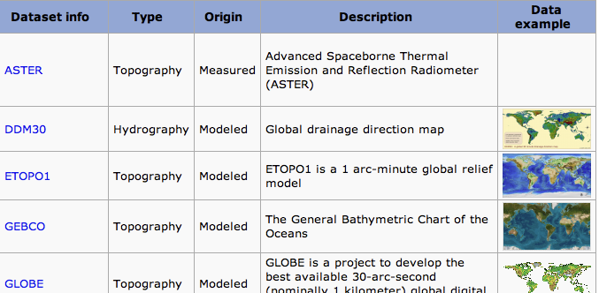
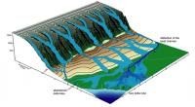
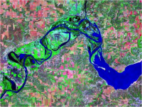
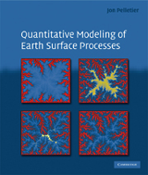
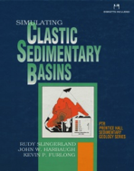
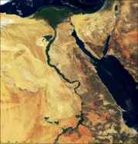
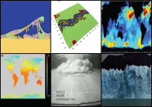
CSDMS Data Repository: includes initialization databases; data tools; test & validation data; benchmarking data
CSDMS Education Repository: Real event & laboratory movies, model animation movies; student labs; modeling short courses, lectures, textbooks, imagery

Slide 12
CSDMS offers instructional material on its YouTube channel — highlighted several times for being in the “Top 50 most viewed channel” in the “non profit” category.

Slide 13
CSDMS instructional videos offer step by step instruction on how to use the various tools and facilities of CSDMS.

Slide 14
CSDMS best-practices or protocols for contributed models
1) Open-source license.
2) Be widely available.
3) Vetted — the software should do what it says it does.
4) In a Babel-supported open-source language (C, C++, Fortran, Java, Python) or have a pathway for conversion.
5) Refactored with an IRF interface [& getter and setter functions].
6) Separate out any user interface
7) Include a metadata file and test I/O files.
8) Be clean and documented using keywords within comment blocks to provide basic metadata for the model and its variables.
9) Provide descriptive state variables with identified units

Slide 15
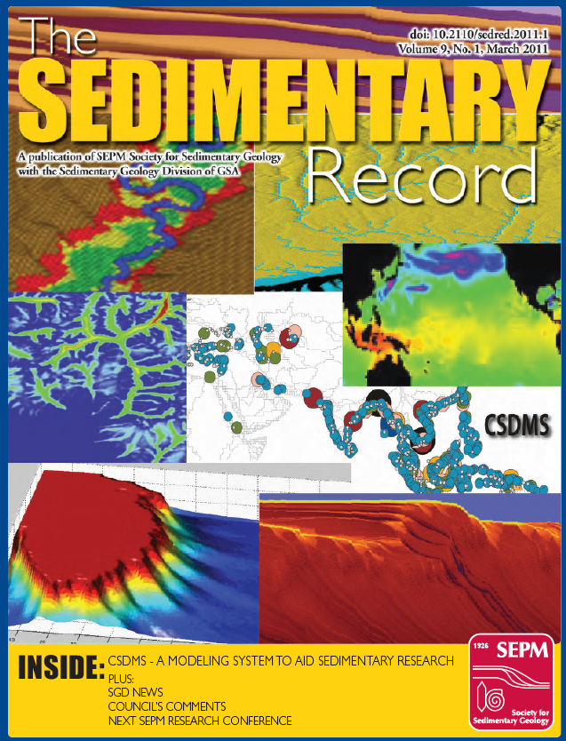
Why Open Source?
Revealing source code provides the scientific hypotheses embodied in a numerical model, and reveals their implementation.
Details are important. A solution to a set of equations can take numerous forms, and each solution has its pyramid of assumptions and limitations.
Code transparency allows for full peer review and replication of results — the foundation of modern science.
Code transparency allows for reuse, often in new and clever ways, and reduces redundancy.

Slide 16
A standalone model is componentized by dividing it into tasks that other components can use
another
component
component
Initial Standalone Model
Initialize
Initialize
Run/Advance
Run/Advance
Finalize
Finalize
Get Value
Get Value
Set Value
Set Value

Slide 17
CSDMS’s component-based modeling Framework:
Supports multiple operating systems (Linux, Mac OS X, Windows)
Language interoperability for contributions in procedural languages (C or Fortran) & object-oriented languages (Java, C++, and Python).
Supports structured & unstructured grids - spatial regridding tool
Offers platform-independent GUIs & graphics.
Uses open-source standards (e.g., CCA, SIDL, OGC, MPI, NetCDF, OpenDAP, XUL) & tools — avoids dependencies on proprietary software (Windows, C#, Matlab).
Supports parallel computation (multiprocessor via MPI standard) and parallel tools (e.g., VisIt, PETSc, ESMF Regrid).
Interoperable or friendly with other coupling frameworks.
Familiarity — developers need not change how they work.

Slide 18
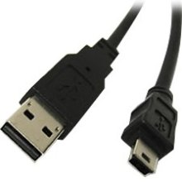
CSDMS pioneering efforts in model coupling have led to a “plug and play" programming environment that increases the performance of contributed models, increases their ease of maintenance and use, their flexibility, stability, portability, and future proofing.
The CSDMS Component Modeling Tool (CMT) offers an environment to link components, provide services accessible to all components, and avoids black box syndrome.
CSDMS Component Library
CCA/CSDMS Services
OpenMI Services
ESMF Services
CSDMS Framework
Model
A
I
R
F
I
R
F
I
R
F
Database
1
CSDMS
Driver
I
R
F
Data
File
1
Model
B
Model
C
I
R
F
I
R
F
I
R
F
Data
File
2
Provide
Port
Use
Port

Slide 19
CSDMS has adopted, integrated and advanced open-source services into its modeling framework — largely invisible to users of the CSDMS Component Modeling Tool (CMT).
CSDMS CMT Services:
language interoperability (C, C++, Java, Python, Fortran) using Babel;
component preparation & project management using Bocca;
low level model coupling within a HPC environment using Ccaffeine;
single-processor spatial regridding (OpenMI Regrid) or multi-processor spatial regridding (ESMF Regrid);
component interface standards advanced by OpenMI;
self-describing scientific data format (NetCDF) & water markup language (WML);
visualization of large data sets within a multiple processor environment (e.g. VisIt);
message passing within the HPC environment using MPI (MPICH) and OpenMP, along with PETSc a Portable, Extensible Toolkit for Scientific Computation.

Slide 21
CSDMS ‘help system’ avoids black-box syndrome

Slide 22
CSDMS members can express which model they want the Integration staff to make into a component --- each member only receives one vote per model

Slide 23

CSDMS componentizing activities are made transparent through web available road maps

Slide 24
CSDMS carries out its activities on a limited budget compared to other experimental or computational programs
5 yr budgets (in $M)
The latest World Economic Forum report ranks the U.S. 51st in science and math education; 6% of U.S. degrees are in engineering compared to 20% in Japan and 16% in Germany.

Slide 25
Future CSDMS Priorities:
CSDMS 2.0: Expanding our Reach — multiple platforms; better HPCC model capability, HPCC code training; advanced GIS support
Coupling physical, biological & human processes: FRGs in geodynamics & CIG? Ecosystems & GRASS? Biogeochemistry & CZO? Polar world? ESM & IAM?
Landscape into Rock Initiative — deep time and space support
Global Environmental Change modeling: for sustainability science support including an International Year of Deltas
Modeling for operational needs: 1) coupling NASA products with CSDMS models; 2) coupling CSDMS models for BOEM; 3) CCMP support
CSDMS Model Benchmarking & Model Inter-comparison
More direct linkage of models to field work/programs — e.g. NSF Delta FESD

Slide 26
CSDMS 2011 ANNUAL Meeting
Impact of time and process scales
October 28-30th, Boulder Colorado, USA
Day 1-3: Mornings: keynote addresses on concepts and models
Day 1-3: Hour lunch
Day 1-3: Early Afternoons: Clinics (models, generic)
Day 1-2: Later Afternoons: Posters with Refreshments
Day 3: Later Afternoon: Working Group or FRG meetings
Day 2: Banquet: Poster Award; Lifetime Achievement Award
Day 4: Morning: ExCom Meeting & Steering Committee Meeting

