Slide 1
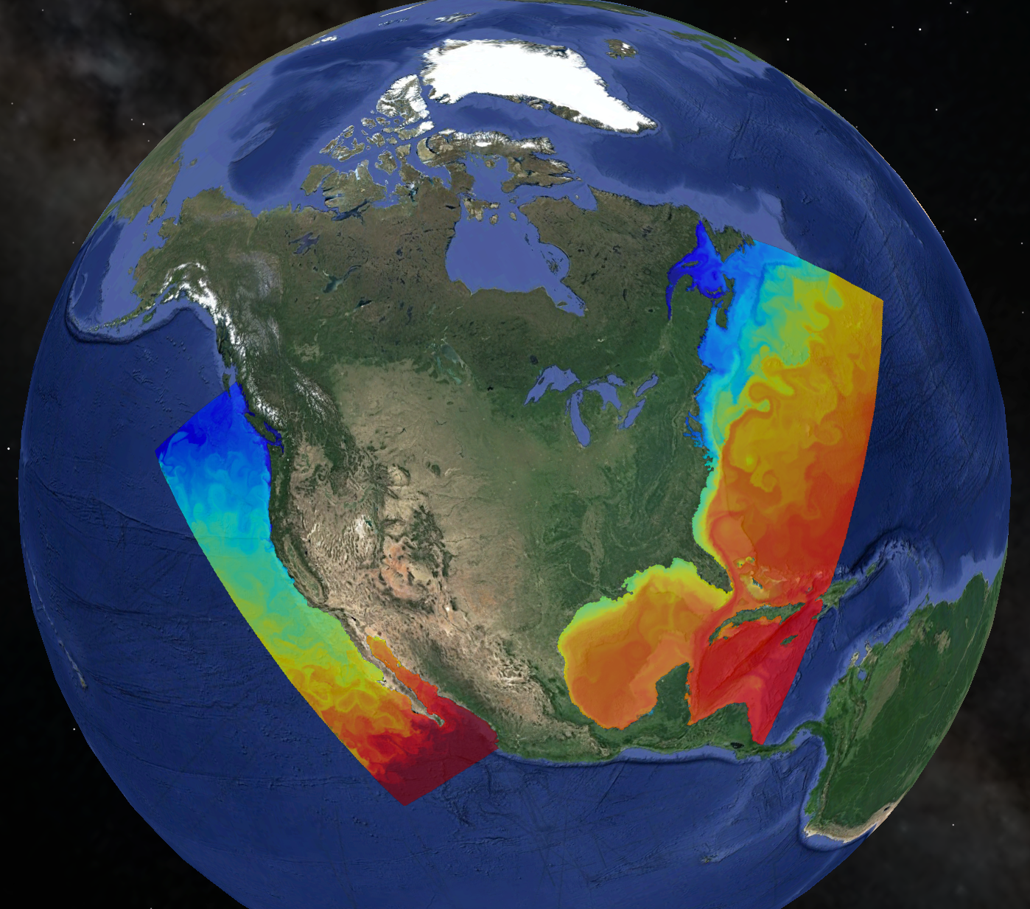
Regional and Global Ramifications of Boundary Current Upwelling
Enrique Curchitser
Department of Environmental Sciences
Rutgers University
Justin Small, Brian Kaufman, Bill Large
NCAR
Kate Hedstrom
U. Alaska Fairbanks
Michael Alexander
NOAA-ESRL

Slide 2
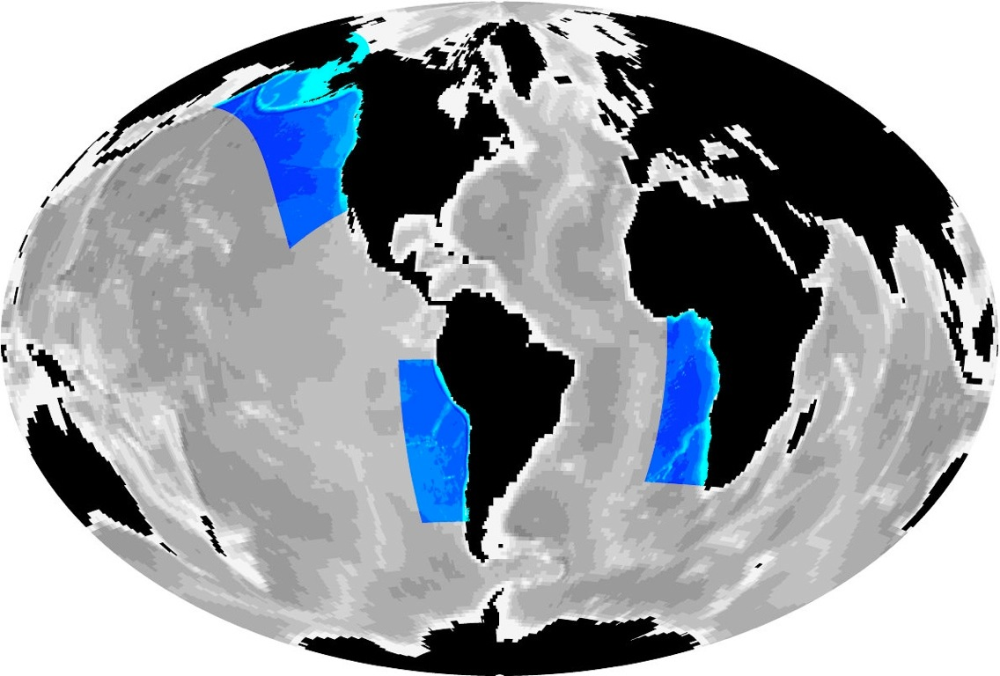
Outline
Background and motivation
Methods: A global climate model with a multi-scale ocean
Implementations:
The California Current System
The Benguela Current
Summary remarks

Slide 3
Why do we want to “downscale”?
Regional impacts:
Improved predictions of changes in statistics of regional climate, especially extreme events, are required to assess impacts and adaptation
Need to improve representation of weather and climate link
Climate model biases:
Working hypothesis is that the internal dynamics of the system are more accurately represented at higher resolution
Ecosystems:
What resolution is needed beyond physics-only considerations?

Slide 4
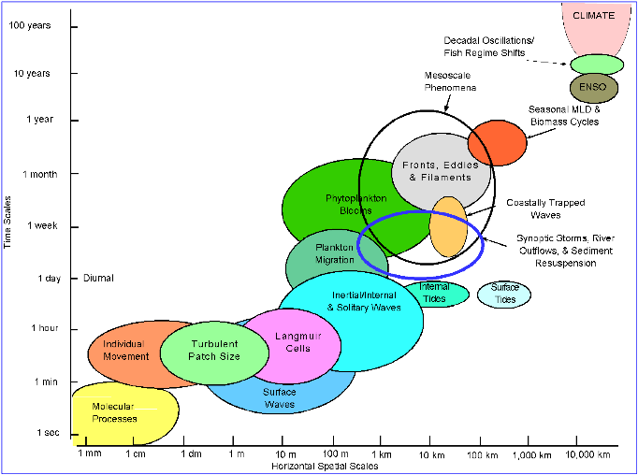
Why do we need regional models?
Temporal and spatial scales of ocean phenomena
Upscaling
Downscaling
Dickey, 1991, 2003

Slide 5
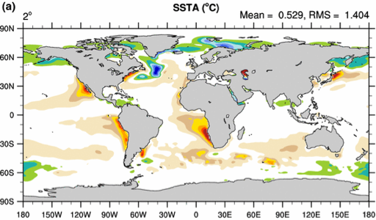

Climate model biases
(Model minus Observations of mean SST)
(CCSM 3.5 - WOA98)
Model-
observations
(mean SST)
Too cold
Too warm
“Models still show significant errors ... The ultimate
source of most is that many important small-scale
processes are not represented explicitly in models …”
Randal et al., 2007.

Slide 6

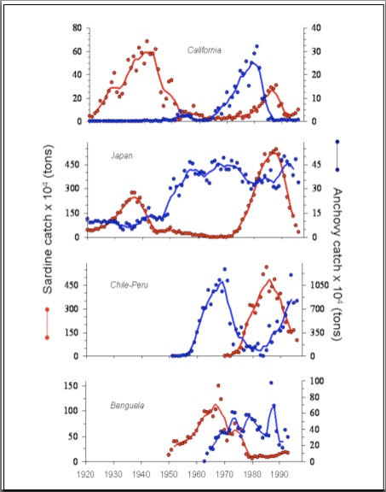
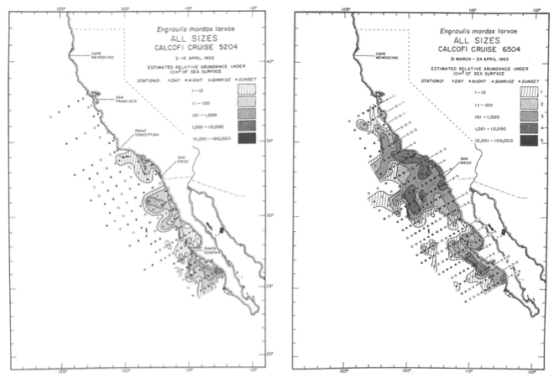
Ecosystems: Sardine and Anchovy
Temporal and Spatial Variability
McCall, 1990
Time series of sardine (red) and anchovy (blue) landings since the 1920’s. Data from
Schwartzlose et al. (1999).

Slide 7
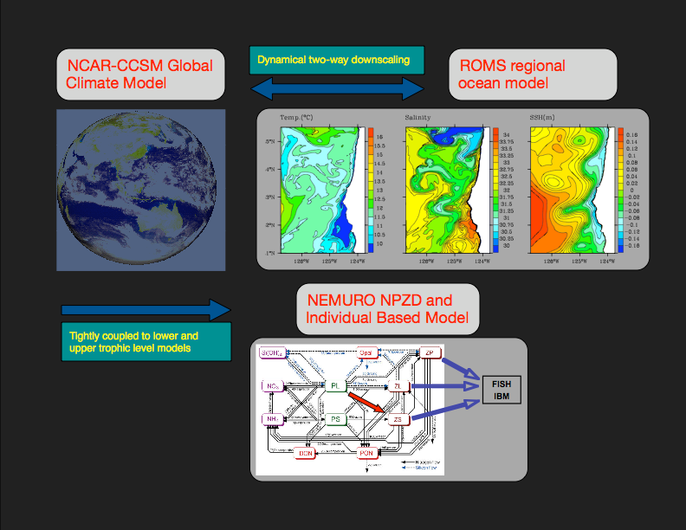
Our approach: Tightly coupled climate-to-fishers model
Growth
Reproduction
Mortality
Movement
Fishing fleet

Slide 8

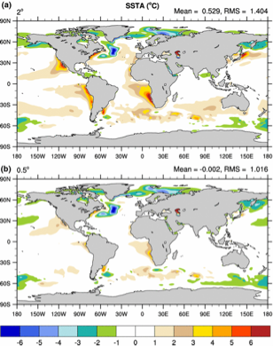
Aside: Approaches to address the bias problem
Higher resolution in the atmosphere--better upwelling favorable winds (Gent et al., 2010)
Improvements to boundary layer physics (Park and Bretherton, 2009)
Improved resolution and physics in ocean--better upwelling (Curchitser et al. 2011; Curchitser et al. In prep., Small et al., 2015)

Slide 9
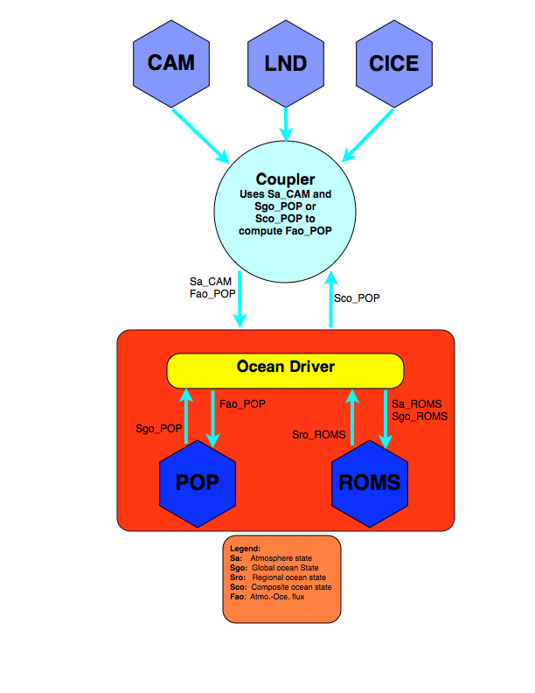
Methods: NCAR-CESM
POP

Slide 10
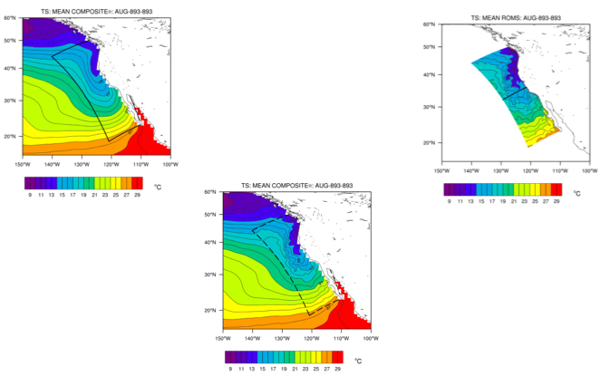
Methods: Embedding a high-resolution ocean (ROMS) within NCAR-CESM

Slide 11
Numerical experiments (typical)
Baseline: 150 year run of CESM1, branched from 1870 control run.
Composite: 150 year run of CESM1-ROMS, same initial conditions.
Ocean:
POP ~1-degree, 40 Z-levels
ROMS 7 km, 50 stretched sigma levels
Atmosphere: CAM-5 1º, 0.5º
Land: CLM 3
Sea ice: CICE
Analysis: 140 years of monthly means.
Statistics: T-test for means, F-test for variability

Slide 12
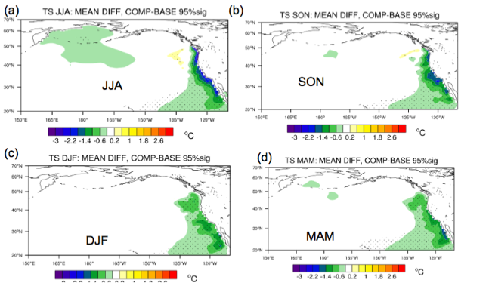
California Current: Local SST response

Slide 13
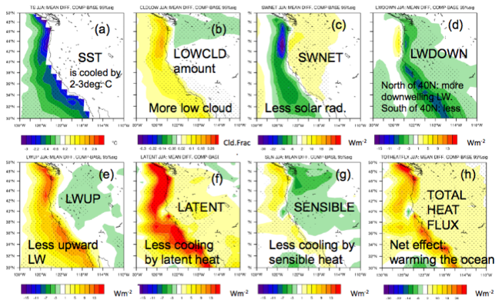
California Current: Surface fluxes

Slide 14
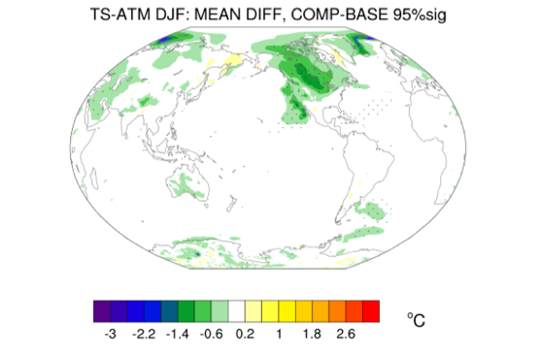
Global response: Surface air temperature

Slide 15
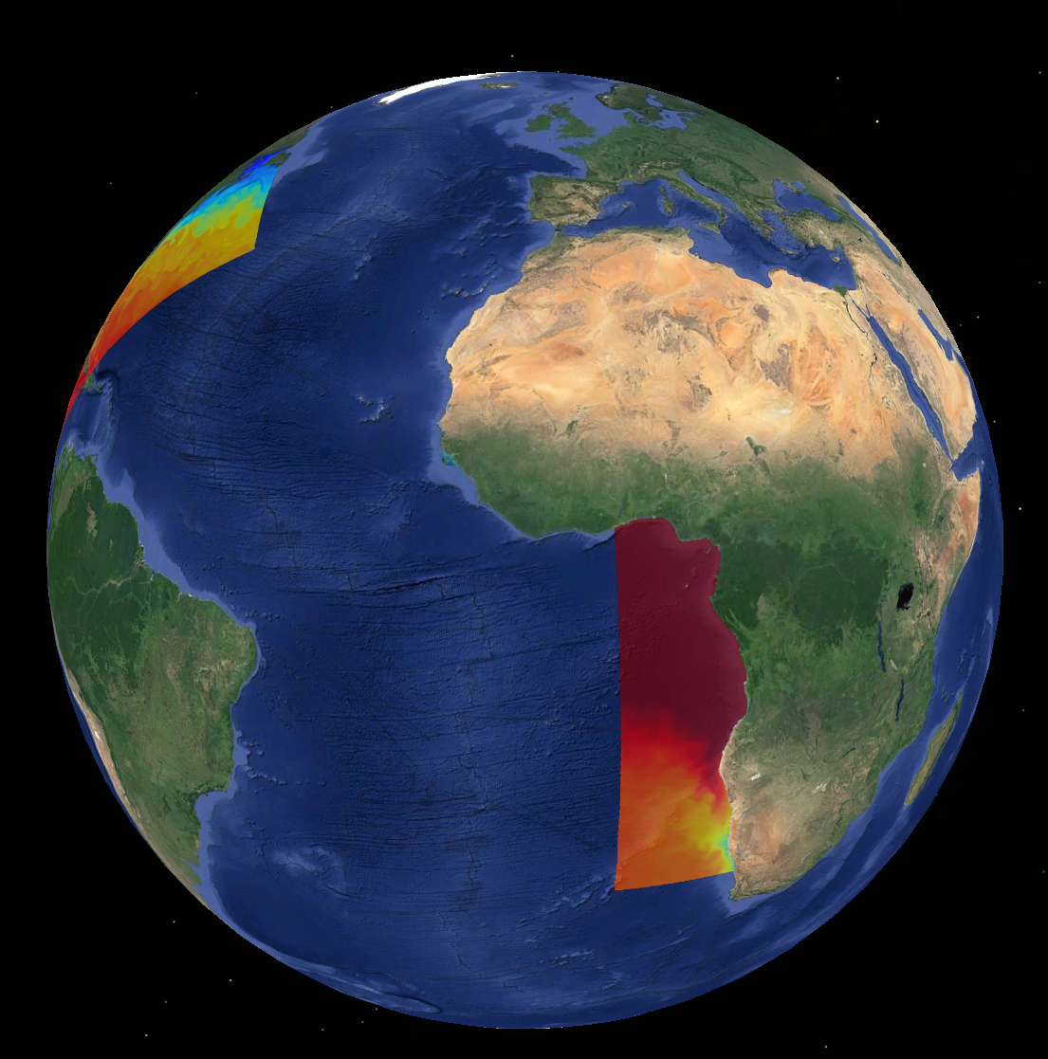
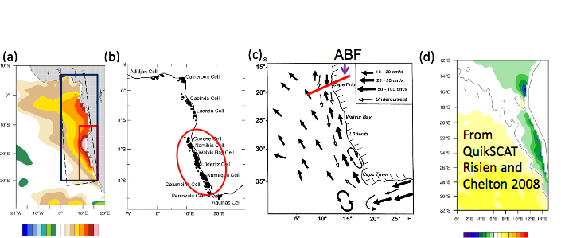
The Benguela Current System

Slide 16
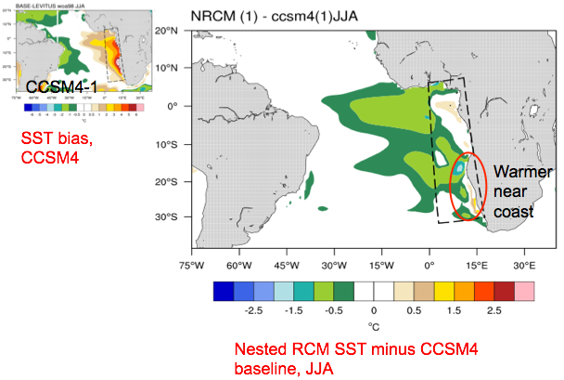
The Benguela Current System

Slide 17
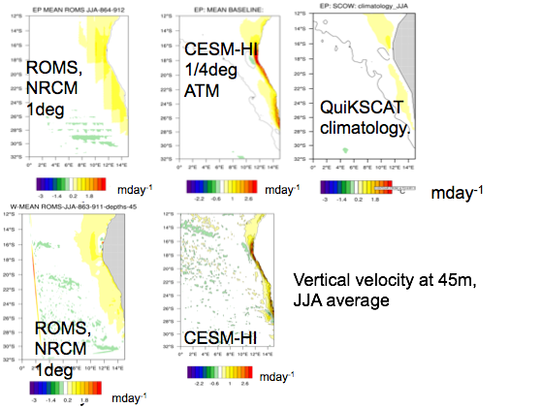
The Benguela Current System

Slide 18
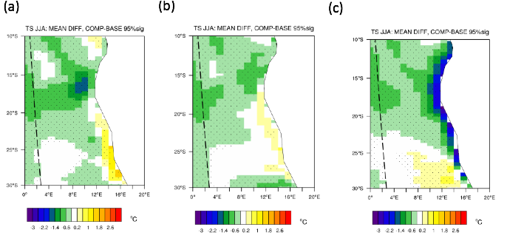
The Benguela Current System:
Shifted winds experiment
NRCM-1º
NRCM-0.5º
NRCM-Shifted winds

Slide 19
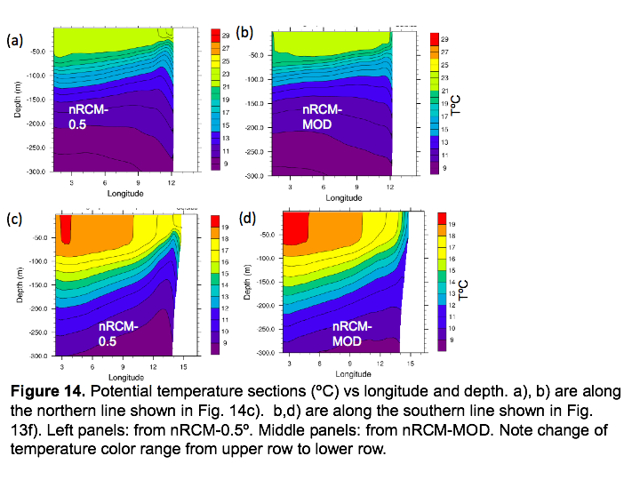
Temperature cross sections
SST Bias

Slide 20
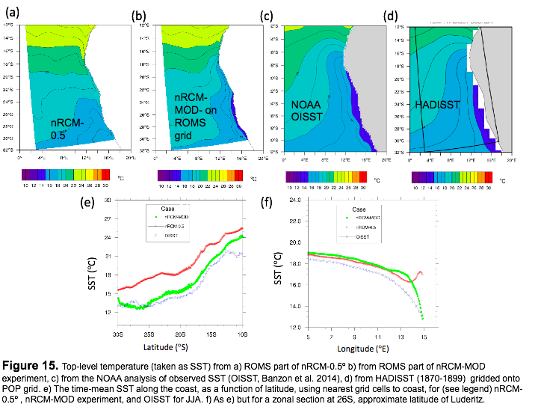
Benguela: Comparing to observations
SST Bias

Slide 21
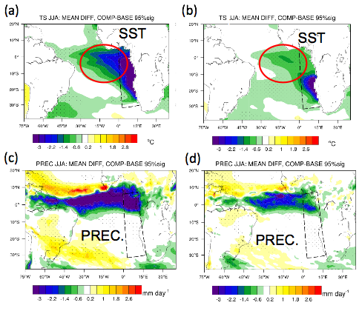
The Benguela Current System: Remote effects— Restoring Experiments

Slide 22
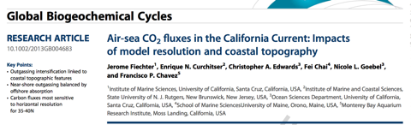
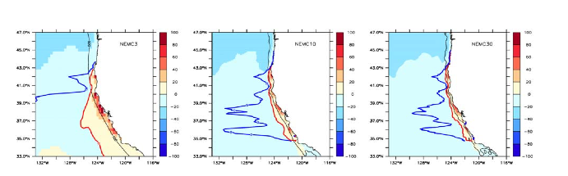
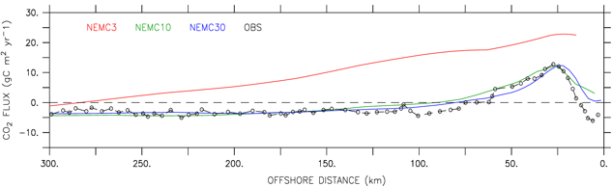
Back to the California Current:
Biogeochemical considerations
CO2 outgassing limit
CO2 equilibrium limit

Slide 23
Final remarks
Upwelling is a coupled phenomena with multiple scales interacting
Air-sea feedbacks modulate the response
Clouds and coastal atmospheric conditions are important
Feedbacks can extend well beyond upwelling region
Dynamics of upwelling are different in the various regions (and within a region)
Ocean dynamics are important and resolution is not the only “fix”
Nesting permits isolating impacts of a given region
Ongoing work: Western boundary currents, ensemble projections
Don’t wait for global high-resolution!

