Slide 1
Creating sediment input into Landlab Network Sediment Transporter component
Community Surface Dynamics Modeling System
ESPIn 2021 Project Team Presentations
10/29/2021
Muneer Ahmmad (VT), Se Jong Cho (USGS), Mel Guirro (Durham Univ), Marius Huber (Univ de Lorraine)
With
Help from Shelby Ahrendt (Univ. of Washington)

Slide 2
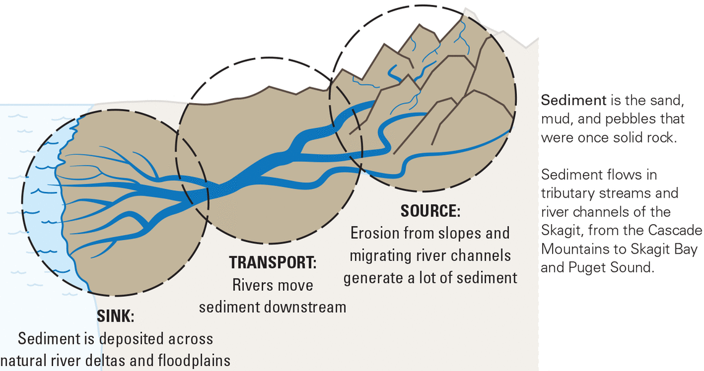
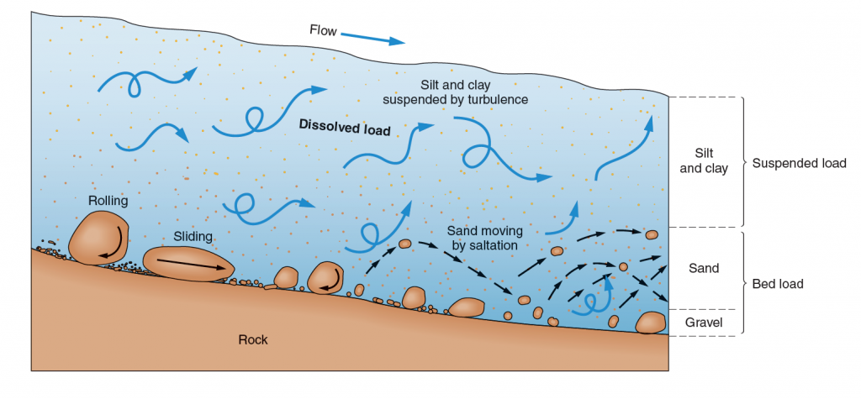
Motivation
One of the most complex and challenging problems in geomorphology is understanding how sediment moves through river system (Wolman 1977).
Storage and residence time
Particle size, channel &FP morphology, energy of alluvial system
Channel morphology, stability, aquatic habitat

Slide 3
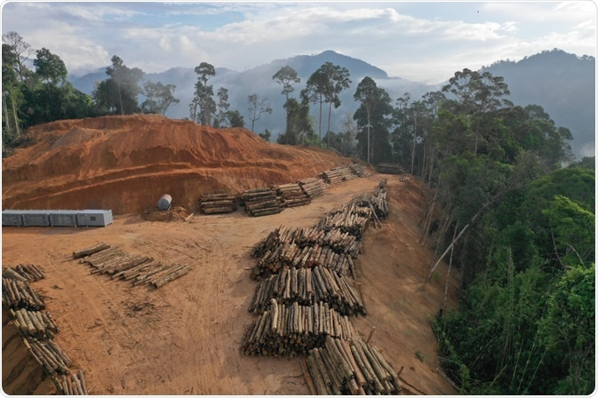
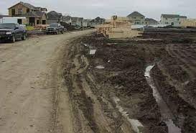
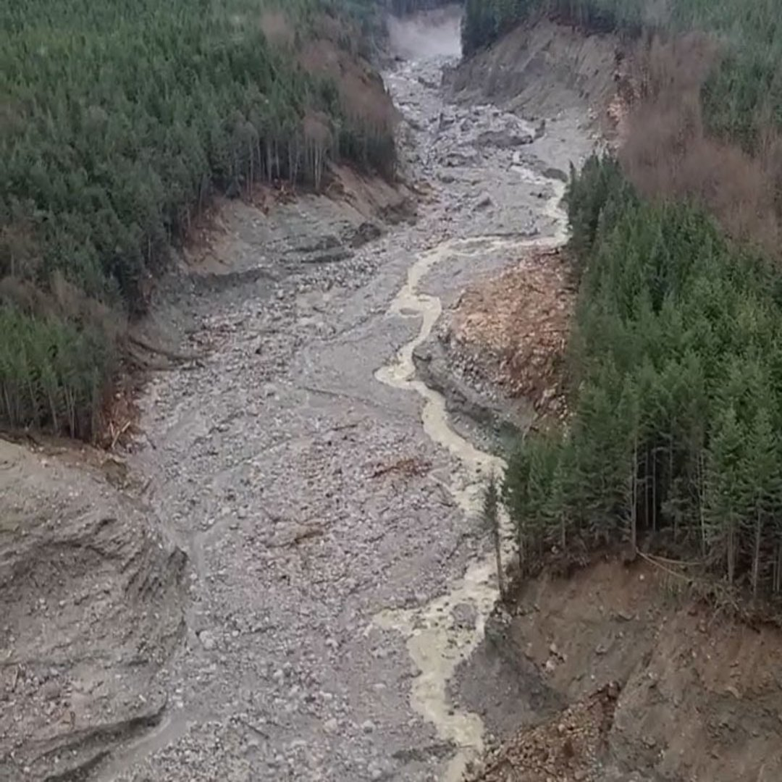
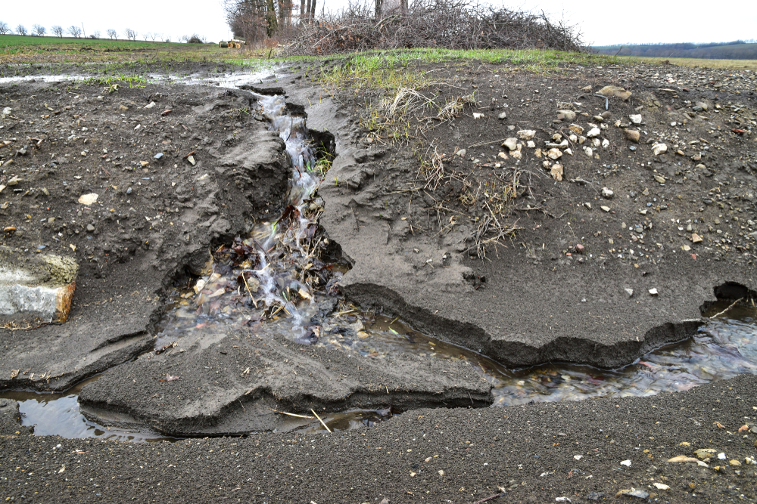
Motivation
Landscape disturbance and its impact on river system
Human-induced disturbance has the potential to introduce large quantities of sediment to steams (Hooke, 1994).
Agriculture, urbanization, timer production
Climate change induced wildfire, flooding, landslide

Slide 4
Project objective
Demonstrate a potential to couple NetworkSedimentTransporter (NST) with existing LANDLAB models (e.g., HyLands, SPACE, etc.,) that generate sediment sources or simulate other sediment input conditions
Run the NST with pulses of sediment to understand the impact of landscape disturbance on sediment yield
→ Go to Jupyter Notebook

