Slide 1


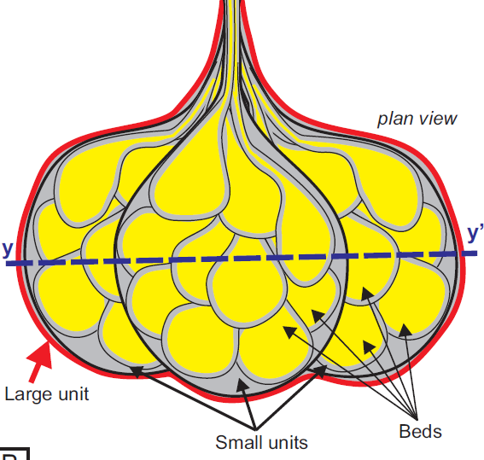
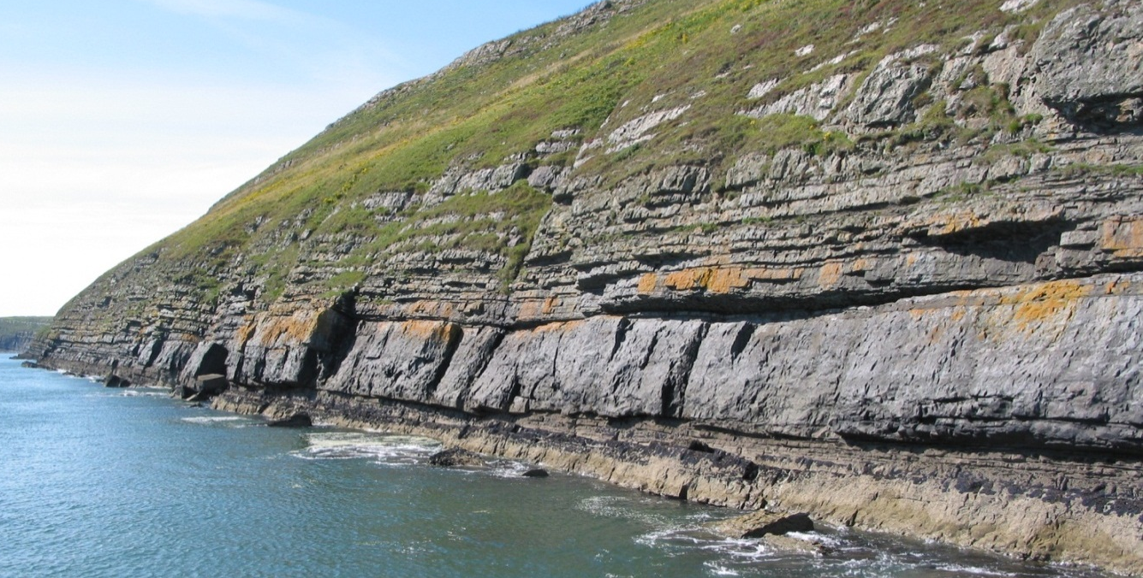
Testing the Efficacy and Uncertainty of Outcrop- and Model-Based Studies through Collaboration:
A Field Geologist’s Perspective
David Pyles
Chevron Center of Research Excellence
Department of Geology and Geological Engineering
Colorado School of Mines
Coauthors/Collaborators: Kyle Straub (Tulane), Doug Edmonds (Indiana U.)
Inspiration: James Syvitski, Irina Overeem, Michael Pyrcz
25 m
25 m
25 m

Slide 2
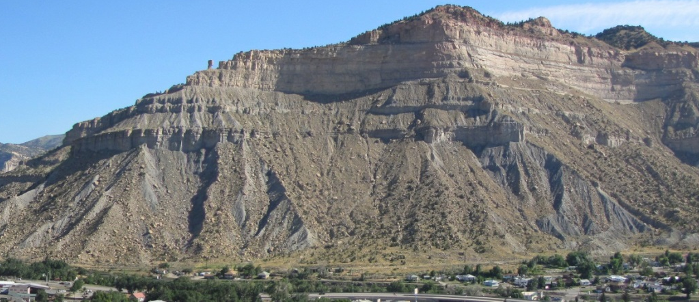
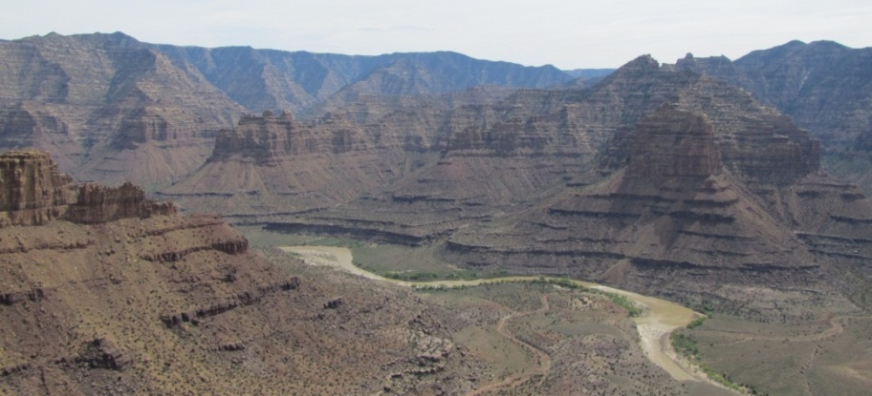
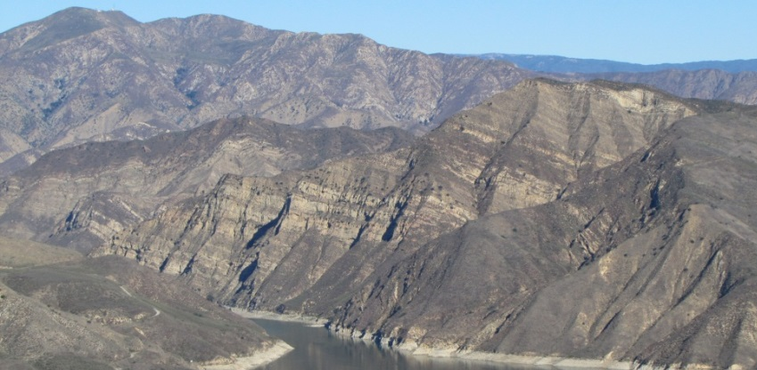
Goal
The goals of this presentation are to review some techniques that can be used to evaluate model (and outcrop) uncertainty and test natural variability in sediment transport systems.
Share my vision for how field geologists and modelers can leverage from each other's perspectives.
Shallow Marine
Fluvial
Deep Water
Notes:
2

Slide 3

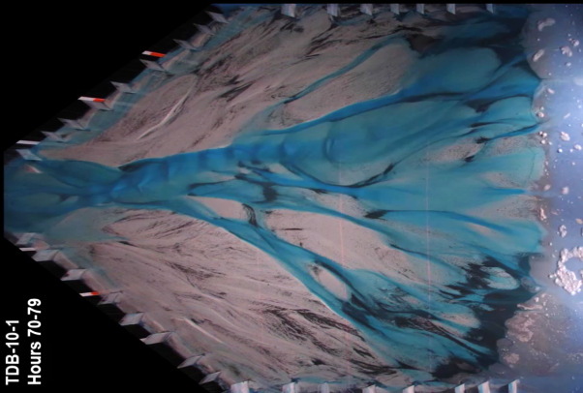
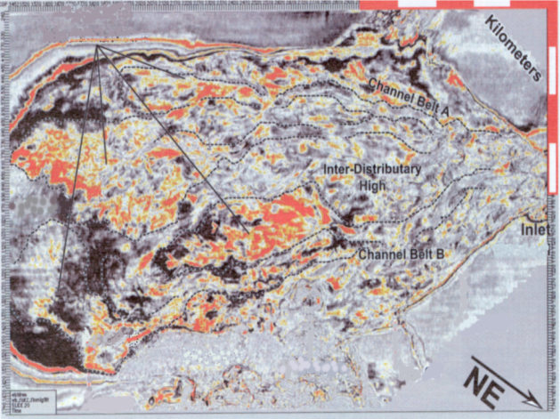
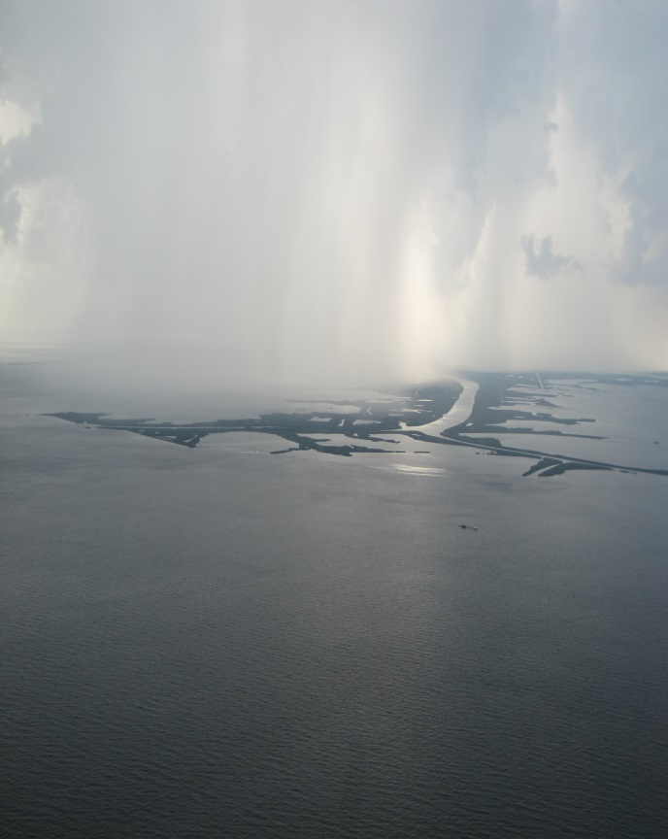
Context
There are numerous ways to address stratigraphic problems….
Outcrop Studies
Numerical Simulations
Physical Experiments
Stratigrapher's World
Overeem et al. (2005)
Subsurface Studies
Tulane Delta Tank (Straub)
Land- and Seascape Studies
sediment
transport
direction
Channel-
Lobe
Transition
Slumps
Zone
Beaubouef et al. (2003)
The whole is different that the sum of its parts (Aristotle, ~360 BC, Metaphysics)
Notes:
3

Slide 4
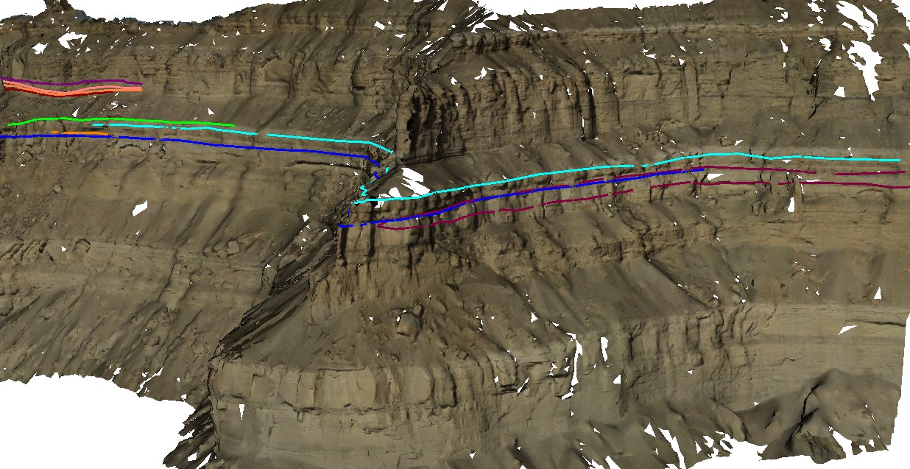
Context
Recent technological advances in data collection techniques have yielded opportunities to better quantify stratigraphic stacking patterns and spatial distributions of deposits from outcrops of ancient sediment transport systems (e.g. lidar studies, photogrammetry, 3D models).
http://en.wikipedia.org/wiki/Digital_outcrop_models
Pyles et al. (in press, Geosphere)
Notes:
4

Slide 5
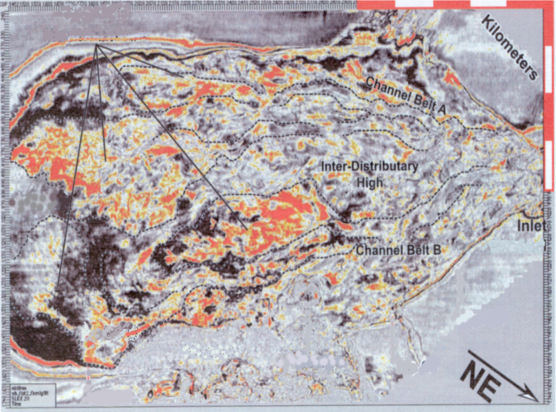
Example: Compensational Stacking
What is compensational stacking?
  The tendency for sediment transport systems to fill topographic lows (Straub et al. 2009, JSR). Results in spatial changes in the locus of deposition (via avulsion).
sediment transport direction
Shelf
Brazos Trinity, GOM
Depositional
Submarine
Lobes
Channels
Distributive submarine fan
2
1
3
Slope
sediment
transport
direction
5
Channel-
2 km
4
Lobe
Transition
sediment transport direction
Zone
Slumps
Basin
Beaubouef et al (2003, GCSSEPM Spec. Pub.)
(Modified from Campion et al., 2005)
Notes:
5

Slide 6
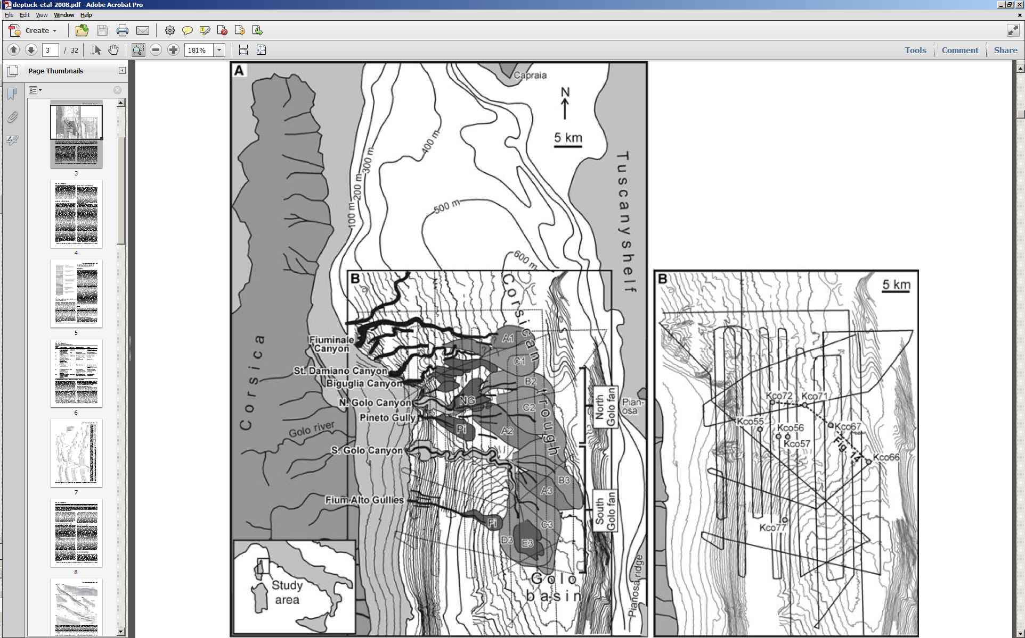
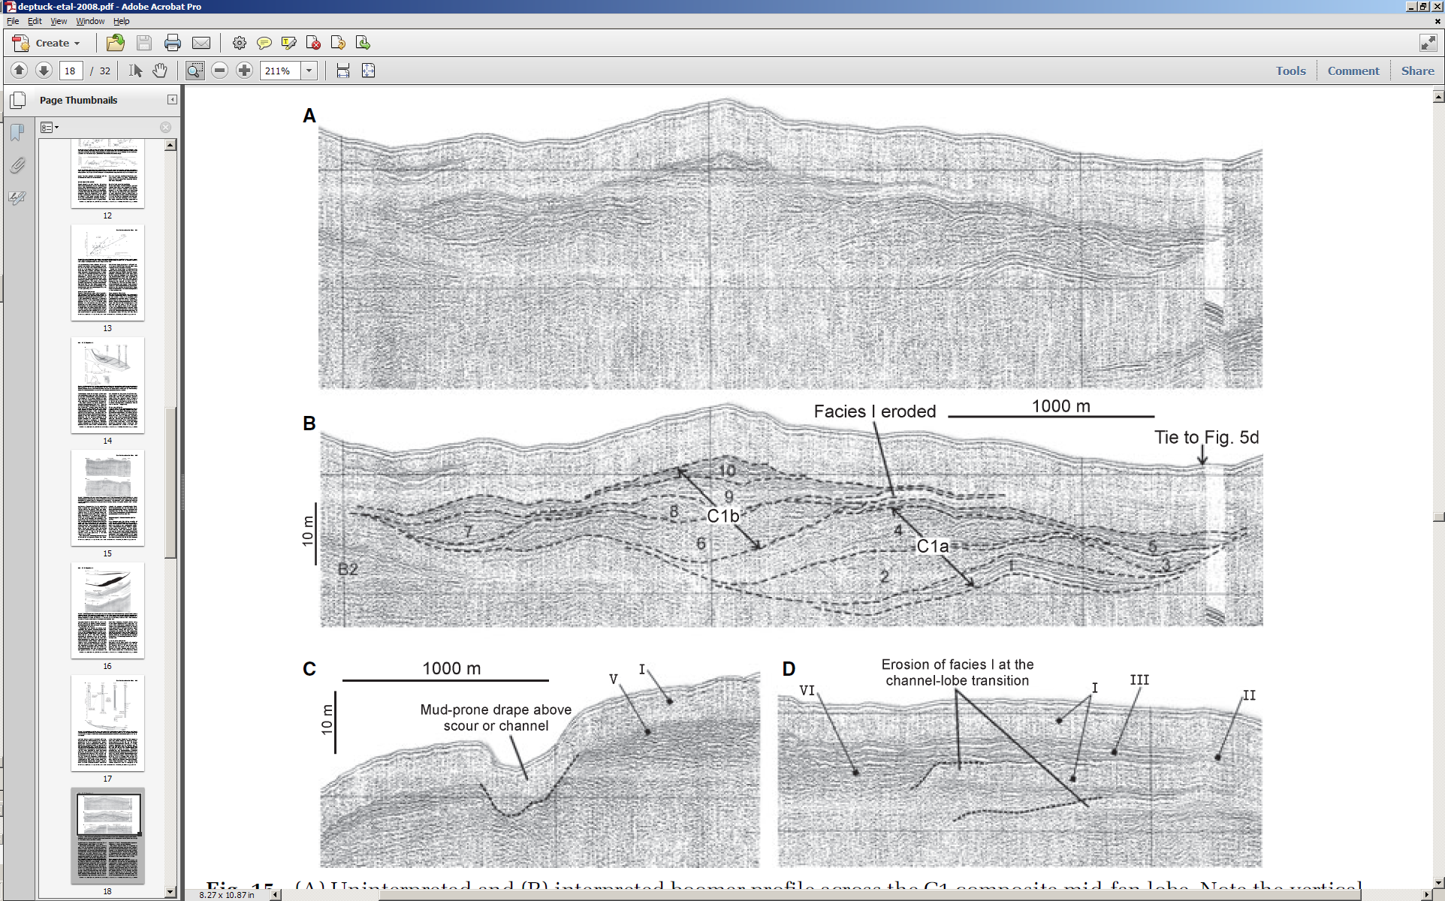
Example: Compensational Stacking
Corsica Fan, Corsica
5 km
sediment transport direction
Deptuck et al. (2008, Sedimentology)
Deptuck et al. (2008)
Notes:
6

Slide 7
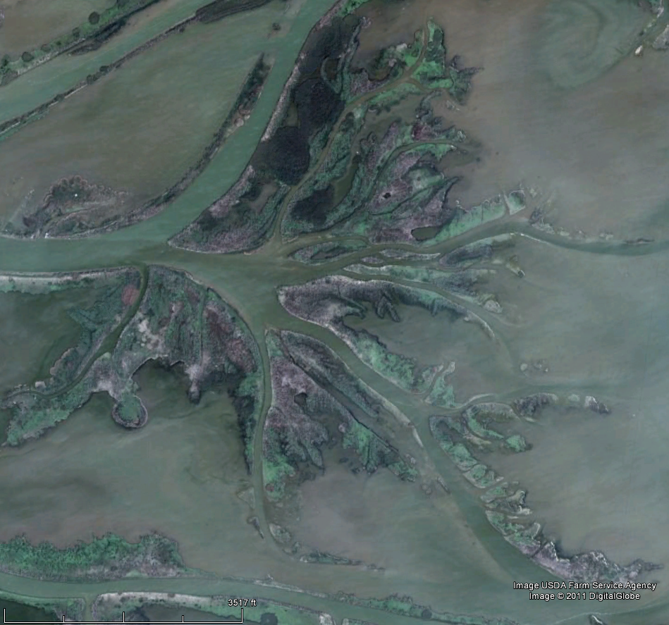
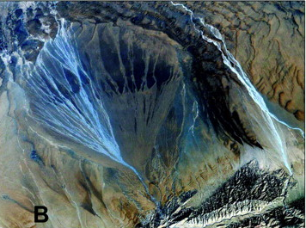
Example: Compensational Stacking
Where else does compensational stacking occur?
  Deltas
  Fluvial systems
Part of Mississippi River Delta
Tarim basin
sediment transport direction
500 m
Weisman et al. (2010, Geology)
GoogleEarth
Notes:
7

Slide 8
Example: Compensational Stacking
Straub et al. (2009, JSR) developed a metric for quantifying compensation.
The metric requires knowledge of subsidence and sedimentation rates (assumes sedimentation → subsidence over long time scales).
Local sedimentation rate
Long-term subsidence rate
Total length of cross section
Exponent of power law decay with increasing thickness of the deposit
Straub et al. (2010, JSR)
Notes:
8

Slide 9
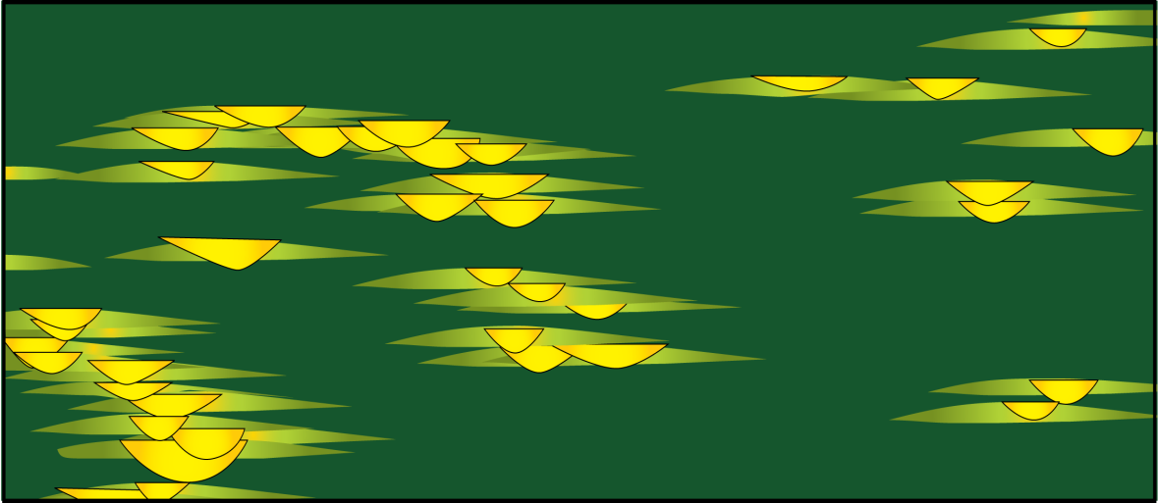
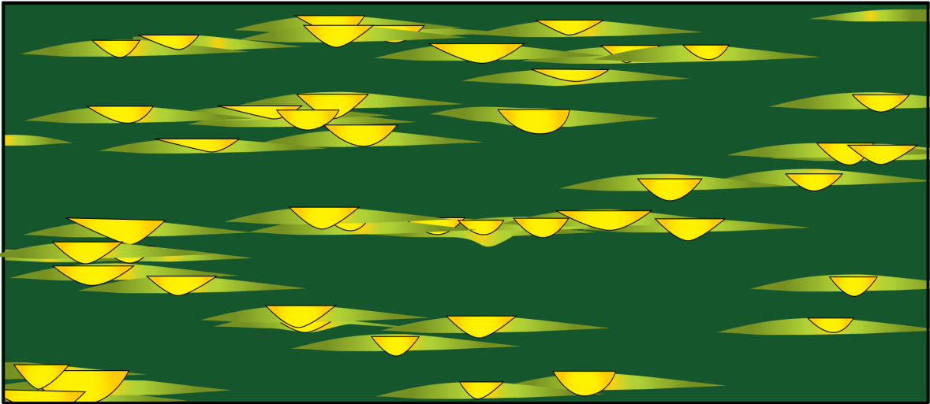
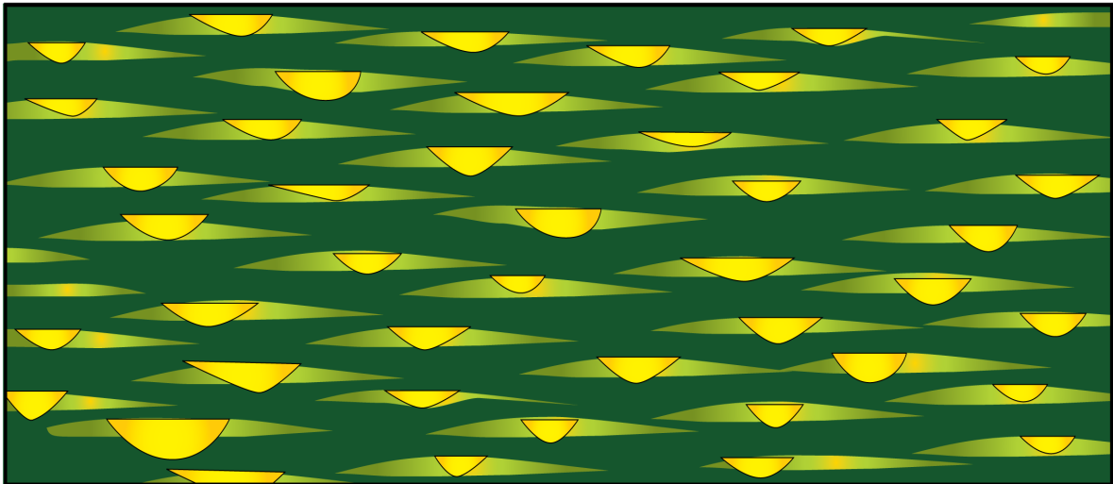
Example: Compensational Stacking
Diagrammatic application of method.
10¹
κ_{CV} = 0
not compensational
10⁰
κ_{CV} = 0.5
κ_{CV} = 1
mixed
10⁻¹
CV
compensational
10⁻²
10⁻³
10³
10⁰
10¹
10²
Mean interval thickness ( )
..every observation must be made for or against some view if it is to be of any service (Darwin, 1861, correspondence with the Geological Survey).
Notes:
9

Slide 10
Example: Compensational Stacking
The metric requires knowledge of subsidence and sedimentation rates (assumes sedimentation → subsidence over long time scales).
We modify the method so it is applicable to field-based data sets (Straub and Pyles, 2012, JSR).
Local sedimentation rate
Long-term subsidence rate
Total length of cross section
Local deposit thickness
25 m
25 m
25 m
Mean Deposit Thickness
Total length of cross section
Exponent of power law decay with increasing thickness of the deposit
Straub et al. (2010, JSR); Straub and Pyles (2012)
Notes:
10

Slide 11
Example: Compensational Stacking
Straub et al. (2010, JSR); Straub and Pyles (2012)
Notes:
11

Slide 12
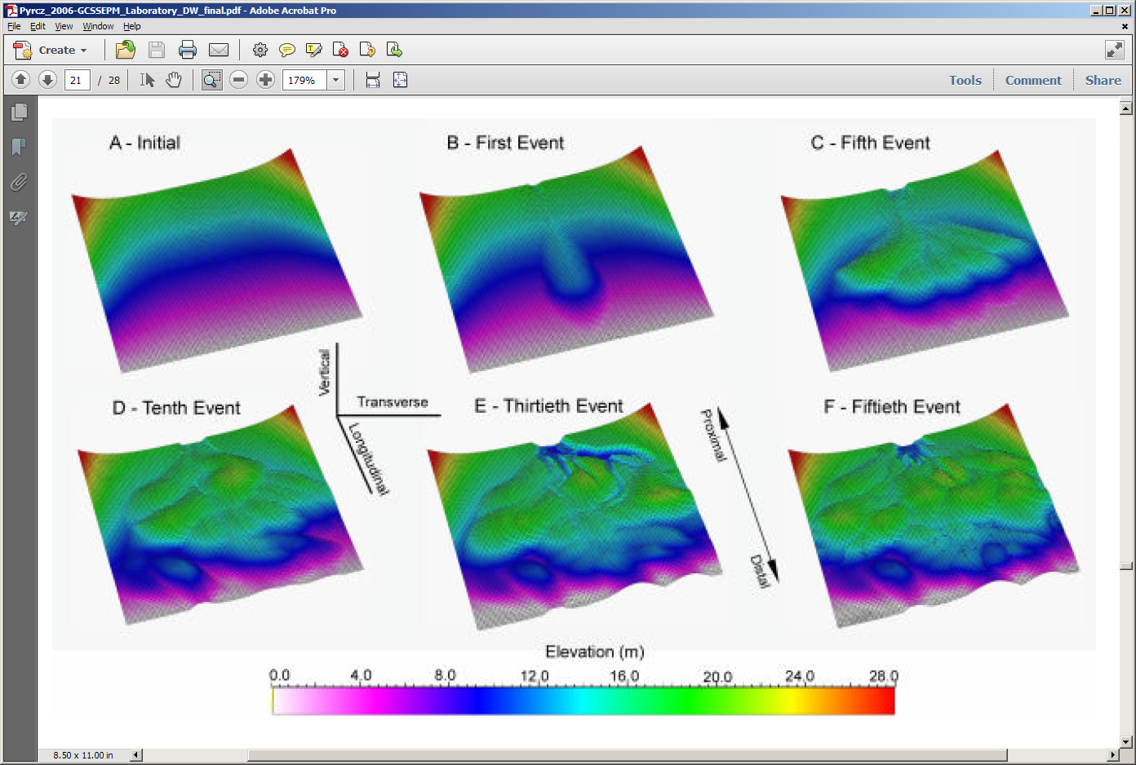
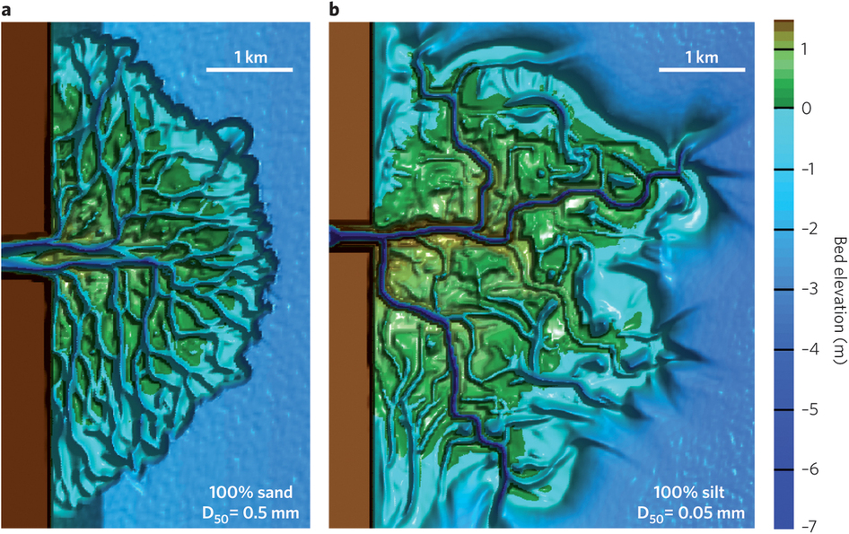
Example: Compensational Stacking
This approach can be transferred to forward models that track stratal surfaces.
Allow us compare measurements from natural systems and physical experiments to model outputs:
    Test of efficacy and uncertainty?
    Provides insight
Overeem et al. (2005, SEPM Spec. Pub.)
Pyrcz et al. (2006, GCSSEPM Spec. Pub.)
Edmonds and Slingerland (2010, Nature Geosciences)
Notes:
12

Slide 13
Example: Compensational Stacking
Does compensation vary spatially in distributive submarine fans?
Does compensation vary by scale?
Corsica Fan, Corsica
5 km
Brazos Trinity, GOM
sediment transport direction
Brazos Trinity, GOM
Depositional
Submarine
Depositional
Submarine
Lobes
Channels
Lobes
Channels
sediment transport direction
sediment
sediment
transport
transport
direction
direction
Channel-
Channel-
2 km
Lobe
Lobe
Transition
Transition
Zone
Slumps
Zone
Slumps
Deptuck et al. (2008)
Beaubouef et al (2003)
Beaubouef et al (2003)
Medial
(predominantly
lobes)
Proximal
(predominantly
channels)
Deptuck et al. (2008)
Notes:
13

Slide 14
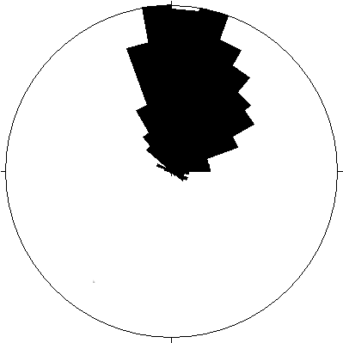
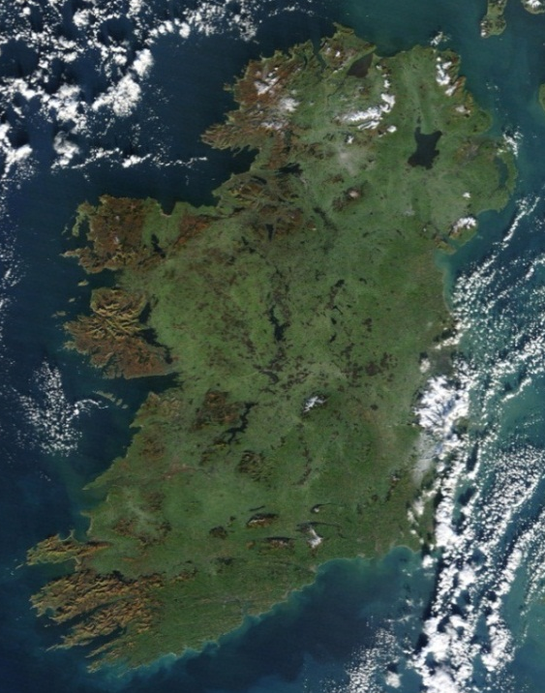
Example: Compensational Stacking
The Carboniferous Ross Sandstone crops out in western Ireland.
The formation was deposited as a ponded, distributive submarine fan in a structurally confined basin (Pyles, 2008).
Namurian
Atlantic
Ocean
n=1043
County Clare
Loop Head Peninsula
Next slide
Shannon Estuary
20 km
Ireland
County Kerry
Pyles (2008, AAPG Bulletin)
NASA
Notes:
14

Slide 15
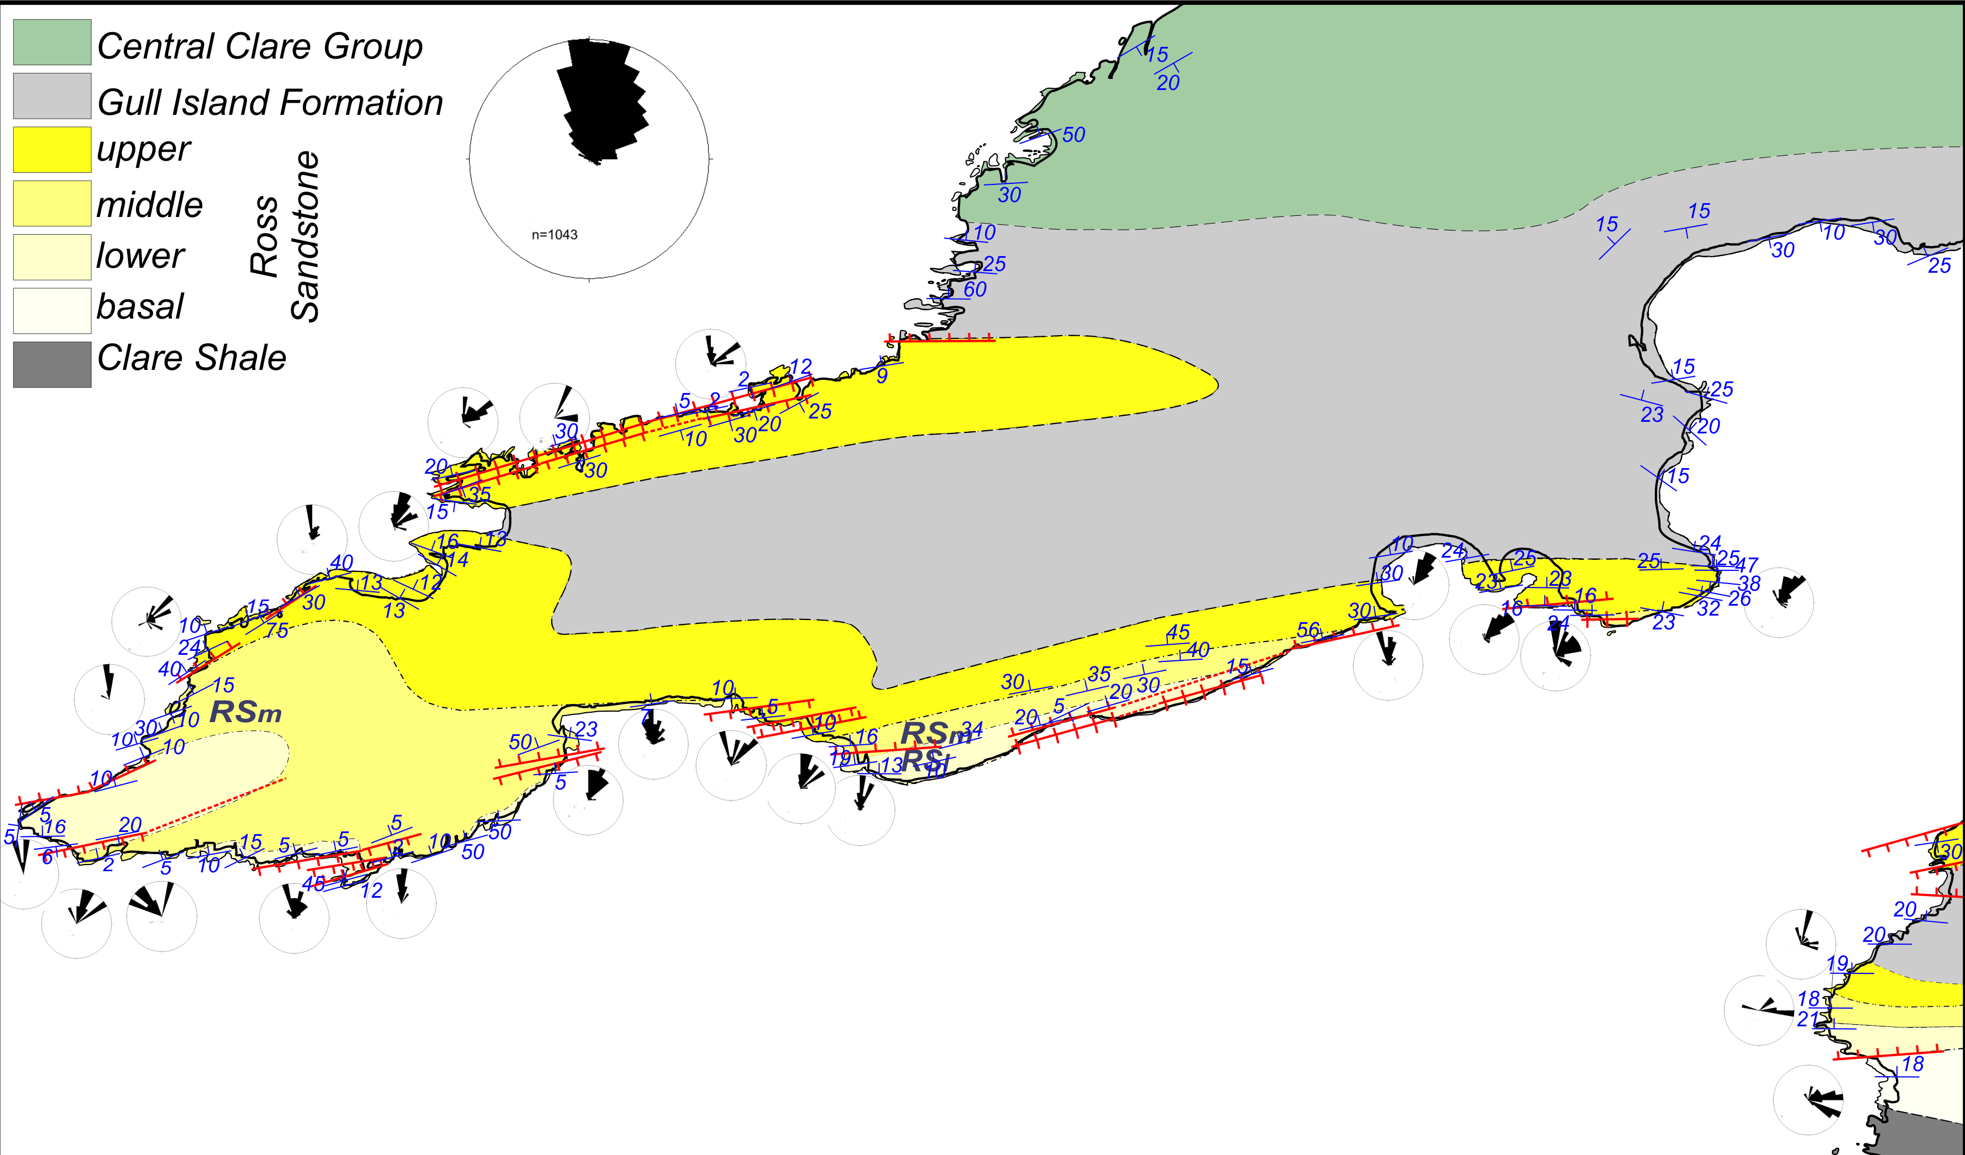

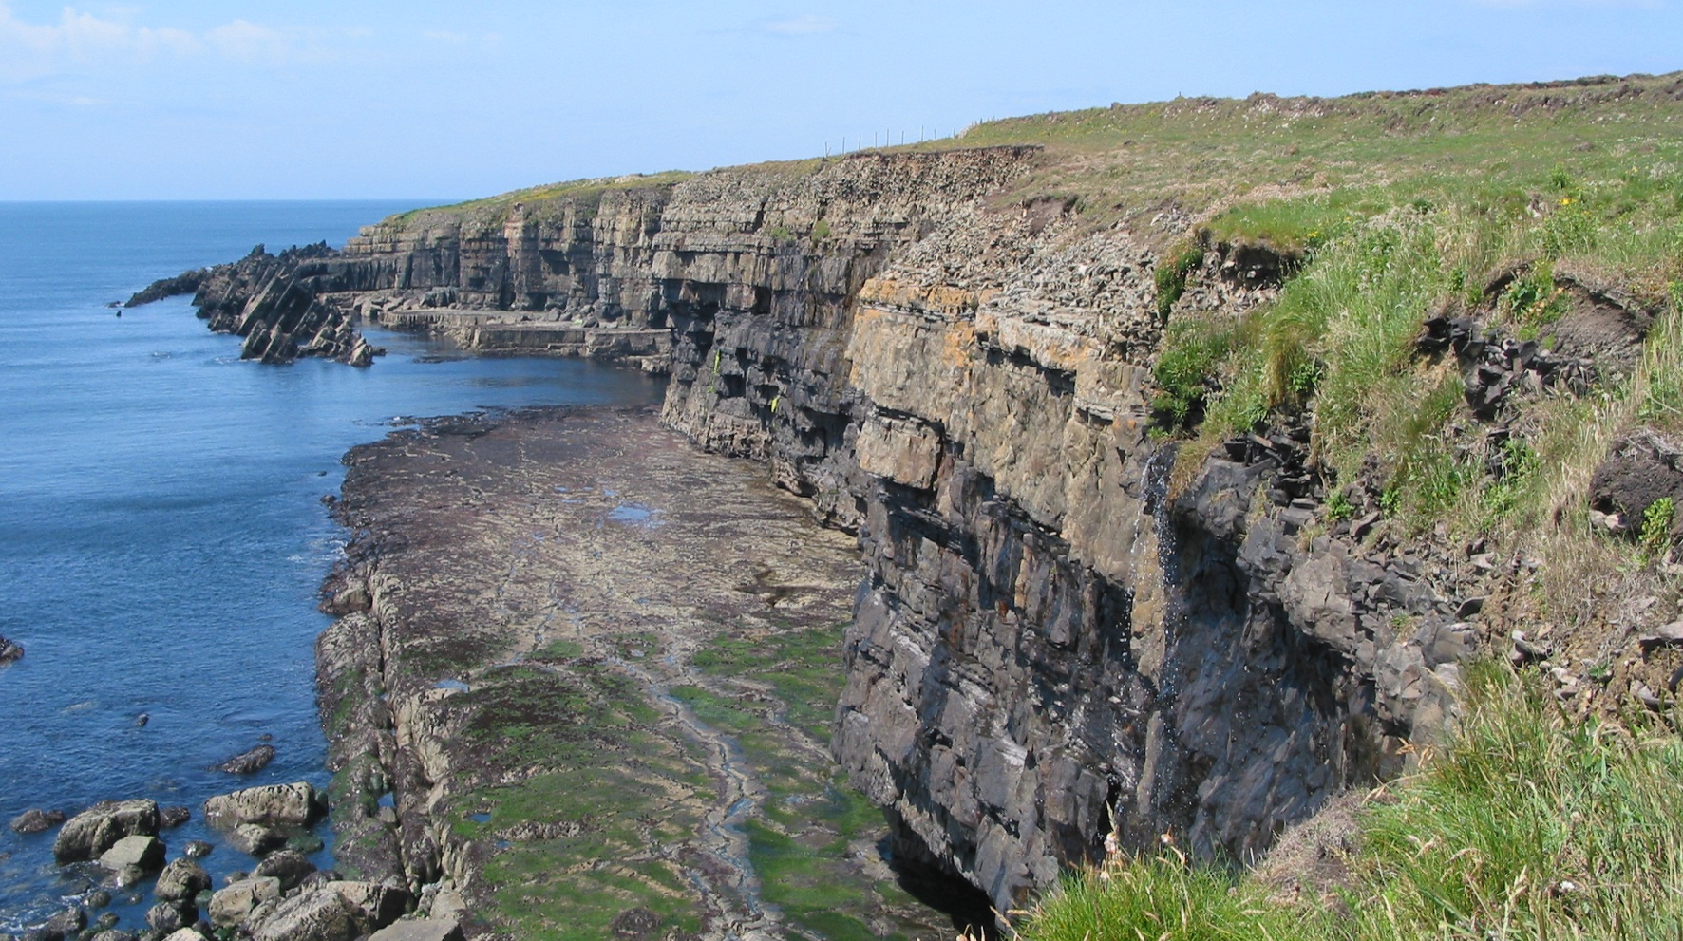
Example: Compensational Stacking
Outcrops of the Ross Sandstone are exceptionally well exposed and ideal for addressing the questions.
Two outcrops are analyzed to determine how compensation varies by: (1) position in a distributive submarine fan, and (2) size of stratal unit.
N=1043
3km
25 m
20 m
Next slide
Rinevella Point
(predominantly
channels)
Kilbaha Bay
(predominantly
lobes)
Pyles (2008)
Notes:
15

Slide 16
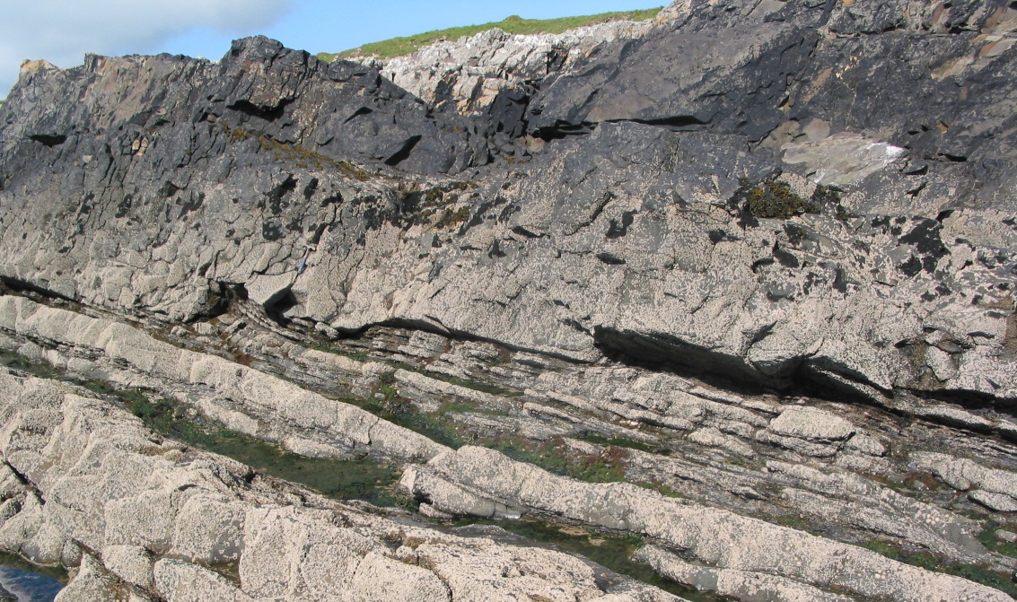
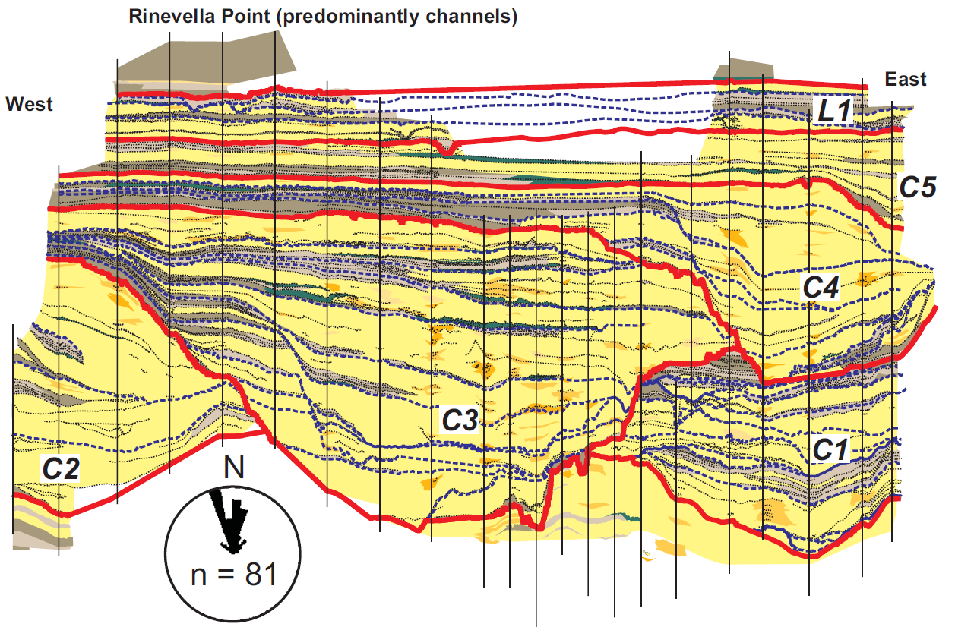
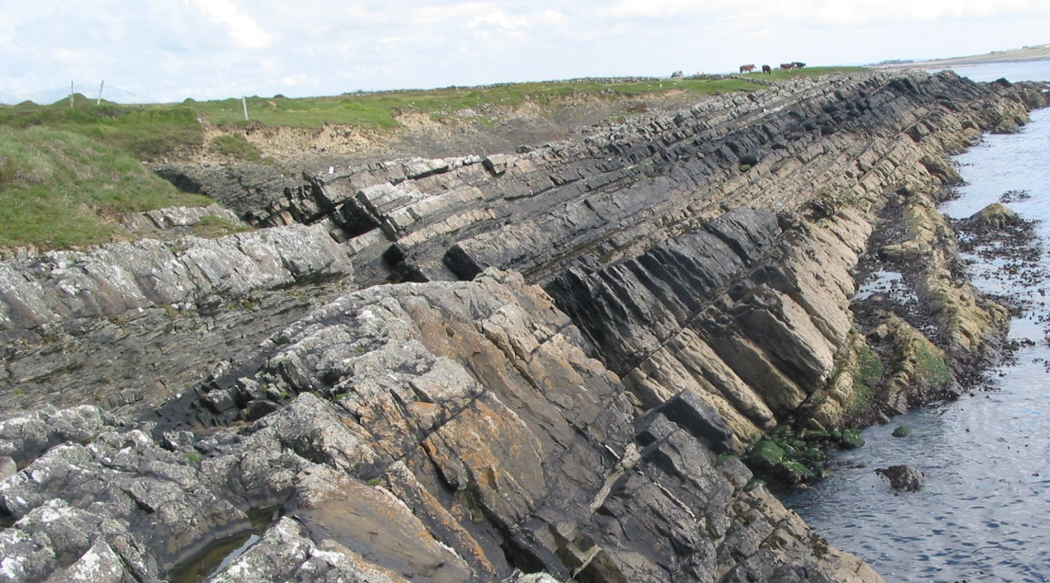
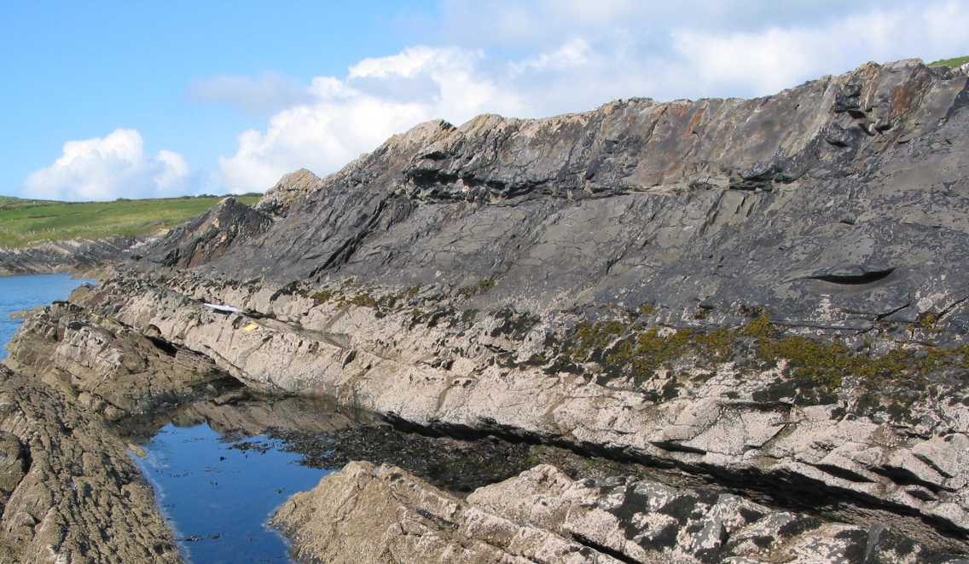
Example: Compensational Stacking
Channel 3 (margin)
Rinevella Point (predominantly channels):
Statistics:
  450 m wide, 35 m thick
  Oriented parallel to depositional strike
  23 detailed strat columns totaling >700m
  Contains 1 lobe and 5 channels (5%, 95% by area respectively)
4m
Channel 3 (margin)
13m
Channel 3 (axis)
25 m
13m
VE=10
Pyles (2004)
450 m
Notes:
16

Slide 17
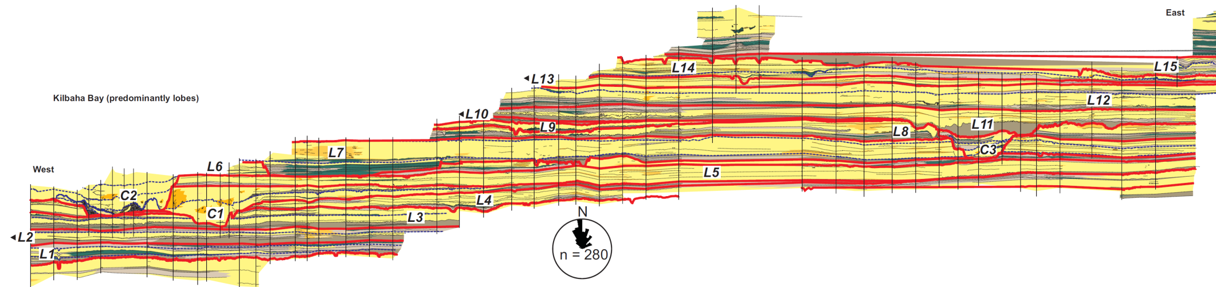
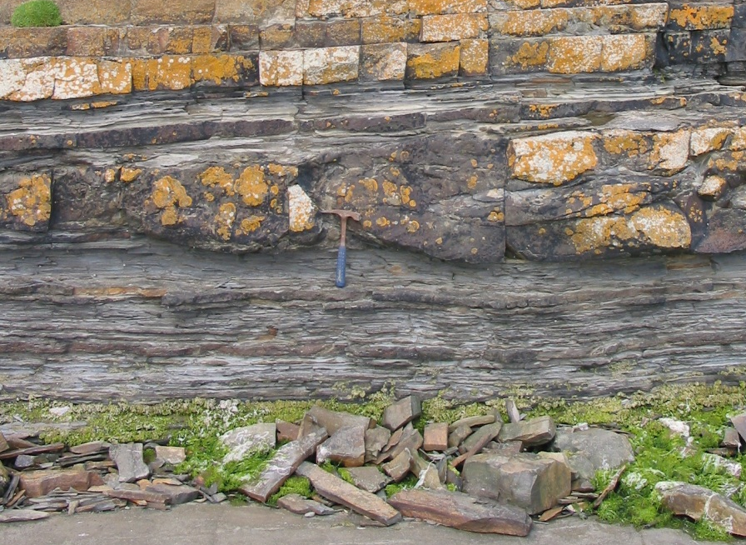
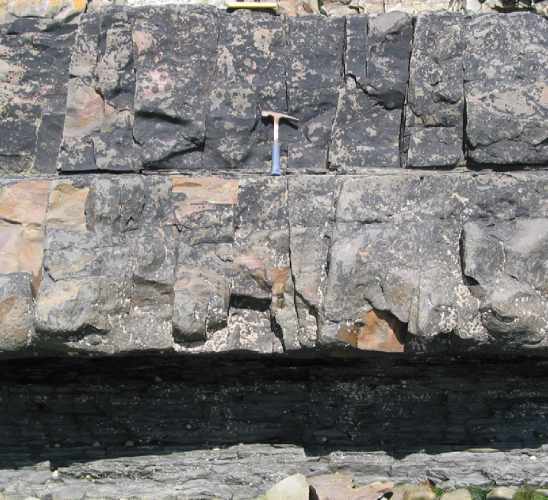
Example: Compensational Stacking
Kilbaha Bay (predominantly lobes):
Statistics:
  1300 m wide, 30 m thick
  54 detailed strat columns totaling >1000m
  Oriented parallel to depositional strike
  Contains 15 lobes and 3 channels (95%, 5% by area respectively)
Pyles (2004)
VE=10
35 m
Lobe 11 (off axis)
Lobe 11 (axis)
1300
Axis
50 cm
50 cm
Notes:
17

Slide 18
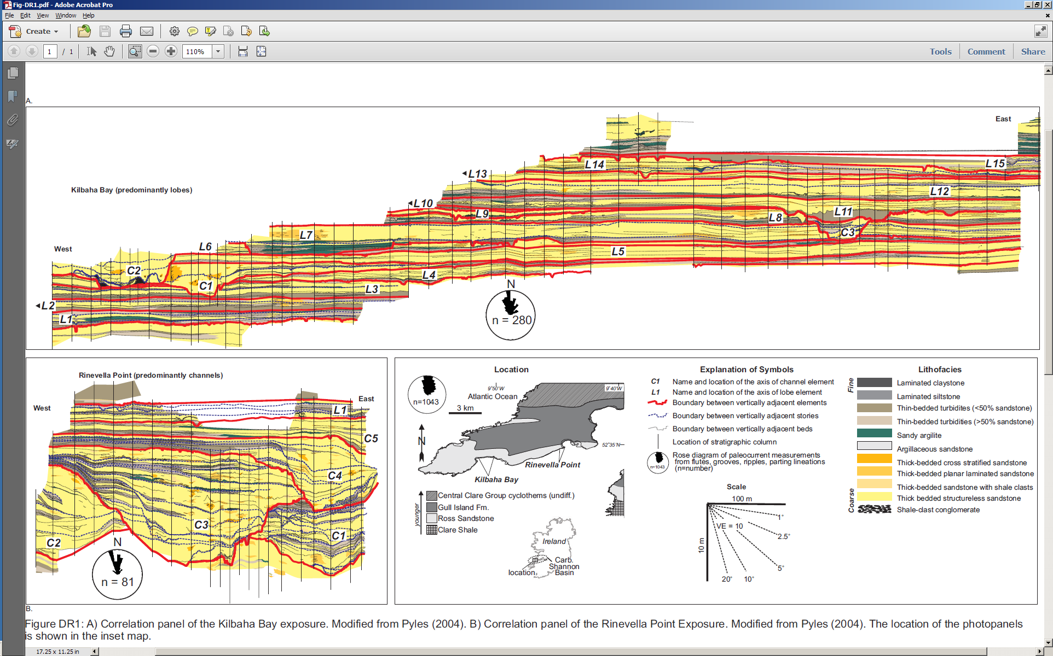
Example: Compensational Stacking
We are comparing two architecturally distinct parts of a submarine fan:
  Proximal, predominantly channels (Rinevella Point)
  Medial, predominantly lobes (Kilbaha Bay)
Rinevella Point (Proximal, Predominantly Channels)
Scale
20 m
VE=10
200 m
Kilbaha Bay (Medial, Predominantly Lobes)
Notes:
18

Slide 19
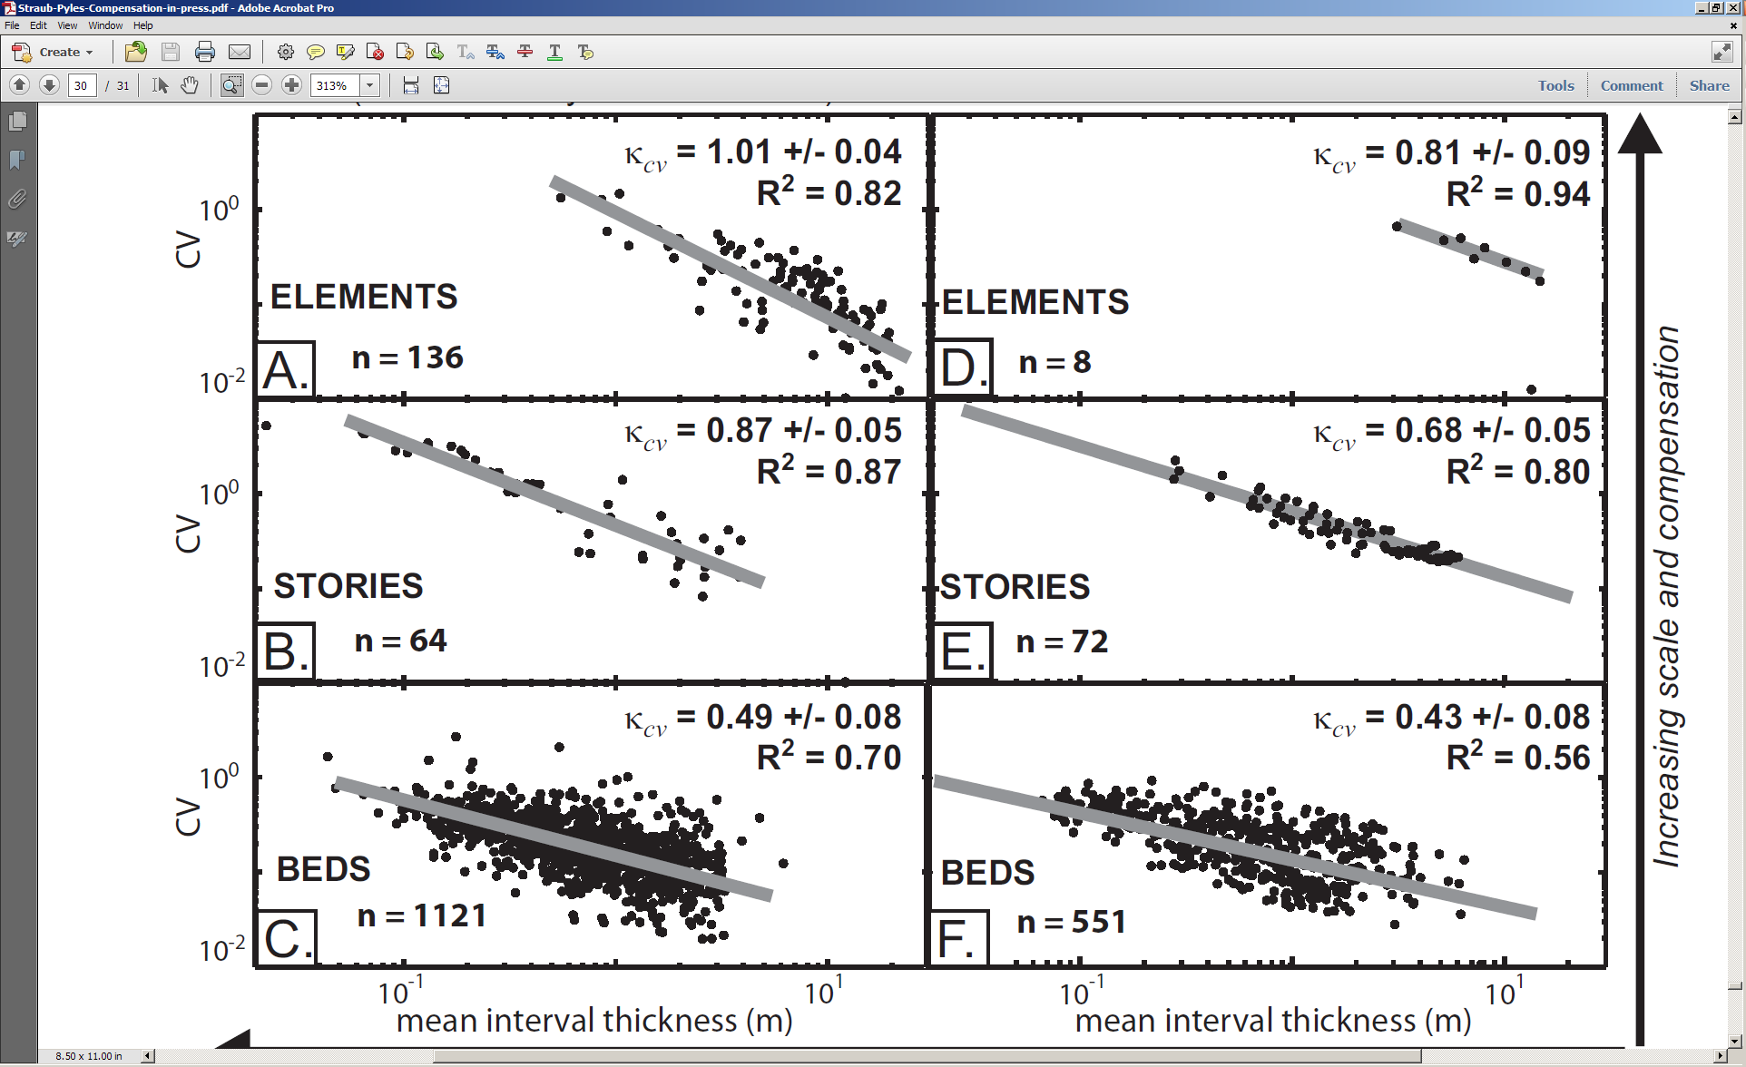
Example: Compensational Stacking
At both field localities, compensation increases with hierarchical scale.
Lobes are more compensational than channels (compensation increases along a proximal-to-distal transect).
sediment transport direction
Straub and Pyles (2012, JSR)
Kilbaha Bay
(Medial, predominantly lobes)
Rinevella Point
(Proximal, predominantly Channels)
Increasing compensation with size
Compensational stacking increases down the fan
Notes:
19

Slide 20
Example: Compensational Stacking
We can use measurements from outcrops of natural systems to evaluate the efficacy of forward models—not yet been done!
Pyrcz et al. (2006, GCSSEPM Spec. Pub.)
Notes:
20

Slide 21
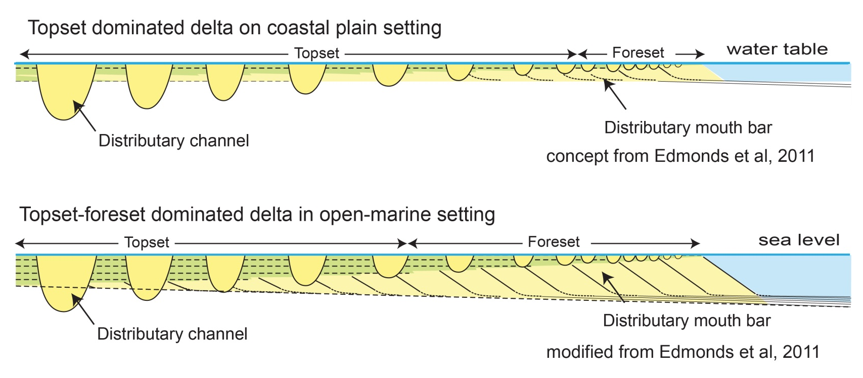
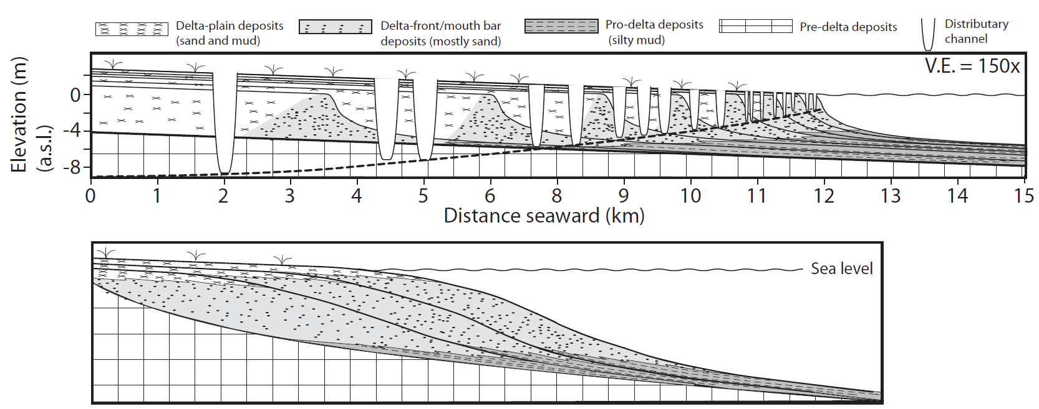
Example: Water Depth and Gradient on Deltas
Edmonds et al. (2001, Geology) proposed a geometrical model that evaluates how water depth and gradient influence stratigraphic architecture of deltas.
Part of Mississippi River Delta
sediment transport direction
Next slide
500 m
Edmonds et al. (2011, Geology)
GoogleEarth
..every observation must be made for or against some view if it is to be of any service (Darwin, 1861, correspondence with the Geological Survey).
Notes:
21

Slide 22
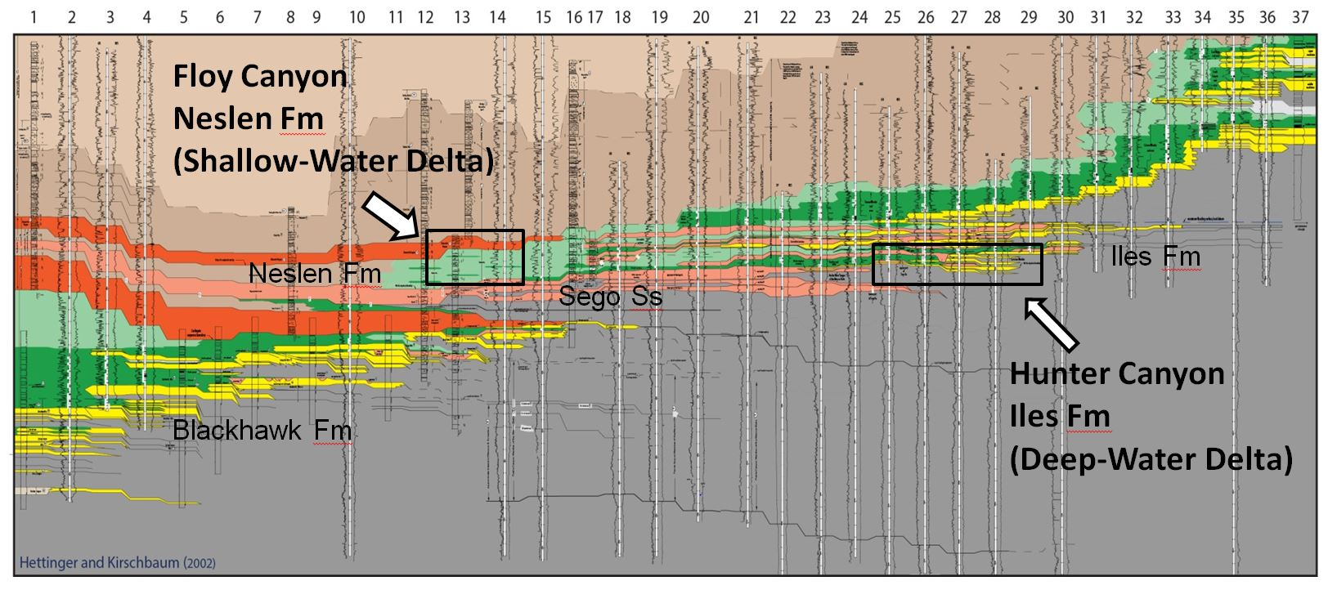
Example: Water Depth and Gradient on Deltas
Field test: Cretaceous Strata in the Book Cliffs Utah
20 km
500 m
Hettinger and Kirschbaum (2002, USGS Open File Report)
Notes:
22

Slide 23
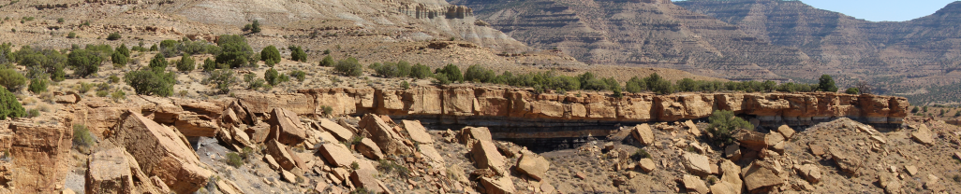
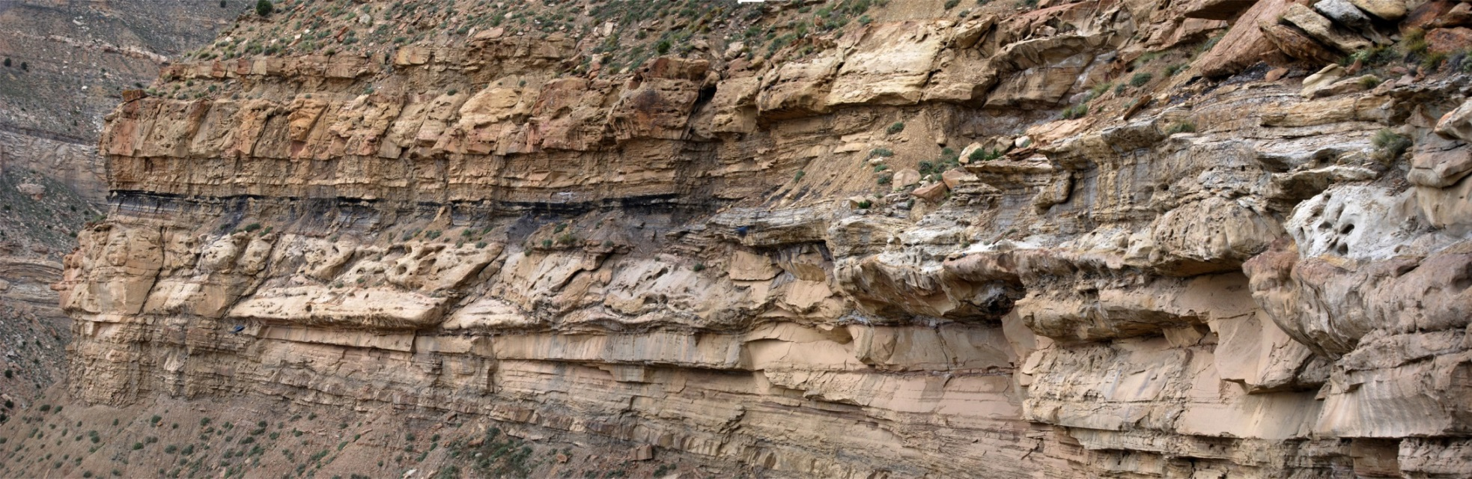
Example: Water Depth and Gradient on Deltas
Field test: Cretaceous Strata in the Book Cliffs Utah
Shallow water (Neslen Fm., Floy Canyon, Utah)
Deep water (Iles Fm., Hunter Canyon, Colorado)
Notes:
23

Slide 24
Example: Water Depth and Gradient on Deltas
This approach can be transferred to a number of forward models.
Allow us compare measurements from natural systems and physical experiments to model outputs:
    Test of efficacy and uncertainty?
    Provides insight.
Overeem et al. (2005, SEPM Spec. Pub.)
Pyrcz et al. (2006, GCSSEPM Spec. Pub.)
Edmonds and Slingerland (2010, Nature Geosciences
Notes:
24

Slide 25
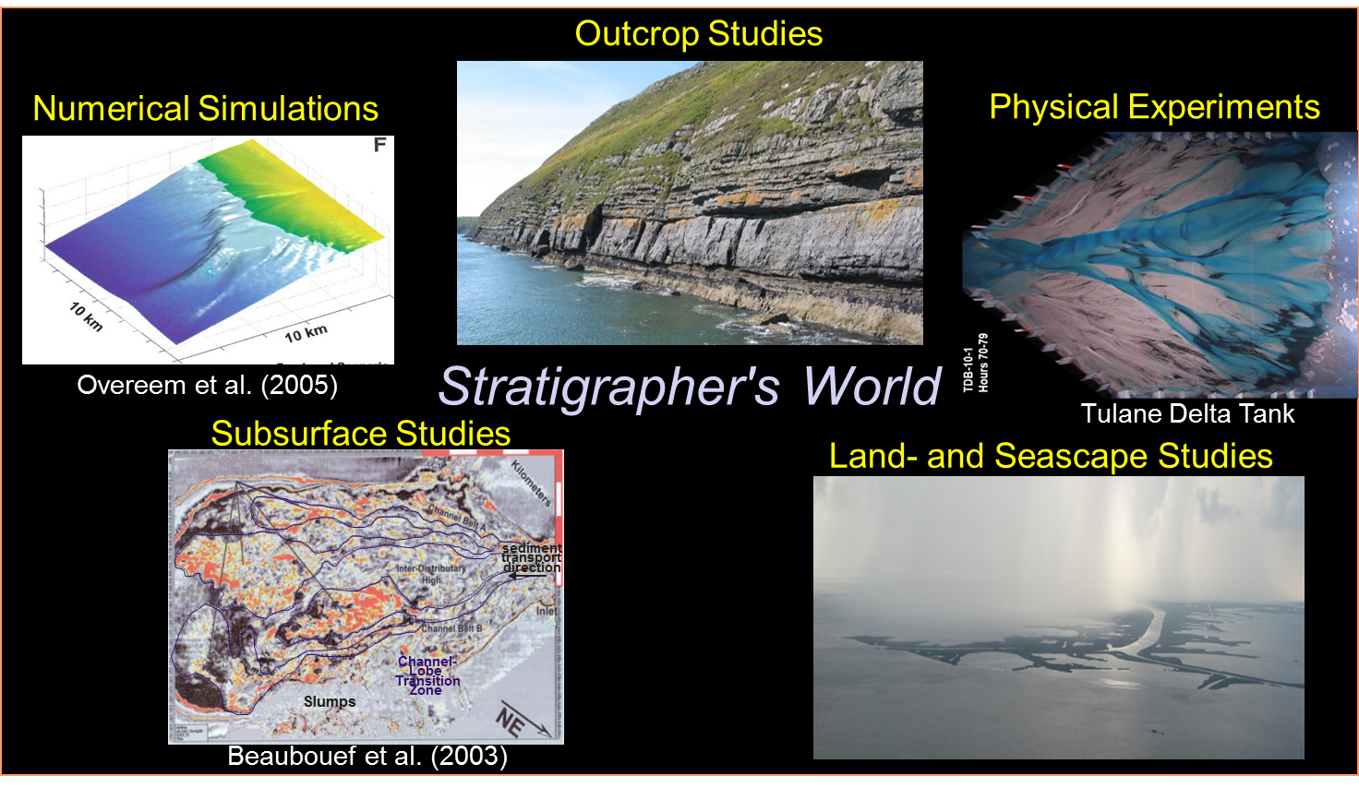
Conclusions
Common workflows can provide a means to relate results of numerical modeling to natural systems: efficacy, natural variability.
Coupled perspectives (outcrops, numerical models, ….) provide insight that can be used to develop new questions about sedimentary systems and their deposits.
Let’s start (keep) talking!
Notes:
25

Slide 26
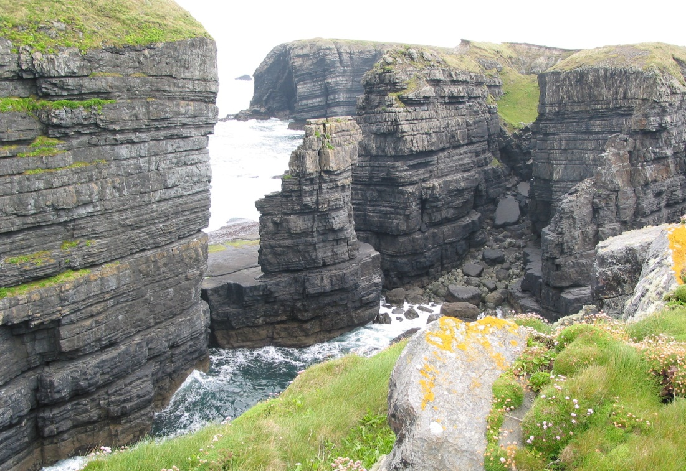
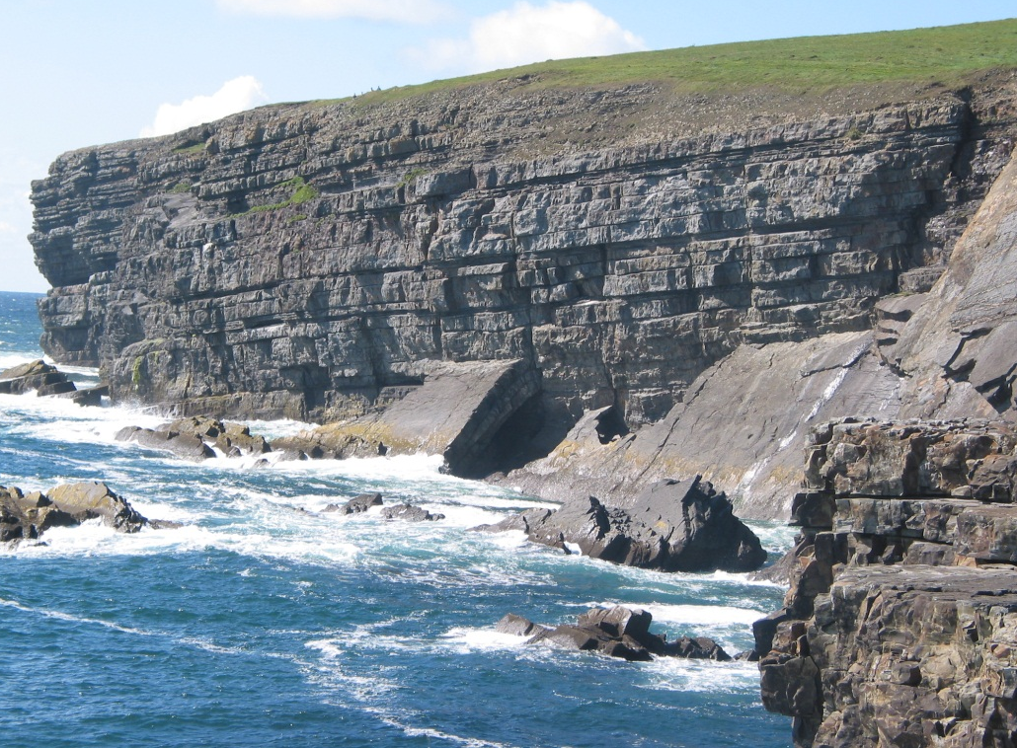
Thank you
50 m
40 m
25 m
25 m
25 m
Notes:
26

