Slide 1

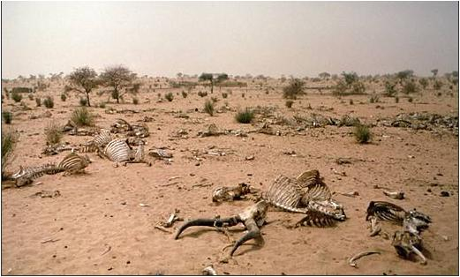
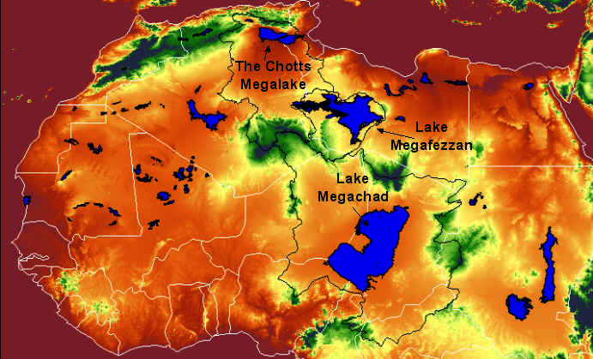
Climate Dynamics of Tropical Africa:
Capturing Paleoclimate Changes
Bette Otto-Bliesner
National Center for Atmospheric Research, Boulder, Colorado
Zhang et al., GMD, 2012
Notes:
From a hydrological perspective … water – too little, too much – likely will be the biggest future climate challenge for the world, including Africa
Sahel drought
Geological record finds tropical Africa at time hyperarid and at other times covered with large megalakes
From the Sahara megalakes project, lake shoreline features confimed by Landsat imagery; luminescence dating

Slide 2
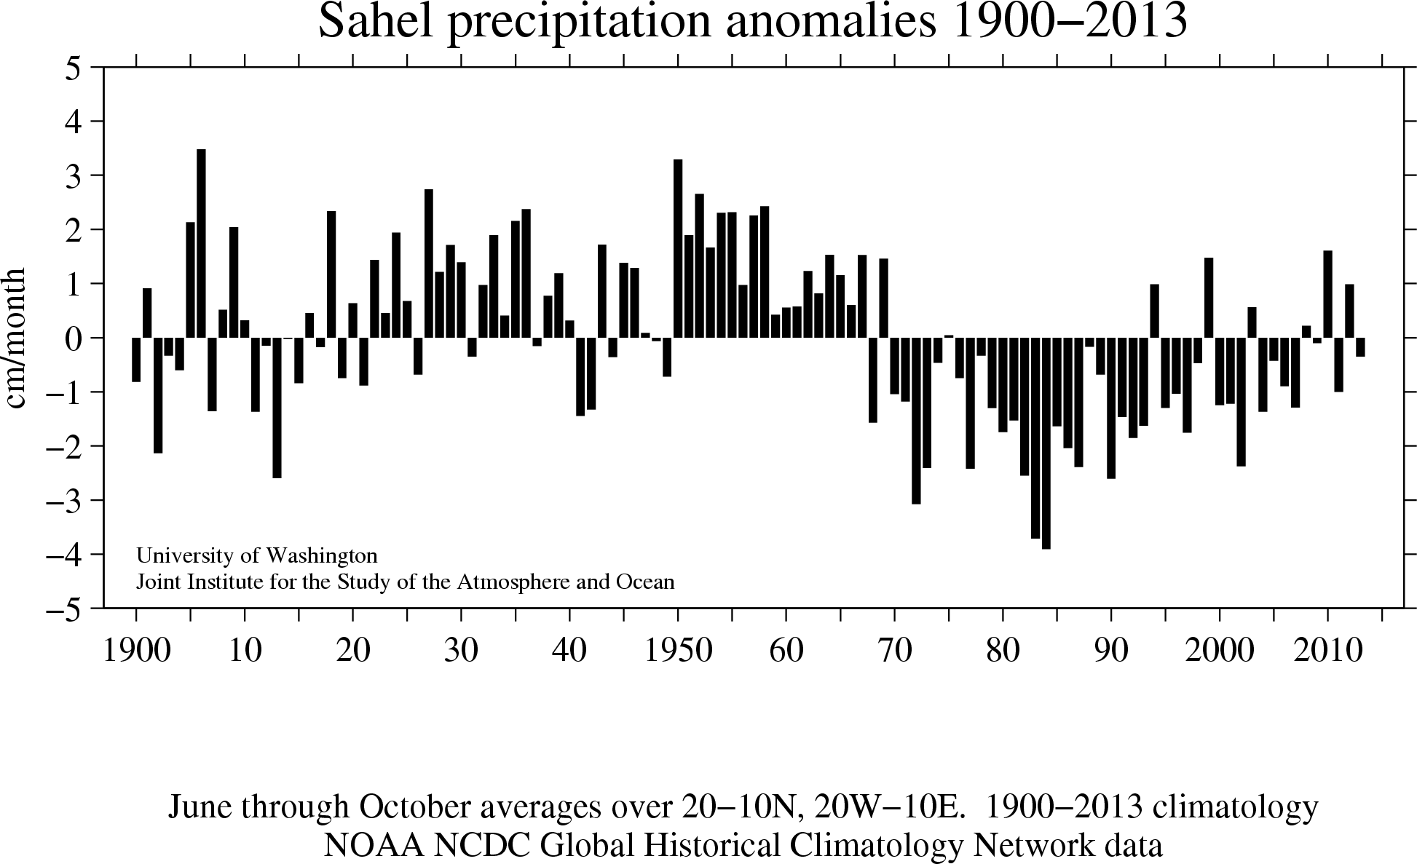
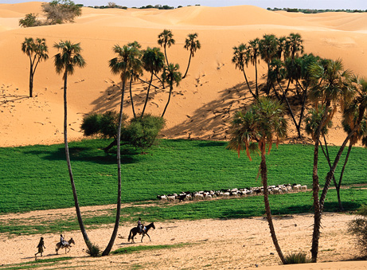
The Sahel
Since 1950, the Sahel has seen persistent anomalies of precipitation:
1950s – 1960s, persistent excessive rainfall
1970s – 1980s, excessive drought
Partial recovery, rise in extreme events
Satellite observations indicate a strong increase in seasonal greenness since the early 1980s.
Proposed cause are numerous, including:
Improved agricultural practices
Increasing GHGs, direct and indirect (SST) effects on Sahel rainfall.
Notes:
The area and its people suffered devastating droughts and famines.
Global climate modeling has suggested a strong link between SST anomalies and rainfall in Sahel, with both internal variability of Atlantic SSTs (AMO), and forced changes associated increases in aerosol, predominantly in the NH modulating the SSTs.
Positive AMO and reduction of NH aerosols both leading to warmer Natl SST
Satellite data over the two decades since early 1980s have shown a remarkable trend in vegettion greenness.
BOTH
Charney hypothesis: overgrazing and cultivation … albedo increases ,,, general cooling of land sfc ... Reductions of ET and sfc convergence ... Reductions in rainfall.

Slide 3
Past and Future − Data and Models
How will precipitation change in the future in the Sahel – all of Africa?
How can the past provide us a perspective to answer this question?
  When was the tropical Africa much wetter/greener and drier than today over the last glacial-interglacial period? What processes influenced this change?
  How abruptly did these humid and dry periods in tropical Africa start and end? And why?
Notes:
And will concentrate on the changes of the time since the last interglacial, time when we have the most records and climate modeling, though hope that we will hear more about earlier periods from our panelist.
Modeling perspective: let us take what the data shows and allows us to look at the causation, climate processes that contribute to signal;
Also allows us to understand what important processes may be missing in our models (feedbacks, resolution, proper variability, upwelling and seasonal cycle)

Slide 4
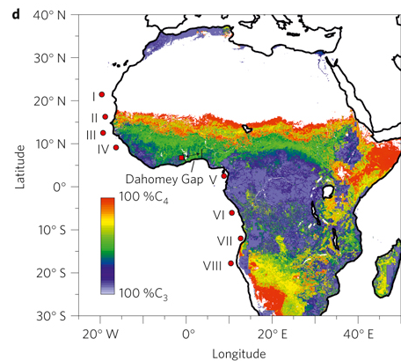
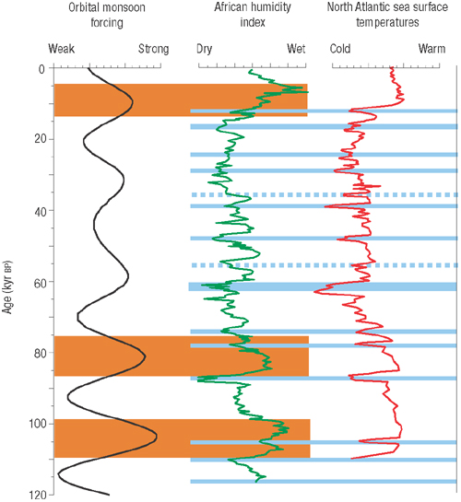
Data − Glacial-Interglacial
Measurements: siliciclastic grain size variations in a deep-sea core off western Africa and alkenone measurements from two sediment cores near Portuguese margin
Interpretation:
African “humidity index” displays eccentricity-modulated precessional cycles (~20 kyr), with millennial variations correlated with North Atlantic SSTs
deMenocal, Science, 2008
Notes:
Much of what we know about G-I interglacial cycles for tropical Africa comes from ocean cores.
Competing influences of local low-latitude processes (solar” summer season at 30N) and high-latitude processes
That is, times when the earth’s orbital configuration provided more insolation to Northern Africa.
Marine sediment core GeoB7920 (20 45,090 N–18 34,900 W, 2,278m water depth)

Slide 5
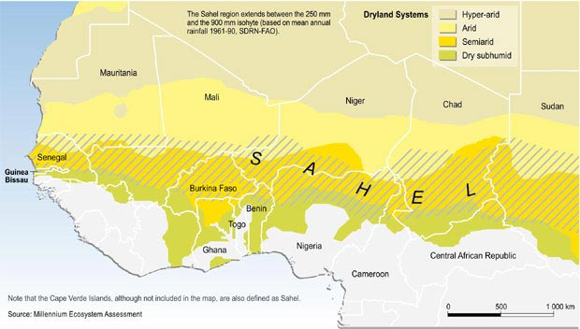
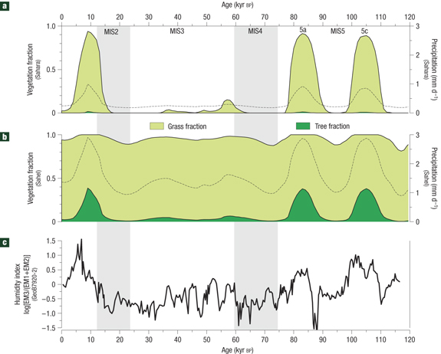
Models − Glacial-Interglacial: Orbital Forcing
CLIMBER2 AOV Model Simulation
Sahara box
Interpretation:
Recurrence of humid periods when precession-forced orbital monsoon forcing is strong.
Greening of Sahel and Sahara associated with precipitation increases.
Sahel box
Wet
Dry
Tjallingii et al., Science, 2008
Notes:
That this mechanism works has been shown for many years, since the early 1980 with relatively simple models and for a snapshot in time, because of our limited computing power. To now with more sophisticated models and models can provide the transient response.
Three wettest periods in the Humidity Index correspond to MIS5c, MIS 5a, and the Holocene (last 11,000 years) when summer insolation at latitudes of NAfrica were highest because of the earth’s orbital configuration
CLIMBER-2: 3 grid boxes over northern Africa forced by the evolution of orbital forcing
They also found African dry periods occuring within the longer orbital variations and could link these to Natl cooling events by measuring a proxy for Natl deep-water circulation in the same core.
Same events are documented in a marine core off Senegal
Figure 3 Model–data comparison of the northern Africa humidity and vegetation cover during the last 120 kyr BP. a,b, AOV-IC model simulation of the vegetation cover
and the annual mean daily precipitation (mm d−1) (black dashed line) in the Sahara grid box (20 –30 N) (a) and the Sahel grid box (10 –20 N) (b). c, Temporal variation of
the continental humidity index of core GeoB7920.
The evolution of the northwest African hydrological balance throughout the Pleistocene epoch influenced the migration of prehistoric humans. The hydrological balance is also thought to be important to global teleconnection mechanisms during Dansgaard–Oeschger and Heinrich events. However, most high-resolution African climate records do not span the millennial-scale climate changes of the last glacial–interglacial cycle, or lack an accurate chronology6. Here, we use grain-size analyses of siliciclastic marine sediments from offthe coast of Mauritania to reconstruct changes in northwest African humidity over the past 120,000 years. We compare this reconstruction to simulations of palaeo-humidity froma coupled atmosphere–ocean–vegetation model. These records are in good agreement, and indicate the reoccurrence of precession-forced humid periods during the last interglacial period similar to the Holocene African Humid Period. We suggest that millennial-scale arid events are associated with a reduction of the North Atlantic meridional overturning circulation and that millennial-scale humid events are linked to a regional increase of winter rainfall over the coastal regions of northwest Africa.

Slide 6
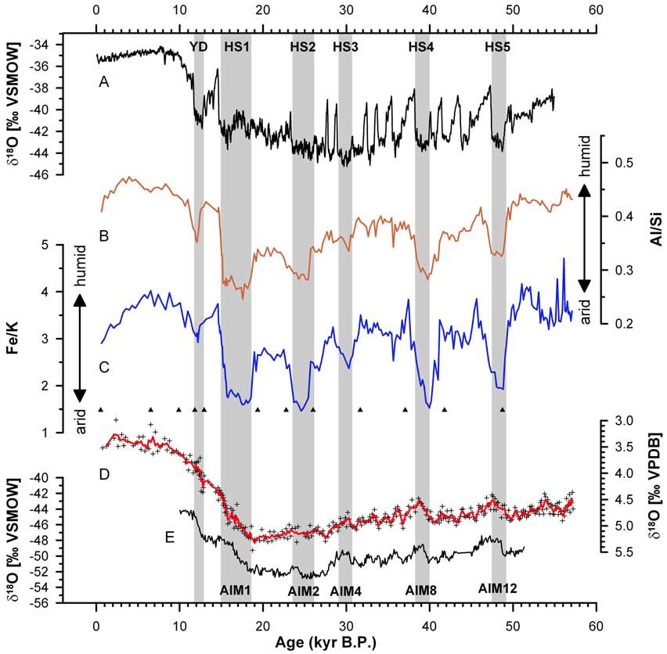
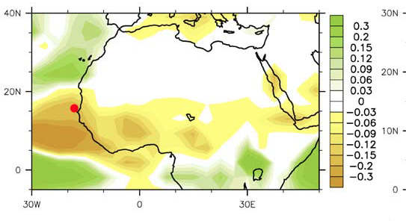
Models − Glacial-Interglacial: Millennial Events
Holocene
LGM
AHP
Measurements: grain size and elemental ratios in marine core GeoB9508-5, on continental slope just west of Senegal River mouth.
Interpretation:
Data: Strong decreases in Al/Si and Fe/K ratios during Heinrich stadials are associated with much lower sediment discharge from Senegal River ➔ arid West African Sahel.
Climate model: Cold North Atlantic during meltwater events induces a southward shift of West African monsoon trough and mid-tropospheric African Easterly Jet.
CCSM2 AO “Hosing” Simulation
P-E (m/yr)
Mulitza et al., Paleoceanography, 2008
Notes:
Atmospheric dust is rich in Si and K
Senegal river suspension is rich in Al and Fe
Heinrich events – dry – changes in ocean circulation (AMOC) can initiate strong and abrupt precip changes in Nafrica
Test this using a more complex AO model than Tjallingii … CCSM2
***Trending towards very dry at LGM (~21kyr ago) and HS1 (17-18ka)
Figure 4. Comparison of sedimentary records of core GeoB9508–5 with (a) d18O of Greenland (North Greenland Ice core Project) and (e) Antarctic (EPICA Dronning Maud Land) ice cores versus time
[EPICA, 2006]. (b) Bulk Al/Si ratios, (c) and (d) oxygen isotope record of benthic foraminifera in core GeoB9508–5 Gray bars indicate the approximate oc.currence of Dansgaard-
Oeschger Stadials associated with Heinrich Events (i.e., Heinrich Stadials (HS)) and the Younger Dryas (YD) in the Northern Hemisphere and the corresponding Antarctic Isotope Maxima in the
Southern Hemisphere.
The influence of the large-scale ocean circulation on Sahel rainfall is elusive because of the shortness of the
observational record. We reconstructed the history of eolian and fluvial sedimentation on the continental slope
off Senegal during the past 57,000 years. Our data show that abrupt onsets of arid conditions in the West African
Sahel were linked to cold North Atlantic sea surface temperatures during times of reduced meridional
overturning circulation associated with Heinrich Stadials. Climate modeling suggests that this drying is induced
by a southward shift of the West African monsoon trough in conjunction with an intensification and southward
expansion of the midtropospheric African Easterly Jet.

Slide 7
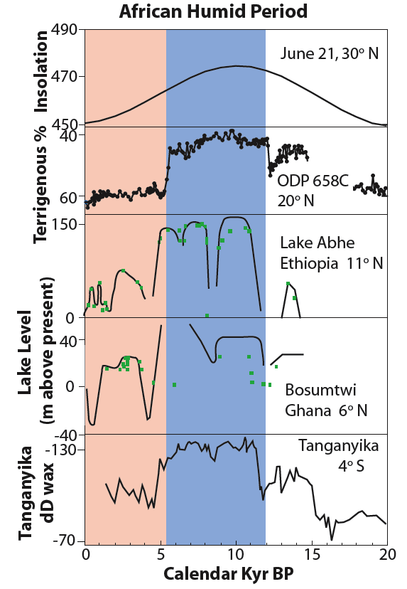
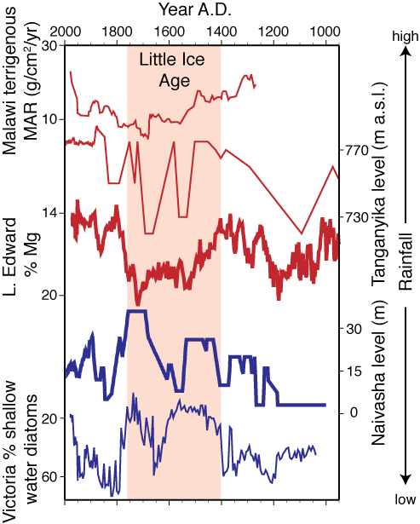
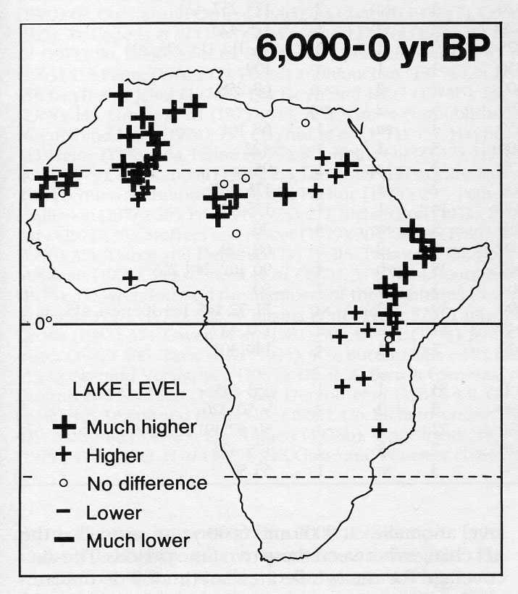
Last 21ka – Deglaciation and Holocene
Abrupt, synchronous initiation of the African Humid Period across Africa?
The DATA
African Humid Period
Street-Perrott & Perrott, 1993
deMenocal et al., 2000; Gasse, 2000; Tierney et al. 2008
Notes:
Fast Climate Changes: Not Just at Polar Latitudes
Coherent Changes of Northern and Eastern Equatorial Africa Rainfall during the Last Deglaciation
Put together a number of published records (blue diamonds) for tropical Africa for the last 20,000 years
Drier LGM and HS1
Wetter over entire tropics starting at ~15ka, [drying during YD (cold event in Greenland( ~12ka, and then resuming AHP tp ~10S in earnest thru EH to MH]
African Great lakes
Terrigenous (eolian) sediment deposition at ODP site 658C exhibits a well-defined period of low influx between 14.8 and 5.5ka
Lake Ahbe in Ethiopia and Lake Bosumtwi in Ghana both have higher lake levels
Lake T sediment cores of deltaD of leaf wax are also interpretted as a wetter AHP eastern tropics.
At 6ka, data suggests that much of north Africa was covered with numerous lakes

Slide 8
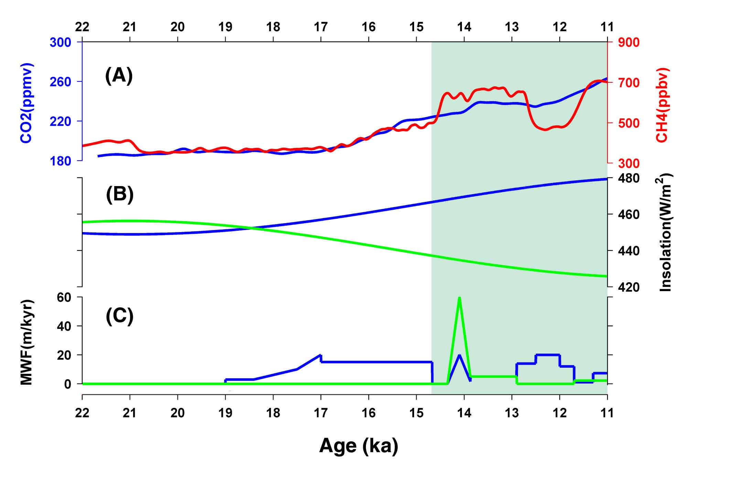
Role of Climate Forcings
TraCE (Transient Climate Evolution) Project to simulate 21ka to present
Community Climate System Model 3
Atmosphere model, 3.75° lat-lon
Land model with predicted vegetation
Ocean model, ~3°, 25 levels
Sea ice model, dynamic & thermodynamic
AHP
20°N JJA
10°S DJF
Three simulations
TraCE – all forcings: GHG, orbital, ice sheets, and meltwater
TraCE – orbital-only*
TraCE – GHG-only*
Ice sheets: ICE-5G
NH meltwater
SH meltwater
* All else held at 17ka
Otto-Bliesner et al., Science, 2014
Notes:
Started a long-term data-model project in 2006
Funding:
September 2006 INCITE: The group’s simulations were executed on “Phoenix” and “Jaguar,” a pair of Cray supercomputers at Oak Ridge National Laboratory in Oak Ridge, Tenn.,
2008: DOE :Feng + partial AS for 8.2ka
2011: P2C2
Researchers ran simulations that used 4.7 million processor hours in 2009, 6.6 million in 2010, and 2.5 million in 2011, and 350,000 in 2012. The Innovative and Novel Computational Impact on Theory and Experiment program, jointly managed by leadership computing facilities at Argonne and Oak Ridge National Laboratories, awarded the allocations.
produce nearly 300 terabytes of data
This is a puzzle though if we consider the precessional cycle which controls when during the year the Earth is closest to the sun.
But the solar insolation changes associated with the precession are not the only forcings acting on the climate system during the deglacial period from 22 to 11ka
Orbital
Also have Atmospheric CO2 (blue) and CH4
(red) concentrations increasing from their low concentrations at LGM to close to PI values
And large continental ice sheets over North America, Europe and Antarctica retreating, adding meltwater into the oceans: Clark and Carlson – evidence from … AMOC primarily
To quantify these effects we analyzed 3 transient simulations with the CCSM3 model
All figures from now on will go from

Slide 9
TraCE simulation versus Proxy Data
AHP
Atlantic ocean overturning circulation
21 ka
Proxy data
TraCE simulation
TLAI
10 ka
Data and TraCE simulation
Relatively dry at LGM (~20ka)
Even drier from ~18 to 15ka
Abrupt increase in moisture at ~14.7ka
Δ SST
Otto-Bliesner et al., Science, 2014
Notes:
AUTHORS of papers
Put together a number of published records (blue diamonds) for tropical Africa for the last 20,000 years
A synchronous initiation of a AHP across western to eastern tropical Africa is also suggested in model simulations
Trace: predict atmosperic, oceanic, and vegetation changes given the evolving orbital insolation changes, GHG changes, and ice sheet changes
Both (red curve show drier conditions at LGM and thru HS1 to 15ka, abruptly increasing precip at 15ka and remaining high to the EH at 11ka
This abrupt and synchronous initiation of the AHP across tropical Africa in the model is concurrent with the AMOC recovery out of the HS1 meltwater period and BA warming in Greenland.
AHP: Sahel, orbital and GHG contributions; Eq E Africa, GHG increases impt
Bering Strait opened at 12.9 ka
YD MWF: St Lawrence (more limited in eastward extent) and MacKenzie River (starting at 12.9ka)

Slide 10
Dominant Pattern of Hydroclimate Variability
21 ka
Pan-African coherent changes
Dry from LGM (20ka) to 17ka
Increase in moisture from 17ka to 11ka
Some drying at Younger Dryas period (~12ka)
TLAI
10 ka
Δ SST
Otto-Bliesner et al., Science, 2014
Notes:
To understand how these changes played out over all of Africa, we performed and EOF analysis of precipitation simulated by the model and proxy data of moisture availability – lake levels, pollen and geochemical data,
The first EOF explains 48% in the proxy data and 39% of the variability in the model precip and show very similar temporal evolution with …
Spatially we see

Slide 11
Sensitivity to GHG and Orbital Forcings
Deglacial change (11ka minus 17ka) of model precipitation
Monsoon nature of rainfall:
North Africa – NH summer months
SE equatorial Africa – SH summer months
21 ka
TraCE simulation with all forcings shows summer rainfall increases from 17ka to 11ka in both regions.
TLAI
Only orbital forcing:
Sahel: Increased summer rainfall plus northward expansion.
SE equatorial Africa: Decreased summer rainfall.
Only GHG forcing:
Sahel: Increased summer rainfall.
SE equatorial Africa: Increased summer rainfall.
Otto-Bliesner et al., Science, 2014
Δ SST
Notes:
Monsoon nature of rainfall in North Africa is such that most of the precipitation falls during the boreal summer months.
While most of the precip in tropical Africa south of the equator falls in the austral summer months
Direct: Warmer the Sahara, the stronger the thermal depression over the Sahara desert, the more intense the monsoon flow – either more LW back radiation from atmos to sfc with increase in GHGs or incr in atmos T due to increase in upward LW radiation from sfc
Indirect: warm SSTs, more in Natl than S Atl or globally
Sea-level pressure decreases over NA, and attendant increased southwesterly flow brings moisture from the Atlantic into NA and enhances precipitation in a broad east-west band over the Sahel and southern Sahara to ~22°N
Results from our single forcing experiments indicate that GHG and orbital forcings each contributed to the enhanced summer monsoon and precipitation increase across NA from 17 to 11 ka seen in the TraCE results.
TraCE GHG-only shows an increase in precipitation in the southern Sahel but little broadening of the tropical rainbely
TraCE orbital-only similarly shows enhanced precipitation in the Sahel while additionally expanding the monsoon precipitation northward
DJF precipitation increases from 17 to 11 ka throughout the southern tropics, extending from the Atlantic Ocean, across Africa, and into the Indian Ocean
The single forcing experiments indicate that much of this response is from the increase in GHGs, which caused DJF precipitation over the SEA region to increase from17 to 11ka.
In the TraCE orbital-only experiment, on the other hand, decreased DJF insolation cools the land relative to the ocean, slightly weakening convection and precipitation over SEA near Lake Tanganyika while enhancing convection and precipitation over the Indian Ocean from 17 to 11 ka

Slide 12
Sensitivity to GHG and Orbital Forcings
21 ka
Annual
Annual
TraCE – all forcings
TLAI
GHG only
10 ka
Orbital only
Δ SST
Otto-Bliesner et al., Science, 2014
Notes:
Looking at time series plots, we see some coherent features in terms of the evolution of annual rainfall in the two regions in the Trace simulations red.A synchronous initiation of a AHP across western to eastern tropical Africa is also suggested in model simulations
Drier conditions at LGM, reaching minimum values at ~17ka during HS1, slowly increasing to ~14.7ka, abruptly increasing precip at 14.7ka and remaining high to 11ka.
In the central Sahel, orbital forcing explains ~60% of the precipitation increase from 17 to 11 ka and GHG forcing explains the remaining ~40%
The single forcing experiments confirm that most of this response (90%) is from the increase in GHGs
COME back to coherent abrupt start of AHP in both regions.

Slide 13
Meltwater and North Atlantic Influence
21 ka
Meltwater to North Atlantic
Slowdown of thermohaline circulation
10 ka
Δ SST
Otto-Bliesner et al., Science, 2014
Notes:
We can see the influence of the meltwater and North Atlantic influence in the 2nd EOF, which explains about 17% of the total variance.
There is a clear relation between the model PC2 and the simulated AMOC, supporting arguments for a strong millennial modulation of African precipitation by changes in the AMOC
This abrupt and synchronous initiation of the AHP across tropical Africa in the model is concurrent with the AMOC recovery out of the HS1 meltwater period and BA warming in Greenland.

Slide 14
Meltwater and North Atlantic Influence
LGM to Heinrich 1 change (17ka minus 20ka)
21 ka
Adding meltwater to the North Atlantic, cooling the SSTs, and slowing the ocean conveyor circulation,
With the ocean transporting less heat northward, the South Atlantic warms,
Shifting rainfall south, drying North Africa.
TLAI
Ocean circulation takes too long to transmit to SE equatorial Africa,
Instead the cooling is transmitted westward over Europe, then southward over the Indian Ocean by the atmosphere,
Shifting rainfall south, drying SE equatorial Africa.
10 ka
When meltwater to North Atlantic ceases, rainfall pattern abruptly flips back
Δ SST
Notes:
Our TraCE simulation shows that millennial-scale changes in the AMOC are critical in synchronizing the onset of the AHP in NA and SEA.
Our simulation agrees with other modeling studies in finding that freshwater added to North Atlantic sites of deepwater formation during HS1 reduces the AMOC, with an attendant shift in the ITCZ southward over the Atlantic Ocean in response to bipolar response of Atlantic SSTs, with higher SSTs south of the equator and cooling north of the equator.

Slide 15
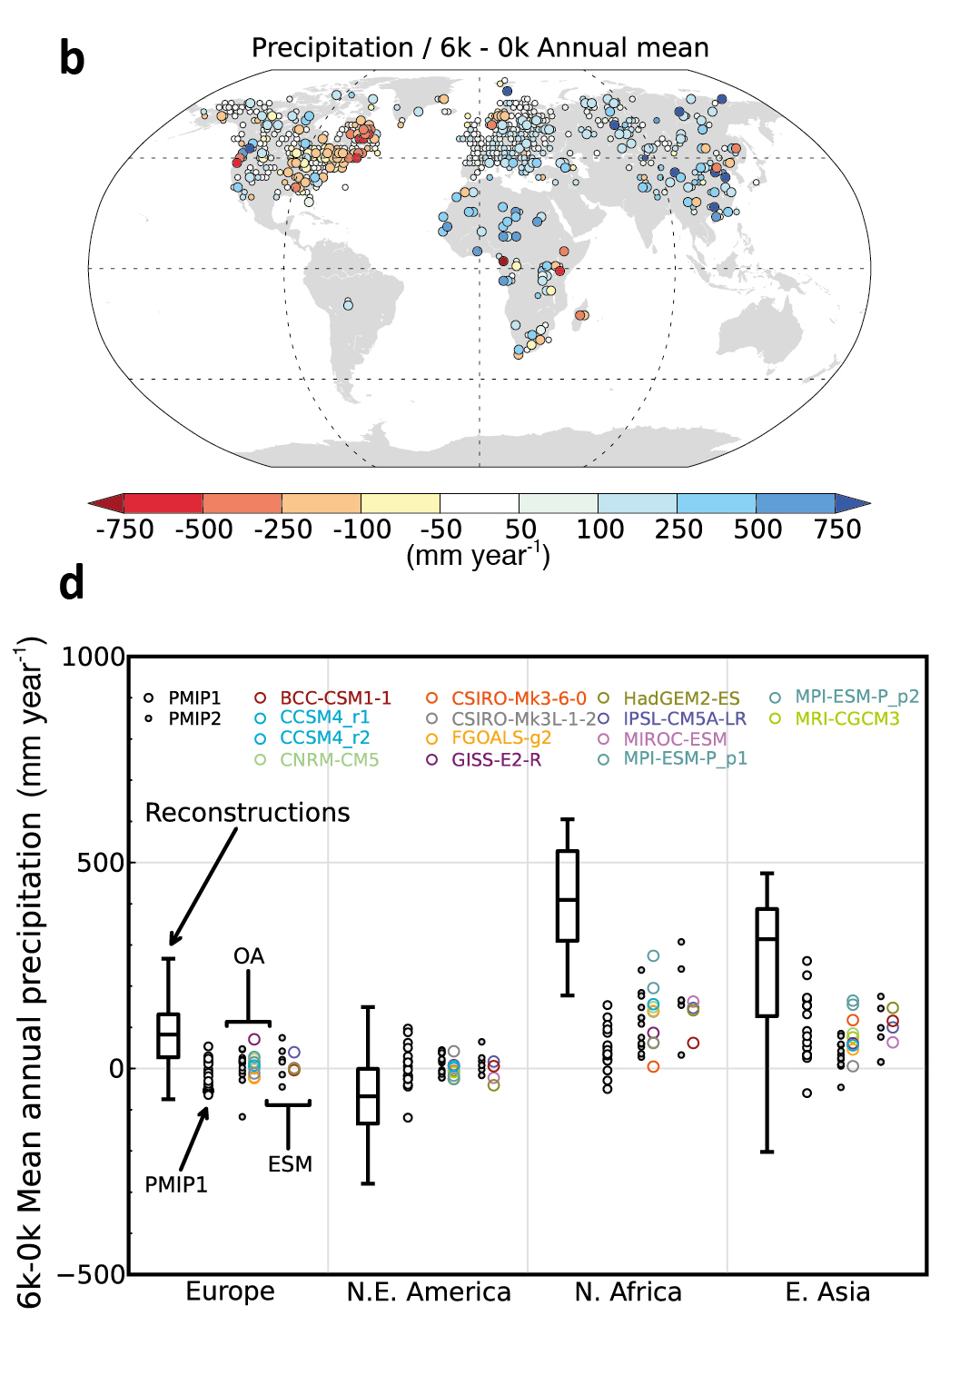
A Challenge: Green Sahara during the AHP
Poorly-represented positive land-atmosphere feedbacks?
21 ka
Vegetation
    (As opposed to desert) influences surface albedo, evapotranspiration.
Soil
    Composition and color affect soil albedo and soil water retention.
Groundwater hydrology
    Groundwater for recharging large lakes in mid-Holocene accumulated during Early Holocene.
Dust
    More vegetated land surface with greater soil moisture and enlarged lakes −> decreased dust production.
TLAI
10 ka
IPCC AR5 WG1 report, Chapter 9, 2013
Δ SST
Notes:
The reconstructions are from Bartlein et al. and the simulations are an ensemble average of the coupled ocean–atmosphere simulations runs in various generations of models.
Expansion of grasslands and steppe vegetation into Sahara
Vegetation (tie to TLAI in TraCE)
Determines how land surface interacts with atmosphere.
Many models still prescribe PD vegetation. For those PMIP2 models that included predictive vegetation, some show improvement while results are more mixed with recent models.
Vegetation should have less bright albedo than desert. Also affect roughness and transpiration.
deploy the logic of “climate envelopes”, whereby recruitment and survival are only permitted within the predefined climate tolerances for a given plant functional type.
These envelopes represent the physiological tolerances of the vegetation types to cold, heat and drought, but are typically derived using the observed distributions of presentday vegetation and isolated experimental data
Ecosystem demography - allow the prediction of biome boundaries directly from plant physiological traits (leaf properties) via their competitive interactions (relative carbon economy).
Soil
In the CCSM’s mid-Holocene simulations, the albedo decreases more because wetter soils are simulated darker than drier soils than due to expanding vegetation. These results isolate albedo [ Bonfils et al found when albedo is low that atmos above is move unstable so that increase in solar forcing leads to large changes in precipitable water] as the key ingredient in obtaining a positive precipitation-vegetation feedback in North Africa.
Confirmed with additional sensitivity simulations artificially lowering the soil albedo.
Schemes are being worked on to include amount of soil organic material and amount of litter in calculation of bare soil albedo.
Groundwater hydrology
French group examined more than 1500 paleohydrological dated records collected between 10 and 28N from 15.5ka to present.
Suggest time lags between the maximum of deep (fresh water) lake formation during the early Holocene and the maximum of water body extensions during the mid-Holocene, highlighting the primary role of aquifer water level in lake response to climate change
Dust
Dust fluxes respond to effective moisture, wind speed, land surface cover, anthro activity
In atmos, have postive RF through radiation absorption and negative through backscatteringChanges in desert dust and its radiative forcing needed to simulate observed drying of Sahel from 1955 to 1990.
Find that need to simulate both changes in desert dust and its radiative forcing to simulated observed drying of Sahel from 1955 to 1990 (black vs ornge dotted).
Dust radiative forcing affects Sahel precip through cooling of troposphere over Nafrica
Dust cools surface (SW cooling > LW warming) with cooling greater over tropical Natl than North Africa)

Slide 16
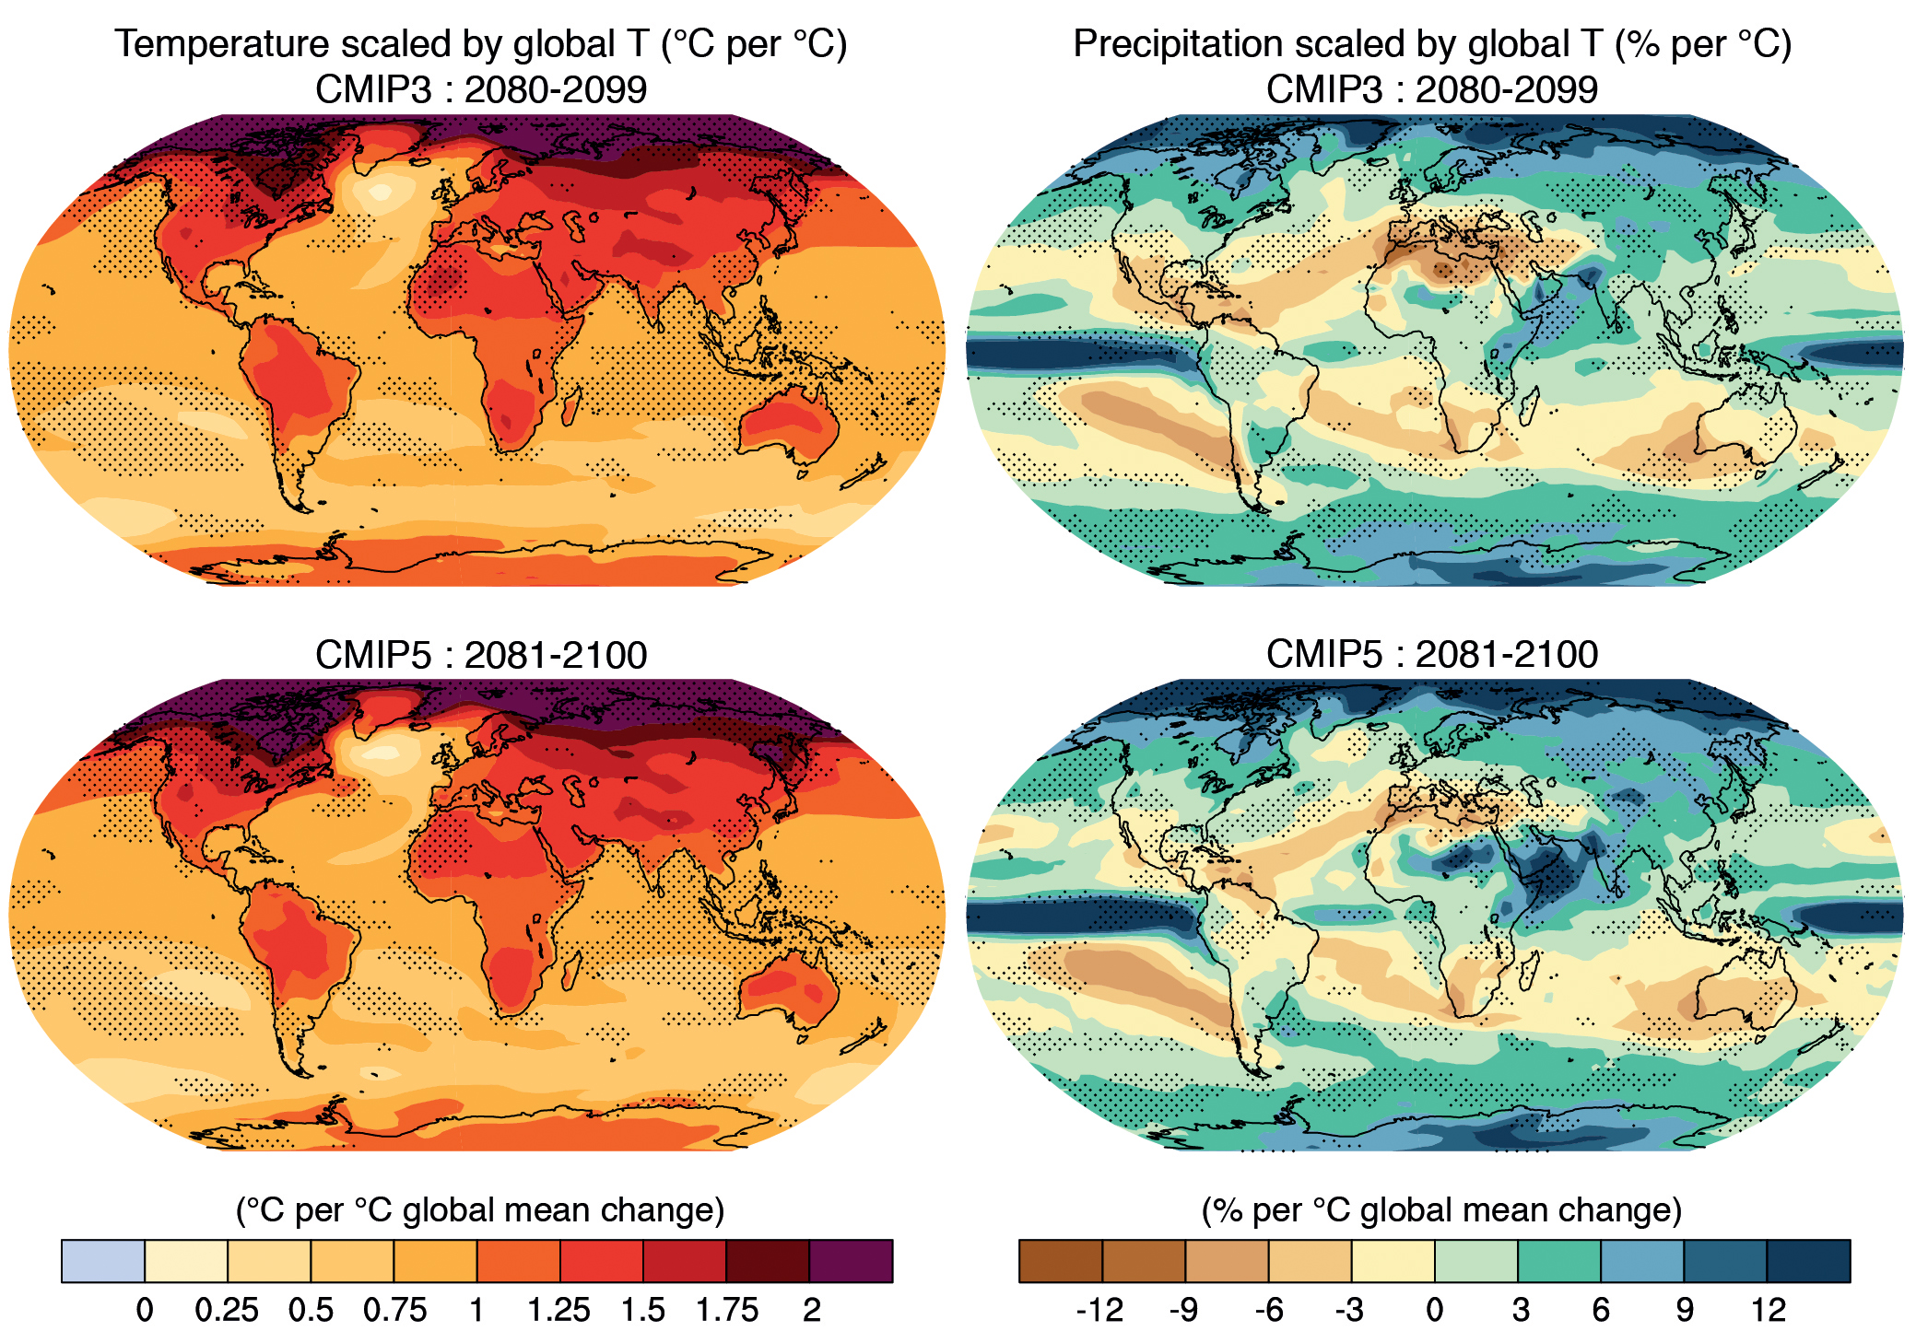
Concluding Remarks
GHG changes, particularly atmospheric CO₂, played an important role in the pan-African rainfall response during the deglaciation,
Onset of African Humid Period synchronized by state of Atlantic Meridional Overturning Circulation.
21 ka
Precipitation scaled by global temperature
(% per °C)
TLAI
10 ka
Δ SST
IPCC AR5 WGI, 2013
Notes:
The spatial pattern of precipitation in EOF1 is markedly similar to the historical patterns, as well as CMIP5 ensemble projection for precipitation changes over tropical Africa by the end of this century
Although multiple forcings influenced African climate during the deglaciation, the agreement between proxy records and our simulated evolution of rainfall indicates that the processes and sensitivity of GHG-driven rainfall change are well simulated in our fully coupled global climate model.
This lends confidence to the CMIP5 climate model ensemble projections of future precipitation change over tropical Africa at the continental scale.
Note W. Africa vs Central Africa Sahel/Sahara rainfall projections.

