Slide 1
A vector-based approach to bank-material tracking in coupled models of meandering and landscape evolution
Ajay B. S. Limaye
California Institute of Technology
CSDMS Annual Meeting 2014

Slide 2
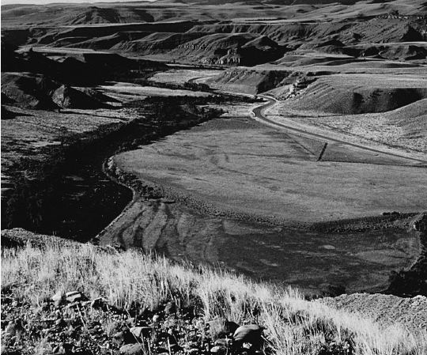
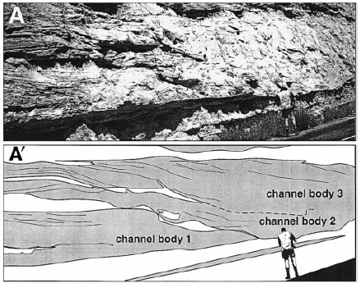
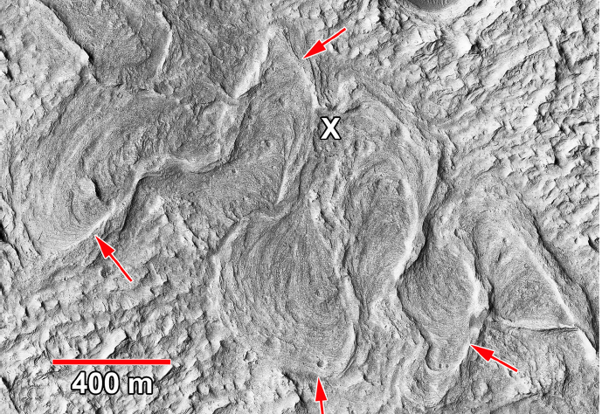
Hancock et al., 1999
Mohrig et al., 2000
Limaye and Lamb,2014
Howard et al., 2009
Notes:
Lateral channel migration is a fundamental geologic process, and connects to a variety of broader Earth science topics.
- Terraces, slot canyons, mars
- Key for broader earth sci topics: climate, tectonics,..

Slide 3
Bank properties change how rivers meander
Colorado R., Texas
Beaver R., Alberta, Canada
San Juan R., Utah
Limaye and Lamb (2014), JGR-ES
Notes:
Meandering channel shape differs strongly
Colorado: all sed. SJ: all rock. Beaver: varying bank strength.

Slide 4
Existing approaches to tracking bank properties use grids
Current channel banks represented as vectors
Limaye and Lamb (2013), JGR-ES

Slide 5
Problem: When bank strength is spatially variable, different grid resolutions cause different channel trajectories
Sediment
Bedrock
Limaye and Lamb (2013), JGR-ES
Notes:
Grid-based solutions are problematic.
Increasing the grid resolution has a high memory cost, particularly for low lateral erosion rates (e.g., <1 cm/yr in bedrock).
Using an adaptive grid at landscape scale is computationally intensive.

Slide 6
The necessary grid resolution
depends on the channel lateral erosion rate
Channel
bank
at t
Grid cell

Slide 7
The necessary grid resolution
depends on the channel lateral erosion rate
Channel
bank
at t
Channel
bank
at t + Δt
Cell does not record channel migration
Grid cell

Slide 8
The necessary grid resolution depends on the channel lateral erosion rate
Channel
bank
at t
Channel
bank
at t+ Δt
Cell records
channel migration
Grid cell

Slide 9
The necessary grid resolution depends on the channel lateral erosion rate
Channel
bank
at t
Channel
bank
at t+ Δt
(lateral erosion rate)Δt
Δt is limited by the channel
evolution timescale
(i.e., recurrence interval of bankfull flood).
Cell records bank properties affected by channel migration
Grid cell

Slide 10
The necessary grid resolution depends on the channel lateral erosion rate
Channel
bank
at t
Channel
bank
at t+ Δt
(lateral erosion rate)Δt
Δt is limited by the channel
evolution timescale
(i.e., recurrence interval of bankfull flood).
As lateral erosion rates decrease,
smaller grid cells are needed.
Cell records bank properties affected by channel migration
Grid cell

Slide 11
The necessary grid resolution depends on the channel lateral erosion rate
Channel
bank
at t
Channel
bank
at t+ Δt
(lateral erosion rate)Δt
Δt is limited by the channel
evolution timescale
(i.e., recurrence interval of bankfull flood).
As lateral erosion rates decrease,
smaller grid cells are needed.
→Valley-scale simulations and low lateral erosion rates (i.e., < 1 cm/yr in bedrock) require an impractical amount of memory (i.e., Terabytes).
Cell records bank properties affected by channel migration
Grid cell

Slide 12
Solution: Track bank-material properties using the channel dimensions themselves
Notes:
Problem is not tractable to test things want to test – large domains, long times, many grid points – specific about limits – give memory # (plot)
Particularly not for bedrock – ok for some others.time step is important.

Slide 13
Solution: Track bank-material properties using the channel dimensions themselves
Channel geometry is archived as vector data (connected points) at each time step.
This vector data is used to reconstruct bank-material properties set by channel scour and sedimentation.
Bank properties are used to scale channel migration rates.
Bedrock
Sediment
Limaye and Lamb (2013), JGR-ES

Slide 14
Application to bedrock river valleys
Memory use for bank-strength tracking:
~ 1,000,000 MB (using 1 cm-resolution grid)
→ 50 MB (using vector-based tracking)
Limaye and Lamb (2014), JGR-ES
Notes:
Point out strath terraces, deformed meander bends, underfit valleys

Slide 15
Conclusions
Bank-material properties can strongly influence river meandering.
Vector-based bank-material tracking makes simulations for resistant bank materials computationally tractable.
The principles of the vector-based framework are transferrable to representing topography and stratigraphy in net-depositional settings.

