Slide 1
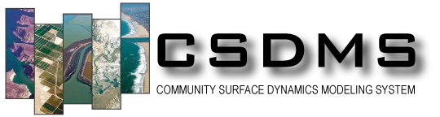

What’s in a Name ?
How the CSDMS Standard Names Support Sharing Variables
Between Models
Scott D. Peckham
Chief Software Architect for CSDMS
December 20, 2012
Frontiers in Computational Physics: Modeling the Earth System, Boulder, CO

Slide 2
Number of CSDMS Members vs. Time
Working Groups:
Focus Research Groups:
Terrestrial: 420
Hydrology: 326
Coastal: 333
Chesapeake: 44
Marine: 229
Carbonate: 63
Cyber: 144
EKT: 138
918 Members
as of Dec. 19, 2012

Slide 3
Linking Component-based Models:
How Can Two Models Differ?
Programming language
(C, C++, Fortran, Java, Python, etc.)
Solution: Babel and Bocca (CCA toolchain)
Computational grid
(triangles, rectangles, Voronoi, etc.)
Solution: ESMF regridder (parallel, spatial interpol.)
Timestepping scheme
(fixed, adaptive, local)
Solution: Temporal interpolation tool
Variable names
    Need some means of “semantic mediation”
Solution: CSDMS Standard Names
Variable units
Solution: UDUNITS (Unidata)

Slide 4

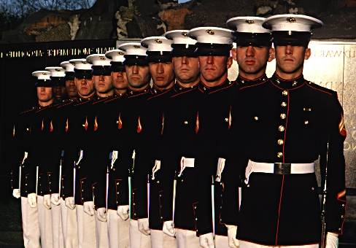
Taming Heterogeneity with Interfaces
Before:
Each resource is unique.
Own ways of doing things.
Respond differently.
Can become unstable.
Difficult to control.
After:
Uniform outward appearance.
Respond to same commands.
Interchangeable units.
Have a chain of command.
Work as a team.

Slide 5
Motivation for Standard Names
Most models require input variables and produce output variables. In a component-based modeling framework like CSDMS, a set of components becomes a complete model when every component is able to obtain the input variables it needs from another component in the set. Ideally, we want a modeling framework to automatically:
Determine if a set of components provides a complete model.
Connect each component that requires a certain input variable to another component in the set that provides that variable as output.
This kind of automation requires a matching mechanism for determining whether — and the degree to which — two variable names refer to the same quantity and whether they use the same units and are defined or measured in the same way.

Slide 6
What About CF Standard Names?
Created by LLNL for naming variables in NetCDF files.
Domain-specific: Almost exclusively ocean and atmosphere model variables. (e.g. “tendency_of” instead of “time_derivative_of”)
Incomplete rules: No rules for constants, dimensionless numbers , reference quantities and many other quantity types.
Complex name-generation template (& inconsistently used):
[surface] [component] standard_name [at surface] [in medium]
[due to process] (for terms in an equation)
[assuming condition] (for assumptions)
May also have a transformation prefix (e.g “magnitude_of”)
Assumptions are included in the name itself via “_assuming_*”.
http://cf-pcmdi.llnl.gov/documents/cf-standard-names/guidelines

Slide 7
The CSDMS Standard Names
Data Models like RDF and EAV use triples like:
Subject + Predicate + Object, and
Entity/Object + Attribute + Value (object-oriented)
CSDMS Standard Names use a similar template for creating unambiguous and easily understood standard variable names or preferred labels according to a set of rules. These are then used to retrieve/match values (and metadata). The template is:
Object name + [Operation name] + Quantity name
Examples:
atmosphere_carbon_dioxide__partial_pressure
atmosphere_water__liquid_equivalent_precipitation_rate
earth_ellipsoid__equatorial_radius
soil__saturated_hydraulic_conductivity

Slide 8
CSDMS Standard Names: Basic Rules
All names consist of an object name and a quantity name separated by double underscores (e.g. air__temperature)
Object name + [Operation name] + Quantity name
Standard names consist of lower-case letters and digits. They contain no blank spaces. Underscores are inserted into some compound words.
Underscores are used as separators between words and hyphens are converted to underscores.
The rightmost word in an object name is a base_object. The rightmost word in a quantity name is a base_quantity but can end with a quantity suffix.
Some naming rules use reserved words, such as: of, in, on, at and to.
A possessive “s” is never added to the end of a person’s name, but many names end in “s”, like “Reynolds” and “Stokes”.

Slide 9
Important Note
Model developers do not replace variables in their code with CSDMS Standard Names. They only need to provide a mapping (e.g. a Python dictionary) of their input and output variables to CSDMS Standard Names and provide a Model Metadata File with assumptions, units, grid type, etc.
This is part of the Basic Model Interface (BMI) that CSDMS asks model developers to provide.

Slide 10
Object Name Patterns
A fairly small number of patterns covers most object names.

Slide 11
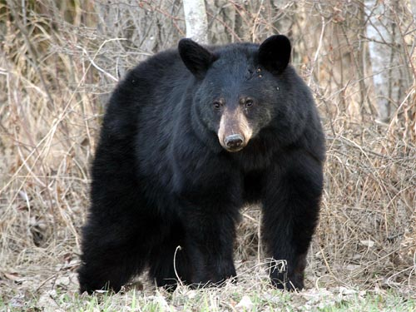
Word Order in Object Names
Starting with a base object, descriptive words are added to the left in an effort to construct an unambiguous and easily understood object name. The addition of each new word (or words) produces a more restrictive or specific name from the previous name. For example:
bear tree
black_bear oak_tree
alaskan_black_bear bluejack_oak_tree
However, in the Part of Another Object Pattern, words added to the left could be objects that indicate nested containment, e.g.:
bluejack_oak_tree_trunk_cross_section__diameter

Slide 12
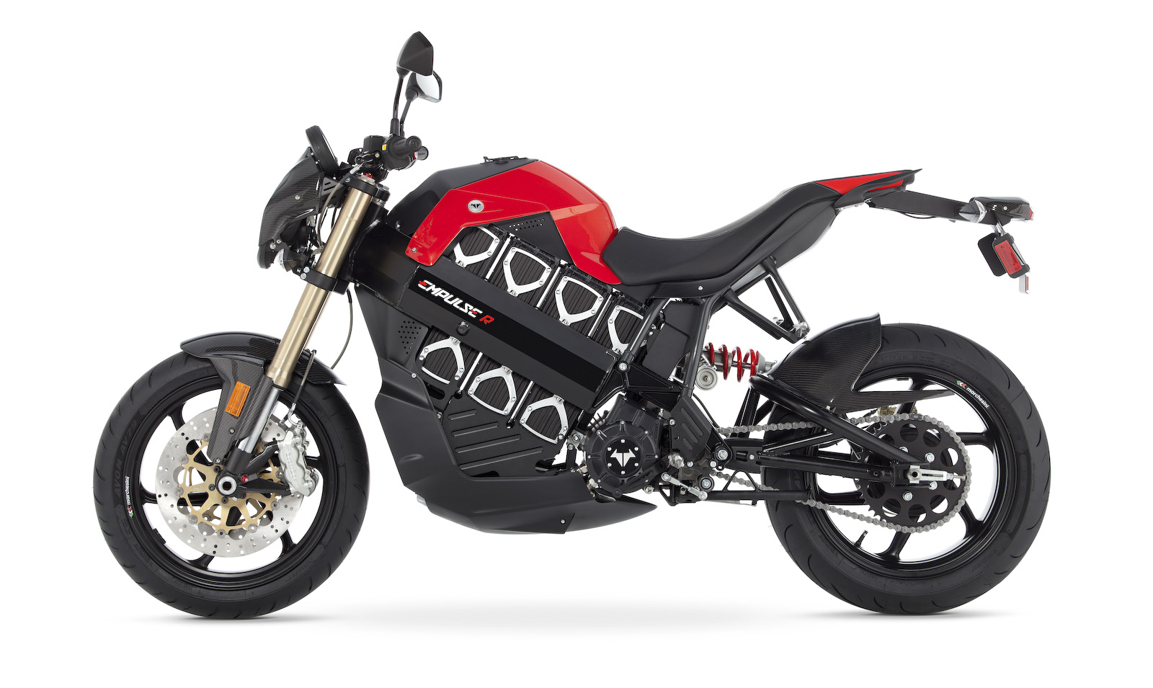
Part of Another Object Pattern
alaskan_black_bear_brain_to_body__mass_ratio
alaskan_black_bear_head__mean_diameter
bluejack_oak_tree_trunk_cross_section__diameter
brammo_empulse_electric_motorcycle__rake_angle
brammo_empulse_electric_motorcycle__wheelbase_length
channel_cross_section__wetted_perimeter
channel_cross_section__area
earth_axis__tilt_angle
earth_orbit__eccentricity
gm_hummer_gas_tank__volume
gm_hummer__fuel_economy [mpg]
We can also use “nested containment” to indicate which part of an object, as in:
atmosphere_top, channel_bed, channel_inflow_end, glacier_top,
sea_floor_surface, sea_surface

Slide 13
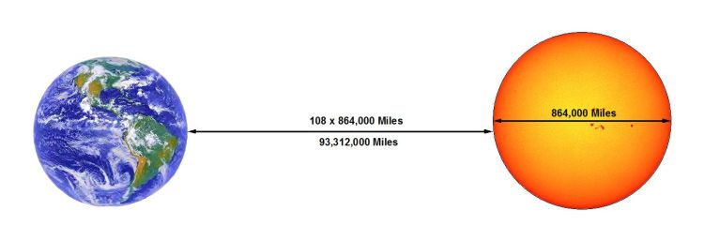
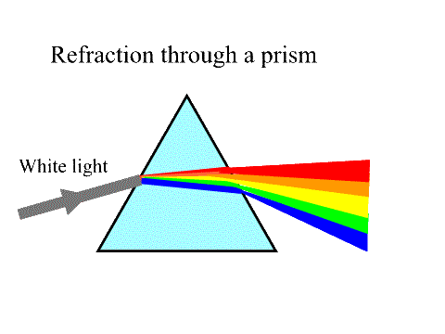
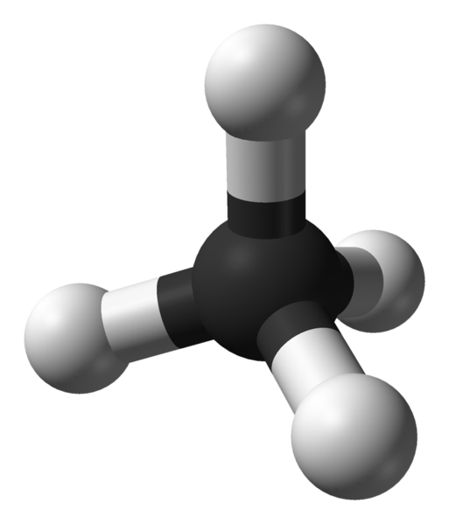

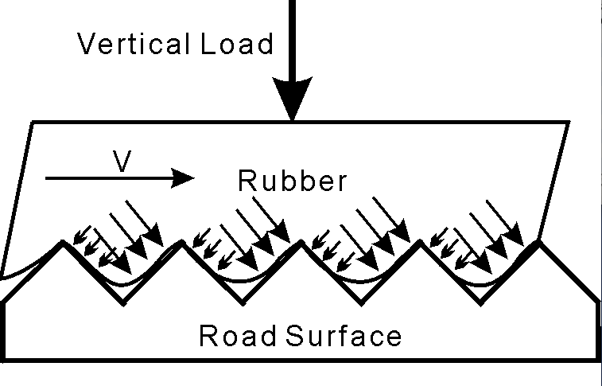
Two-Object Quantities
visible_light_in_glass
__standard_
refraction_index
earth_to_sun__mean_distance
methane_molecule_c_to_h
__bond_length
rubber_to_pavement
__kinetic_friction_coefficient
carbon_dioxide_in_water__solubility

Slide 14
Object-in-object Quantity Pattern
carbon_dioxide_in_air__partial_pressure
carbon_dioxide_in_air__relative_saturation
carbon_dioxide_in_water__solubility
clay_in_soil__volume_fraction (or silt or sand or water)
helium_plume_in_air__richardson_number
oxygen_in_water__mole_concentration
suspended_sediment_in_water__volume_concentration
visible_light_in_air__speed
water_in_ethanol__dilution_ratio
Object-to-object Quantity Pattern
brain_to_body__mass_ratio
carbon_to_hydrogen_bond__length
carbon_to_hydrogen_bond__dissociation_energy
earth_to_mars__travel_time
earth_to_sun__mean_distance
rubber_to_pavement__static_friction_coefficient

Slide 15
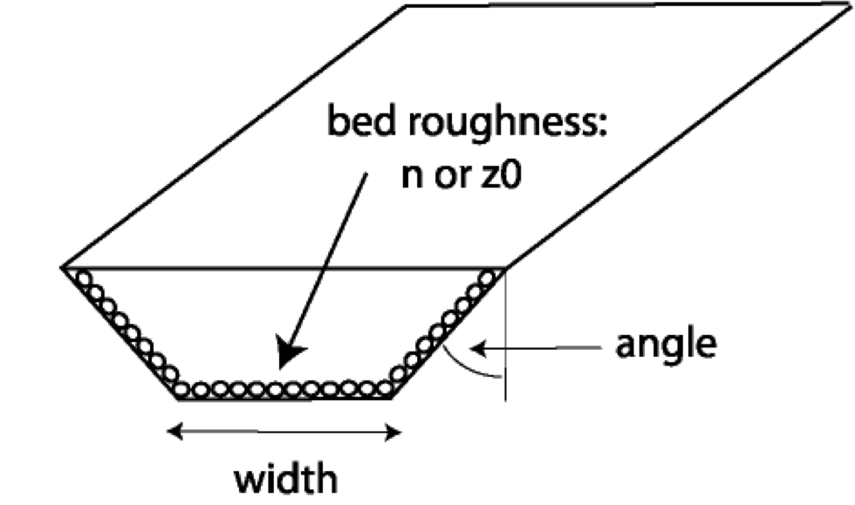
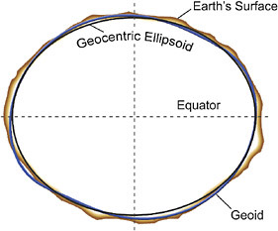
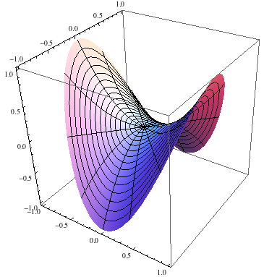
Object Name + Model Name Pattern
Objects are often idealized by a geometric shape or other “model”. Certain quantities may only be well-defined for the model as opposed to the actual object. Examples include:
bubble_sphere__radius
channel_centerline__valley_sinuosity
channel_cross_section_trapezoid__bottom_width
crater_circle__radius
earth_ellipsoid__equatorial_radius
land_surface__plan_curvature

Slide 16
Quantity Name Patterns
A fairly small number of patterns covers most quantity names.

Slide 17
Word Order in Quantity Names
Starting with a base quantity, descriptive words are added to the left in an effort to construct an unambiguous and easily understood object name. The addition of each new word (or words) produces a more restrictive or specific name from the previous name. For example:
conductivity
hydraulic_conductivity (vs. electrical or thermal)
saturated_hydraulic_conductivity
effective_saturated_hydraulic_conductivity
Note: hydraulic_conductivity and saturated_hydraulic_conductivity are both fundamental quantities used in groundwater models. The adjective effective could be applied to either of them to indicate application at a given scale. Note also that saturated could have been applied to "soil", the associated object, but saturated_hydraulic_conductivity is a fundamental quantity.

Slide 18
Process Name + Quantity Pattern
Process names are typically nouns derived from verbs, usually ending with:
tion (e.g. absorption, convection, radiation),
sion (e.g. conversion, dispersion),
ing (e.g. swimming, upwelling),
age (e.g. drainage, seepage, storage),
y (e.g. discovery, recovery),
ance (e.g. acceptance, maintanence) and
ment (e.g. alignment, improvement, recruitment).
The ing ending is often dropped as in: burn, creep, flow, lapse, melt, shear and tilt.
(e.g. snow__melt_rate, channel_bed___shear_stress.)
Process names can almost always be paired with "_rate” and this then creates a quantity name: e.g. precipitation_rate. Some process names may be naturally paired with an ending other than (or in addition to) "_rate", such as:
dilution_ratio
drainage_area
escape_speed
gestation_period
identification_number
inclination_angle
penetration_depth
radiation_flux
relaxation_time
striking_distance
turning_radius
vibration_frequency

Slide 19
Process Name + Quantity Pattern
When a process name is used to construct a quantity name, the process should be one that pertains to the object name part. If chosen carefully, the process name can usually clarify whether the quantity (especially fluxes and flow rates) is incoming or outgoing
(or incident or emitted, etc.) e.g.
land_surface__diffuse_shortwave_irradiation_flux
land_surface__longwave_radiation_flux
lake_water__volume_inflow_rate
lake_water__volume_outflow_rate
For an object/substance that can be a gas, liquid or solid, an adjective like liquid equivalent may be needed to remove ambiguity, e.g.
atmosphere_water__liquid_equivalent_precipitation_flux

Slide 20
Model-specific Quantity Pattern
Many variables are associated with some kind of mathematical model of a natural object or its properties. Many are associated with power-law approximations and a person’s name, e.g.
channel_water__hydraulic_geometry_depth_vs_discharge_exponent
channel_water__hydraulic_geometry_slope_vs_discharge_coefficient
channel_water__hydraulic_geometry_width_vs_discharge_exponent
channel_bed__manning_coefficient
glacier__glen_law_coefficient
glacier__glen_law_exponent
soil__brooks_corey_conductivity_exponent (Smith, 2002)
soil__brooks_corey_pore_size_distribution_parameter
soil__green_ampt_capillary_length_scale
soil__transitional_brooks_corey_curvature_parameter (Smith, 2002)
watershed__flint_law_coefficient
watershed__flint_law_exponent
watershed__hack_law_coefficient
watershed__hack_law_exponent

Slide 21
Quantity-to-Quantity Pattern
Sometimes a compound quantity is created through some combination of two other quantities that are associated with the same object. For example, this can occur when ratio is used as a quantity suffix, as in:
channel_cross_section__width_to_depth_ratio
electron__charge_to_mass_ratio
watershed_outlet_cross_section__width_to_depth_ratio

Slide 22
Quantity Suffix Pattern
A quantity suffix is a word that is added as a suffix to a quantity name that creates a new quantity, but usually with the same units.
Examples:
elevation_increment
equation_term
frequency_limit
gradient_magnitude
length_scale
mass_ratio
time_step
pressure_anomaly
temperature_correction
velocity_component
volume_fraction
In most cases, they can also be viewed as an operation that is applied to the quantity, e.g.
increment_of_elevation
vs.
elevation_increment
magnitude_of_gradient
vs.
gradient_magnitude

Slide 23
Operation Name + Quantity Pattern
Mathematical operations are often applied to a quantity in order to create a new quantity which often has different units. These operations have standard names or abbreviations and in the CSDMS Standard Names they always end with the reserved word of (used as a delimiter) as in:
bedrock_surface__2nd_time_derivative_of_elevation
sea_water__time_derivative_of_northward_velocity_component
soil__log_of_hydraulic_conductivity
soil__time_derivative_of_saturated_hydraulic_conductivity
watershed_outlet_water__area_time_integral_of_volume_outflow_rate
watershed_outlet_water__daily_mean_of_volume_outflow_rate
watershed_outlet_water__time_of_max_of_volume_outflow_rate
Note that they can also be chained together as in: time_of_max_of.

Slide 24
Standard Assumption Names
Assumptions --- interpreted broadly to include:
conditions, simplifications, approximations, limitations,
conventions, provisos, exclusions, restrictions, etc.
--- are not included in CSDMS Standard Variable Names.
Instead, developers are encouraged to use multiple <assume> tags in a Model Metadata File to clarify how they are using a CSDMS Standard Name within their model. (Read once at start.)
In order for a Modeling Framework to be able to compare the assumptions made by different models (about the model or its variables), standard assumption names are needed, in addition to the standard variable names.

Slide 25
Standard Assumption Names
Assumption Type: Example
Boundary conditions: no_slip_boundary_condition
Conserved quantities: momentum_conserved
Coordinate system: cartesian_coordinate_system
Angle conventions: clockwise_from_north_convention
Dimensionality: 2_dimensional
Equations used: navier_stokes_equation
Closures: eddy_viscosity_turbulence_closure
Flow-type assumptions: laminar_flow
Fluid-type assumptions: herschel_bulkley_fluid
Geometry assumptions: trapezoid_shaped
Named model assumptions: green_ampt_infiltration_model
Thermodynamic processes: isenthalpic_process
Approximations: boussinesq_approximation
Averaging methods: reynolds_averaged
Numerical methods used: arakawa_c_grid
State of matter: liquid_phase

Slide 26
Summary
The CSDMS Standard Names are a work in progress but they are already being used successfully for several of the CSDMS component models.
More rules and patterns will be added as they are identified. The goal is to create unambiguous and easily understood standard names. Developers map variable names to them.
Standardized metadata such as units, assumptions and georeferencing info can be associated with any standard name to further clarify how the model developer is using it.
For more information, please see the wiki pages at:
http://csdms.colorado.edu/wiki/CSDMS_Standard_Names

